Slide 1
Introduction to version control system
Lesson-1

Slide 2

Objective
What is Git?
What is Version Control?
Benefits of version controls

Slide 3

What is Git?
Git is a version control system/software
What is Version Control system?
Tracking & managing changes in computer files

Slide 4


Benefits of version control system
Collaborate work between different user
Track who make changes
What are the changes
When change are made

Slide 5
Benefits of version control system
Revert back the changes(if needed)
Store in local & remote repository (e.g Github)

Slide 6

Git
Easy
Free
Open Source

Slide 7
Wh0 and why should study Git & github
Lesson-2

Slide 8
Objective
Who should study or use Git
Why should use
How to use

Slide 9

Who should study or use Git
IT Professional
Non-IT Professional
Programmer
Web Specialist
Data Science
Student
Collaborative working environment

Slide 10
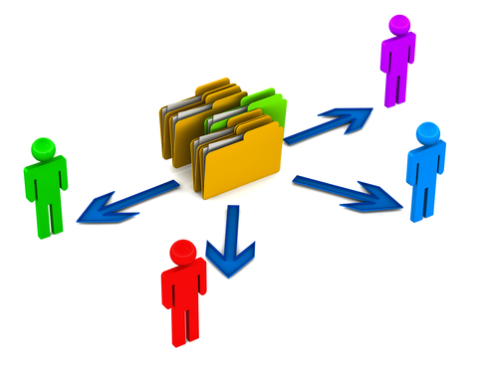







Before version control system
File sharing is only solution
Online
Offline

Slide 11
Why should use
Teamwork
Working alone
Version control
Backup
Recovery
Collaborative working environment
Many more

Slide 12

How to use
Version Control System
Hosting service to store files

Slide 13
Git & github terminology and commands
Lesson-3

Slide 14
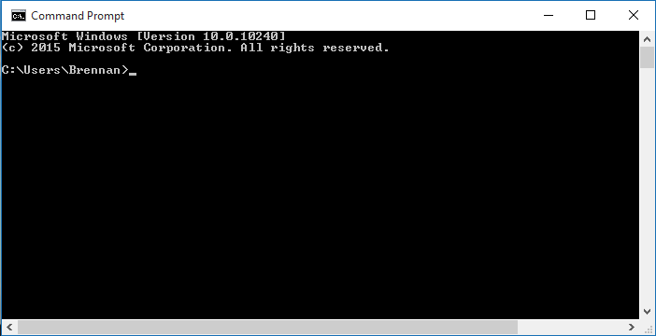


terminology
Folder/Directory/URL
Command/Command line/ CLI(command line interface)
Remote repository-a folder or a place where your files are stored
Git- version control software
GitHub –web hosting for Git repository
Staging area –temporary location
Watch-get notification about a repository whenever there are changes
Star – bookmark repository, easy access

Slide 15
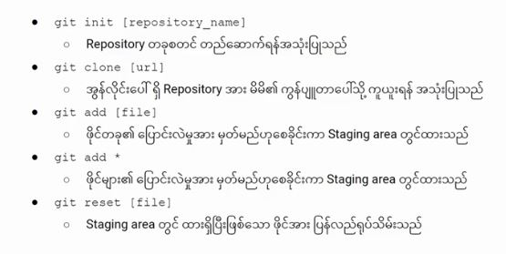
Git commands

Slide 16
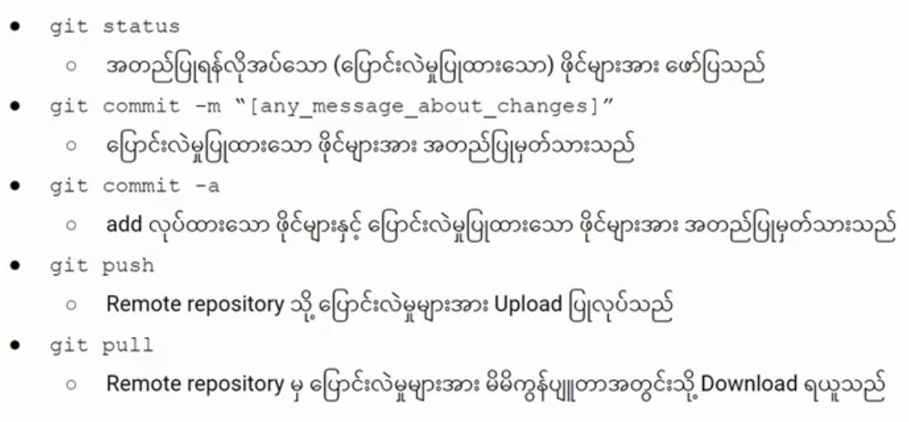
Git commands

Slide 17
Sign up on github
Lesson-4

Slide 18
Git installation
Lesson-5

Slide 19
GitHub
Local Computer
Create account
Install Git
Create Repository
Configure Git
Create/ add files
Clone Remote repository
https://git-scm.com/download/win

Slide 20
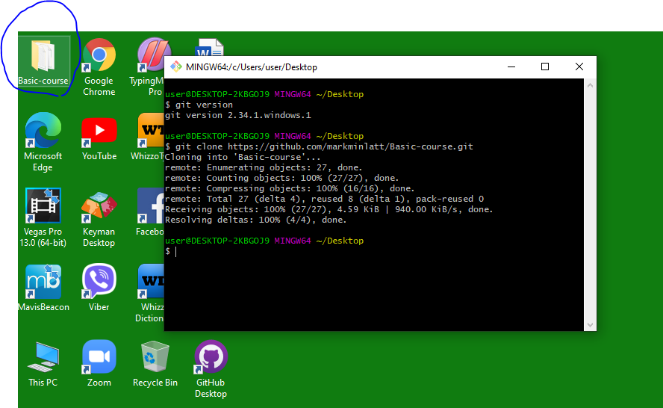
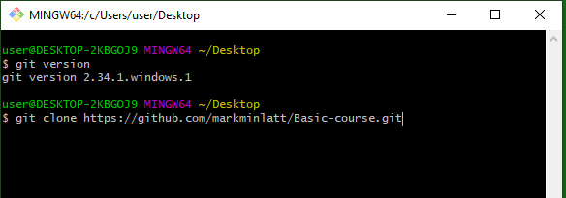

Slide 21
Update files to remote repository
Lesson-6

Slide 22

Local Computer
GitHub
GitHub Hosting
Make changes to file
Commit to staging area
Staging area
Push files to remote repository

Slide 23
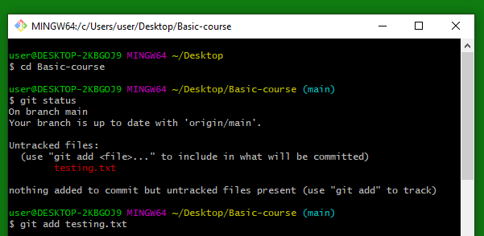
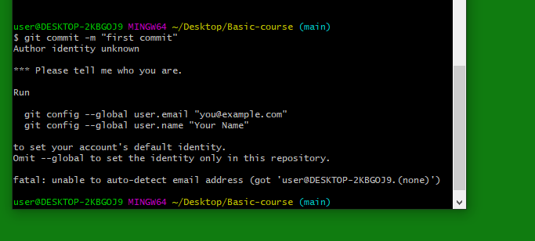
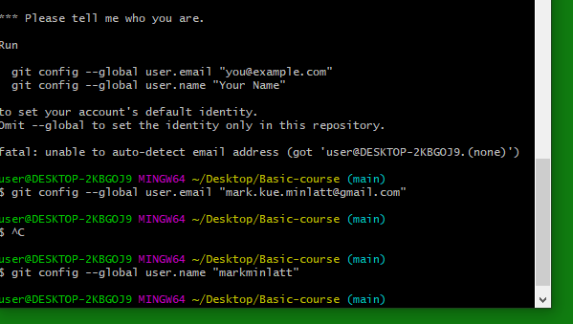

Slide 24
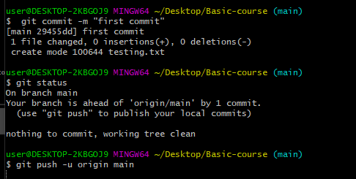
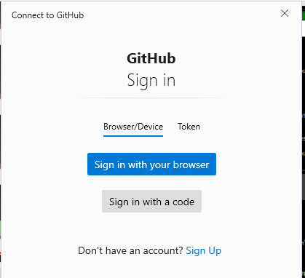
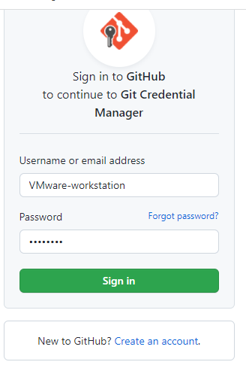
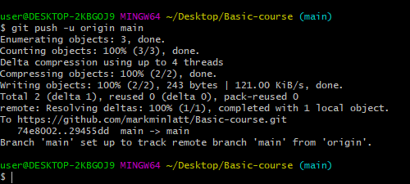

Slide 25
Creating git repository locally
Lesson-7

Slide 26
Local Computer
GitHub
GitHub Hosting
Git init
Create file, add file
Staging area
Push files to remote repository

Slide 27
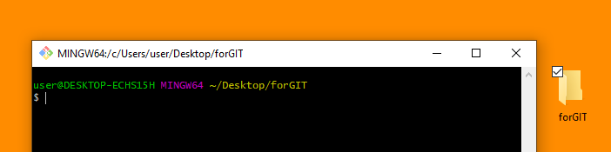
Tasks
Create a folder in local computer
Create a file in that folder
Right Click on that folder and Select Git Bash Here

Slide 28

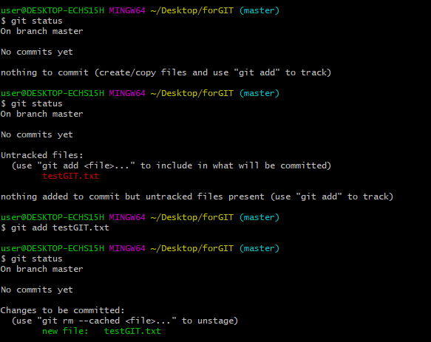


Slide 29
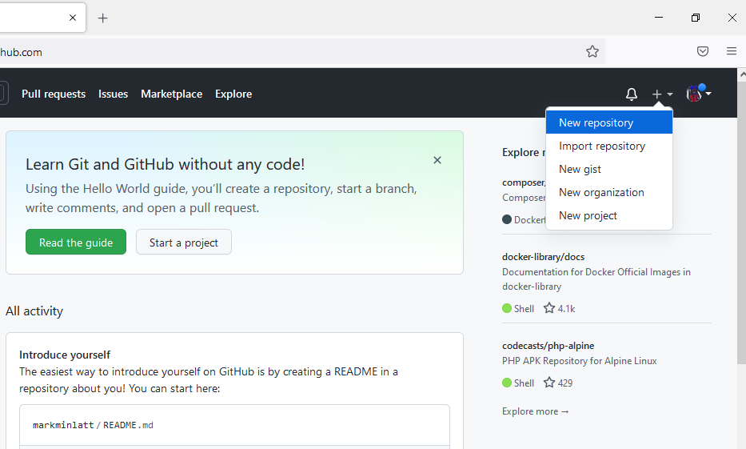
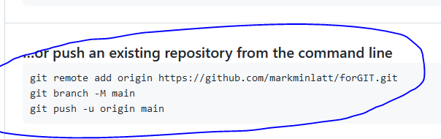
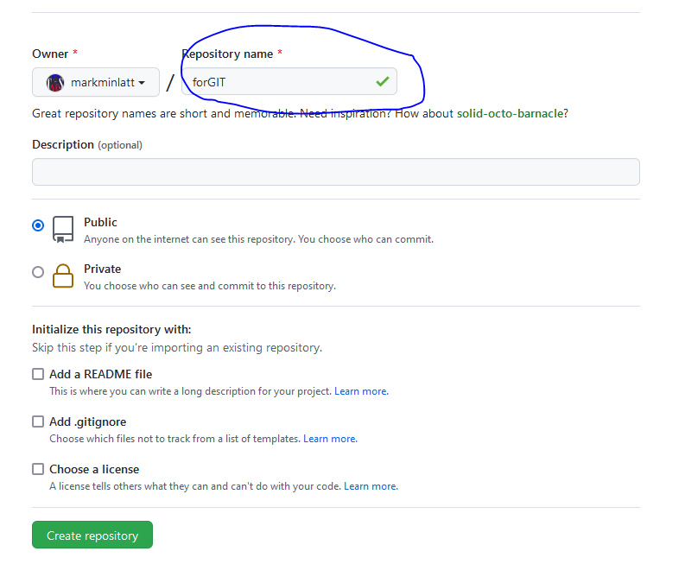
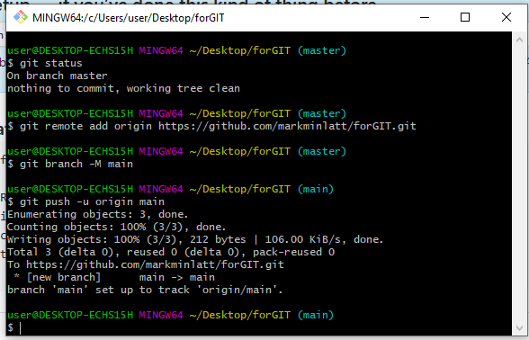
Create a repository in GitHub

Slide 30
Understanding .gitignore
Lesson-8

Slide 31
Local Computer
GitHub
Create .gitignore
Create files/folders, add to .gitignore
Git status
Add file to staging area
Staging area

Slide 32
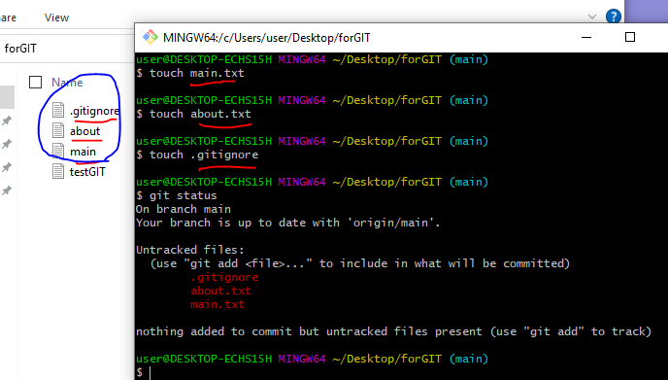
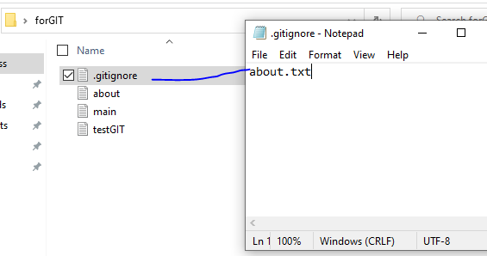
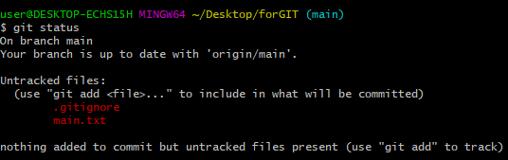

Slide 33
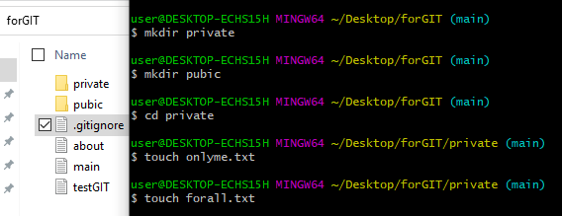
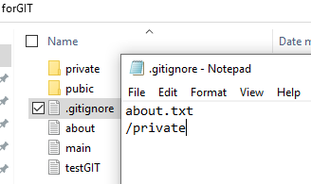
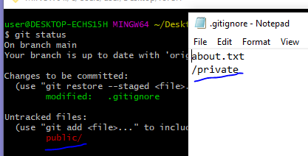
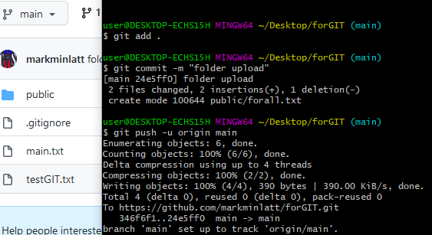
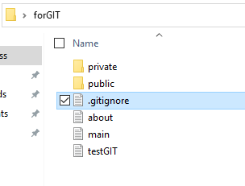

Slide 34
Branching Basic
Lesson-9

Slide 35


new Branch
Modules/Features
Modules/Features
Master Branch
Master Branch
Checkout
Merge

Slide 36
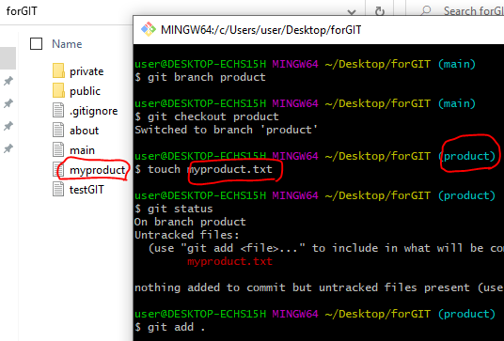
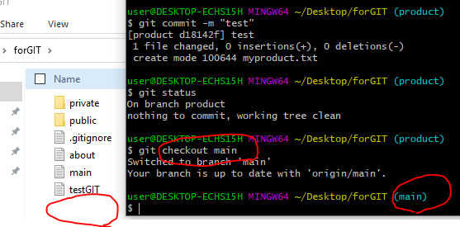

Slide 37
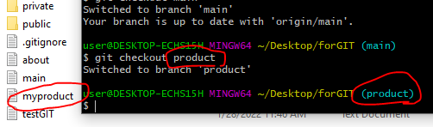
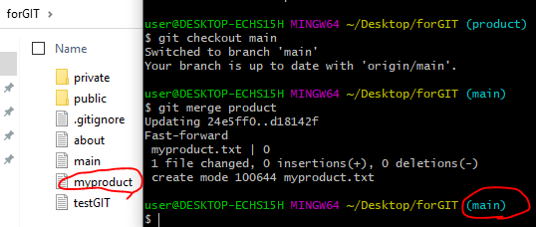

Slide 38
Git and GitHub use cases
Lesson-10

Slide 39
Local Computer
GitHub
GitHub hosting
Clone Remote to local
Perform Changes
Update local Repo
Use Case-1

Slide 40
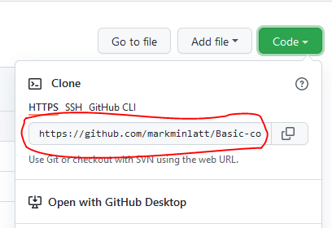
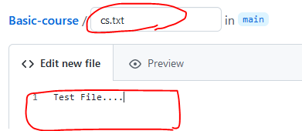
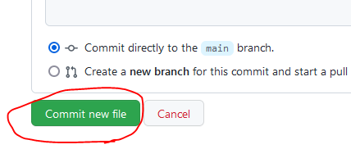
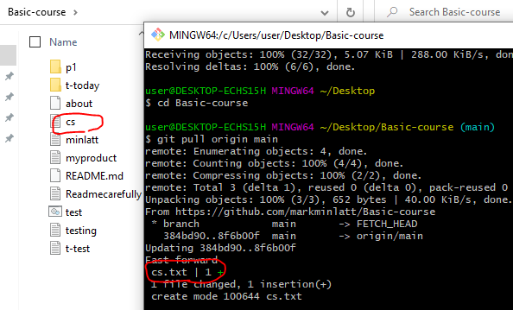
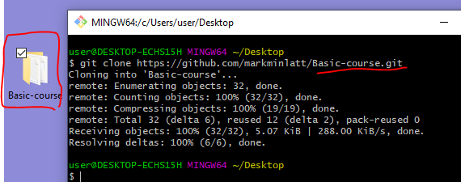
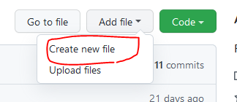
1
4
5
6
2
3

Slide 41
Local Computer
GitHub
GitHub hosting
Update file and commit to staging area
Staging area
Push files to remote repository
Use Case-2

Slide 42
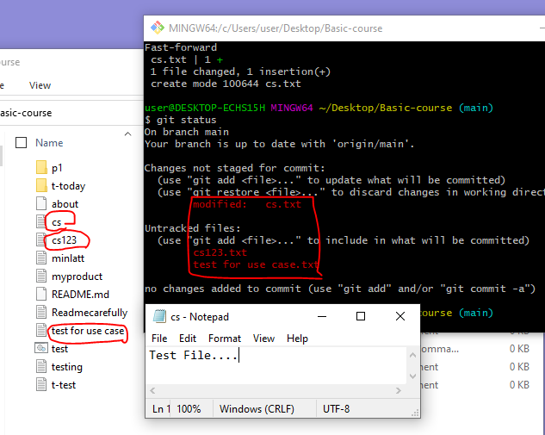
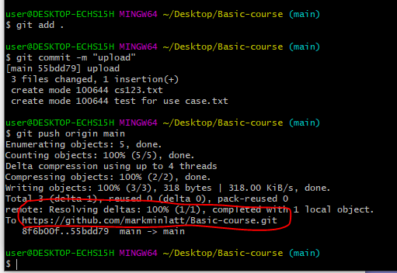
Add or Edit file in your local folder

Slide 43
Local Computer
GitHub
GitHub Hosting
Git init
Create file, add file
Staging area
Push files to remote repository
Use Case-3

Slide 44
Tasks
Create a folder in local computer
Create a file in that folder
Right Click on that folder and Select Git Bash Here

Slide 46
Create a repository in GitHub

