Slide 1




Grid-computing based data-mining of the Sloan Digital Sky Survey (SDSS) for optimising searches for exoplanets via the Transit method
Eugene Hickey, Oisín Creaner, & Kevin Nolan.
Scientific Computing Group Institute of Technology, Tallaght, Dublin (SCG - ITTD).

Slide 2
Grid-computing based data-mining of the Sloan Digital Sky Survey (SDSS) for optimising searches for exoplanets via the Transit method
Eugene Hickey, Oisín Creaner, & Kevin Nolan.
Scientific Computing Group Institute of Technology, Tallaght, Dublin (SCG - ITTD).

Slide 3
Scientific Computing Group at ITT Dublin
Close collaborators of BCO Labs in CIT (Niall Smith)‏
Computer solutions group for astrophysics problems
Work closely with Grid Ireland
Expertise is handling very large datasets rather than computationally intensive problems
  Embarrassingly parallel
Data-mining astronomical surveys
Don't do much telescope work

Slide 4
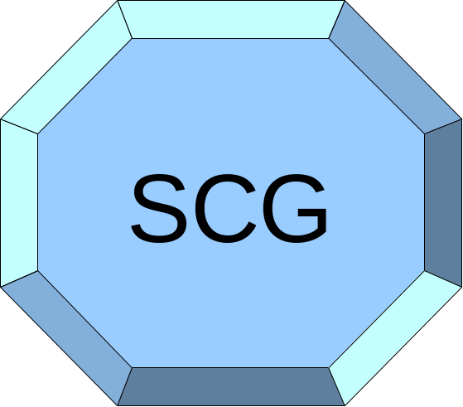
Catalogues and Software
to astronomical community
BCO Labs
Robotic Surveys
Output catalogues
Grid metrics and know-how
Grid Ireland
Expertise, Pedagogy,
IP to ITTD

Slide 5
Software Design
Good software design is key to our group
Software needs to be modular and flexible
Seamless transposition to multiple astrophysics catalogues
  Software structure is layered to facilitate this
Needs to be designed for Grid (Cloud in future)
  Data explosion in astrophysics
Need to be able to control Grid batch size to optimise use of computing resources
  Take full advantage of parallel nature of problem

Slide 6
Current Project
Download SDSS catalogue
Reformat it to a local catalogue
Examine each point source in the catalogue to determine its suitability for exoplanet searches
Determine stars that are especially amenable to differential photometry

Slide 7
Catalogue Index
Catalogue Index
Catalogue Index
Source catalogue
Source catalogue
Source catalogue
Data Access API
Data Access API
Data Access API
For all files
For all files
For all files
diagnose
diagnose
diagnose
extract
extract
extract
Master target list
Local Index
Local catalogue
For all targets
Target finder program
Parameterisation
Parameter List
Core Data Pipeline
Filter
Algorithm
Output Indexing
Output Index
Output catalogue

Slide 8
Differential Photometry
Looking at temporal variations from astronomical sources
Ground based studies need to worry about atmospheric effects
Compare source of interest to other stars in same field of view
If only target flickers then it's probably an intrinsic variation
If all sources flicker then it's the atmosphere
Need “good” reference stars – that’s where we come in
Can observe millimag variations with a moderately sized telescope (in conjunction with SelPhot from BCO Labs)

Slide 9
3 Phases of Process
Optimising fields of view
  Positioning field of telescope around target so that we can see the best reference stars
Quasar Fields Catalogue
  Finding quasars that have the best set of reference stars
  Expect differential photometry to give outstanding results for these
Exoplanets by transit
  Find fields of view that are populated by many stellar clones
  Get best chance of observing transits

Slide 10
Optimising Fields
Centering target not the best option
Developed “Locus Algorithm” to figure out best pointing
  Accesses FIT tables from SDSS local catalogue
  Filters out unnecessary rows to get all potential reference stars
  Generates set of intersection points
  Evaluates quality of field at each intersection
  Reference stars graded based on magnitude and colour difference to target

Slide 11
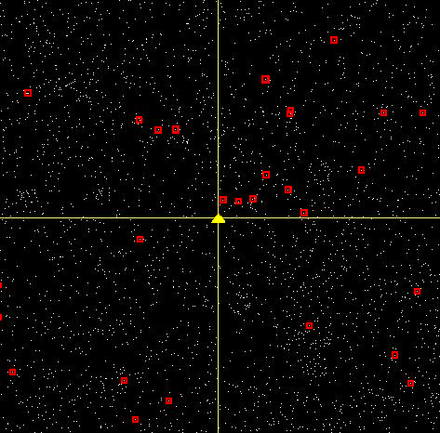
Locus Algorithm 1
From a field of 6000 stars, only 28 are in the right magnitude range, highlighted in red.

Slide 12
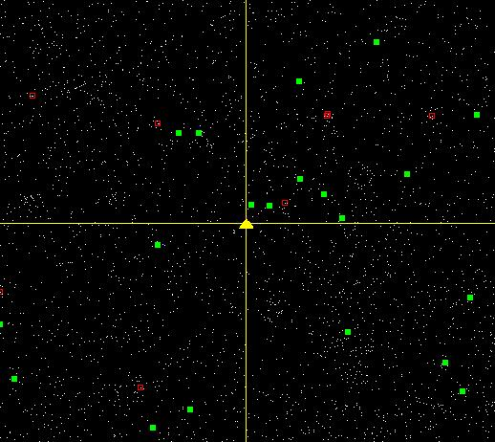
Locus Algorithm 2
Of those 28, 8 are too close to another star to be viable candidates, leaving 20, marked in green.

Slide 13
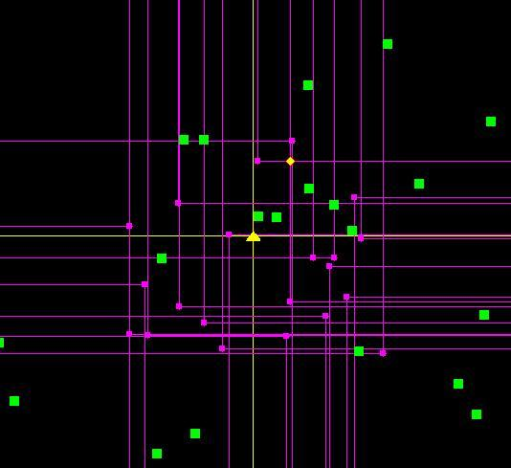
Locus Algorithm 3
The Locus algorithm is applied. The “boxes” are shown in magenta. The intersection with the highest score is highlighted in red and yellow.

Slide 14
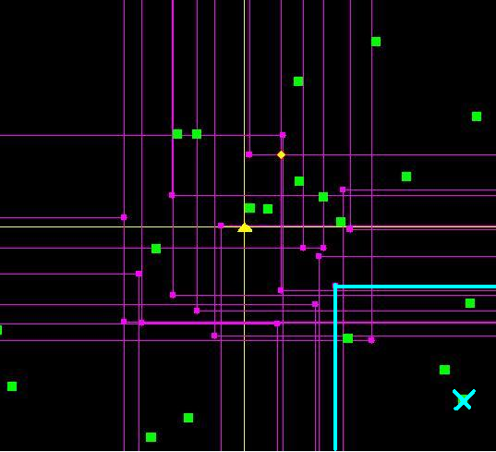
Locus Algorithm 3
The Locus algorithm is applied. The “boxes” are shown in magenta. The intersection with the highest score is highlighted in red and yellow.

Slide 15
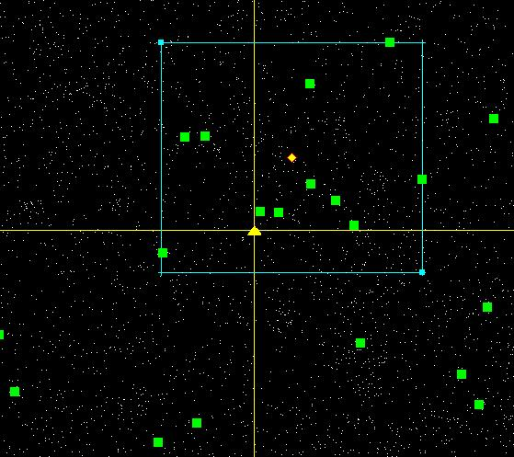
Locus Algorithm 4
The final field of view is shown in cyan. 11 reference stars are contained in this field.

Slide 16
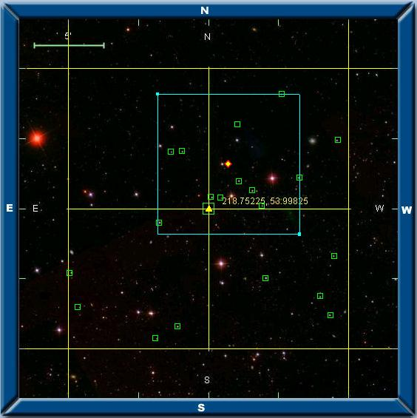
Locus Algorithm Result
The results overlaid onto an SDSS DR6 Navigation tool image. In the image can be seen the reference stars and the field of view.

Slide 17
Quasar Catalogue
SQL search on SDSS to obtain data on 77,126 QSO’s
Run Locus Algorithm on each one
For each QSO, Algorithm finds
  Best pointing
  Score depending on suitability for diff. photometry
Produces ranked list
This is running right now on Grid Ireland
Will be published as a searchable database

Slide 18
Exoplanet Transits
Similar to quasar catalogue
Different scale of problem
  106 million point sources in SDSS DR7
  400 thousand FIT files
Experience from quasar catalogue used in Grid implementation
Looking for fields with multiple similar stars

Slide 19
Achievements – Data
Download of SDSS fit tables in Grid Ireland
  Download took 6 weeks for 4.2TB
Entire database optimised and reduced in size
  Reduced each file from several MB to ~30kB
  400 thousand files
  Reduction took 2 weeks
Reduced dataset allows much easier repetition of pipeline analysis

Slide 20
Achievements – Computing
New algorithm developed that searches for the best pointing of a telescope
Applying this algorithm to immense number of targets
Grid software developed that can run these problems with enhanced computer power
Metrics on computing resources needed for large scale data mining

Slide 21
Achievements – Astronomy
Individual stars and quasars optimised for Differential Photometry
All SDSS quasars optimised and ranked (In Progress)
All SDSS point sources optimised for exoplanet searches (ETA November 2010)

Slide 22
Outputs
QSO catalogue (to be published)‏
Exoplanets catalogue (to be published)‏
Software to be made available to community
  As a grid suite of software to run for specific telescopes and particular scoring parameters
  With a web front end for amateurs to optimise individual fields on the fly
Publication of computer experience and metrics in technical paper
Potential IP with the Locus Algorithm

Slide 23
Abstract – not part of talk
Ground based searches for transiting exoplanets require high precision differential photometry. A key requirement of this technique is the presence of suitable reference stars, spectrally similar and in the same field of view as the target star. The Scientific Computing Group in ITT Dublin, in collaboration with BCOLabs at Cork institute of Technology (CIT) and Grid-Ireland (TCD), is developing software that datamines large astronomical catalogues to enable high precision differential photometric studies of large numbers of stars for smaller planets via the transit method.
In this project, the Sloan Digital Sky Survey (SDSS) DR7 catalogue has been downloaded onto the Grid Ireland network. Each of the 400,000 fields of this catalogue has been optimised to facilitate targeted searches. A newly developed algorithm, designated the Locus Algorithm, determines both the optimum pointing for each target , i.e. the pointing in RA and Dec. that includes the best reference stars for each target; and also grades each target on the criterion of the number and quality of its reference stars. The output of this analysis will be a new catalogue whose entries contain an optimised pointing (field) and rank for each of the 370 million point sources contained in SDSS. The new catalogue will be published for use by the astronomical community.
Two uses are envisaged for the software and output catalogues generated. Firstly, the new catalogue can act as input into large-scale robotic searches for smaller exoplanets. Secondly, individual observatories (including serious amateur astronomers) can avail of subsets of the catalogue for specific exoplanet searches.
This project requires significant computing resources and showcases the application of grid computing to astrophysical problems.

