Slide 1
Circular Motion
Rotational kinetics
Angular Momentum
Circular Forces - Torques
Work energy power in Circular Motion
1
1
Notes:
1

Slide 2
Rotational Mechanics
So far we've pretty much confined our study to objects moving in straight lines
These are 1-D problems
Important set of problems where objects move in circle
Called rotational mechanics
We'll see analogies for speed, acceleration, momentum, force, energy, mass
2
Notes:
2

Slide 3
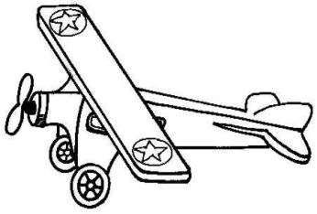
Same speed, but in different directions
Acceleration
Need to define some quantities before we go any further
These will be:
Period
Frequency
Angular velocity
3
Notes:
3

Slide 4
Rotational Mechanics – rate of motion
Periodic time (T)
This is the time for one rotation, one lap
Frequency (f)
This is the rate of rotation
How many laps per second
Units are s⁻¹ or Hertz (Hz)
Angular Velocity (ω, pronounced omega)
Angle that the radius sweeps out per unit time
Units are radians per second (rads s⁻¹)
Equations: f=1/T, ω = 2πf
4
Notes:
4

Slide 5
Angular Kinematics
In the same way that things moving in a straight line can be made to move faster or slower, stuff moving in a circle can rotate faster or slower
This means a change in angular velocity
Call this an angular acceleration
Different from the centripetal acceleration we’ll see later
Use symbol α
Units for α are radians per second squared
Rad s⁻²
Direction of α are tangent to the circle
Parallel or anti-parallel to velocity
5

Slide 6
Angular Kinematics
Now have:
Angular acceleration, α (note, this is not the same acceleration we met on slide 5)
Angular velocity, ω
Angular position, θ
Put these together to get a set of equations for angular motion:
ω = ω₀ + αt
θ = ω₀t + ½ αt²
ω² = ω₀² + 2αθ
θ = (ω₀ + ω)t / 2
These should look familiar
6

Slide 7
Angular Kinematics - example
A disc starts from rest and rotates with constant angular acceleration of 2rad s⁻². How many revolutions does it make in 10s?
[100rads = 15.92 revolutions]
During a jump, an ice-skater increases their angular velocity from 16 rads s⁻¹ to 34.265 rads s⁻¹ in 0.5s by tucking in their arms. How many revolutions do they do in this time?
[12.566 rads = 2 revolutions]
After leaving the clubface, a golf ball spins at 346rads s⁻¹. When it lands 7.5s later, its rate of rotation has slowed to 210rads s⁻¹. Calculate the angular deceleration.
[18.13rads s⁻²]
7

Slide 8
Angular Kinematics - example
A discus thrower with a throwing arm length of 1.3m begins his throwing motion with an angular velocity of 5 rads s⁻¹. During the throw he spins through 15 rads. The entire movement takes 0.8s. Calculate the angular acceleration, the final angular velocity, the speed of the discus as it is released, and the tangential acceleration of the discus as it released.
[34.38 rad s⁻², 32.5 rads s⁻¹, 42.25 ms⁻¹, 44.69ms⁻²]
8

Slide 9
Speed and Acceleration on a Circle
Speed (v)
The speed is distance divided by the time
Acceleration (a_{r})
Acceleration has units of m/s² and the magnitude
of the acceleration can be shown to be equal to
9
Notes:
9

Slide 10
Speed and Acceleration on a Circle Tangential and Radial Acceleration
There are two types of acceleration in circular motion
Radial
Tangential
The radial acceleration is the a_{r}=ω²r feature we just described
Changes direction of object as it moves on the circle
The tangential acceleration, a_{t}, is connected to angular acceleration
Changes speed of object, faster or slower
Just like v = ωr for angular velocity, we get a_{t} = αr
10
Notes:
10

Slide 11
Centrifuge
The centripetal acceleration of the chamber points radially inwards
However a particle inside the chamber is not directly subjected to the centripetal force
It has an acceleration relative to the chamber of vω directed outwards
This is called centrifugal acceleration
11
Notes:
11

Slide 12
The types of materials placed in a centrifuge are those that do not sediment quickly under the action of gravity
Centrifugal acceleration plays the role of an artificial gravity acting on the particles suspended in the liquid in the chamber
Associated with the centrifugal acceleration is the centrifugal force which is IMAGINARY
It appears as if the particle is being pushed outwards
12
Notes:
12

Slide 13
Moments of Inertia
In linear momentum we multiplied mass by velocity to get the momentum
There is an analogous quantity in circular motion
We’ll replace the velocity by the angular velocity
Need some rotational equivalent for the mass
Need to factor in that some of the mass in a spinning system is pretty much stationary, stuff near the axis, while some is moving very fast, stuff far from the axis.
Get Moment of Inertia which depends of size of each piece of mass and how far it is from the axis
I = Σmr²
13

Slide 14
Moments of Inertia
Let's first examine how I depends of the shape of the object
For a shell about its axis: I = MR²
For a solid cylinder about its axis: I = ½MR²
For a spherical shell about its diameter: I = ⅔ MR²
For a solid ball: I = ⅖MR²
For a club about one end: I = ⅓ MR²
14

Slide 15
Moments of Inertia - examples
Calculate the moment of inertia of a golf ball, mass = 0.046kg, radius = 2.134cm
[ 8.38x10⁻⁶kgm²]
Calculate the moment of inertia of a tennis ball, mass = 0.0567kg, radius = 3.35cm
[ 4.24x10⁻⁵kgm²]
Estimate the moment of inertia of a baseball bat, mass = 0.9kg, length = 0.81m
[ 0.197 kgm²]
15

Slide 16
Moments of Inertia - Axes
With mass, the same object has the same mass every time
Not so with moment of inertia
Depends on the axis about which it rotates
Take human body in standing position:
Small I around axis along spine (sagittal)
Medium I around axis through midriff from left to right (transverse)
Big I around axis coming out through your navel (frontal)
16

Slide 17
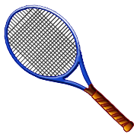
Moments of Inertia - axes
Same object has different moments of inertia along different axes
Will depend on average distance of the mass of the object from the axis.
Take a tennis racket:
First axis is longer, it’s closer to
most of the mass, has a smaller
moment of inertia
For three dimensional object, cannot spin stably about intermediate axis – Tennis Racket Theorem
second axis
Centre of
gravity
First axis
17

Slide 18
Angular Momentum
When we discussed linear motion we had momentum which was conserved as long as no outside force is acting.
Of course, get an analogous feature in rotational motion
Linear momentum was = mass x velocity
Angular momentum is = (moment of inertia) x (angular velocity)
L = Iω
And angular momentum is conserved as long as no outside torque is acting

Slide 19
Conservation of Angular Momentum - examples
High board diver spins at 5 rads s⁻¹ about transverse axis in a layout position when her moment of inertia is 15kgm². When she tucks, her moment of inertia decreases to 4 kgm². Calculate the new rate of spin.
[18.75 rads s⁻¹]
During a bicycle kick a player swings their leg with an angular momentum of 22kgm²s⁻¹ about their hip joint. If the rest of their body has a moment of inertia of 18kgm² about this joint calculate the rate of rotation of their body during the kick. Relative to their kicking leg, in what direction does their body rotate?
[1.22rads s⁻¹]
19

Slide 20
Torques
What causes angular accelerations?
Need an analogy for the force we used in linear motion
This change in angular velocity produced by a Torque
20

Slide 21
Torques - definition
Push middle of an object – it accelerates
Push edge of an object – it accelerates and turns
Push in opposite directions at top and bottom – it turns
acceleration
Acceleration
&
twist
twist
21

Slide 22
Torques - definition
Making something rotate depends on:
How hard you push
How far from centre you push
Concept of lever arm
Magnitude of torque is defined to be:
Torque = Force x Distance
The distance is measured from the line of action of the force to the hinge, the centre of rotation, of the object
22

Slide 23
Torques - definition
Torques can be positive or negative
Torque is a vector
By convention, torques causing counter-clockwise rotations are positive
Torques can add, subtract, cancel each other out
Units for torque are Newtons x metres = Nm
(bizarrely this is the same for work and energy, but they are totally different things)
23

Slide 24
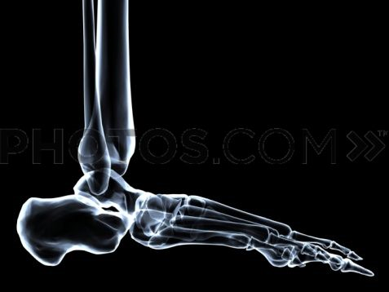
Torques - example
When jumping a person exerts a force through their Achilles tendon of 850N. The tendon is attached 3.5cm from the ankle joint. Calculate the torque about the joint.
[ 29.75Nm]
Force = 850N
3.5cm
24

Slide 25
Torques in Sport
Any sporting action that involves a turn, spin, or swing
e.g rowing, golf, tennis, cricket
Feature of tackling and wrestling
Principle behind how most weights machines work
25

Slide 26
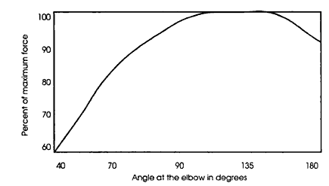
Torques in Sport
Also important to understand muscle action
See previous example
Different torques as a joint is flexed
Maximum torque for elbow at a right angle
Weight machines designed to match this torque curve (dynamic variable resistance)
26

Slide 27
Torques in Muscles
action | Peak muscle torque (Nm)
Trunk extension | 258
Trunk flexion | 177
Knee extension | 204
Knee flexion | 109
Hip extension | 150
Ankle plantar flexion | 74
Elbow flexion | 20
Wrist flexion | 8
Wrist extension | 4
(from Knudson, Biomechanics, p.171)
27

Slide 28
Torque and Moments of Inertia - examples
A string is wound around a disk of mass 3kg and radius 0.25m. The string is pulled with a force of 10N. The disk is intially at rest
What is the moment of inertia of the disk?
What is the torque on the disk?
What is the angular acceleration of the disk?
what is the angular velocity after 7s?
[ 0.0938kgm², 2.5Nm, 26.7rads s⁻², 186.7rads s⁻¹]
28

Slide 29
Torque and Moments of Inertia - examples
A 2.9kg mass is attached to a string wound around a wheel of mass 6.1kg and radius 0.75m.
Calculate the moment of inertia of the wheel
Calculate the weight of the attached mass
Calculate the acceleration of the attached mass as it falls
[ 1.716kgm², 28.45N, 4.78ms⁻²]
29

Slide 30
Moments of Inertia - planes
To identify the axis of rotation it can help to think about the plane of rotation
If you can picture a two dimensional sheet in which a part of the object is moving, then the axis of rotation is perpendicular to this sheet.
Sagittal Plane – divides body left and right
Coronal Plane – divides body back and front
Transverse Plane – divides body top and bottom
Transverse Axis – perpendicular to sagittal plane
Anteroposterior Axis – perpendicular to coronal plane
Longitudinal Axis – perpendicular to transverse plane
30

Slide 31
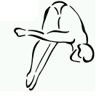
Torques at Equilibrium
As torques are vectors they can add and subtract
Can get a force couple that gives us no net torque
This is the law of the lever
Consider the diver on a spring board below:
Can figure out that the force on the bolt is 1800N and on the fulcrum is 2400N
Note that in equilibrium, it doesn’t matter where we choose the axis of rotation
4m
1m
600N
31

Slide 32
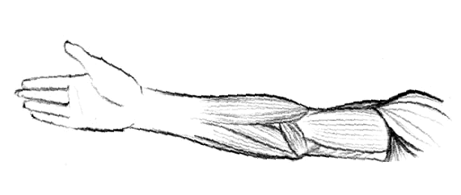
Centre of Gravity
Point at which entire mass of a body seems to be concentrated
Example: consider a human arm
4N
17N
11N
0.13m
0.38m
0.61m
32

Slide 33
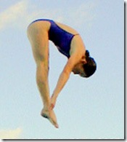
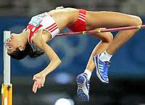
Centre of Gravity
In humans, COG depends on position of limbs
In normal resting position (arms by your side), your COG is slightly below your navel
About 55% of body height for women
About 57% of body height for men
If limbs move COG changes
Can be outside body
Highjumper clearing bar, COG below backbone
Springboard diver in piked position, COG between limbs
Centre
Of
Gravity
Centre
Of
Gravity
33

Slide 34
Centre of Gravity
Lots of sporting techniques involve adjustments of the COG
Example is high jump from previous slide
In other sports players can seem to hang in the air
COG follows parabola, as it must
Movement of limbs means other parts of body can be stable in the air
Example; dropping your non-striking arm in volleyball gives steadier platform from which to spike
Easier to reach higher with one arm raised rather than two
34

Slide 35
Measuring Centre of Gravity
Two methods
Suspend object twice from different points of support
Intersection of vertical lines from points of support is COG
Measure total mass of object then measure mass with one end supported
Fractional decrease in measured mass tells you how far up object COG is
35

Slide 36
Stability
Ability to return to balance, to equilibrium, after having been displaced
Sometimes stability desirable
Golfers
Wrestlers
Sometimes not
Goalie
Serve receive
36

Slide 37
Stability
Factors affecting stability
Size of base of support
The bigger the more stable
Height of centre of gravity
Closer to support the more stable
Weight of object
Greater weight means more stable
Torque of force trying to disturb equilibrium
Greater the torque, the further from COG, the greater the chance of upsetting stability
Most stable stance is the one which minimises your potential energy
37

Slide 38
Stability - Example
Car negotiating a turn. Given the wheelbase of the car, the height of the COG, and the radius of curvature of the corner, calculate the maximum speed the car can travel without overturning.
Torque produced by centrapetal force of circular motion (a=v²/r)
This is counteracted by weight of car
End up with
38

Slide 39
Moments of Inertia - planes
Human body’s moment of inertia is largest around anteroposterior axis, smallest around longitudinal axis
By tennis racket theorem, rotation around transverse axis unstable
Typical moments of inertia are 10’s of kgm²
Depends on axis and depends on body position
39

Slide 40
Moments of Inertia – human movement
Terms describing movement of:
Elbow
Knee
Shoulder
Hip
Wrist
Ankle
40

Slide 41
Moments of Inertia – human movement
In sagittal plane
Flexion –around transverse axis, away from rest position
Extension – opposite of flexion, returns to rest position
Dorsiflexion – flexion of the ankle joint
Plantar Flexion – extension for the ankle (standing on your toes is plantar flexion)
In frontal plane
Abduction – around anteroposterior axis, away from rest position
Adduction – opposite of abduction, back to rest position
41

Slide 42
Rotational Kinetic Energy
Spinning object has energy
Depends on rate of rotation and of mass distribution
Get Rotational Kinetic Energy = RKE = ½ Iω²
42

Slide 43
Rotational Kinetic Energy - examples
Re-examine the problem on slide 29 and solve using energy conservation. Note how much easier it is to do this way.
A bowling ball has a radius of 0.269m, a mass of 6.5kg, and a moment of inertia of 0.188kgm². Its speed is 5ms⁻¹. Calculate its kinetic energy, its angular velocity, and its angular kinetic energy.
[81.25J, 18.6rads s⁻¹, 32.52J]
43

Slide 44
https://ciechanow.ski/bicycle/

Slide 45
Biomechanics Summary
Period / frequency
Radians / angular velocity
Angular kinetics
Angular momentum, conservation
Moment of inertia
Torques
Rotational kinetic energy

Slide 46
Biomechanics Summary
T = 1/f = 2π/ω
F = 1/T = ω/2π
ω =2πf = 2π/T
v = ωR: a_{t} =αR
a_{r} = vω = v²/R = ω²R
τ = force x distance
ω = ω₀ + αt
θ = ω₀t + ½ αt²
ω² = ω₀² + 2αθ
θ = (ω₀ + ω)t / 2
I = ΣmR²
τ = Iα
RKE = ½Iω²
L = Iω
L_{before} = L_{after}

