Slide 1
Eugene
Energy in Sport

Slide 2
Energy & Training
Homeostasis
optimum temperature
optimum pH
optimal glucose levels
etc
Adaptations
overload principle
specificity
reversibility
individuality

Slide 3
Calorimetry
Direct: measure heat produced during exercise - Human Calorimetry Chamber
Indirect: measure O₂ consumption (VO₂) typically about 0.25mL/kg/s of VO₂ during exercise 0.05mL/kg/s of VO₂ during rest
Maximum VO₂ measured by exercising to exhaustion get up to 1mL/kg/s
corresponds to about 250 Watts of power
training will increase your VO₂ max
cardiovascular adaptations giving better O₂ delivery
muscle mitocondrial O₂ utilisation
athletes using large muscle masses for extended periods tend to have highest VO₂ max

Slide 4
Respiratory Exchange Ratio (RER)
as well as measuring O₂ levels we also monitor CO₂ gives us the RER
$$RER=\frac{V_{CO_{2}}}{V_{O_{2}}}$$
This gives information on type of food being used
for fats, RER = 0.7
for glucose, RER = 1.0
Fats, e.g. palmitate, C₁₆H₃₂O₂ + 23 O₂ -> 16 CO₂ + 16 H₂O
$$\frac{16}{23}=0.70$$
Glucose, C₆H₁₂O₆ + 6 O₂ -> 6 CO₂ + 6 H₂O
$$\frac{6}{6}=1.0$$

Slide 5
Fuel depends on Type of Exercise
for long distance, endurance, RER lets us deduce that mostly fats are burned
for high-powered activities like sprinting, mostly carbohydrates

Slide 6
Fuel used During a Marathon
muscle triglycerides: provide ~ 30% of energy initially but fades to ~10% gradually over four hours
plasma FFA: provide ~ 20% initially but this grows to 50% over four hours
blood glucose: provides 10% initially, this grows to 40% after four hours
muscle glycogen: provides ~ 40% initially but fades out over about 3 hours
decrease in CHO use leads to a decrease inperformance and to the onset of fatigue
See this video for a discussion of energy use in sled dogs.

Slide 7
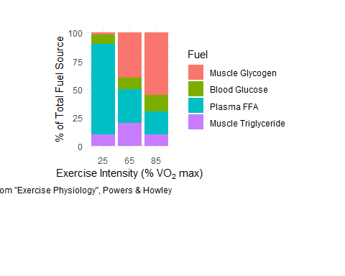
Fuel used During a Marathon

Slide 8
Crossover Concept
As exercise intensity increases
progressive decrease in fats as fuel source
progressive increase in CHO as fuel source
Training adaptation - push this crossover point to higher intensities
Leads to sparing of precious CHO stores
Pushes back onset of fatigue

Slide 9
ATP & Muscle Work
Only ATP can be used to directly cause muscle contraction
Breakdown of ATP allows crossbridge formation between actin and myosin (enzyme ATPase)
Amount of ATP in muscle is extremely low
During exercise as ATP utilisation goes up, need to replace it
$$ATP_{prod}=ATP_{util}$$
ATP producing pathways turns on by the energy charge in the cell
$$ Energy\; Charge = \frac{[ATP] + {1\over2} [ADP]}{[ATP] + [ADP] + [AMP]} $$
At rest, the energy charge in muscle is about 0.85 As energy charge decreases, ATP producing pathways are turned on while ATP utilising pathways are turned off

Slide 10
Mitochondria
Oxidative production of ATP occurs in mitochondria.
This is vast majority of ATP production.
Aerobic activity
Last minutes or longer

Slide 11
Anaerobic Sources of Energy
Activities lasting seconds need energy immediately Access stores of ATP in the cell
$$ATP+H_{2}O → ADP+P_{i} ATP_{ase}$$
$$CP+ADP → ATP+C creatine kinase$$
No O₂ in either process

Slide 12
Carbohydrates
Carbohydrate can be broken down anaerobically
$$C_{6}H_{12}O_{6} → 2ATP+2 lactate$$
Or aerobically
$$C_{6}H_{12}O_{6}+6O_{2} → 30ATP+6CO_{2}+6H_{2}O$$
(note, for the same glucose molecule we get 15 times more ATP when broken aerobically) Limited amount of carbohydrate in the body, aerobic metabolism helps preserves carbohydrate stores.
Fats can also be broken down aerobically
$$Palmitate+23O_{2} → 108ATP+16CO_{2}$$

Slide 13
Carbohydrate Storage
Carbohydrates stored as Glycogen
Glycogen = strings of glucose attached to each other
When glucose needed, peeled off from glycogen
Muscle Glycogen
typically 400g = 1600kCal
this is ~90mM/kg of muscle
can be depleted in minutes
carbohydrate loading: supercharges muscles with up to 250mM/kg of muscle
useful for exercises of > 90 minutes
Liver Glycogen
typically 100g = 400kCal
needed to maintain blood glucose levels
Blood
typically 3g = 12kCal (i.e. not very much)
Total of 2000kCal can be depleted during endurance exercise

Slide 14
Compare to Fat Storage
Adipose Tissue
typically 12kg = 108,000kCal
fifty times more energy than carbohydrates
key aerobic training adaptation is being able to use fat stores
this preserves carbohydrate stores

Slide 15
To What Extent do we use Carbohydrates?
Intensity and duration of exercise
at low intensities use fats
at high intensities use carbohydrates
at high intensities use mostly type II muscle fibres
Type of activity
Nutritional status

Slide 16
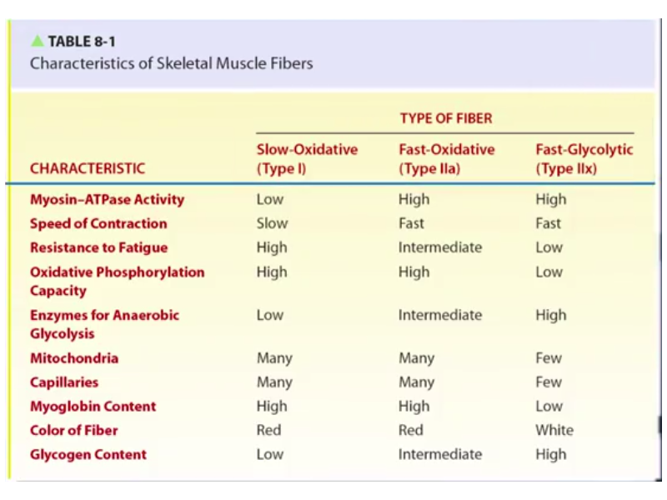
Different Muscle Fibres
Training level
Muscle Fibres

Slide 17
Liver Glycogen
provides glucose for blood glucose levels
necessary to avoid exercise induced hypoglycemia
muscle uptake from blood is up to 50mM/min

Slide 18
Carbohydrate Loading
increase CHO content in muscles prior to exercise
can get up to 250 mM/kg of muscle
(compare to 90 mM/kg normally)
increase CHO intake in week prior to exercise
roughly double it to ~0.6kg/day
rest for day or so before exercise

Slide 19
Carbohydrate Feeding
consumption of very dilute CHO drink during exercise
athletes at 70 VO₂ max can exercise for ~4 hours rather than 3 hours before fatigue
gives addition source of CHO thus sparing liver glycogen

Slide 20
Training Adaptations
sedentary individuals can double their cell mitochondrial content through training
takes several weeks
means using more CHO aerobically rather than anaerobically
as we’ve seen, this is more more efficient
spares muscle CHO content
also observe a lower RER for individuals after training
lower RER means greater fat usage
this happens at all VO₂ % levels

