Slide 1
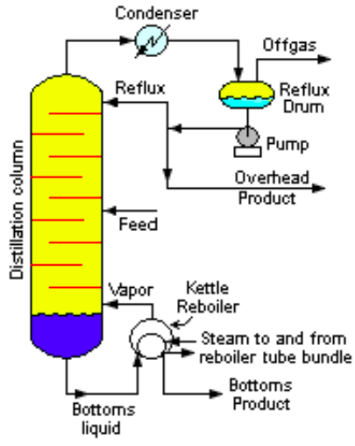

Slide 2
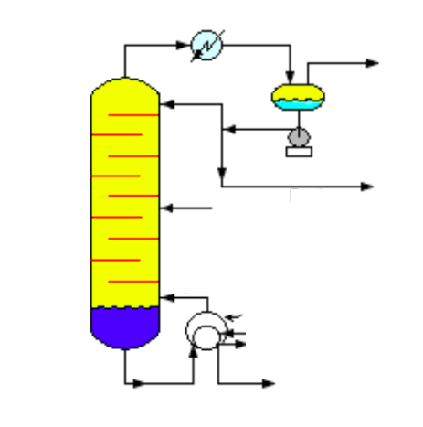
Feed
Reboiler
Reflux
Condenser
Reflux Drum
Bottom Product

Slide 3
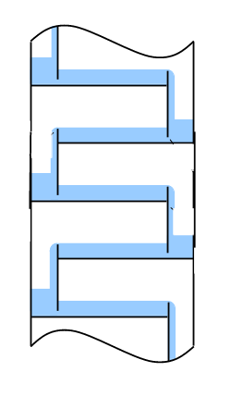
Overflow Weir
Underflow Weir
Downcomer

