Slide 1
C#程序设计及应用
唐大仕
dstang2000@263.net
北京大学
Copyright © by ARTCOM PT All rights reserved.

Slide 2
语法要素小结
••••••••••••••••••••••••••••••••••••••
Notes:
Custom animation effects: dotted line with text fade by letter
(Basic)
To reproduce the text effects on this slide, do the following:
On the Home tab, in the Slides group, click Layout, and then click Blank.
On the Insert tab, in the Text group, click Text Box, and then on the slide, drag to draw a text box that spans the entire width of the slide.
On the Insert tab, in the Text group, click Symbol. In the Symbol dialog box, do the following:
In the Font list, select (normal text).
In the Subset list, select General Punctuation.
In the Character Code box, enter 2022 to select BULLET, and then click Insert.
Click Insert 33 more times until there is a row of 34 bullets in the text box.
In the text box, select the text, and then on the Home tab, in the Font group do the following:
In the Font list, select Arial Black.
In the Font Size list, select 44.
Click the arrow next to Font Color, and then under Theme Colors click White, Background 1 (first row, first option from the left).
On the Home tab, in the Drawing group, click Arrange, point to Align, and then do the following:
Click Align to Slide.
Click Align Center.
Click Align Middle.
On the Insert tab, in the Text group, click Text Box. Drag to draw a text box on the slide.
Enter and select the text. On the Home tab, in the Font group, do the following:
In the Font list, select Corbel.
In the Font Size box, enter 50.
Click the arrow next to Font Color, and then under Theme Colors click White, Background 1 (first row, first option from the left).
Click Bold.
With the text still selected, on the Home tab, in the Paragraph group, click Center.
Select the second text box. On the Home tab, in the Drawing group, click Arrange, point to Align, and then do the following:
Click Align to Slide.
Click Align Center.
Click Align Middle.
To reproduce the background effects on this slide, do the following:
Right-click the slide background area, and then click Format Background. In the Format Background dialog box, click Fill in the left pane, select Gradient fill in the Fill pane, and then do the following:
In the Type list, select Radial.
Click the button next to Direction, and then click From Center (third option from the left).
Under Gradient stops, click Add or Remove until two stops appear in the drop-down list.
Also under Gradient stops, customize the gradient stops that you added as follows:
Select Stop 1 from the list, and then do the following:
In the Stop position box, enter 0%.
Click the button next to Color, and then under Theme Colors select Blue, Accent 1, Darker 25% (fifth row, fifth option from the left).
Select Stop 2 from the list, and then do the following:
In the Stop position box, enter 100%.
Click the button next to Color, and then under Theme Colors select Black, Text 1 (first row, second option from the left).
To reproduce the animation effects on this slide, do the following:
On the Animations tab, in the Animations group, click Custom Animation.
On the slide, select the first text box. In the Custom Animation task pane, do the following:
Click Add Effect, point to Entrance, and then click More Effects. In the Add Entrance Effect dialog box, under Basic, click Fly In.
Select the animation effect (fly-in effect for the first text box). Click the arrow to the right of the selected effect, and then click Effect Options. In the Fly In dialog box, do the following:
On the Effect tab, do the following:
In the Direction list, select From Left.
In the Animate text list, select By Letter.
In the % delay between letters box, enter 10.
On the Timing tab, do the following:
In the Start list, select With Previous.
In the Speed list, select 0.5 seconds (Very Fast).
On the slide, select the first text box. In the Custom Animation task pane, do the following:
Click Add Effect, point to Exit, and then click More Effects. In the Add Exit Effect dialog box, under Subtle, click Fade.
Select the second animation effect (fade effect for the first text box). Click the arrow to the right of the selected effect, and then click Effect Options. In the Fade dialog box, do the following:
On the Effect tab, do the following:
In the Animate text list, select By Letter.
In the % delay between letters box, enter 10.
On the Timing tab, do the following:
In the Start list, select With Previous.
In the Delay box, enter 1.5.
In the Speed list, select 0.5 seconds (Very Fast).
On the slide, select the second text box. In the Custom Animation task pane, do the following.
Click Add Effect, point to Entrance, and then click More Effects. In the Add Entrance Effect dialog box, under Subtle, click Fade.
Select the third animation effect (fade effect for the second text box). Click the arrow to the right of the selected effect, and then click Effect Options. In the Fade dialog box, do the following:
On the Effect tab, do the following:
In the Animate text list, select By Letter.
In the % delay between letters box, enter 6.
On the Timing tab, do the following:
In the Start list, select With Previous.
In the Delay box, enter 2.
In the Speed list, select 0.5 seconds (Very Fast).

Slide 3
类的主要成员
语法要素 | 解决的问题 | 用法举例 | 定义 | 备注
字段（field) | 成员变量 | Math.PI | int age;
方法（method) | 成员函数 | 7.ToString() | void SayHello(){}
属性（property) | 字段的包装getter/setter | "hello".Length DateTime.Now textbox1.Text="abc" | int Age {get;set;}
索引（indexer) | 子项的包装 getItem/setItem | "hello"[3] record["age"]=18 | string this[int i]{ set{a=value;} get{return a;} } | 无名字
运算符（operator) | 方法的符号化 | DateTime.Now – t0 | public static Complex operator + (Complex c1, Complex c2)

Slide 4
类型系统
语法要素 | 解决的问题 | 用法举例 | 定义 | 备注
类（class) | 对象 | Button b = new Button(); | class Person {字段，方法，…}
结构（struct) | 值类型 | Size s = new Size(w,h); | struct Point { int x; int y; }
接口（interface) | 某方面的特征 | IList a = new List(); | interface IList{ void add(); int get(int i); } | 包含多个抽象函数
枚举（enum) | 几种可能的情况 （常量的符号化) | DialogResult.OK | enum Dir{ E, S, W, N};
委托（delegate) | 函数指针原型的定义 | new Thread( new ThreadStart(fun)); | delegate void Fun(double a);

Slide 5
事件系统
语法要素 | 解决的问题 | 用法举例 | 定义 | 备注
委托（delegate) | 函数指针 | f = new Func(myfun); f +=… b=f(5.0) | delegate void Fun(double); | 多播
Lambda表达式 （=>) | 匿名函数 | a => { } | x => x/2
事件（event) | 消息与回调 | button1.Clicked += 函数； | event MyDelegate Clicked; | {add,remove}
事件的六步曲 |  | 委托及参数 事件声明及激发Clicked(o,e) 事件注册+=及函数
Linq | 查询语言 | from b in books where b.Price<30 select new {b.Title, b.Author}

Slide 6
修饰符
语法要素 | 解决的问题 | 能修饰的语法要素 | 备注
internal, private | 访问控制 | 类、字段、方法
static | 类的 | 类、字段、方法 | 非实例的 Math.sin
abstract | 抽象的 | 类、方法
sealed | 不能继承 | 类、方法
const | 常量 | 字段、局部变量
readonly | 只读量 | 字段、局部变量

Slide 7
继承
冒号（继承父类及实现多个接口）
base及构造函数
virtual 及 override

Slide 8
异常处理系统
异常处理
try{……}catch{…}finally{…}

Slide 9
Attribute系统
Attribute
用 [ ] 表示的附件信息
用反射type.GetCustomerAttributes()来使之

Slide 10
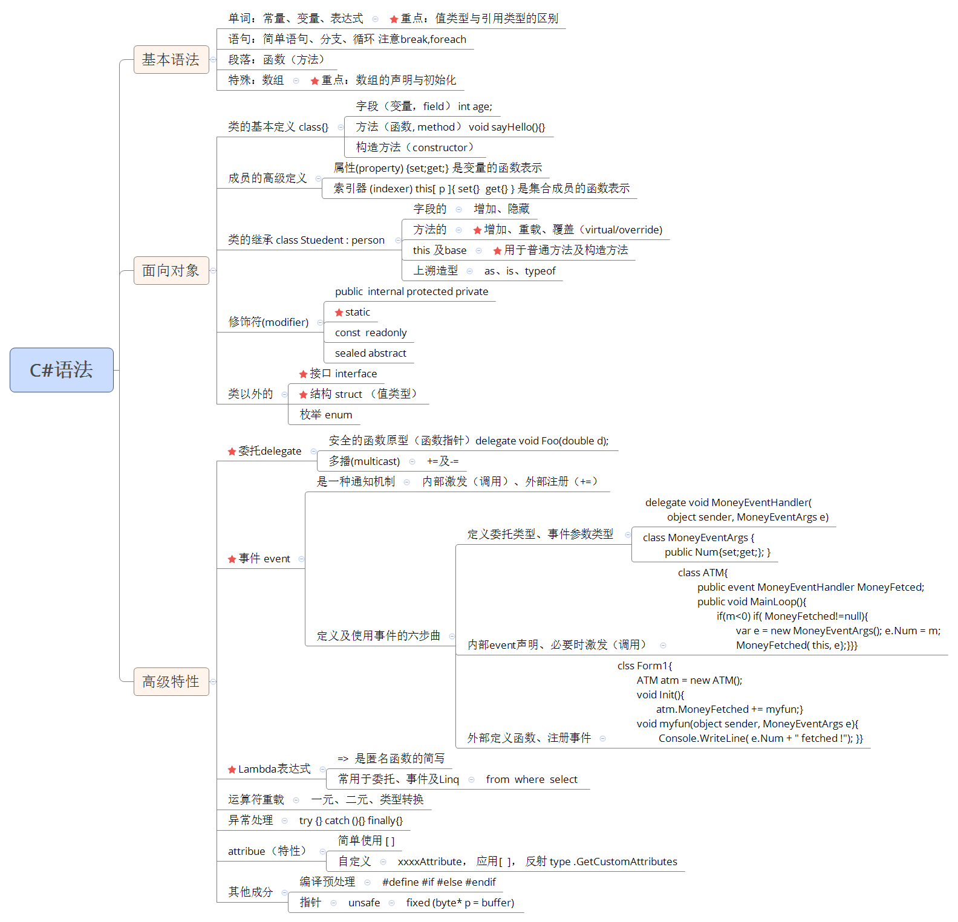
小结

