Slide 1
Introduction to Spring
Distributed Java - Unit 2

Slide 2



Our Application
A puzzle with a missing piece
Needs a date formatter
Doesn't create one itself
Asks something else to provide it
DateFormatter

Slide 3
Why Not Just Create It?
Creation always violates the Dependency Inversion Principle
Calling a constructor is tight coupling
We've solved this problem before by using Factory patterns

Slide 4
Interfaces Create Boundaries
<I>
MyApplication
DateFormatter
MilitaryDate Formatter
EuropeanDate Formatter

Slide 5
Who Creates Concrete Classes?
<I>
MyApplication
DateFormatter
Above-the-line knows about below-the-line
MilitaryDate Formatter
EuropeanDate Formatter
<creates>

Slide 6

Factory Class Calls Constructor
MilitaryDate Formatter
One DateFormatter, please
EuropeanDate Formatter

Slide 7

Spring Is Like a Factory
Our application no longer contains the factory
Spring contains our application
Spring is a container

Slide 8


Spring Creates Puzzle Pieces
Our application indicates what it needs
Declares a field of an interface type
Spring searches its collection of components
Inserts best match where required
File Logger
Email Sender
Date Formatter
MilitaryDate Formatter

Slide 9
Puzzle Pieces Are Beans
Singletons by default
Spring creates one object of every class identified as a bean at startup
File Logger
Email Sender
MilitaryDate Formatter

Slide 10
Dependency Injection
The process of Spring filling in missing puzzle pieces in your application
A form of "inversion of control"
Date Formatter
MilitaryDate Formatter

Slide 11
Agenda
What is Spring?
Core Spring
Spring Projects
Inversion of Control
Dependency Injection
Bean Scope and Lifecycle

Slide 12
What is Spring?

Slide 13
J2EE
Started in 1999
Servlets, EJB, Web Services
Lots of configuration
Multiple interfaces
Poor performance

Slide 14
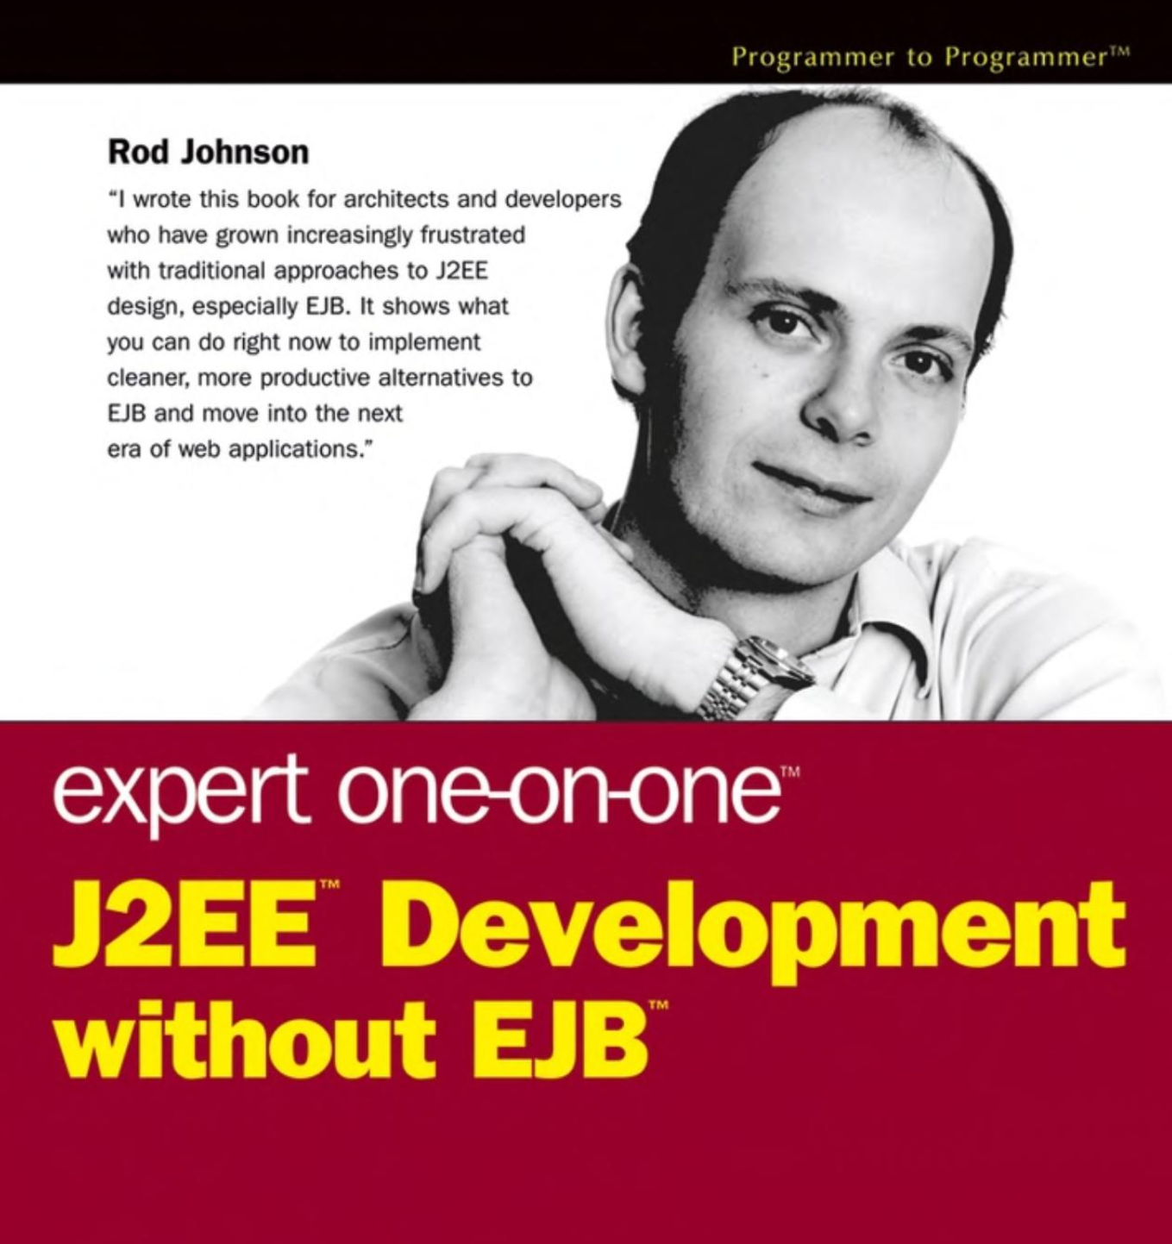
J2EE Without EJB
Rod Johnson released Spring in 2004
In 2006, EJB 3 started to mimic Spring

Slide 15

Spring Container
Also the Spring application context
Another layer between our application and the server
Spring
Tomcat
App

Slide 16

Creates and manages application components (beans)
Wires beans together via dependency injection
Dependency == helper

Slide 17
Goals of Spring
Lightweight development with POJOs
Dependency injection
Objects don't ask for what they need, they're given it

Slide 18
Core Spring

Slide 19

Core Container
Beans
Programmatic singletons
Application context
Gives applications access to beans
Expression language
Like ${variable}

Slide 20
Spring Projects
https://spring.io/projects

Slide 21

Java Spring Jobs
https://www.indeed.com/jobs?q=java+spring&l=Milwaukee%2C+WI&start=10

Slide 22
Inversion of Control

Slide 23

Inversion of Control Principle
"Don't call us, we'll call you"
The framework tells your project what to do

Slide 24
IoC Examples
Callbacks
Service locator pattern
Dependency injection pattern
Template method design pattern
Strategy design pattern

Slide 25
Dependency Injection
A type of IoC
Your program needs to create objects
Doing so creates a dependency
In IoC, objects are created and managed by something else
That something else is the IoC container

Slide 26

Dependency Injection
"Tell me what you need and I'll get it for you"
Usually a service
The container injects the service in the client

Slide 27
Spring App Demo

Slide 28
Create IntelliJ Maven Project
File > New > Project > Maven
Set language level to 8
Add spring-context dependency
<properties> <maven.compiler.source>1.8</maven.compiler.source> <maven.compiler.target>1.8</maven.compiler.target> </properties>

Slide 29

Dice Wager Game
Standalone Spring application - no server
Players join the game with $10
Place a bet each round
If the sum of dice is even, double your bet
Can cash out early

Slide 30
Create Player Class
Represents a player in the game
Holds name, current bet amount, cash pool
Just a plain Java class, really

Slide 31
Create DiceGame Class
Our first bean!
Annotate class with @Component
Spring will create one DiceGame object when application starts

Slide 32
Prove It!
Create a Spring application class: MyApp
Add a main method
We'll create another class to configure it

Slide 33
Create AppConfig Class
Annotate with @Configuration
@Configuration
public class AppConfig {
}

Slide 34
Component Scanning
Config tells Spring where the beans (components) are
Spring will scan the given package(s) and initialize all @Components
@Configuration
@ComponentScan("edu.wctc.dice")
public class AppConfig {}

Slide 35
Finish Main Method
Create the Spring context
Also known as the "container"
AnnotationConfigApplicationContext context = new AnnotationConfigApplicationContext();

Slide 36
Configure the Context
Tell context which class to use for configuration
context.register(AppConfig.class);
context.refresh();

Slide 37
Add Constructor to DiceGame
When does the printline happen?
public DiceGame() {
System.out.println("DiceGame created");
}

Slide 38
DiceGame Input and Output
DiceGame will use console for input and output
Fortunately, we remember Single Responsibility Principle!
Create ConsoleInput and ConsoleOutput classes

Slide 39
Class to Handle Input
public class ConsoleInput {
private Scanner scanner = new Scanner(System.in);
public String getInput(String prompt) {
System.out.print(prompt);
return scanner.nextLine();
}
}

Slide 40
Class to Handle Output
public class ConsoleOutput {
public void output(String text) {
System.out.println(text);
}
}

Slide 41
DiceGame Logic Pseudocode
public void play() {
// init players
// while there are still players in the game
// begin a round of gameplay
// everyone bets
// roll the dice
// handle wins/losses
// end the round
}

Slide 42
Add Fields to DiceGame
private List<Player> players = new ArrayList<>();
private int currentRound = 1;
private ConsoleInput in = new ConsoleInput();
private ConsoleOutput out = new ConsoleOutput();

Slide 43
Create Methods
private void initPlayers()
private void beginRound()
private String getPlayerChoice(String playerName)
private int getBet(int cash)
private boolean rollDice()
private int rollDie()
private void endRound(boolean evens)
private void playerReport()

Slide 44
Bean IDs
Ask Spring for the DiceGame bean it created using its ID
By default, a bean's ID is its class name with lowercase first letter
context.getBean("diceGame");

Slide 45
Bean IDs
Could have given it a different ID using annotation
@Component("game")
public class DiceGame { ... }
Then we would have said:
context.getBean("game");

Slide 46
Cast to DiceGame
getBean() returns an object
To call the play() method, need to cast
((DiceGame)context.getBean("diceGame")).play();

Slide 47
Oh No! Requirements Change!
You've been tasked with modifying the game so it can use popups or the console
But we've tightly coupled the I/O objects to the DiceGame!
public class DiceGame { private ConsoleInput in = new ConsoleInput(); private ConsoleOutput out = new ConsoleOutput();

Slide 48

How Do We Uncouple?
How do we create system boundaries?
Hint: See this slide

Slide 49
Create an Interface!
In a package called iface, create two interfaces
public interface GameInput {
String getInput(String prompt);
}
public interface GameOutput {
void output(String text);
}

Slide 50
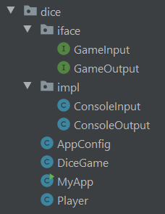
Move and Update Concrete Classes
Move ConsoleOutput and ConsoleInput to a package named impl
Let them implement their respective interfaces

Slide 51
Refactor Dice Game
This isn't much of an improvement
DiceGame is still coupled to implementations by calling their constructors
public class DiceGame {
private GameInput in = new ConsoleInput();
private GameOutput out = new ConsoleOutput();

Slide 52
Have Spring Supply the Pieces
Review this slide
Our application needs to tell Spring to supply a GameOutput bean
Game Output
Console Output

Slide 53
Make Some Beans
ConsoleInput and ConsoleOutput need to become beans
Spring will create one of each
They go into the "puzzle piece cache"

Slide 54
Annotate the Concrete Classes
Do not annotate the interfaces!
@Component
public class ConsoleInput implements GameInput {
@Component
public class ConsoleOutput implements GameOutput {

Slide 55
Autowiring
Implicit dependency injection
"Spring, find a bean that can fill this field"
"Spring, find a bean that implements this interface"
Game Output
Console Output

Slide 56
Three Types of Injection
How does DiceGame tell Spring to supply a GameOutput object?
Annotation in one of three places:
Constructor
Setter
Field

Slide 57
Constructor Injection
Spring creates the DiceGame (it's a bean too, remember?)
Spring will supply beans as arguments to the constructor
@Autowired
public DiceGame(GameInput in, GameOutput out) {
this.in = in;
this.out = out;

Slide 58
Setter Injection
Spring will call the setter after it creates the bean
@Autowired
public void setGameInput(GameInput in) {
this.in = in;
}

Slide 59
Field/Property Injection
Spring uses reflection to set the fields
@Autowired
private GameInput in;
@Autowired
private GameOutput out;

Slide 60
Create Popup I/O Implementations
We were told to make DiceGame able to use popups or the console
Create two more implementations of GameInput and GameOutput

Slide 61
PopupInput Class
In the impl package
@Component
public class PopupInput implements GameInput {
@Override
public String getInput(String prompt)
{ return JOptionPane.showInputDialog(prompt); }
}

Slide 62
PopupOutput Class
Also in the impl package
@Component
public class PopupOutput implements GameOutput {
@Override
public void output(String text)
{ JOptionPane.showMessageDialog(null, text); }
}

Slide 63
We Broke It
DiceGame won't start!
org.springframework.beans.factory.NoUniqueBeanDefinitionException:
No qualifying bean of type 'edu.wctc.dice.iface.GameInput' available:
expected single matching bean but found 2:
consoleInput,popupInput

Slide 64

Too Many Matches
Autowiring means, "Spring, find a bean that implements this interface"
Spring finds two
Need a way to disambiguate
Game Output
Console Output
Popup Output

Slide 65
Remember Our Config Class?
It can tell Spring which bean to create
Create one method per bean/interface
@Bean
public GameOutput gameOutput() {
// return new ConsoleOutput();
return new PopupOutput();
}

Slide 66
@Bean Methods
Name of method doesn't matter
Usually just the class name/bean ID
@Bean
public GameInput gameInput() {
// return new ConsoleInput();
return new PopupInput();
}

Slide 67
Remove @Component
Remove the @Component annotation from all four implementation classes
Don't want Spring creating them all!
AppConfig will create and return the desired bean

Slide 68
Bean Scope and Lifecycle

Slide 69
Bean Scope
Default is "singleton"
One bean per application
Every time the container is asked for a bean, it returns the same object

Slide 70
Bean Scope
"prototype" scope
One bean per request/reference
Every time the container is asked for a bean, it returns a new object

Slide 71
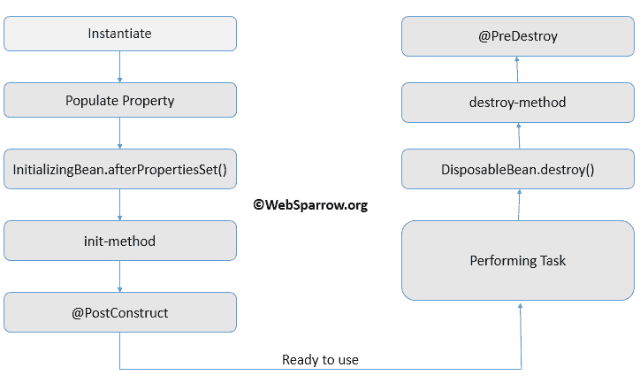
Bean Lifecycle
Spring manages creating and destroying beans
The whole process is the bean's lifecycle
There are hooks at certain points in the lifecycle where we can run custom code

Slide 72
Bean Lifecycle: Startup
Container started
Bean is instantiated
Dependencies are injected
Internal Spring processing
Your custom init method is called
Bean is ready for use

Slide 73
Bean Lifecycle: Shutdown
Container is shut down
Your custom destroy method is called
The destroy method is not called for prototype-scoped beans

Slide 74
Which Injection Type to Use?
Constructor injection
Pros:
Helps identify SRP violation (code smell)
Fields can be final
Cons:
Boilerplate code

Slide 75
Which Injection Type to Use?
Setter injection
Pros:
Overcome circular references
Fields can be optional
Cons:
Lots of boilerplate code

Slide 76
Which Injection Type to Use?
Field injection
Pros:
No boilerplate code
Cons:
Fields could be used before initialized
Argument against field injection

Slide 77
What Injection Type to Use?
Professional recommendation is:
Constructor: Required fields
Setter: Optional fields
Field: Avoid

Slide 78
What Injection Type to Use?
Instructor recommendation is:
Choose a style
Stay consistent in your project

Slide 79

Concept Recap

Slide 80
Application Context
The core of Spring
Also known as the container
Creates and manages beans
Makes them available to our application

Slide 81
Component Scanning
Spring scans your Java classes for special annotations like @Component
Automatically registers beans with the container

Slide 82
Default Bean ID
If no element provided, bean is given default ID
Name of the class with first letter in lower case
The bean below would have ID tennisCoach
@Component
public class TennisCoach implements Coach { ... }

Slide 83
Dependency Injection
A type of inversion of control
The Hollywood Principle
Application doesn't create helper objects
Instead, Spring provides them

Slide 84
Autowiring
Implicit dependency injection
Spring searches for a bean that implements the required interface
Injects it automatically

Slide 85

@Qualifier

Slide 86
@Qualifier Annotation
What if there are multiple implementations of a bean interface?
Which will autowiring choose?
Springs expects a unique bean
Injection fails with NoUniqueBeanDefinitionError

Slide 87
Alternative to @Bean Methods
There are often many, many ways to accomplish the same goal in Spring
Usually I'll show you the easiest, recommended, or most common way
@Qualifier is another way to disambiguate between multiple beans

Slide 88
@Qualifier Annotation
Use with @Autowired
Provide desired bean ID
@Autowired
@Qualifier("popupInput")
private GameInput in;

Slide 89
@Qualifier Annotation
Can use on all three injection types
Constructor
Setter
Field

Slide 90
@Qualifier with Constructors
Annotation goes with the injected parameter
@Autowired
public GameInput
(@Qualifier("popupInput") GameInput in) {
this.in = in;
}

