Slide 1
JavaScript
152-168 Class 15

Slide 2
The Stateless Problem
The web is stateless
No memory of who you are, what you did on previous pages
Hangman retained some state using global variables -- until page reloads

Slide 3
Solutions
Query string (URL-encoded information)
Cookies (client-side storage)
Web storage (HTML5 client-side storage)

Slide 4
Query String
Common solution for pagination
Information is made part of the link
Server reads the parameter and modifies the return page accordingly

Slide 5
Query String
Can be easily modified, typed directly
Can be bookmarked or hyperlinked:
https://www.google.com/search?q=javascript
https://www.amazon.com/s?k=javascript
Length limitations vary by browser/server

Slide 6
Forms with GET Method
The <form> tag takes two attributes we haven’t been using
We've been preventing form submission with event.preventDefault()
<form action="confirm.html" method="get">

Slide 7
Form Action Attribute
Action is the destination
Loads after the form is submitted
Default action is the current page
<form action="confirm.html" method="get">

Slide 8
Form Method Attribute
Method is how to send the data in the form
post: Send form data in message body (securable)
get: Send form data in query string (default)
<form action="confirm.html" method="get">

Slide 9
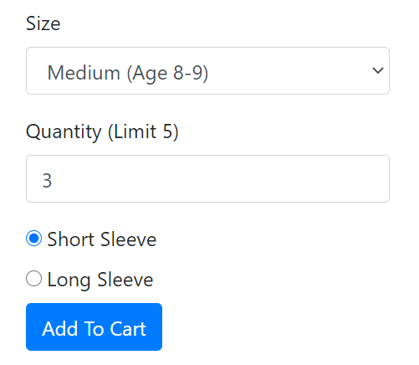
A Simple Order Form
For simplicity, Bootstrap markup has been removed from the HTML on the following slide

Slide 10
A Simple Order Form
<form action="cart.html" method="get">
<label for="size">Size</label> <select id="size" name="size"> <option value="S">Small (Age 6-7)</option> <option value="M">Medium (Age 8-9)</option> <option value="L">Large (Age 10-11)</option> </select>
<label for="qty">Quantity (Limit 5)</label> <input type="number" id="qty" name="qty">
<input type="radio" id="style-short" name="style" value="Short"> <label for="style-short">Short Sleeves</label> <input type="radio" id="style-long" name="style" value="Long"> <label for="style-long">Long Sleeves</label> <button type="submit">Add To Cart</button> </form>

Slide 11
After Submitting the Form
You've been taken to cart.html
The URL includes data from the form
cart.html?size=M&qty=3&style=Short

Slide 12
URL = Action + Query String
The base URL is the form's action attribute
The query string contains the form data
cart.html?size=M&qty=3&style=Short
form action
query string (form data)

Slide 13
Names and Values
Forms submit the names and values of their controls
For <select>, the value is part of each <option>
<select id="size" name="size"> <option value="S">Small (Age 6-7)</option> <option value="M">Medium (Age 8-9)</option> <option value="L">Large (Age 10-11)</option> </select>

Slide 14
Names and Values
For text <input> controls, the value is whatever the user typed in the box
<label for="qty">Quantity (Limit 5)</label> <input type="number" id="qty" name="qty">

Slide 15
Names, Not IDs
The name attribute matters, not the ID!
ID ties the <label> to the <input> but is not part of submitted data
<label for="qty">Quantity (Limit 5)</label> <input type="number" id="qty" name="qty">

Slide 16
Radio Buttons and Checkboxes
Having the same name makes radio buttons and checkboxes part of the same button group
<input type="radio" id="style-short" name="style" value="Short">
<label for="style-short">Short Sleeves</label>
<input type="radio" id="style-long" name="style" value="Long">
<label for="style-long">Long Sleeves</label>

Slide 17
Reading Form Values
Use JavaScript within the destination page (the form’s action page) to read the query string
order.html
cart.html
<form method="get"
action="cart.html">
<!-- form here -->
</form>
<script>
// read form values
</script>
cart.html?size=M&qty=3&style=Short

Slide 18
URLSearchParams
Create a URLSearchParams object that contains the query string data
var params = new URLSearchParams(window.location.search);

Slide 19
Get a Value
Provide the name as a string
If the name is not found, returns null
var userSize = params.get("size");

Slide 20
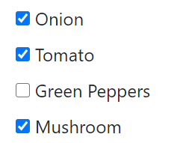
Multiple Values
Checkboxes can have multiple values for the same name
Think of the pizza toppings in your order form
veg=onion&veg=tomato&veg=mushroom

Slide 21
Get All Values
Using getAll returns an array of values
Returns an empty array if the name is not found
var veggies = params.getAll("veg");
// ["onion", "tomato", "mushroom"]

Slide 22
Internet Explorer
URLSearchParams is not supported in IE
See GitHub for an alternative if you need to support IE

Slide 23
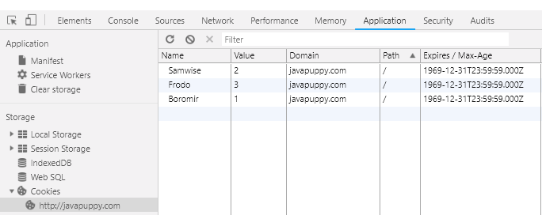
Cookies
Also a name-value pair, stored in browser memory
For this page, cookies look like this:

Slide 24
Cookies
Can be created and read by client OR server
Frequently used to store a session ID when user logs in
Or stores username when you check "Remember Me" box
Sent in the HTTP header

Slide 25
Creating a Cookie
Just a regular string like "name=value"
Assign the string to document.cookie
document.cookie = "username=sread";
document.cookie = "school=WCTC";

Slide 26
Two Cookies?
When you print document.cookie, it looks like this
One string with all name/value pairs, separated with semicolons
console.log(document.cookie);
> "username=sread; school=WCTC"

Slide 27
Update a Cookie
Update a cookie's value by writing the new value with the same name
document.cookie = "school=UWM";
console.log(document.cookie);
> "username=sread; school=UWM"

Slide 28
Reading One Cookie Value
How could we retrieve the value of the school cookie ("WCTC")?
Remember: It's one big string
console.log(document.cookie);
> "username=sread; school=WCTC"

Slide 29
Cookie Search Algorithm
Find index of "school="
Find index of semicolon after "school="
Or end of string if no semicolon found after "school="
Slice string between first and last indexes
"username=sread; school=WCTC"

Slide 30
Cookie Search Algorithm
slice
"username=sread; school=WCTC"
index of "school="
index of "school=" plus length of "school="
index of ";" after "school=" (or end of string)

Slide 31
Extra Information
Domain: Site associated with the cookie
Path: Path associated with cookie relative to domain
Expires: When the browser should delete the cookie

Slide 32
Rules for Domain and Path
A cookie can only be read if its domain/path matches the current domain/path
A path of / matches anything
http://javapuppy.com/javascript/cookies/count.html
domain
path

Slide 33
Default Domain and Path
If you don't specify a domain when creating a cookie, it defaults to the current domain
For example: "wctc.edu" or "javapuppy.com"
If you don't specify a path, default is current path

Slide 34
Expiration
When a cookie expires, the browser automatically deletes it
If no expiration specified, it is a session cookie
Deleted when the browser is closed

Slide 35
Persistent Cookies
If you set an expiration, the cookie will be persistent
Can specify age of cookie in seconds (newer way) or expiration date (older way)

Slide 36
Set Maximum Age
You can set the maximum age (max-age) of a cookie in seconds
var twoDays = 60 * 60 * 24 * 2;
document.cookie = "username=sread;max-age=" + twoDays;

Slide 37
Deleting a Cookie
Delete a cookie by setting its max-age to zero
document.cookie = "username=x;max-age=0";

Slide 38
Internet Explorer
All browsers can use max-age, except Internet Explorer
IE only uses the older "expires" syntax, which takes a date
If you set both "expires" and "max-age", browsers will prefer "max-age"

Slide 39
Expires Date
Specify an expiration date in GMTString format
See Date.toUTCString for proper formatting
var newYearsDay = new Date("01 Jan 2025");
console.log(newYearsDay.toUTCString());
> Wed, 01 Jan 2025 06:00:00 GMT

Slide 40
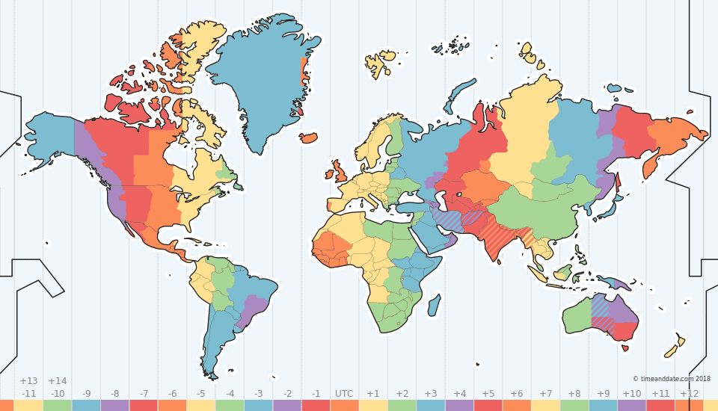
What is GMT?
GMT stands for Greenwich Mean Time
No time zone offset
Also known as UTC 0 (Coordinated Universal Time)

Slide 41
Append Expires to Cookie
Add the expires date to the cookie when you create it
document.cookie =
"username=sread;expires="
+ newYearsDay.toUTCString();

Slide 42
Client-Server Cookies
All cookies for the current domain and path are sent to the server with every request
You can’t pick and choose which ones to send
Can increase transit time if too many cookies

Slide 43
Cookies and Security
Cookies are easily modifiable and not secure
Improper use of cookies exposes users to attacks such as:
cross-site request forgery (CSRF)
cross-site scripting (XSS)
cross-site tracing (XST)

Slide 44
Size Restrictions
Amount of data a cookie can store varies by browser
Around 4000 characters of data
Around 50 cookies per domain
IETF Cookie Standards and Browser Limitations

Slide 45
URI Encoding
Cookie values cannot contain spaces, commas, or semicolons
To avoid forbidden characters, encode and decode the value using JavaScript utility functions

Slide 46
Encode and Decode
Encode the value when creating a cookie
var rawValue = "Oops, some bad chars; sorry.";
var encoded = encodeURIComponent(rawValue);
document.cookie = "test=" + encoded;

Slide 47
Encode and Decode
Decode the value when reading a cookie
var value = decodeURIComponent(encoded);

Slide 48
Web Storage
Need more space than cookies allow?
Need to store complex data?
Is your data only used on the client/browser side?
Try web storage!

Slide 49
Similarities to Cookies
Contains key/value pairs
Values are stored as a strings
Storage is domain-specific

Slide 50
Differences vs Cookies
Data in web storage is never sent to the server
Size varies by browser, but ~5 MB
Fires an "onstorage" event

Slide 51
Session vs Persistent
Web storage can be persistent (stored indefinitely, even after browser closed)
window.localStorage
Session storage cleared when browser closed
window.sessionStorage

Slide 52
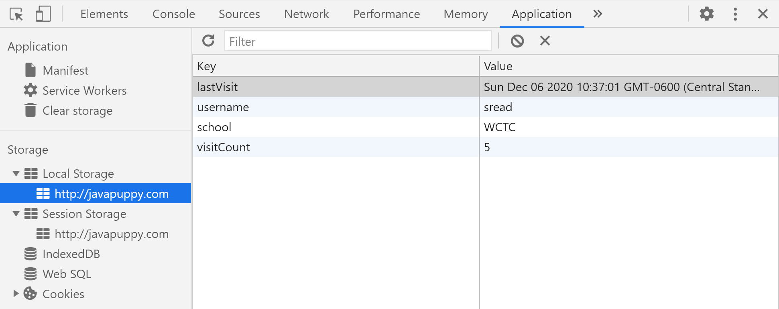
Viewing Web Storage
Browsers allow you to view/modify stored values

Slide 53
Storing Data
Use setItem to store the name and the value
localStorage.setItem("username", "sread");
localStorage.setItem("visits", 5);

Slide 54
Updating Data
To update a value, use setItem again to overwrite the old value
localStorage.setItem("username", "gread");
localStorage.setItem("visits", 1);

Slide 55
Retrieving Data
Use getItem to retrieve data from storage
Will always be a string, so may need to parse it
var visitCount = parseInt(localStorage.getItem("visits"));

Slide 56
Deleting Data
Remove a single item with removeItem
localStorage.removeItem("visits");
localStorage.removeItem("username");

Slide 57
Clearing Web Storage
Removes all stored data for the domain
Users can also clear storage using browser tools
localStorage.clear();

Slide 58
Storing Objects
It can be cumbersome to store individual pieces of data
Use JSON to store entire arrays or objects as strings

Slide 59
Stringify Objects to Store Them
var toppings = ["Onions", "Tomatoes", "Mushrooms"];
localStorage.setItem ("veg", JSON.stringify(toppings));

Slide 60
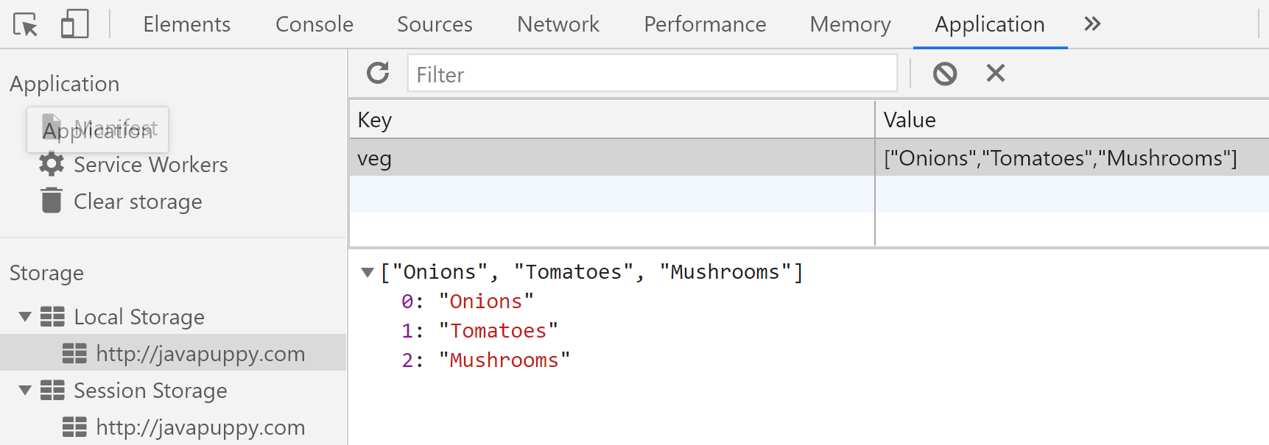
Objects in LocalStorage

Slide 61
Parse Objects to Retrieve Them
var array =
JSON.parse(localStorage.getItem("veg"));
for(var topping of array)
console.log(topping);

