Slide 1
JavaScript
152-168 Class 8

Slide 2
Using the jQuery Validation Library
Writing our own validation logic can require a lot of code!
Instead of writing our own, we can use a validation library written in jQuery
Demo on GitHub Pages

Slide 3
Benefits of Validation Library
Autofocus topmost field with error
Automatically places error message next to field
Easy to create custom error messages
Easy to specify complex criteria:
data type
value range
pattern (email, URL, date)
length

Slide 4
Import the Library
Order of imports:
jQuery core library
Validation library
Your JavaScript file

Slide 5
Must Have a Form
Fields to be validated must be inside a form
Form must have a submit button
<form>
<button type="submit">Submit</button>
</form>

Slide 6
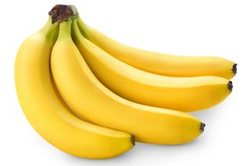
Required Fields
In our HTML, we have a field named "bananas"
We want this field to be required
<input type="text" name="bananas">

Slide 7
Name versus ID
Validation library uses the name attribute, not id
Make sure both have the same value
(The id is omitted on remaining slides to save space)
<input type="text" name="bananas" id="bananas">

Slide 8
Configuring Validation
We need to tell the library three things:
What are the validation rules?
What are the messages to display if the rules are broken?
What function should be called if user input passes validation?

Slide 9
What Are the Rules?
This is a JavaScript object
We will learn more about them in Unit 3
Holds many values with one variable (myRules)
var myRules = { };

Slide 10
Adding Rules
In myRules, create another object for the bananas field
<input type="text" name="bananas">
Name, not id!
var myRules =
{
bananas:
{
}
};

Slide 11
Adding Rules
In myRules, create another object for the bananas field
<input type="text" name="bananas">
Name, not id!
var myRules =
{
bananas:
{
required: true
}
};

Slide 12
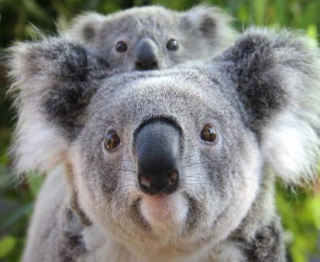
Adding Number Rules
In the HTML, we have a field named "koalas"
Must be a whole number between 1 and 10
<input type="text" name="koalas" id="koalas">

Slide 13
Adding Number Rules
In myRules, add a comma after the bananas rule
Create another object for the koalas field
var myRules =
{
bananas:
{
required: true
},
koalas:
{
required: true,
min: 1,
max: 10,
digits: true
}
};

Slide 14
What Are the Error Messages?
Create another JavaScript object
Just like myRules
var myMessages = { };

Slide 15
Match 'Em Up!
var myRules =
{
bananas:
{
required: true
},
koalas:
{
required: true,
min: 1,
max: 10,
digits: true
}
};
var myMessages =
{
bananas:
{
required: "Oh no"
},
koalas:
{
required: "Oops",
min: "Too small",
max: "Too big",
digits: "Bad!"
}
};

Slide 16
If Everything Is Valid... Then What?
If everything is valid, the library will call a function
function feedKoalas() {
var b = $("#bananas").val();
var kCount = parseInt($("#koalas").val());
$("p").text(`${kCount} koalas ate ${b} bananas.`);
}

Slide 17
Don't Prevent Default
Even though this is a form, don't use event.preventDefault()
function feedKoalas(event) {
event.preventDefault();
// other code...
}

Slide 18
Gather Up All Three Things
What are the validation rules? myRules
What are the messages to display if the rules are broken? myMessages
What function should be called if user input passes validation? feedKoalas

Slide 19
Before: Form Submit Event
When using forms, we usually say
$("form").submit(runMyProgram);
"jQuery, find all of the forms. When their submit event happens, call runMyProgram."

Slide 20
Now: Form Validate Event
$("form").validate(
{
submitHandler: feedKoalas,
rules: myRules,
messages: myMessages
}
);
The three
important things

Slide 21
Possible Properties
sampleField: {
required: true, // User must enter something
minlength: 5, // Minimum number of characters in a string
maxlength: 10, // Maximum number of characters in a string
min: -1, // Minimum number value
max: 1, // Maximum number value
email: true, // Must be an email address
url: true, // Must be a URL
date: true, // Must be a date
number: true, // Must be a number (negative and decimal allowed)
digits: true // Numeric digits only (0 through 9)
}

Slide 22


Styling the Error Message
The library creates a <label> with a class of "error"
Define a CSS style to change its appearance
label.error {
color: #6C0;
font-size: 16px;
display: inline;
margin-left: 10px;
padding: 2px;
border: thin groove #6F0;
}

Slide 23
Miscellaneous Requirements
The fields you want to validate must be inside a <form>
The validation only happens when the form submits
Don't use event.preventDefault()
Button click events won't trigger validation

Slide 24
Lab
See Canvas for the Validation lab

Slide 25
Non-Booleans in Conditionals
Whatever is between the parentheses must resolve to either true or false
if (temperature < 50) {
console.log("Let the cat inside");
}

Slide 26
Non-Booleans in Conditionals
If you put a non-boolean between the parentheses, JavaScript will convert it
Will we let the cat inside?
if ("raining") {
console.log("Let the cat inside");
}

Slide 27
What Is True?
Anything that's not false is true
Things that are false are:
false (the boolean value)
the number 0
an empty string ("")
NaN (Not a Number)
null
undefined

Slide 28
What Is True?
The five non-boolean values are falsey
Anything else is truthy
false (the boolean value)
the number 0
an empty string ("")
NaN (Not a Number)
null
undefined

Slide 29
Will We Let the Cat Inside?
if ("raining") {
console.log("Let the cat inside");
}
if (87) {
console.log("Let the cat inside");
}
if (document) {
console.log("Let the cat inside");
}

Slide 30
Will We Let the Cat Inside?
if ("") {
console.log("Let the cat inside");
}
if (0) {
console.log("Let the cat inside");
}
var emptyVar;
if (emptyVar)
console.log("Let the cat inside");

Slide 31
Is a Text Box Empty?
If the user left the #apartment box empty, what value is in the variable aptNum?
var aptNum = $("#apartment").val();

Slide 32
Empty String is Falsey
Empty textboxes return the empty string ("") as their value
What would a conditional like this do?
if (aptNum)
$("p").text(`Apartment ${aptNum}`);

Slide 33
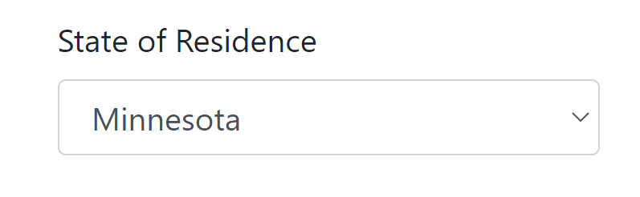
College Application Fees
A college charges a reduced application fee for students from the tri-state region

Slide 34
Duplicate Code
Testing each discounted state results in a lot of duplicate code!
if (state === "WI")
fee = 35;
else if (state === "MN")
fee = 35;
else
fee = 50;

Slide 35
What We're Trying to Say
If a student is from Wisconsin OR student is from Minnesota, the fee is $35

Slide 36
||: The Logical OR Operator
Double "pipe" character (above the Enter key)
if (state === "WI" || state === "MN") {
fee = 35;
}

Slide 37
Truth Table for ||
B
state === "MN"
 | True | False
True | True | True
False | True | False
A
A || B
state === "WI"

Slide 38
Short Circuiting
If the left side is true, the right is not evaluated
If state is "WI", won't test if state is "MN"
if (state === "WI" || state === "MN") {
fee = 35;
}

Slide 39
Multiple ORs
Associates left-to-right
if (state === "WI" || state === "MN" || state === "IL") {
fee = 35;
}
1st
2nd

Slide 40
Watch Out
It's tempting to write something like this, but it doesn't work
if (state === "WI" || "MN" || "IL") {
fee = 35;
}

Slide 41
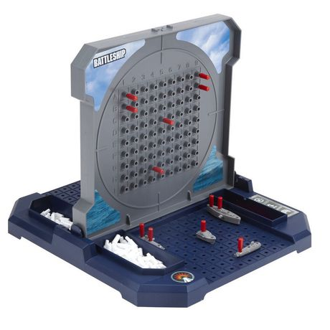
Battleship
Players take turns blindly firing shots at each other's ships
If a shot hits a ship, it gets a red peg
When a ship is full of pegs, it is sunk
Demo on GitHub Pages

Slide 42
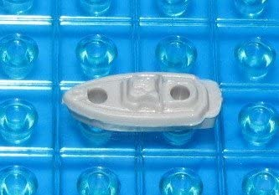
Battleship
place peg
We only do the operation if both tests are true
If the ship has a hit in spot 1 AND a hit in spot 2 then it is sunk
hit in spot 1?
false
true
hit in spot 2?
false
true
ship is sunk

Slide 43
Logical Operators
The variables contain boolean values
If ship has hit 1
AND
ship has hit 2
then the ship is sunk
if (hasHit1) {
if (hasHit2) {
shipSunk = true;
}
}

Slide 44
&&: The Logical AND Operator
Double "ampersand" (above the 7 key)
if (hasHit1 && hasHit2) {
shipSunk = true;
}

Slide 45
Truth Table for &&
B
hasHit2
 | True | False
True | True | False
False | False | False
A
A && B
hasHit1

Slide 46
Short Circuiting
If the left side is false, the right is not evaluated
If hasHit1 is false, won't check hasHit2
if (hasHit1 && hasHit2)
shipSunk = true;

Slide 47
Multiple ANDs
Associates left-to-right
if (hasHit1 && hasHit2 && hasHit3)
{
shipSunk = true;
}
1st
2nd

Slide 48
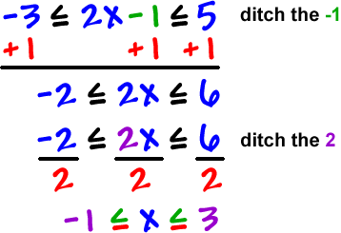
Beware!
In algebra, you can say that a variable is between two numbers like this:

Slide 49
Beware!
In JavaScript, you must perform two comparisons
if (-1 <= x <= 3)
if (-1 <= x && x <= 3)

Slide 50
Beware Again!
The result of && and || is not necessarily a boolean
May result in other data types
Check the official documentation for more info

Slide 51
Beware Again!
expression1 && expression2
Returns expression1 if it can be converted to false; otherwise, returns expression2
expression1 || expression2
Returns expression1 if it can be converted to true; otherwise, returns expression2

Slide 52
Non-Boolean Data Types
"cat" && false
"cat" && "dog"
true || (3 + 7)
(1 – true) || (3 + 7)
expr1 && expr2
Returns expr1 if it can be converted to false; otherwise returns expr2
expr1 || expr2
Returns expr1 if it can be converted to true; otherwise returns expr2

Slide 53
Why?!
Can provide default-value functionality
If the form field is blank (empty string), use the value "N/A"
var aptNum = $("#aptmt").val() || "N/A";

Slide 54
Is a Checkbox Checked?
Did the user check this box or not?
<input type="checkbox" id="chkUsr">
<label for="chkUsr">I accept the user agreement</label>

Slide 55
jQuery's .is() Function
Returns true if the selection matches the selector
Does selection #chkUsr match selector :checked
var isChecked = $("#chkUsr").is(":checked");

Slide 56
Ask the Opposite Question
That tells us if the box was checked
How can we ask if it was not checked?
This logic is backwards:
if (isChecked)
alert("Must accept user agreement!");

Slide 57
! The Logical Not Operator
A unary operator (one operand)
Changes false to true, and true to false
if (!isChecked)
alert("Must accept user agreement!");

Slide 58
Operator Precedence
==
!=
===
!==
<
<=
>
>=
*
/
%
!
++
--
+
-
=
||
&&
Slower
Faster
https://developer.mozilla.org/en-US/docs/JavaScript/Reference/Operators/Operator_Precedence

Slide 59
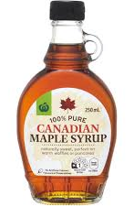
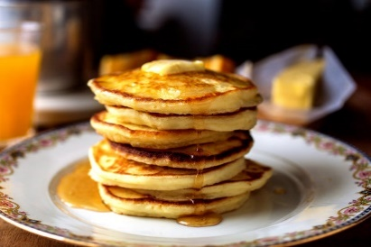
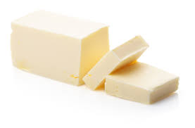
Should I Go To the Store?
I only eat pancakes with butter and syrup
When I want pancakes, if I don't have both butter and syrup, I'll go to the store

Slide 60
Should I Go To the Store?
If I want then
If I'm out of or out of then
I'll go to the store

Slide 61
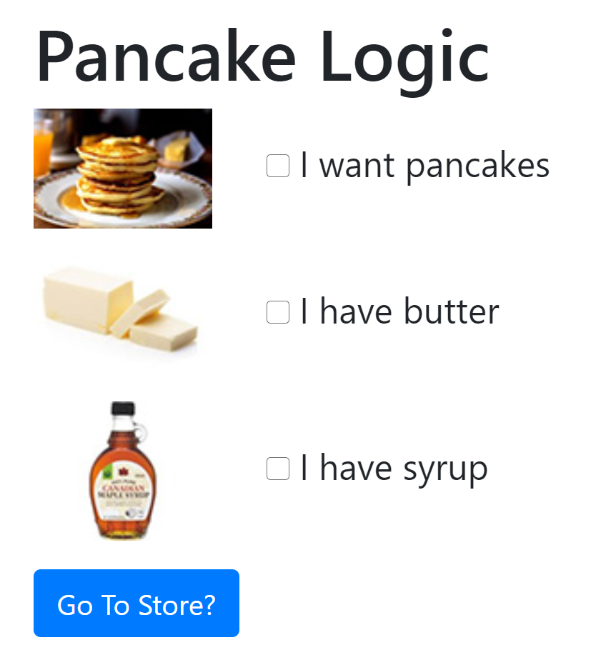
Demonstration: Pancake Logic
Completed demo on GitHub:
https://github.com/oroborous/javascript-pancakes

Slide 62
Lab
See Canvas for the Battleship lab

Slide 63
Simple Choices
Person chooses a number
The variable message gets one of two values, depending on condition
Does it match the winning number?
true
false
Message is "You win!"
Message is "You lose!"
Display message

Slide 64
Simple Choices
Choose number
var winningNum = 5;
var guess = parseInt($("#number").val());
var message;
if (guess === winningNum)
message = "Win!";
else
message = "Lose!";
$("#output").text(message);
Match?
true
false
"Win!"
"Lose!"
Display message

Slide 65
Conditional (Ternary) Operator
Unary has one operand
!false -6
Binary has two operands
8 + 3 false && true
Ternary has three operands

Slide 66
Conditional Operator
One operator (?:) but its symbols are separated
Like a mini if-else statement
var msg = (x < y) ? "x is smaller" : "x is bigger";
1
2
3

Slide 67
Common Usage
Assign one of two possible values to a variable
var message = (guess === winningNumber) ? "Win!" : "Lose!";
T
F
Does guess match the winning number?
true
false
T
Message is "You win!"
Message is "You lose!"
F

Slide 68
Plural or Not?
Problem: If the user has one of something, the message should be singular, otherwise plural
"You have 1 credit"
"You have 0 credits"
"You have 2 credits"
"You have 0.75 credits"

Slide 69
Plural or Not: if-else
var numCredits = parseFloat($("#credits").val());
var singularOrPlural;
if (numCredits === 1)
singularOrPlural = "credit";
else
singularOrPlural = "credits";
var message = `You have ${numCredits} ${singularOrPlural}.`;

Slide 70
Plural or Not? Take 2
var numCredits = parseFloat($("#credits").val());
var singularOrPlural = (numCredits === 1) ? "credit" : "credits";
var message = `You have ${numCredits} ${singularOrPlural}.`;

Slide 71
Operator Precedence
==
!=
===
!==
<
<=
>
>=
*
/
%
!
++
--
+
-
=
?:
||
&&
Slower
Faster
https://developer.mozilla.org/en-US/docs/JavaScript/Reference/Operators/Operator_Precedence

Slide 72
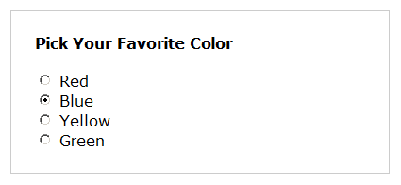
Ice Cream Flavor Recommender
red
true
strawberry
false
blue
true
Blue Moon
false
yellow
true
banana
false
green
true
mint
false
chocolate

Slide 73
Ice Cream Recommender Using Ifs
if (favColor === "red")
iceCream = "strawberry";
else if (favColor === "blue")
iceCream = "Blue Moon";
else if (favColor === "yellow")
iceCream = "banana";
else if (favColor === "green")
iceCream = "mint";
else
iceCream = "Chocolate";

Slide 74
Switch Statement
Good for when you're testing a known set of possible values
The days of the week
Canadian provinces
High school class year
Favorite color options

Slide 75
Switch Statement
Acts like an if-else-if statement
Can have a default that acts like a final else statement
Sometimes called the case statement

Slide 76
Switch Statement Outline
Begin with the switch keyword
Inside the parentheses, the variable whose value you're testing
switch (favColor)

Slide 77
Switch Statement Outline
Curly braces enclose the cases (possible values)
switch (favColor)
{
}

Slide 78
Cases
If the variable favColor contains the string "red", the code under this case will run
switch (favColor)
{
case "red":
iceCream = "berry";
}

Slide 79
Break Statements
End every case with a break statement
switch (favColor)
{
case "red":
iceCream = "berry";
break;
}

Slide 80
Additional Cases
Continue adding cases for each possible value of the variable
switch (favColor)
{
case "red":
iceCream = "berry";
break;
case "green":
iceCream = "mint";
break;
}

Slide 81
Fall-Through
Stacked cases act like a logical OR
If favColor equals "red" or "pink", then "berry" ice cream is recommended
switch (favColor)
{
case "red":
case "pink":
iceCream = "berry";
break;
case "green":
iceCream = "mint";
break;
}

Slide 82
Default Case
Add an optional default case
If none of the cases match, the default case will run
switch (favColor)
{
case "red":
case "pink":
iceCream = "berry";
break;
case "green":
iceCream = "mint";
break;
default:
iceCream = "chocolate";
}

Slide 83
Case and Data Types
var grade = prompt("Enter grade");
var regDate;
switch (grade) {
case 9:
regDate = "March 20th";
break;
case 10:
regDate = "March 15th";
break;
case 11:
regDate = "March 10th";
break;
default:
regDate = "N/A";
}
Switch acts like ===
What data type is grade?
Which case will match?

Slide 84
Limitations of Switch
Can only test for equality (===)
For < or > (or <= or >=) you must use an if statement
var creditScore = parseInt(prompt("Credit score"));
var loanAmount;
switch (creditScore) {
case < 400:
loanAmount = 0;
break;
case <= 600:
loanAmount = 1000;
break;
default:
loanAmount = 15000;
}
Nope!

Slide 85
More Than One Statement
You can have more than one statement in each case
Each case block ends with break;
var loanAmount = parseInt(prompt("Loan amount"));
var manager, months, interestRate;
var commission = 0;
switch (loanAmount) {
case 1000:
manager = "Li";
months = 36;
interestRate = 15.9;
break;
case 5000:
manager = "White";
months = 48;
interestRate = 9.9;
break;
default:
manager = "Patel";
months = 60;
commission = 500;
interestRate = 5.9;
}

Slide 86
Lab
See Canvas for the Weekly Schedule lab

Slide 87
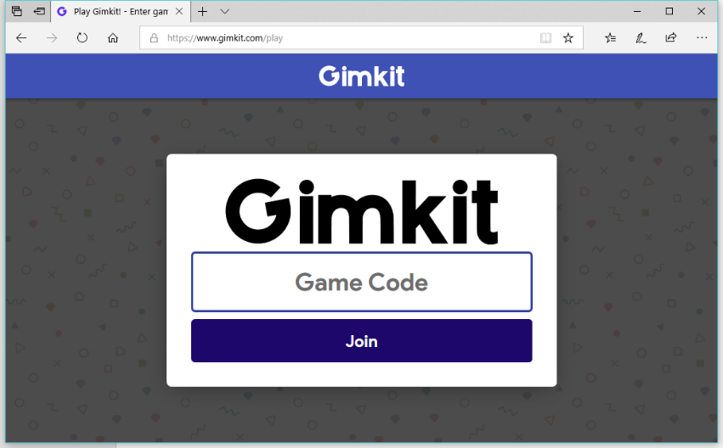
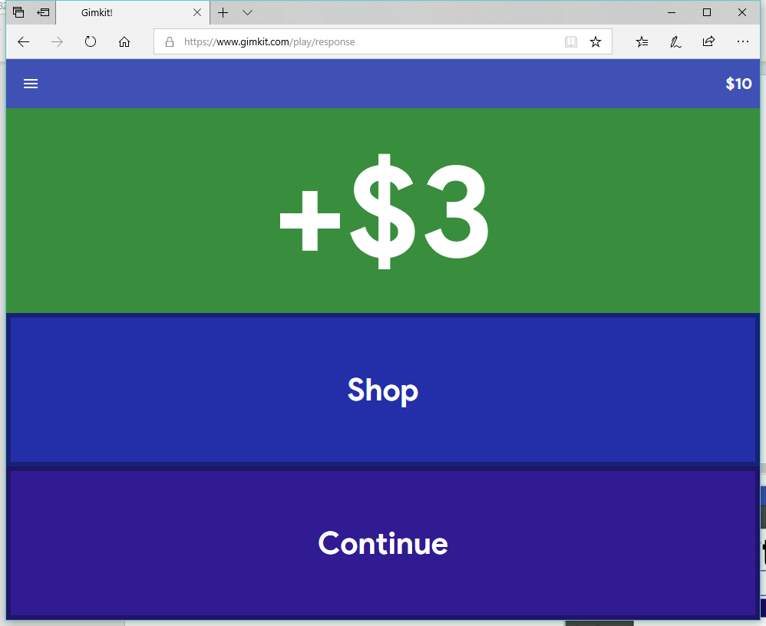
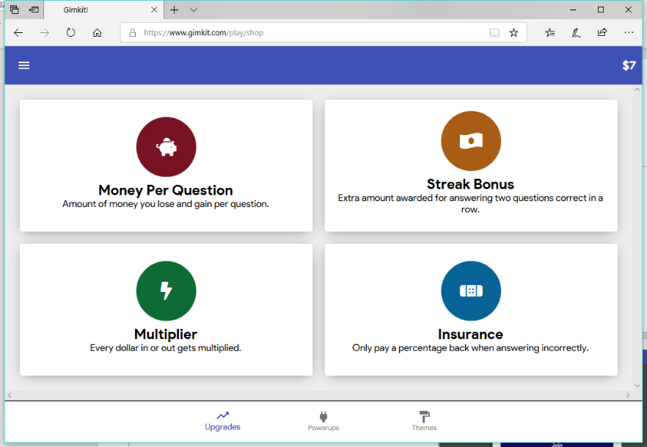
Flash Quiz
Go to https://www.gimkit.com/play

