Slide 1
JavaScript
152-168: Class 12

Slide 2
Sorting with .sort()
Arrays can sort themselves
Numbers sort lowest to highest
var scores = [ 99.1, 87.3, 94.5 ];
scores.sort(); // [ 87.3, 94.5, 99.1 ]

Slide 3
Sorting with .sort()
Strings sort in dictionary order
Will be case sensitive!
var fruits = [ "cherry", "apple", "banana" ];
fruits.sort(); // [ "apple", "cherry", "banana"]

Slide 4
Other Sorting Rules
What if you want to sort case-insensitively?
Highest to lowest?
Sort by number of characters?
JavaScript needs our help to do it

Slide 5
Comparator Functions
You can still use .sort for complex sorting criteria
Must define a function that JavaScript can use to compare array items
A comparator function

Slide 6
How Comparator Functions Work
The function takes two parameters: a and b
If a comes before b, return a number < 0
If b comes before a, return a number > 0
If a and b are equal (sorting-wise), return 0
https://developer.mozilla.org/en-US/docs/Web/JavaScript/Reference/Global_Objects/Array/sort

Slide 7
How Does A Compare to B?
Given two strings, a and b
If a has fewer characters than b, return -1
If a has more characters than b, return 1
If a and b have the same number of characters, return 0

Slide 8
Example Comparator Function
function compareByLength (a, b) {
if (a.length < b.length)
return -1;
if (a.length > b.length)
return 1;
return 0;
}

Slide 9
How to Use Comparator Functions
Pass the function to .sort
names will contain ["Li", "Gigi", "Stacy", "Patrick"]
var names = ["Stacy", "Gigi", "Patrick", "Li"];
names.sort(compareByLength);

Slide 10
Lab
See Canvas for the Fruit Comparators lab

Slide 11
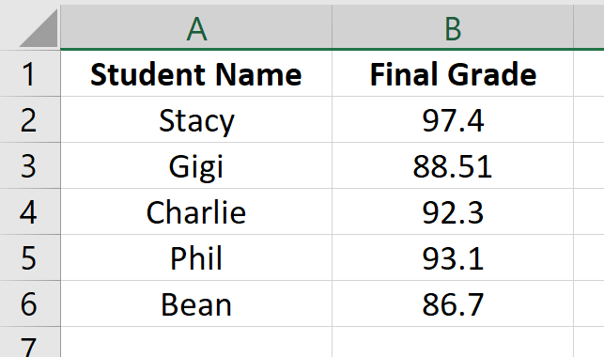
Data Tables
Spreadsheets and tables are great for organizing related data
Grade in row 2 is for student in row 2

Slide 12
No JavaScript "Table" Structure
JavaScript doesn't have a built-in way of storing tabular data
Just linear arrays (one line)

Slide 13
Faking a Table
Could you divide up the table data into multiple arrays?
One array per column?

Slide 14
Faking a Table
One array per row?

Slide 15
One Array Per Column
var studentNames = [];
var finalGrades = [];

Slide 16
One Array Per Column
var studentNames = [
"Stacy",
"Gigi",
"Charlie",
"Phil",
"Bean"
];
var finalGrades = [
97.4,
88.51,
92.3,
93.1,
86.7,
];

Slide 17
One Array Per Column
var studentNames = [
"Stacy",
"Gigi",
"Charlie",
"Phil",
"Bean"
];
var finalGrades = [
97.4,
88.51,
92.3,
93.1,
86.7,
];
Index X is related

Slide 18
Parellel Arrays
Data in the same position in each array is related
Grade in [3] for student in [3], grade in [0] is for student in [0]

Slide 19
Looping Over Parallel Arrays
Hopefully they are the same .length !
for (var i = 0; i < studentNames.length; i++) {
var name = studentNames[i];
var grade = finalGrades[i];
console.log(`${name} earned ${grade}%`);
}

Slide 20
Potential Problems
What if you push/pop one array but not the other?
How can you sort (for example, by name) and keep related data in sync?

Slide 21
One Array Per Row
This looks like it will be a lot of little arrays!
How many little arrays should we make?

Slide 22
Is This a Viable Solution?
var student1 = ["Stacy", 97.4];
var student2 = ["Gigi", 88.51];
var student3 = ["Charlie", 92.3];
var student4 = ["Phil", 93.1];
var student5 = ["Bean", 86.7];

Slide 23
Make an Array of Arrays
var gradebook = [
["Stacy", 97.4],
["Gigi", 88.51],
["Charlie", 92.3],
["Phil", 93.1],
["Bean", 86.7]
];

Slide 24
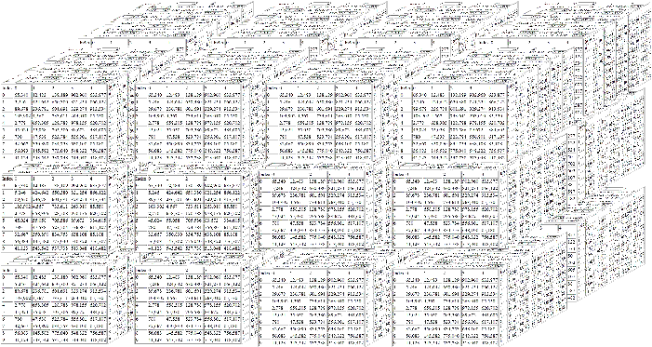
Multidimensional Arrays
A two-dimensional array is like a table
You can have unlimited dimensions!
An array of arrays of arrays of arrays of arrays...

Slide 25
Using Two-Dimensional Arrays
To access data in a speadsheet, use its row and column
A2, B5, A4, etc.

Slide 26
Using Two-Dimensional Arrays
Think of a 2D-array as having rows and columns
Use two indexes
gradebook[3][0]
var gradebook = [
["Stacy", 97.4],
["Gigi", 88.51],
["Charlie", 92.3],
["Phil", 93.1],
["Bean", 86.7]
];

Slide 27
Potential Problems
Readability!
What does gradebook[3][0] contain?
(The grade for Phil, but that's not obvious at all!)

Slide 28
Better Solutions
Tables are nice, but we have another option that is:
More descriptive
Easier to sort
Easier to iterate

Slide 29
Previews of Objects
var student1 = ["Stacy", 97.4];
versus
var student1 = { name: "Stacy",
finalGrade: 97.4 };

Slide 30
Demo and Lab
See Canvas for the Music Machine lab

