Slide 1
JavaScript
152-168 Class 9

Slide 2

Do Something Multiple Times
A program may perform the same action multiple times
Avoid duplicate code
We don't know how many times until runtime

Slide 3
How Many Repetitions?
The program should stop repeating eventually!
If not, infinite loop

Slide 4
Stopping Repetition
A true/false test controls the repetition
As long as the test is true, the code repeats again

Slide 5
Pre-Test vs. Post-Test
We can test before each repetition, or after each repetition
Test before: pre-test
Test after: post-test

Slide 6
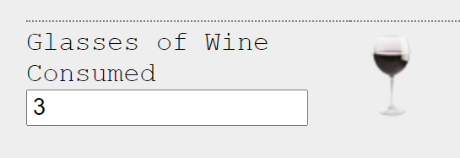
Basic Pre-Test Loop
Less than 3 wine glasses?
No
(false)
Yes (true)
Add a wine glass image

Slide 7
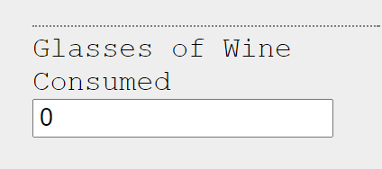
While Loop
A pre-test loop
If the test condition is initially false, the operation never runs
Less than 0 wine glasses?
No
(false)
Yes (true)
Add a wine glass image

Slide 8
While Loop Pseudocode
while less than 3 wine glasses displayed
add a wine glass image
Operation does not run if condition is initially false

Slide 9
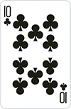
Basic Post-Test Loop
Dealer plays a card
Dealer's total less than 17?
Yes
(true)
No (false)

Slide 10
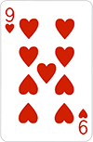
Do-While Loop
A post-test loop
Operation always runs at least once
Dealer plays a card
Dealer's total less than 17?
Yes
(true)
No (false)

Slide 11
Do-While Loop Pseudocode
dealer plays a card
while dealer's total is less than 17
Always performs the operation at least once

Slide 12
What's Wrong With this Flowchart?
Start
Player chooses a number
If number matches, player wins
Repeat until best 2 out of 3
End

Slide 13
What's Wrong With this Flowchart?
Start
Alarm rings
Ready to get up?
false
Hit snooze button
true
Climb out of bed
End

Slide 14
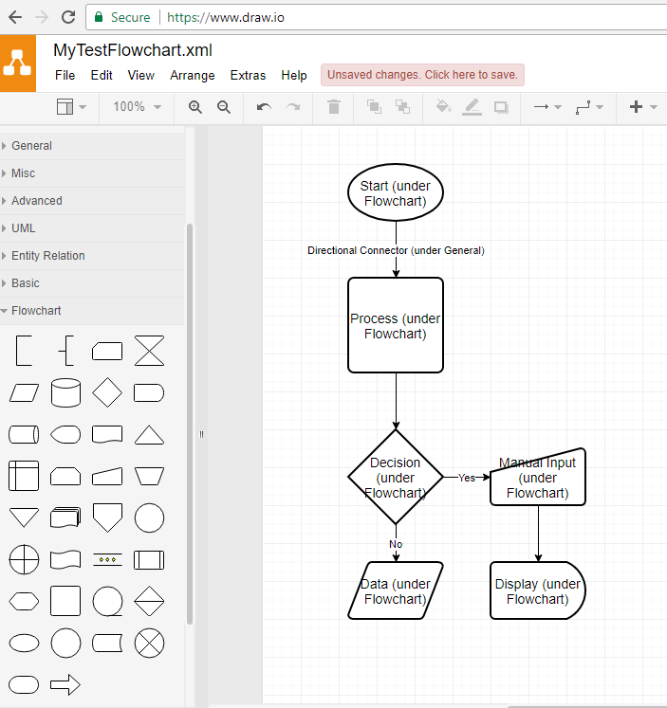
draw.io
File > New > Blank Diagram
Symbols are under the Flowchart menu
Connector arrow is under General menu

Slide 15
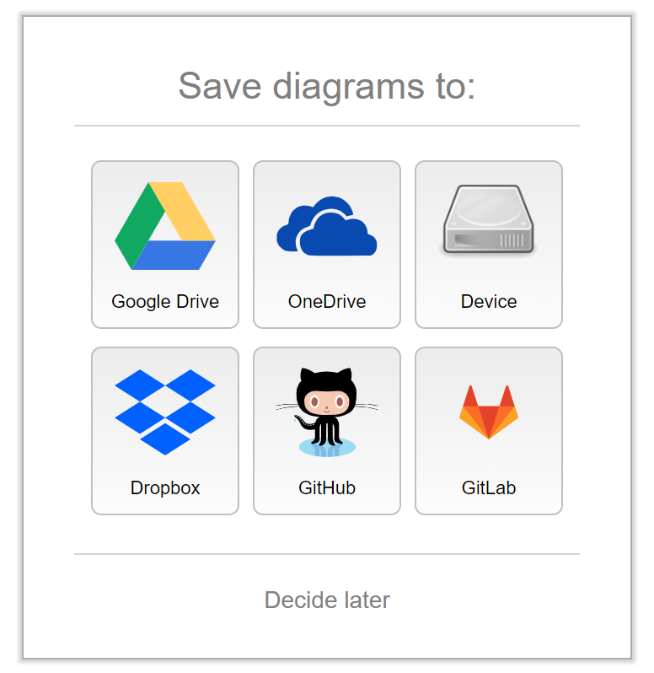
draw.io
File > Save As
Google Drive
Dropbox
OneDrive
GitHub
Save to device (download)

Slide 16
Three Parts of a Loop
Initialize a variable (the loop counter or control variable)
Test a condition (usually related to control variable)
Update the control variable's value
Failure to do one of these steps can lead to an infinite loop!

Slide 17
Three Parts of a Loop
Initialize variable
Test variable
Update variable
Failure to do one of these steps can lead to an infinite loop!

Slide 18
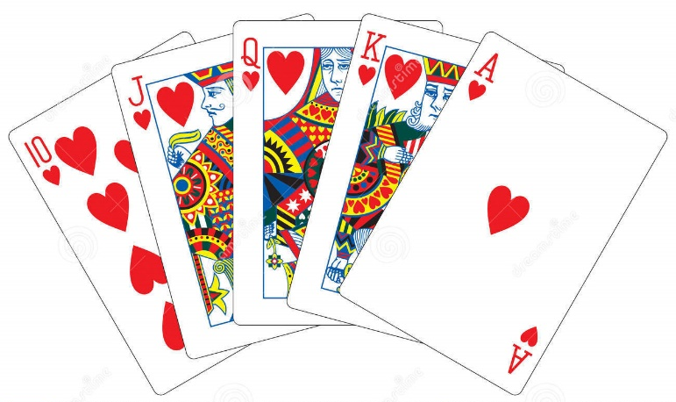
Deal Cards
Hand less
than five?
false
true
Computer deals the player five cards
One at a time
Game begins when the player has five cards
Deal a card
Add one to card count
Start the game

Slide 19
Deal Cards
var handSize = 0;
handSize < 5
false
true
dealCard();
handSize++;
console.log("Start the game!");

Slide 20
Parts of a Loop
var handSize = 0;
handSize < 5
false
Initialize variable
Test variable
Update variable
What if handSize never changes?
true
dealCard();
handSize++;
console.log("Start the game!");

Slide 21
While Something Is True
Instead of dealing a card if you have too few, deal a card while you have too few
var handSize = 0;
while (handSize < 5) {
dealCard();
handSize++;
}
console.log ("Start the game!");

Slide 22
While Loop
var handSize = 0;
handSize < 5
false
The condition is tested before the associated code is run
The code may not run at all
If I had 5 cards to start, no extra cards are dealt
true
dealCard();
handSize++;
console.log("Start the game!");

Slide 23
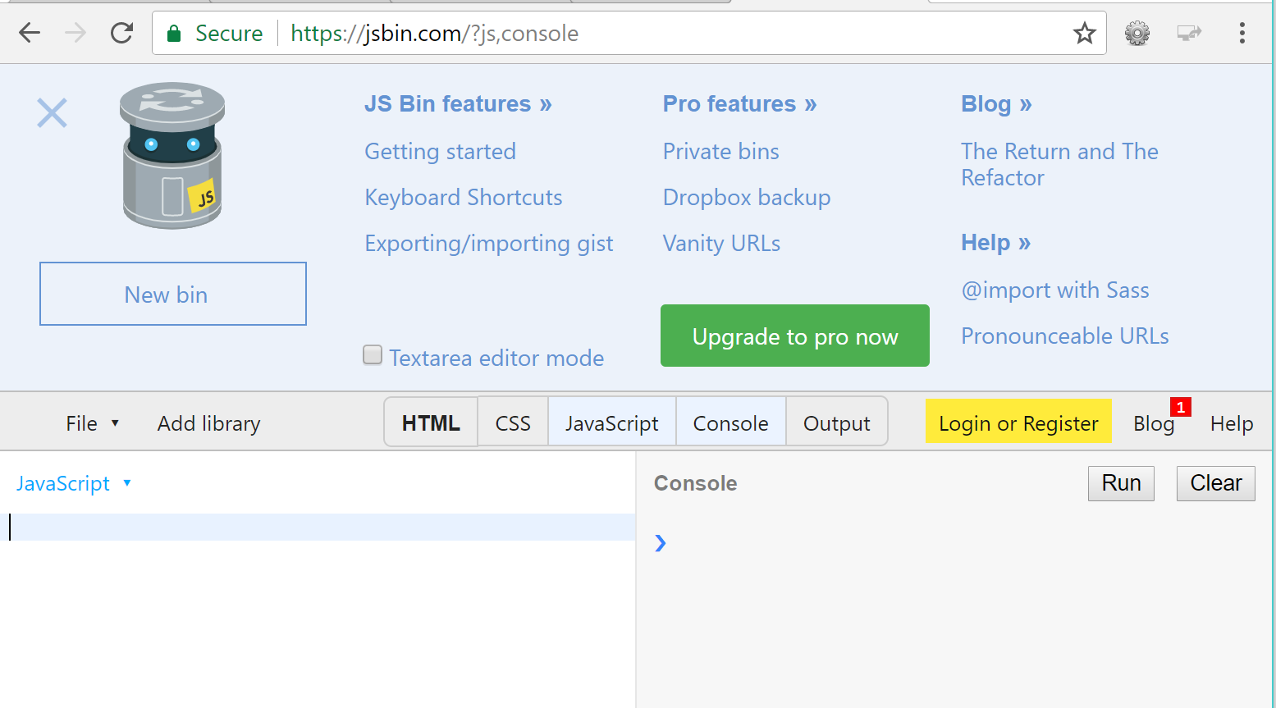
Try It Out
Go to jsbin.com and activate JavaScript and Console tabs
In the JavaScript side, create a while loop that prints five "*" using console.log()
Click the Run button to test your loop

Slide 24
Run At Least Once
What if you want to ensure that your code runs at least once?
Instead of checking the condition before running the code, check it after
This requires a different kind of loop
A post-test loop

Slide 25
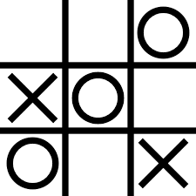
Tic Tac Toe
Computer opponent must pick an empty square
Pick a square at random
If not empty, pick another square
Pick random square
Is square already full?
true
false
Place game piece

Slide 26
Tic Tac Toe
var squareId;
squareId = computerPick();
Imagine we have some functions...
computerPick() gets a number 1 - 9
squareTaken() checks if that square is open
computerMove() places a piece
squareTaken
(squareId)
true
false
computerMove(squareId);

Slide 27
Parts of a Loop
var squareId;
squareId = computerPick();
Initialize a variable
Update variable
Test variable
What if squareId never changes?
squareTaken
(squareId)
true
false
computerMove(squareId);

Slide 28
How To Make It Loop?
var squareId;
squareId = computerPick();
var squareId;
var invalidMove;
do {
squareId = computerPick();
invalidMove = squareTaken(squareId);
} while (invalidMove);
squareTaken
(squareId)
true
false
computerMove(squareId);

Slide 29
Try It Out
Go to jsbin.com and activate JavaScript and Console tabs
In the JavaScript side, create a do-while loop that prints five "*" using console.log()
Click the Run button to test your loop

Slide 30
For Loop
Another way of writing a while (pre-test) loop
Usually used when you want to repeat X times
Consolidates the three parts of a loop into one line

Slide 31
Loop X Times
X can be known in advance
Loop 12 times, once for each month in the year
X may be dynamic
Loop once for each letter in a person's name, input at runtime

Slide 32
Loop 12 Times with a While Loop
var month = 1;
while (month <= 12)
{
console.log(`Month ${month}`);
month++;
}

Slide 33
Important Parts of a While Loop
var month = 1;
while (month <= 12)
{
console.log(`Month ${month}`);
month++;
}

Slide 34
Loop 12 Times with a For Loop
for (var month = 1; month <= 12; month++)
{
console.log(`Month ${month}`);
}

Slide 35
Try It Out
Go to jsbin.com and activate JavaScript and Console tabs
In the JavaScript side, create a for loop that prints five "*" using console.log()
Click the Run button to test your loop

Slide 36
Iterables
Strings (and arrays, Unit 3) are iterable
We can loop over their contents
For a string, step through each character it contains

Slide 37
For-Of Loop
Each character will be placed in the variable letter
for (var letter of "Hello world")
console.log(letter);

Slide 38
Counting Vowels
Ask user for name
Initialize counter for vowels
var firstName = prompt("Enter name");
var vowelCount = 0;

Slide 39
Counting Vowels (Continued)
for (var letter of firstName) {
switch (letter) {
case "a":
case "e":
case "i":
case "o":
case "u":
vowelCount++;
}
}

Slide 40
Try It Out
Go to jsbin.com and activate JavaScript and Console tabs
In the JavaScript side, create a for-of loop that prints the letters in your hometown's name
Click the Run button to test your loop

Slide 41
Print Stars
Turn on JavaScript and Console in JSBin
Write a for loop to print 8 stars
for (var numStars = 0; numStars < 8; numStars++) {
console.log("*");
}

Slide 42
Print a Row of Stars?
Stars are all on separate lines!
for (var numStars = 0; numStars < 8; numStars++)
{
console.log("*");
}
*
*
*
*
*
*
*
*

Slide 43
Building Up Output
To print X stars on a single line, we have to build them up (concatenate them) into one string
Don't output the string until after the loop

Slide 44
Building Up Output
var lineOfStars;
for (var numStars = 0; numStars < 8; numStars++) {
lineOfStars += "*";
}
console.log(lineOfStars);

Slide 45
Uninitialized Variable
Oops! What's wrong now?
We didn't initialize lineOfStars
First "*" was concatenated with undefined
var lineOfStars; // uninitialized!

Slide 46
Better!
Initialize lineOfStars with an empty string
var lineOfStars = "";
for (var numStars = 0; numStars < 8; numStars++)
lineOfStars += "*";
console.log(lineOfStars);

Slide 47
Building Up Output with jQuery
.html() and .text() replace any existing text
var lineOfStars = "";
for (var numStars = 0; numStars < 8; numStars++)
lineOfStars += "*";
$("p").text(lineOfStars);

Slide 48
Looping a Loop
Now that we can build up a row of stars, how about multiple rows?
Can we loop the whole row-making loop?

Slide 49
Make a Table of Rows of Stars
var tableOfStars = "";
for (var numStars = 0; numStars < 8; numStars++)
tableOfStars += "*";
console.log(tableOfStars);
This loop
will go
inside a
loop!

Slide 50
Nesting Loops
Use a different variable to control the outer loop!
This loop will print 5 rows
var tableOfStars = "";
for (var numRows = 0; numRows < 5; numRows++)
{
// other loop goes in here
}
console.log(tableOfStars);

Slide 51
Start a New Line
var tableOfStars = "";
for (var numRows = 0; numRows < 5; numRows++)
{
for (var numStars = 0; numStars < 8; numStars++)
{
tableOfStars += "*";
}
tableOfStars += "\n";
}

Slide 52
Multiple Rows in JQuery
How would you print the grid of stars to a paragraph using jQuery?
Can't print each line when it's done
Need to build the whole grid in one string, then output

Slide 53
Multiple Rows in JQuery
var tableOfStars = "";
for (var numRows = 0; numRows < 5; numRows++) {
for (var numStars = 0; numStars < 8; numStars++) {
tableOfStars += "*";
}
tableOfStars += "<br>"; // use HTML to start new line
}
$("#output").html(tableOfStars); // .html instead of .text

