Slide 1
NCTU DLP Lab5-Conditional sequence-to-sequence VAE
complementary materials
TA 陳璽存
April 27, 2021
Notes:
‹#›

Slide 2
Outline
Common Problems
Training
Notes:
This course is a graduate-level course, which was first offered in spring term of 2017.
It is instructed by two other professors and me.
Back then, about 55 students were enrolled in this course.
In fact, we had a lot more students hoping to take it.
But, we could accept only 60 of them due to limited GPUs we have.
This course was concluded with a workshop in July this summer, with 26 teams presenting their final projects.
In this workshop, we also invited few experts from the industry to grade the students’ performance.
Some of them were amazed by the diversity of the students’ projects.
‹#›

Slide 3
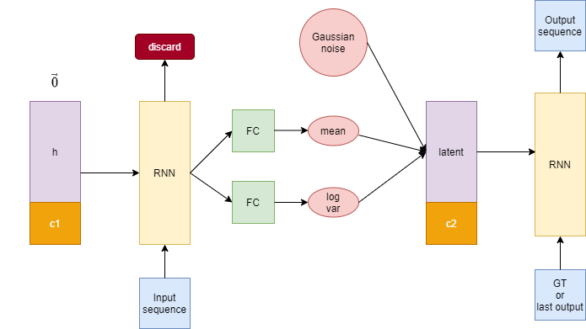
Common Problems – GRU to LSTM

Slide 4
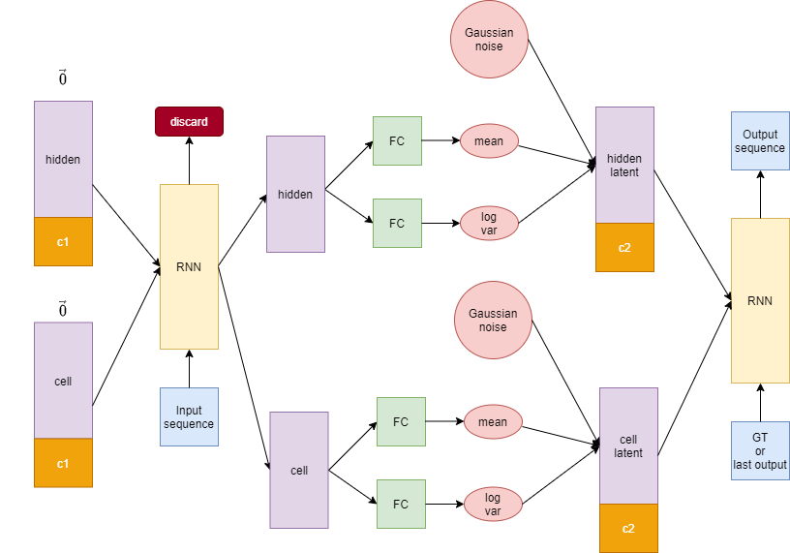
Common Problems – GRU to LSTM (cont’d)

Slide 5
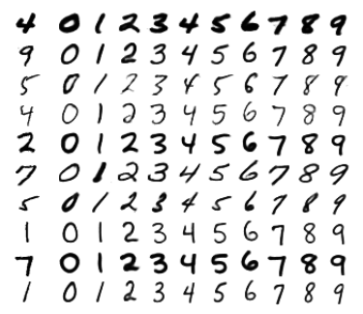
Common Problems – Condition
Information loss of autoencoder
10 x 28
128
128
128
10 x 28

Slide 6
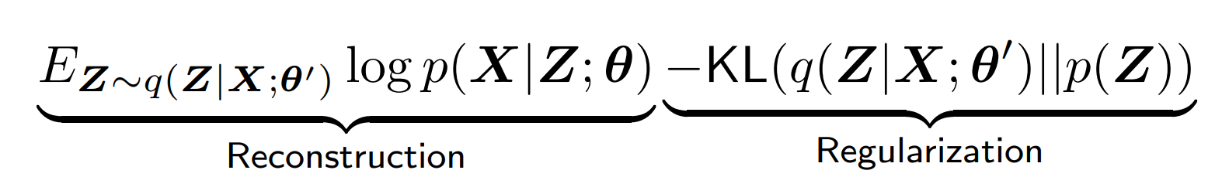
Common Problems – Loss
Cross Entropy Loss
KL-divergence Loss
Reconstruction result
Generation result
BLEU score
Gaussian score

Slide 7
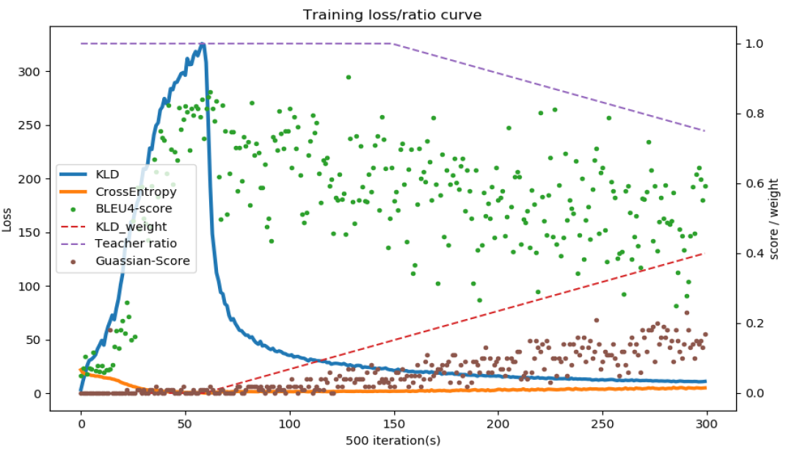
Training
Hidden size : 256
Learning rate : 0.007
Training iterations : 150k

