Slide 1
The software platform for the component-oriented development of knowledge-based systems
Knowledge-based systems (KBS) are widely used in various problem and subject domains, such as diagnostics, classifications, planning, forecasting, finance and banking, engineering, medicine, transport. One of the notable advantages of KBS is the ability to solve poorly formalized problems.
Development and maintaining applied KBS in the up to date adequate state requires a lot of efforts devoted to solving problems of
  data model evolution,
  functionality expansion,
  graphical user interface modification.
To address these problems and, therefore, reduce the cost of creating, modifying and upgrading of applied KBS an automation of KBS development process is required.
Virtually it means that we need to develop the specialized software platform for KBS creation which originally includes methods and tools aimed at reconfiguring its architecture without significant efforts on rewriting the source code of applied KBS by utilizing a set of reusable components.

Slide 2
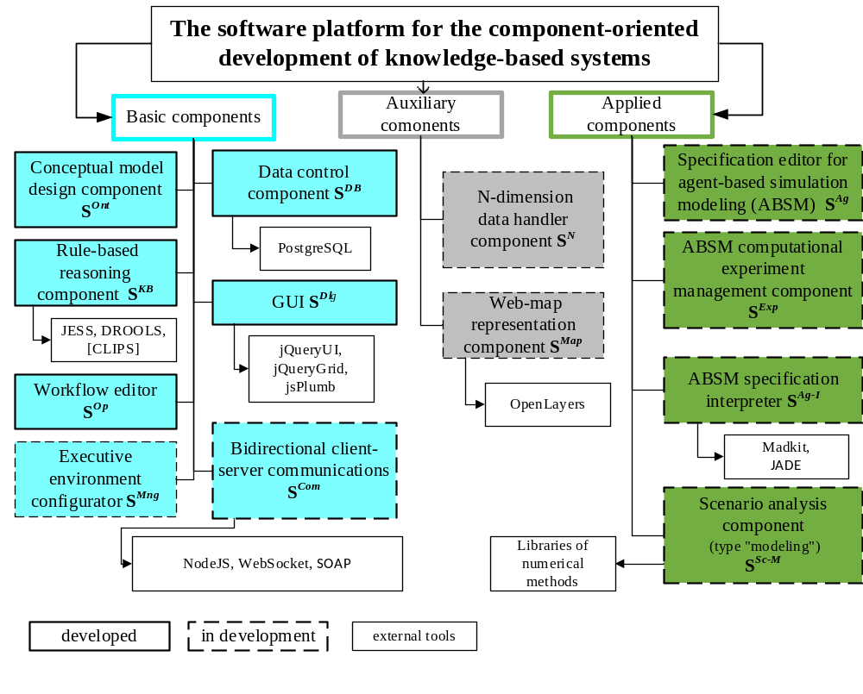

Slide 3
Examples of the platform components
The S^{CM} component provides the formation of a hierarchical structure of concepts from abstract to more concrete ones; the definition of the properties and relations; creation of instances of concepts. The description of relations is carried out by constructing a semantic network.
The S^{KB} component provides the creation of rule-based knowledge bases with the conceptual model of the subject area as a data source, as well as the visual construction of the rules, the formation of initial conditions, code generation (Drools) and execution of reasoning.
The S^{Dlg} component contains a standard set of graphical controls (single/multi-line input fields, date and time representations, checkbox) and elements for displaying data in tabular form including nested tables and displaying data in the form of a network.
The S^{Ag} , S^{Exp} , S^{Ag-I} components provide the creation of agent-based simulation models (ABSMs) specifications based on the author’s methodology which specializes the well-known MDD (Model-Driven Development) approach to the ABSM development process. The third-party software (Madkit, Jade, Drools) was also adapted for supporting components functionality.

Slide 4
Publications
Nikolaychuk O.A., Pavlov A.I., Stolbov A.B. The software platform architecture for the component-oriented development of knowledge-based systems // Proc. 41st Intern. Convention on Information and Communication Technology, Electronics and Microelectronics (MIPRO 2018). 2018. pp. 1064-1069. DOI: 10.23919/MIPRO.2018.8400194.
Nikolaychuk O.A., Pavlov A.I., Stolbov A.B. Models and software for agent-based model development based on model-driven approach // Proc. 1st Scientific-Practical Workshop on Information Technologies: Algorithms, Models, Systems (ITAMS 2018). 2018. Vol. 2221. pp. 13-19. URL: http://ceur-ws.org/Vol-2221/paper3.pdf.
Nikolaychuk O.A., Pavlov A.I., Stolbov A.B. The Agent-Based Modeling Method For The Study Of Unique Mechanical Systems // Advances in Intelligent Systems Research. 2019. Vol. 166. pp. 201-206. DOI: https://doi.org/10.2991/itids-19.2019.36.
Pavlov A.I., Stolbov A.B. The Application of the Knowledge-Based Systems Development Platform for Creating Scenario Analysis Support Tools // Advances in Intelligent Systems Research. 2019. Vol. 169. pp. 43-48. DOI: https://doi.org/10.2991/iwci-19.2019.8.
Pavlov A.I., Stolbov A.B., Dorofeev A.S. The workflow component of the knowledge-based systems development platform // CEUR Workshop Proceedings, 2nd Scientific-Practical Workshop Information Technologies: Algorithms, Models, Systems, ITAMS 2019. 2019. Vol. 2463. pp. 47-58.
Pavlov A.I., Stolbov A.B., Dorofeev A.S. The architecture of the software tool for the agent-based simulation models specification development // CEUR Workshop Proceedings, 2nd Scientific-Practical Workshop Information Technologies: Algorithms, Models, Systems, ITAMS 2019. 2019. Vol. 2463. pp. 112-121.

