Slide 1
Online service for modeling forest dynamics on the geoportal

Slide 2
To assess changes in forest resources over time, mathematical models are used to describe their dynamics. Such an assessment is a tool to study the dependencies of the development of the resource and to predict the results of the impact of various factors.
A comprehensive description of the state of the forest should include the parameters of natural dynamics and human impact. Then, combinations of initial parameters form a resource dynamics scenario that reflects the effects of factors. A set of various scenarios forms information for decision support for choosing a management strategy that combining economic efficiency in the operation of the forest with maintaining the ecological environment.

Slide 3

Mathematical model
$$\frac{dS_{N}}{dt}=−a_{N0}S_{N}(t)+u_{non N}(t);$$
$\frac{dS_{0}}{dt}=a_{N0}S_{N}\left(t\right)−a_{01}S_{0}\left(t\right)+u_{ncov 0}(t)+u_{cut 0}(t)−u_{non 0}(t);$
$$\frac{dS_{i}}{dt}=a_{i−1i}S_{i−1}(t)−a_{i i+1}S_{i}(t)−u_{non i}(t)−u_{ncov i}(t)−u_{cut i}(t),$$
where a_{ij} are the coefficients of transition from one category of land or age group to the next;
S_{N} is the non-forest area;
S₀ is an area that is uncovered by forest;
Si is forest areas of different classes of age;
u_{non i} is annual increase in non-forest area at the expense of other categories of land;
u_{ncov i} is increase in the area uncovered by forest;
u_{cut i} is the area of cutting, is subtracted only from the category of mature and over-mature forests, in other classes of age cutting is not carried out.

Slide 4
The fires (43.7%), forest diseases (25.2%) and insect damage (16.2%) are the most important factors for drying up and destruction of forest resources, so these factors should be taken into account in the model:
The increase in non-forest area in the process of forest exploitation is as follows:
where k_{N} is the area of settlements per person, the remaining coefficients characterize the increase of forest population, ∆N, agricultural area, ∆S, recreational zones, ∆R, area of fields, ∆G, construction of linear objects, ∆Bl, and maintenance of hydraulic structures, ∆Bv.

Slide 5
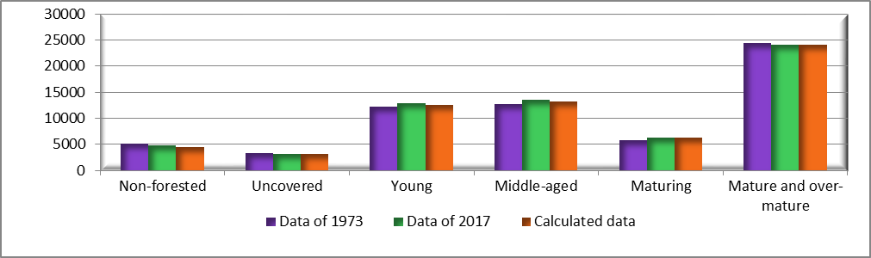
Verification of the model
Verification of the adequacy of the model and coefficients of transition a_{ij} calculation is done on the base of forestry input data of Baikal region for 1973. Input includes natural dynamics – the distribution of forest areas by age categories, anthropogenic use and adverse factors – volumes of cuttings, fires and forest plantations on the territory of 53 forest districts. Computations for the model were conducted for an interval of 45 years. The final results of the simulation were compared with the available data on forest areas for 2017, obtained from the official «Forest Plan of the Irkutsk Region».

Slide 6

Verification of the model
COMPARISON OF REAL AND CALCULATED DATA
Area type | Actual data, years |  | Simulation | Error, %
 | 1973-1985 | 2017
Non-forested | 5108,223 | 4670,194 | 4401,66 | 5,75
Uncovered | 3273,893 | 3032,455 | 3166,37 | 4,42
Young | 12161,067 | 12847,546 | 12044,61 | 6,25
Middle-aged | 12648,814 | 13411,571 | 13137,08 | 2,05
Maturing | 5783,593 | 6170,173 | 6215,15 | 0,73
Mature and overmature | 24444,429 | 24128,406 | 23089,60 | 4,3
Total | 63420,02 | 64260,35 | 62054,47 | 3,43
The formula of the error is as follows:
$Е=\frac{|S_{calc}−S_{true}|}{S_{true}}∗100\%$,
where S_{calc} is simulation data, S_{true} is actual data.

Slide 7
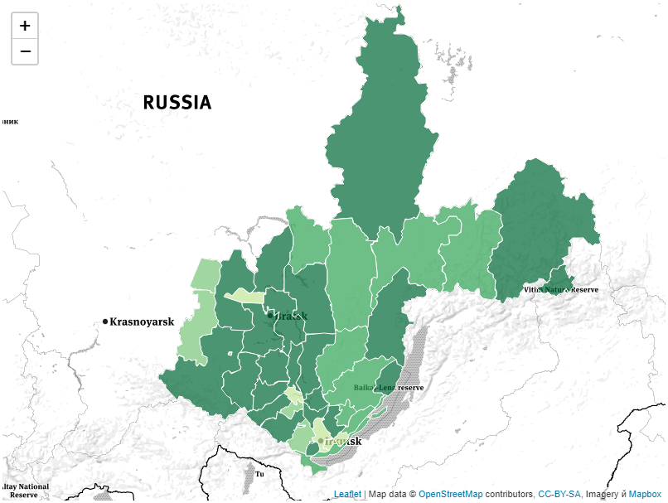
Resulted map
For example, calculations were carried out for a period of 50 years, taking into account the preservation of the current volumes of logging, fires and other adverse factors. The simulation results are shown on the map of the Irkutsk region.
The difference between the forest area for all categories of age at the end and the beginning of the simulation interval was taken as a measure. Lighter shades correspond to negative values ​​relative to the initial values, it is a decrease, darker shades is positive values, i.e. their area increases.

Slide 8
Thanks for your attention!

