Slide 1
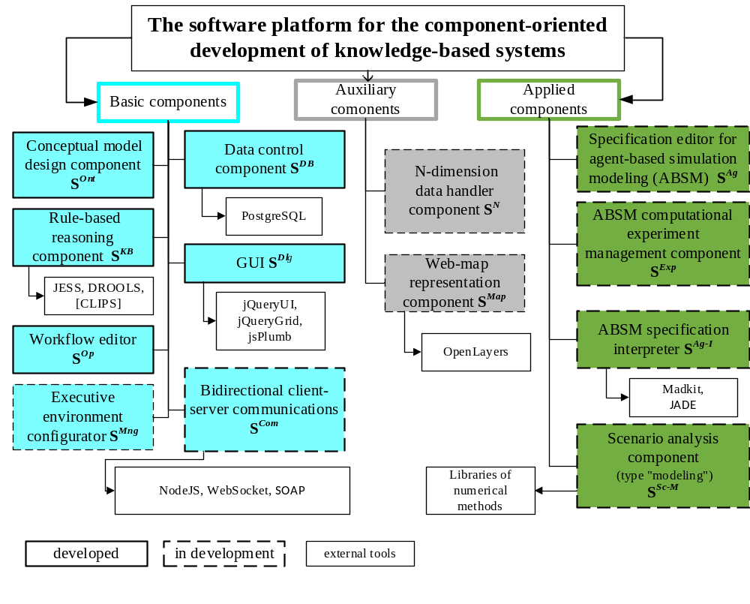

Slide 2
The software platform for the component-oriented development of knowledge-based systems
The S^{CM} component provides the formation of a hierarchical structure of concepts from abstract to more concrete ones; the definition of the properties and relations; creation of instances of concepts. The description of relations is carried out by constructing a semantic network.
The S^{KB} component provides the creation of rule-based knowledge bases with the CM of the subject area as a data source, as well as the visual construction of the rules, the formation of initial conditions, code generation (Drools) and execution of reasoning.
The S^{Dlg} component contains a standard set of graphical controls (single/multi-line input fields, date and time representations, checkbox) and elements for displaying data in tabular form including nested tables and displaying data in the form of a network.
The S^{Ag} , S^{Exp} , S^{Ag-I} components provide the creation of agent-based simulation models (ABSMs) specifications based on the author’s methodology which specializes the well-known MDD (Model-Driven Development) approach to the ABSM development process. The third-party software (Madkit, Jade, Drools) was also adapted for supporting components functionality.

Slide 3
Publications
Nikolaychuk O.A., Pavlov A.I., Stolbov A.B. The software platform architecture for the component-oriented development of knowledge-based systems // Proc. 41st Intern. Convention on Information and Communication Technology, Electronics and Microelectronics (MIPRO 2018). 2018. pp. 1064-1069. DOI: 10.23919/MIPRO.2018.8400194.
Nikolaychuk O.A., Pavlov A.I., Stolbov A.B. Models and software for agent-based model development based on model-driven approach // Proc. 1st Scientific-Practical Workshop on Information Technologies: Algorithms, Models, Systems (ITAMS 2018). 2018. Vol. 2221. pp. 13-19. URL: http://ceur-ws.org/Vol-2221/paper3.pdf.
Nikolaychuk O.A., Pavlov A.I., Stolbov A.B. The Agent-Based Modeling Method For The Study Of Unique Mechanical Systems // Advances in Intelligent Systems Research. 2019. Vol. 166. pp. 201-206. DOI: https://doi.org/10.2991/itids-19.2019.36.
Pavlov A.I., Stolbov A.B. The Application of the Knowledge-Based Systems Development Platform for Creating Scenario Analysis Support Tools // Advances in Intelligent Systems Research. 2019. Vol. 169. pp. 43-48. DOI: https://doi.org/10.2991/iwci-19.2019.8.
Pavlov A.I., Stolbov A.B., Dorofeev A.S. The workflow component of the knowledge-based systems development platform // CEUR Workshop Proceedings, 2nd Scientific-Practical Workshop Information Technologies: Algorithms, Models, Systems, ITAMS 2019. 2019. Vol. 2463. pp. 47-58.
Pavlov A.I., Stolbov A.B., Dorofeev A.S. The architecture of the software tool for the agent-based simulation models specification development // CEUR Workshop Proceedings, 2nd Scientific-Practical Workshop Information Technologies: Algorithms, Models, Systems, ITAMS 2019. 2019. Vol. 2463. pp. 112-121.

