Slide 1
Research in the field of artificial intelligence conducted by lab 4.2 ISDCT SB RAS
Yurin A.Yu.

Slide 2
ISDCT SB RAS <number>
Main areas of research
Knowledge representation, acquisition and processing;
Development of tools for AI methods and systems;
Development of knowledge-based systems (ES, DSS);
Agent-based simulation.

Slide 3
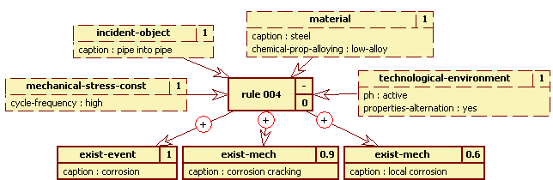
ISDCT SB RAS <number>
Rule Visual Modeling Language
(defrule rule_004 ""
(mechanical-stress-const (cycle-frequency "HIGH") (cf "1") )
(technological-environment (ph "ACTIVE") (properties-alternation "YES")
(cf "1")
) …
Yurin A.Yu., Dorodnykh N.O., Nikolaychuk O.A., Grishenko M.A. Designing rule-based expert systems with the aid of the model-driven development approach // Expert Systems, 2018, Vol. 35, No. 5, P. 1-23.

Slide 4
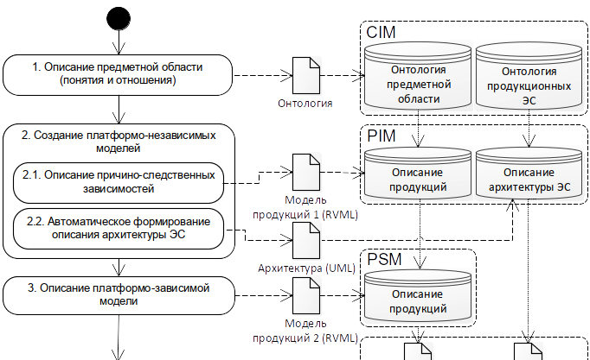
ISDCT SB RAS <number>
An approach for prototyping expert systems

Slide 5
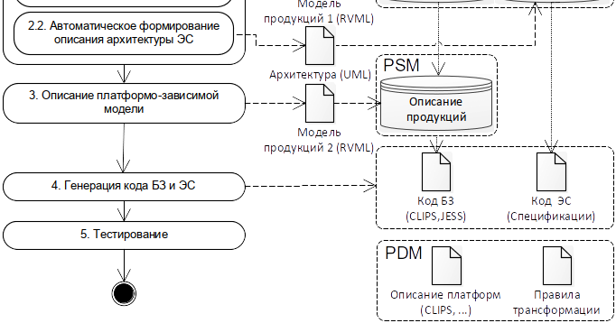
ISDCT SB RAS <number>
An approach for prototyping expert systems

Slide 6
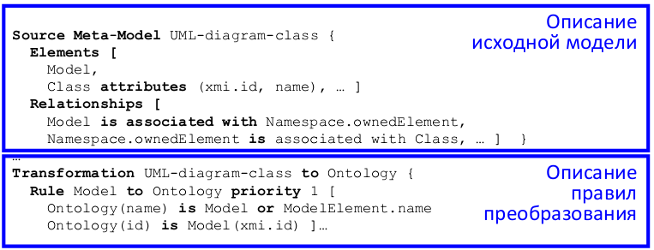
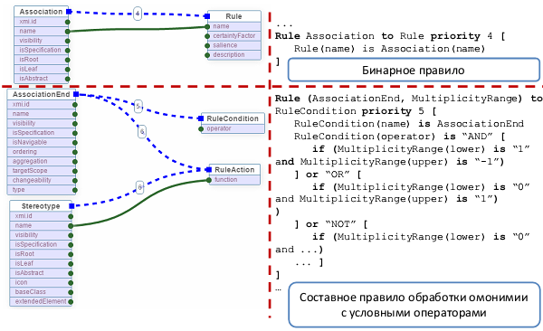
ISDCT SB RAS <number>
Transformation Model Representation Language

Slide 7
ISDCT SB RAS <number>
Main results: software tools
Software tool for prototyping knowledge bases of rule-based expert systems – Personal Knowledge base designer (PKBD).
Web-based tool for knowledge base creation on the basis of conceptual model transformation - Knowledge Base Development System (KBDS).
A multi-component tool for building knowledge-based systems.
Tool prototyping systems for agent-based simulation.

Slide 8
ISDCT SB RAS <number>
Personal Knowledge Base Designer
Main functions:
- knowledge base management;
- logical inference;
- support of “domain-specific editor" mode;
- support of RVML.
Yurin A.Yu., Dorodnykh N.O., Nikolaychuk O.A., Grishenko M.A. Designing rule-based expert systems with the aid of the model-driven development approach // Expert Systems, 2018, Vol. 35, No. 5, P. 1-23.

Slide 9
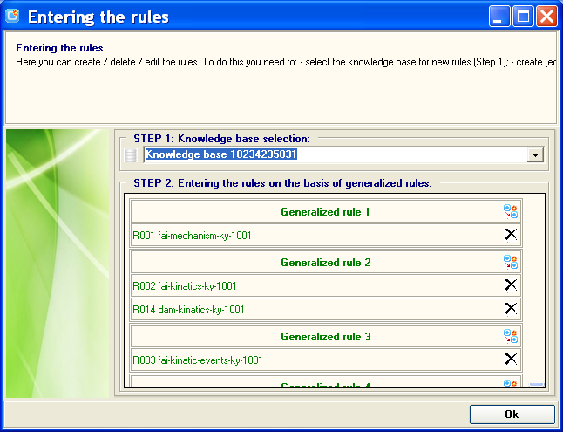
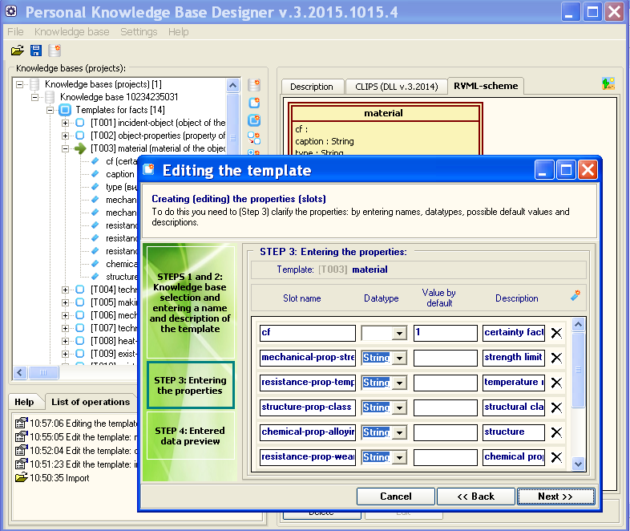
ISDCT SB RAS <number>
Personal Knowledge Base Designer
АС №№ 2016617733, 2012614093, 2007613714

Slide 10
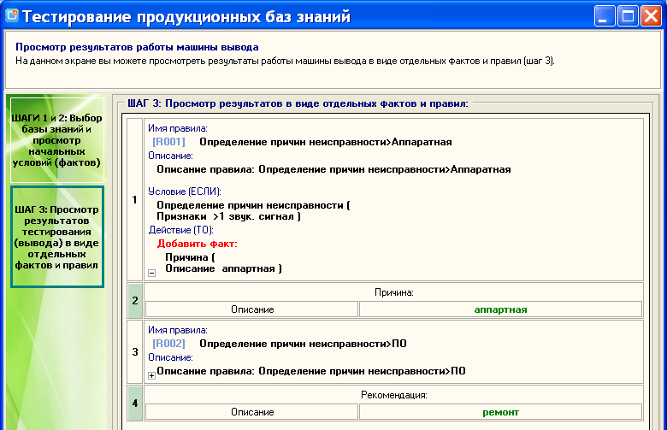
ISDCT SB RAS <number>
Personal Knowledge Base Designer

Slide 11
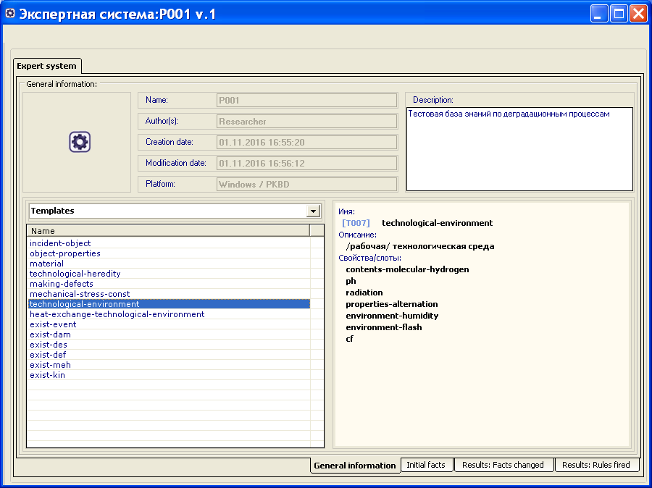
Институт динамики систем и теории управления им. В.М. Матросова СО РАН <number>
Тестирование базы знаний. Результаты логического вывода

Slide 12
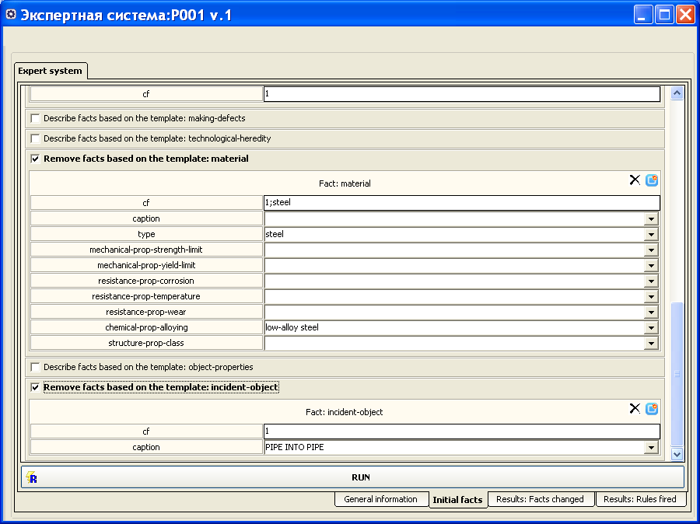
Институт динамики систем и теории управления им. В.М. Матросова СО РАН <number>
Тестирование базы знаний. Результаты логического вывода

Slide 13
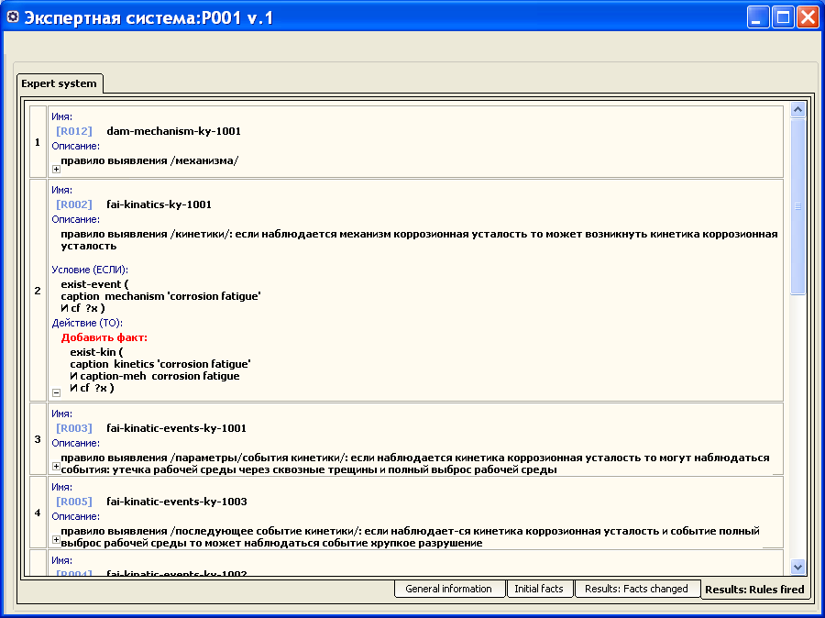
Институт динамики систем и теории управления им. В.М. Матросова СО РАН <number>
Тестирование базы знаний. Результаты логического вывода

Slide 14
ISDCT SB RAS <number>
Knowledge Base Development System
Main functions:
- visual construction of transformation models (rules of elements correspondence);
- support of TMRL;
- CLIPS codes generation;
- support of RVML;

Slide 15
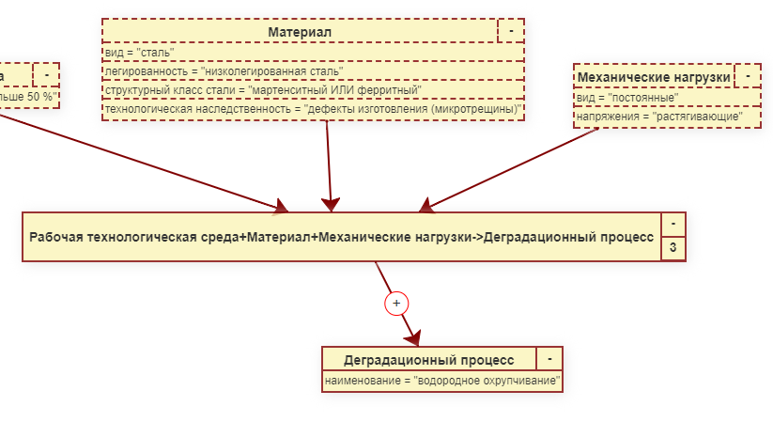
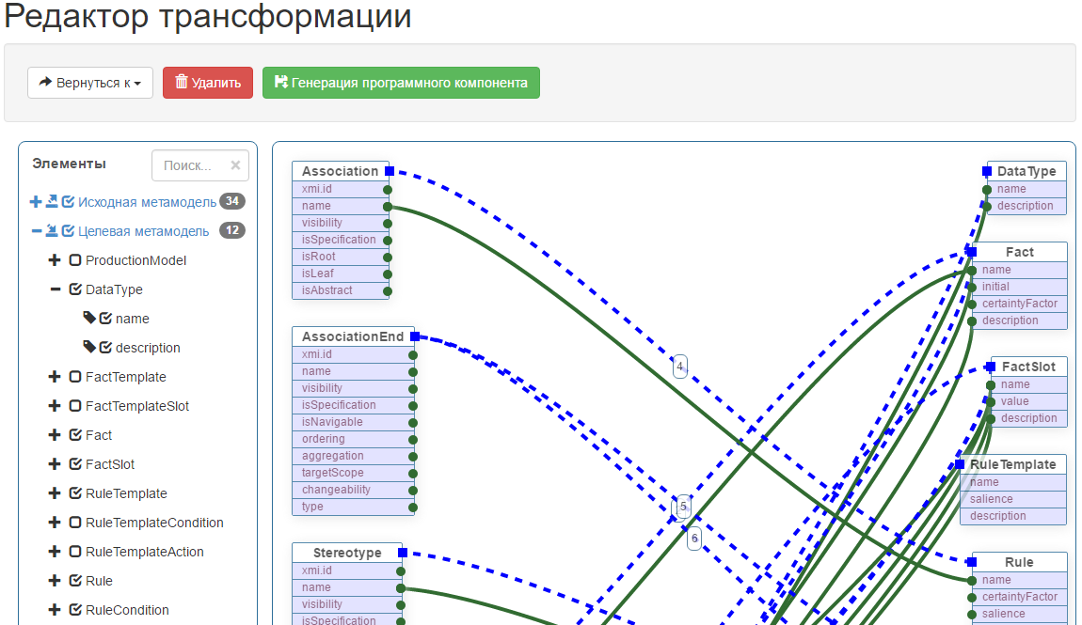
ISDCT SB RAS <number>
Knowledge Base Development System
АС №№ 2018660815, 2017618430 , 2017618446

Slide 16
ISDCT SB RAS <number>
A multi-component tool for building knowledge-based systems
Main functions:
- conceptual modeling;
- rule-bases modeling;
- DROOLS code generation;
- testing obtained codes;
- generation of GUI.
Nikolaychuk O.A., Pavlov A.I., Stolbov A.B. The software platform architecture for the component-oriented development of knowledge-based systems // MIPRO 2018. pp. 1064-1069.

Slide 17
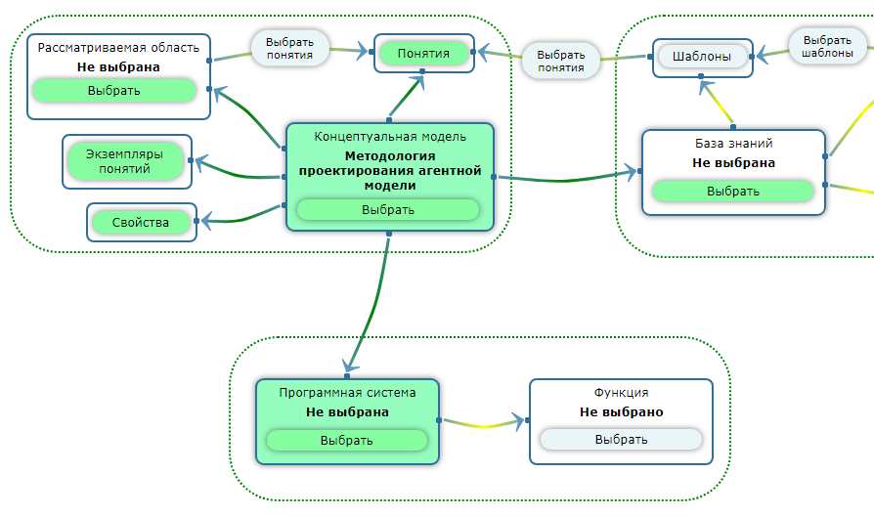
ISDCT SB RAS <number>
A multi-component tool for building knowledge-based systems
АС №№ 2016617626, 2016663618, 2017660160

Slide 18
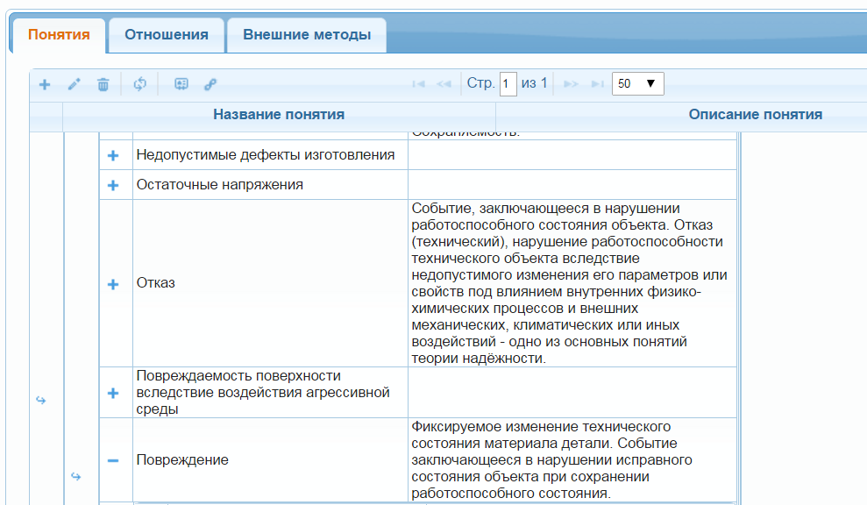
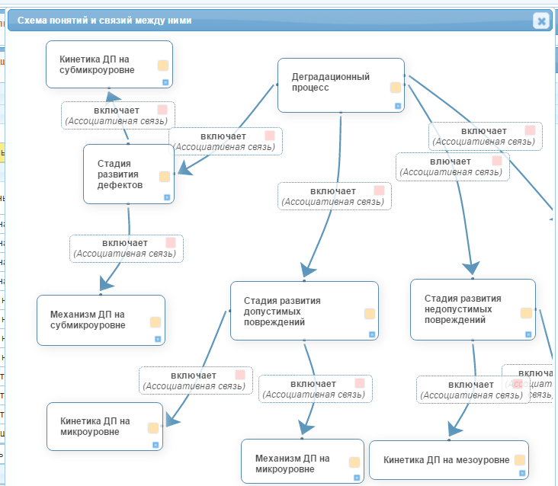
ISDCT SB RAS <number>
A multi-component tool for building knowledge-based systems

Slide 19
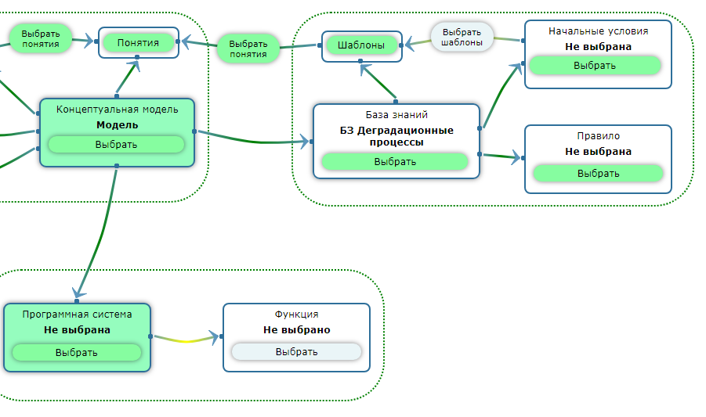
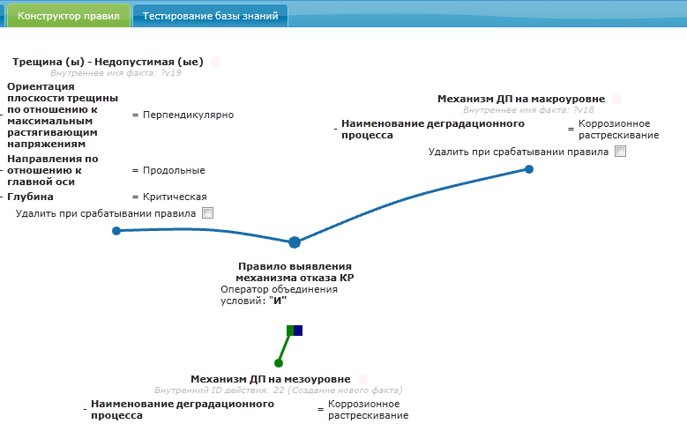
ISDCT SB RAS <number>
A multi-component tool for building knowledge-based systems

Slide 20
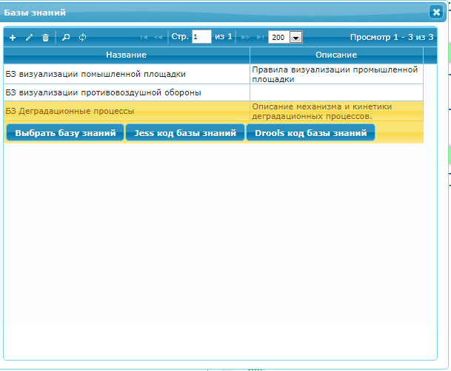
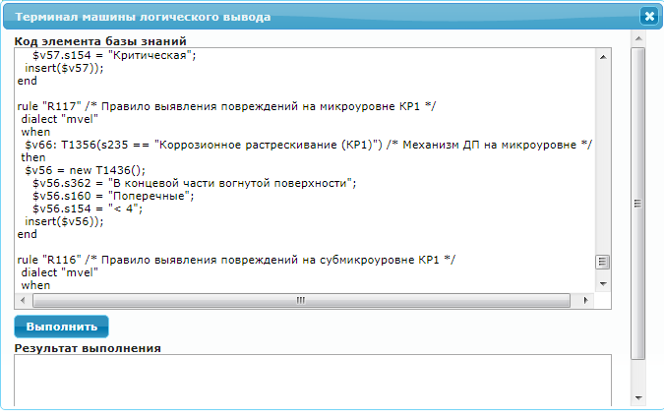
ISDCT SB RAS <number>
A multi-component tool for building knowledge-based systems

