Slide 1
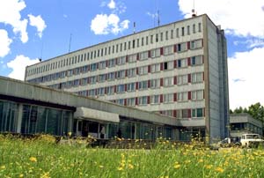
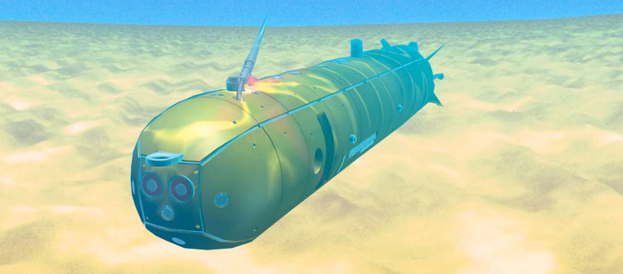
Matrosov Institute for System Dynamics and Control Theory of Siberian Branch of Russian Academy of Sciences (ISDCT SB RAS)
HIERARCHICAL CONTROL SYSTEM DESIGN PROBLEMS FOR MULTIPLE AUTONOMOUS UNDERWATER VEHICLES
Igor Bychkov, Artem Davydov, Maksim Kensin, Nikolay Maksimkin,
Nadezhda Nagul, Ul’yanov Sergey
E-mail: sau@icc.ru
Tomsk, 2019
Notes:
Good afternoon, dear colleagues ['kɔliːg]). My name is Ul’yanov Sergey and I’m from the Matrosov Institute for System Dynamics and Control Theory. My talk is concerned with the control design problems for multiple autonomous [ɔˈtɑnəməs] underwater [ˈʌndəˈwɔːtə] vehicles [ˈviːɪkl] (AUV, for short).

Slide 2
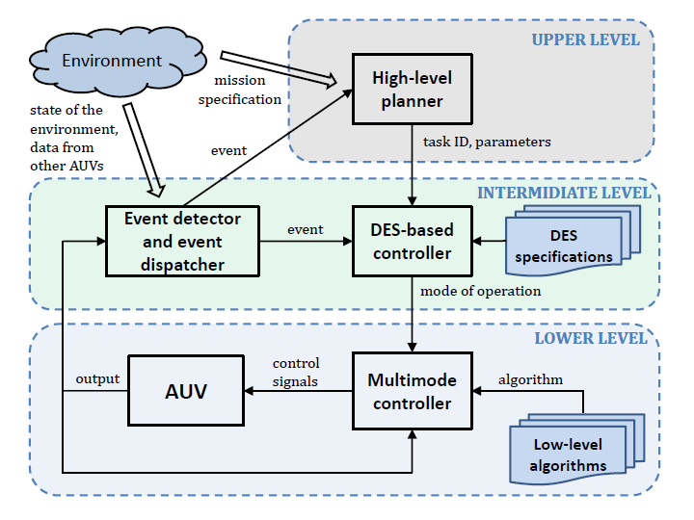
Hierarchical Control System
Notes:
Nowadays unmanned technologies based on the use of coordinated groups of autonomous [ɔˈtɑnəməs] underwater vehicles (AUV) are becoming the main tool for performing a wide range of long-term underwater operations. To perform these operations in an efficient manner, an advanced, often multi-level, control system is required. We exploit a three-level control system presented on the slide. The main task of the lower level is to execute control algorithms corresponding to the current mode of operation. The mode of operation is selected by a discrete-event system based on events related to changes in the state of the environment and vehicles. The high-level planner at the top level performs decomposition of the mission into a sequence of tasks to be performed by each vehicle. Next, I’ll briefly outline some of the control design problems arising at each of the presented levels.

Slide 3
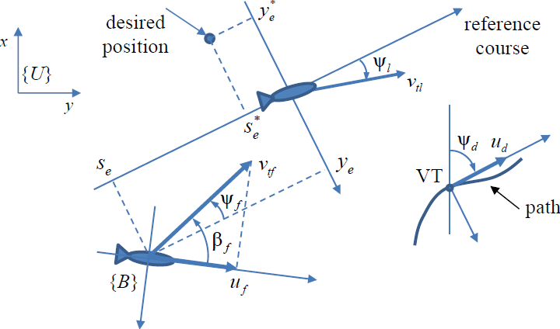
Formation Path-Following Control Problem
Leader-follower dynamics:
AUV dynamics:
Formation path-following control problem: derive control laws for force F and torque G of each AUV such that
define a desired position of the follower w.r.t. the leader (or virtual target - VT).
The derived distributed control scheme includes:
Control law for VT that adjusts VT’s travel speed to the irregularities of the path.
Sampled-data control algorithm for each AUV to keep its relative position.
Simple communication scheme for information exchange between AUVs.
Notes:
In many underwater applications, vehicles have to maintain a desired formation while following a predefined path. This problem related to the lower level is called the formation or cooperative [koʊˈɑpəˌreɪtɪv ] path-following. It is being actively [ˈæktɪvli] studied in the literature subject [ˈsʌbʤɪkt] to three main aspects [ˈæˌspɛkts]: 1) uncertainty of the underwater environment, 2) communication delays, 3) control constraints [kənˈtroʊl kənˈstreɪnts]. We propose a decentralized [dɪˈsɛntrəˌlaɪzd] control [kənˈtroʊl] scheme that fully or partially [ˈpɑrʃəli] takes into account all of these aspects. It is based on the leader-follower approach [ˈlidər-ˈfɑloʊər əˈproʊʧ ]. We assume [əˈsum] that the leader of the fleet tracks the movement of the virtual target moving along the path, and every other vehicle as a follower has to keep its relative position with respect to its leader.

Slide 4
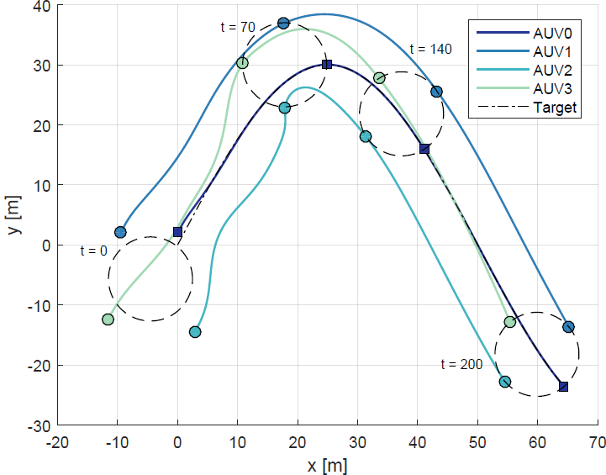
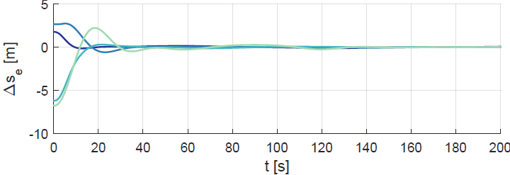
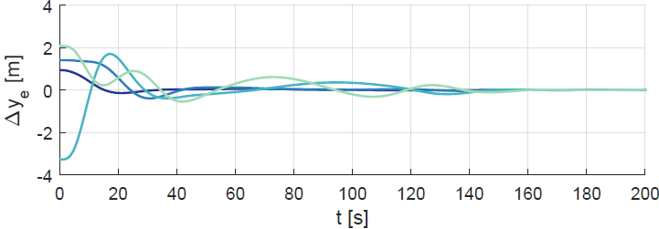
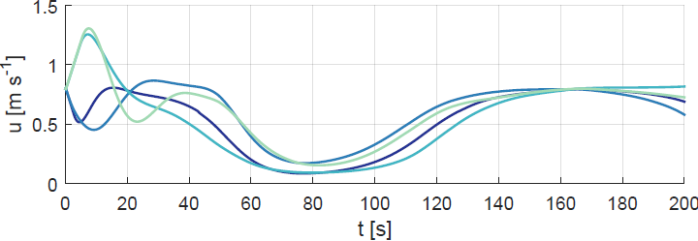
Formation Path-Following Control Problem
Implementation of the control scheme:
Gain-scheduled controllers with the path curvature as a scheduling variable.
Synthesis of feedback gains for each scheduling region with the use of sublinear vector Lyapunov functions, taking into account: formation structure, communication delays, measurements errors, and control saturation.
Simulation results for underactuated AUVs with
Notes:
Feedback controllers for vehicles are designed as gain-scheduled ones [geɪn-ˈskɛʤʊld wʌnz], that is, the gains of controllers are automatically [ˌɔtəˈmætɪkli] adjusted as a function of scheduling variables. We use the path curvature [ˈkɜrvəʧər] as the scheduling variable [ˈvɛriəbəl]. To design feedback gains for each scheduling region using sublinear vector Lyapunov functions, the closed loop system is represented as a sampled-data model [ˈsæmpəld-ˈdeɪtə ˈmɑdəl] with uncertainties, constant delay, and control saturations [sæʧəˈreɪʃənz]. Numerical [nuˈmɛrəkəl] computations were conducted for a fleet of large-sized AUVs that have to follow a sinusoid-like [ˈsaɪnəˌsɔɪd] path keeping a circular type formation. Some simulation results that confirm the high quality of the designed system are presented on the slide.

Slide 5
Analysis of Logical Discrete-Event Systems
Logical DES as a generator of formal language
is the state set;
is the set of events,
is controllable events;
is the transition function;
is the initial state;
is the set of marked states;
Language marked by :
Supervised DES:
Supervisor
Discrete-event system
Supervisory control problem:
Find that provide
is a specification (language) on DES behavior.
Notes:
The behavior of the control [kənˈtroʊl] system at the middle level, which is responsible for switching modes of operation, is convenient to describe using logical discrete-event systems (or DES) [ˈlɑʤɪkəl dɪˈskrit-ɪˈvɛnt ˈsɪstəmz]. Nowadays a state machine is the most popular [ˈpɑpjələr] way to represent logical DESs. It can be considered as a generator of some formal language whose words are admissible sequences of events [ ədˈmɪsəbəl ˈsikwənsəz ʌv ɪˈvɛnts]. To provide a discrete-event system with the desired behavior, the supervisory control theory [supərˈvaɪzəri kənˈtroʊl ˈθɪri ] is widespread. It assumes that some events of the system may be prevented from occurring, and the supervisor is a device that realizes [ˈriəˌlaɪzɪz] these preventions. The main goal of supervisory control is to construct such a supervisor that the language generated by the supervised system is the same as a specification language that describes the desired behavior of the system.

Slide 6
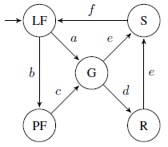
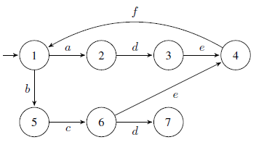
Analysis of Logical Discrete-Event Systems
DES model that describes AUVs modes switching during a survey mission
PCF (positively-constructed formulas) inference search using the special developed strategy that gives the answer about the presence of the required property
Generator
Specification
Formalization of DES in the original first-order language of PCFs
Notes:
In multi-agent systems, where individual agents can observe only a part of occurring events, it is important to be able to construct a decentralized supervisor as well as to check the conditions of its existence. We developed a first order logic [ˈlɑʤɪk ] based approach to formalization of discrete event-systems [dɪˈskrit ɪˈvɛnt-ˈsɪstəmz] and checking their properties, particularly [pərˈtɪkjələrli ] the co-observability property, which ensures the existence of the decentralized [dɪˈsɛntrəˌlaɪzd] supervisor. In the approach, a system and its specification are written in the language of positively-constructed formulas [ˈpɑzətɪvli-kənˈstrʌktəd ˈfɔrmjələz] and then the property checking is performed using logic inference [ˈɪnfərəns] machine. The approach was validated on an example of discrete event model that describes the behavior of the leader-follower formations in a survey mission. More details about the example [ɪgˈzæmpəl] can be found in the paper.

Slide 7
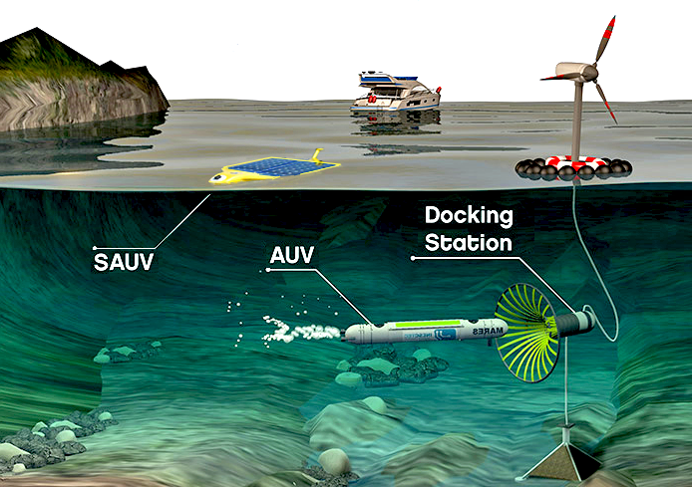


Coordinated AUVs Group Recharging Scheme
Large-scale monitoring missions of long duration:
Vehicles have to recharge their batteries periodically;
Vehicles should alternate charging cycles if possible to decrease temporary loss of performance capability;
Vehicles have to deal with dynamic mission conditions.
Discrete representation of the group rotation schedule:
Binary matrix $H=\{h_{ij}\}$ of $N×e$ size, where $e=\text{T}/\text{△}\text{T}\text{.}$
Includes traveling time & charging time (considering both AUV’s speed and charging speed)
AUV #1
AUV #2
AUV #3
AUV #N
– time segment (△T): – vehicle is working; – vehicle is charging (or traveling).
The effectiveness of the group schedule is ensured by:
Keeping all vehicles in good working order (well-timed recharging);
Excluding simultaneous charging of big number of vehicles (at least, excluding simultaneous charging of the fastest vehicles in the group);
Minimizing group rendezvous’ frequency where possible.
Notes:
In large-scale missions, underwater vehicles should be capable of maintaining their battery life to complete all mission tasks. This requirement forces [ˈfɔrsɪz] vehicles to leave the group periodically to recharge their batteries by docking to a specialized underwater station. Since the group works continuously for a long time, vehicles should alternate [ˈɔltɜrnət] their charging cycles to reduce the loss of productivity. Thus [ðʌs], it is important to develop an efficient long-term strategy by scheduling [ˈskɛʤʊlɪŋ] recharging cycles of vehicles . The desirable schedule should ensure timely recharging of all vehicles. In addition, it is important to exclude the simultaneous [ˌsaɪməlˈteɪniəs] charging of a large number of vehicles and minimize the frequency of rendezvous [ˈrɑndɪˌvu], which are used to update the group actual status but distracts them from accomplishment of mission tasks. We use the search space discretization to speed up both encoding and finding solutions.
(In this case, the group schedule can be represented as the matrix shown on the slide where colored time segments correspond to AUV’s charging periods.)

Slide 8
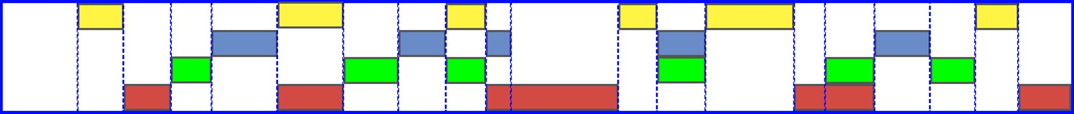
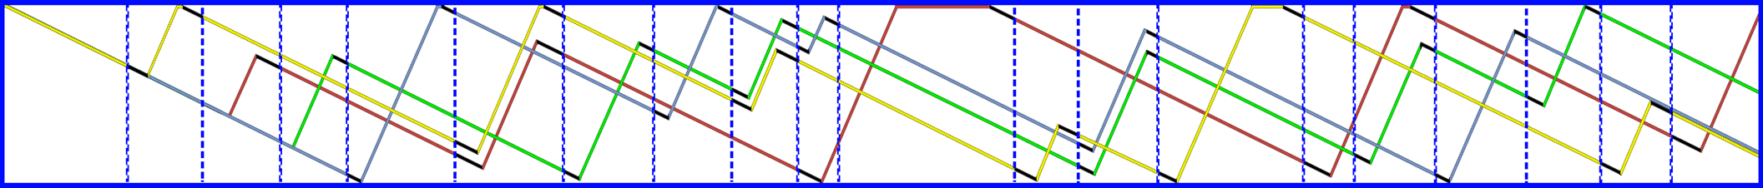
Coordinated AUVs Group Recharging Scheme
Loss function (1) evaluates the cumulative performance capability of currently charging AUVs on each time segment.
(1)
Function (2) estimates the number of expected rendezvous (time intervals, where at least one vehicle changes its status).
(2)
Ultimate schedule efficiency criteria:
(3)
Genetic algorithm – simple, fast and scalable. Allows quick and effective re-planning.
Chromosome (compressed schedule representation to decrease the problem dimension):
Repairing procedure combines solution decoding (into the matrix form) with local optimization.
#
Group schedule for 4 speed-differed AUVs
AUVs battery level during the mission
Notes:
To solve the scheduling problem, we propose a dynamic group recharging scheme, which is based on the use of a modification of the genetic [ʤəˈnɛtɪk] algorithm. The proposed scheme is simple, reliable and fast. In addition, it provides quick re-planning whenever an unexpected event occurs. The compressed [ kəmˈprɛst] schedule [ˈskɛʤʊl] representation is proposed to reduce the complexity of the problem. An example of charging schedule for four underwater vehicles, obtained using the developed planner, is presented on the slide. The second plot here illustrates the battery level of all vehicles (with black sections depicting the travelling periods necessary to reach the charging station).

Slide 9
Thank you for your attention!
Notes:
Thank you very much for your attention. I am ready to answer questions and discuss the results after the session.

