Slide 1
Modeling forest dynamics
Anastasia Popova, Ph.D.,
Aleksander Cherkashin, Prof of Science

Slide 2
Aim of research
Assessment of the forest resource development in time (predict the results) under the impact of various factors.
We investigate a corresponding model, giving the parameters of natural dynamics and human impact, a SCENARIO.
A set of various scenarios forms information for decision support, e.g., choosing a management strategy that combine economic efficiency in the operation with maintaining the ecological environment.

Slide 3

Mathematical model
$$\frac{dS_{N}}{dt}=−a_{N0}S_{N}(t)+u_{non N}(t);$$
$$\frac{dS_{0}}{dt}=a_{N0}S_{N}\left(t\right)−a_{01}S_{0}\left(t\right)+u_{ncov 0}(t)+u_{cut 0}(t)−u_{non 0}(t);$$
$$\frac{dS_{i}}{dt}=a_{i−1i}S_{i−1}(t)−a_{i i+1}S_{i}(t)−u_{non i}(t)−u_{ncov i}(t)−u_{cut i}(t),$$
where a_{ij} are the coefficients of transition from one category of land or age group to the next; S_{N} is the non-forest area;
S₀ is an area that is uncovered by forest;
Si is forest areas of different classes of age;
u_{non i} is annual increase in non-forest area at the expense of other categories of land;
u_{ncov i} is increase in the area uncovered by forest;
u_{cut i} is the area of cutting, is subtracted only from the category of mature and over-mature forests, in other classes of age cutting is not carried out.

Slide 4
Anthropogenic impact assessment
The fires (43.7%), forest diseases (25.2%) and insect damage (16.2%) are the most important factors of destruction of forest resources, we take them into account in the model:
The increase in non-forest area in the process of forest exploitation is as follows:
Here k_{N} is the area of settlements per person, the remaining coefficients characterize the increase of forest population, ∆N, agricultural area, ∆S, recreational zones, ∆R, area of fields, ∆G, construction of linear objects, ∆Bl, and maintenance of hydraulic structures, ∆Bv.

Slide 5
Graph representation of the equation
a_{1i}
x₁
a_{i3}
x₃
a_{i4}
x_{i}
x₄
a_{2i}
u_{j}
a_{i5}
x₂
x_{u}
x₅

Slide 6
Knowledge Base
∀a,t₀:Problem(a,model_dyn),Progn(a,ten_year,t₀),
GR(a,landscape),LT(a,forest) →
∃m,S₀:MT(m,a,forest_res,t₀),
State(m,S_{0,}square(no_forest,t₀))
S₀
fm ModelDeterm()=a:a,t0[Problem(a, model_dyn), Prognose(a, ten_years, t0), Geosystem_Range(a, landscape), Landscape_Type(a, forest) > e:m,s0[ModelType(m, a, forest_res, t0), State(m, s0, no_forest, square(None, no_forest, t0))]];

Slide 7
Forest occupies free areas
fm Cultures()=a:ck,m,a,t0,s1[ ModelType(m,a,forest_res,t0), State(m,s1,mol1,square(ck,mol1,t0)), TakesPlace(a,forest_cultures,yes),culture_kind(k) > e:sk[State(m,sk,cult,square(ck,cult,t0)), DefineCultures(ck,square(ck,mol1,t0),Trans(m,sk,s1,trans_time(cult,mol1,ck,t0))]]
S_{I}
S₀
S_{k}
?
Reforestation activities ???

Slide 8
Forest growth (natural process)
S_{I}
S_{II}
S_{ma}
S₀
fm AToB()=a:m,t0,a,k,cl,cl1,s [ ModelType(m,a,forest_res,t0),tree_kind(a,k), age_class(cl),after(cl,cl1), State(m,s,cl,square(k,cl,t0))> e:s1[State(m,s1,cl1,square(k,cl1,t0)),Trans(m,s,s1,trans_time(cl,cl1,k,t0))]]

Slide 9
Forest logging
S_{I}
S_{II}
S_{ma}
S_{rip}
S_{mt}
S_{omt}
S₀
fm FiresProp()=a:m,a,t0,s,s0,name,sq,sq_no_forest,fi[ ModelType(m,a,forest_res,t0), State(m,s,name,sq), State(m,s0,no_forest,sq_no_forest), FiresBaseIntensity(m,a,fi) > Trans(m,s,s0,mul(fi, sq))].

Slide 10
Forest dynamics example for Irkutsk region
Forest-free areas
young forest
middle-aged
ripening
mature
overmatured
I
II
1/20
1/20
Pine
1/20
1/20
1/20
S₀
Larch
1/20
1/20
1/20
1/20
Spruce, Fir
1/20
1/20
1/20
1/20
1/40
1/40
1/40
1/40
1/40
Cedar (Sib. Pine)
1/10
Birch
1/10
1/10
1/10
1/10
Aspen
1/10
1/10
1/10
1/10
Transitions to S₀
Logging

Slide 11
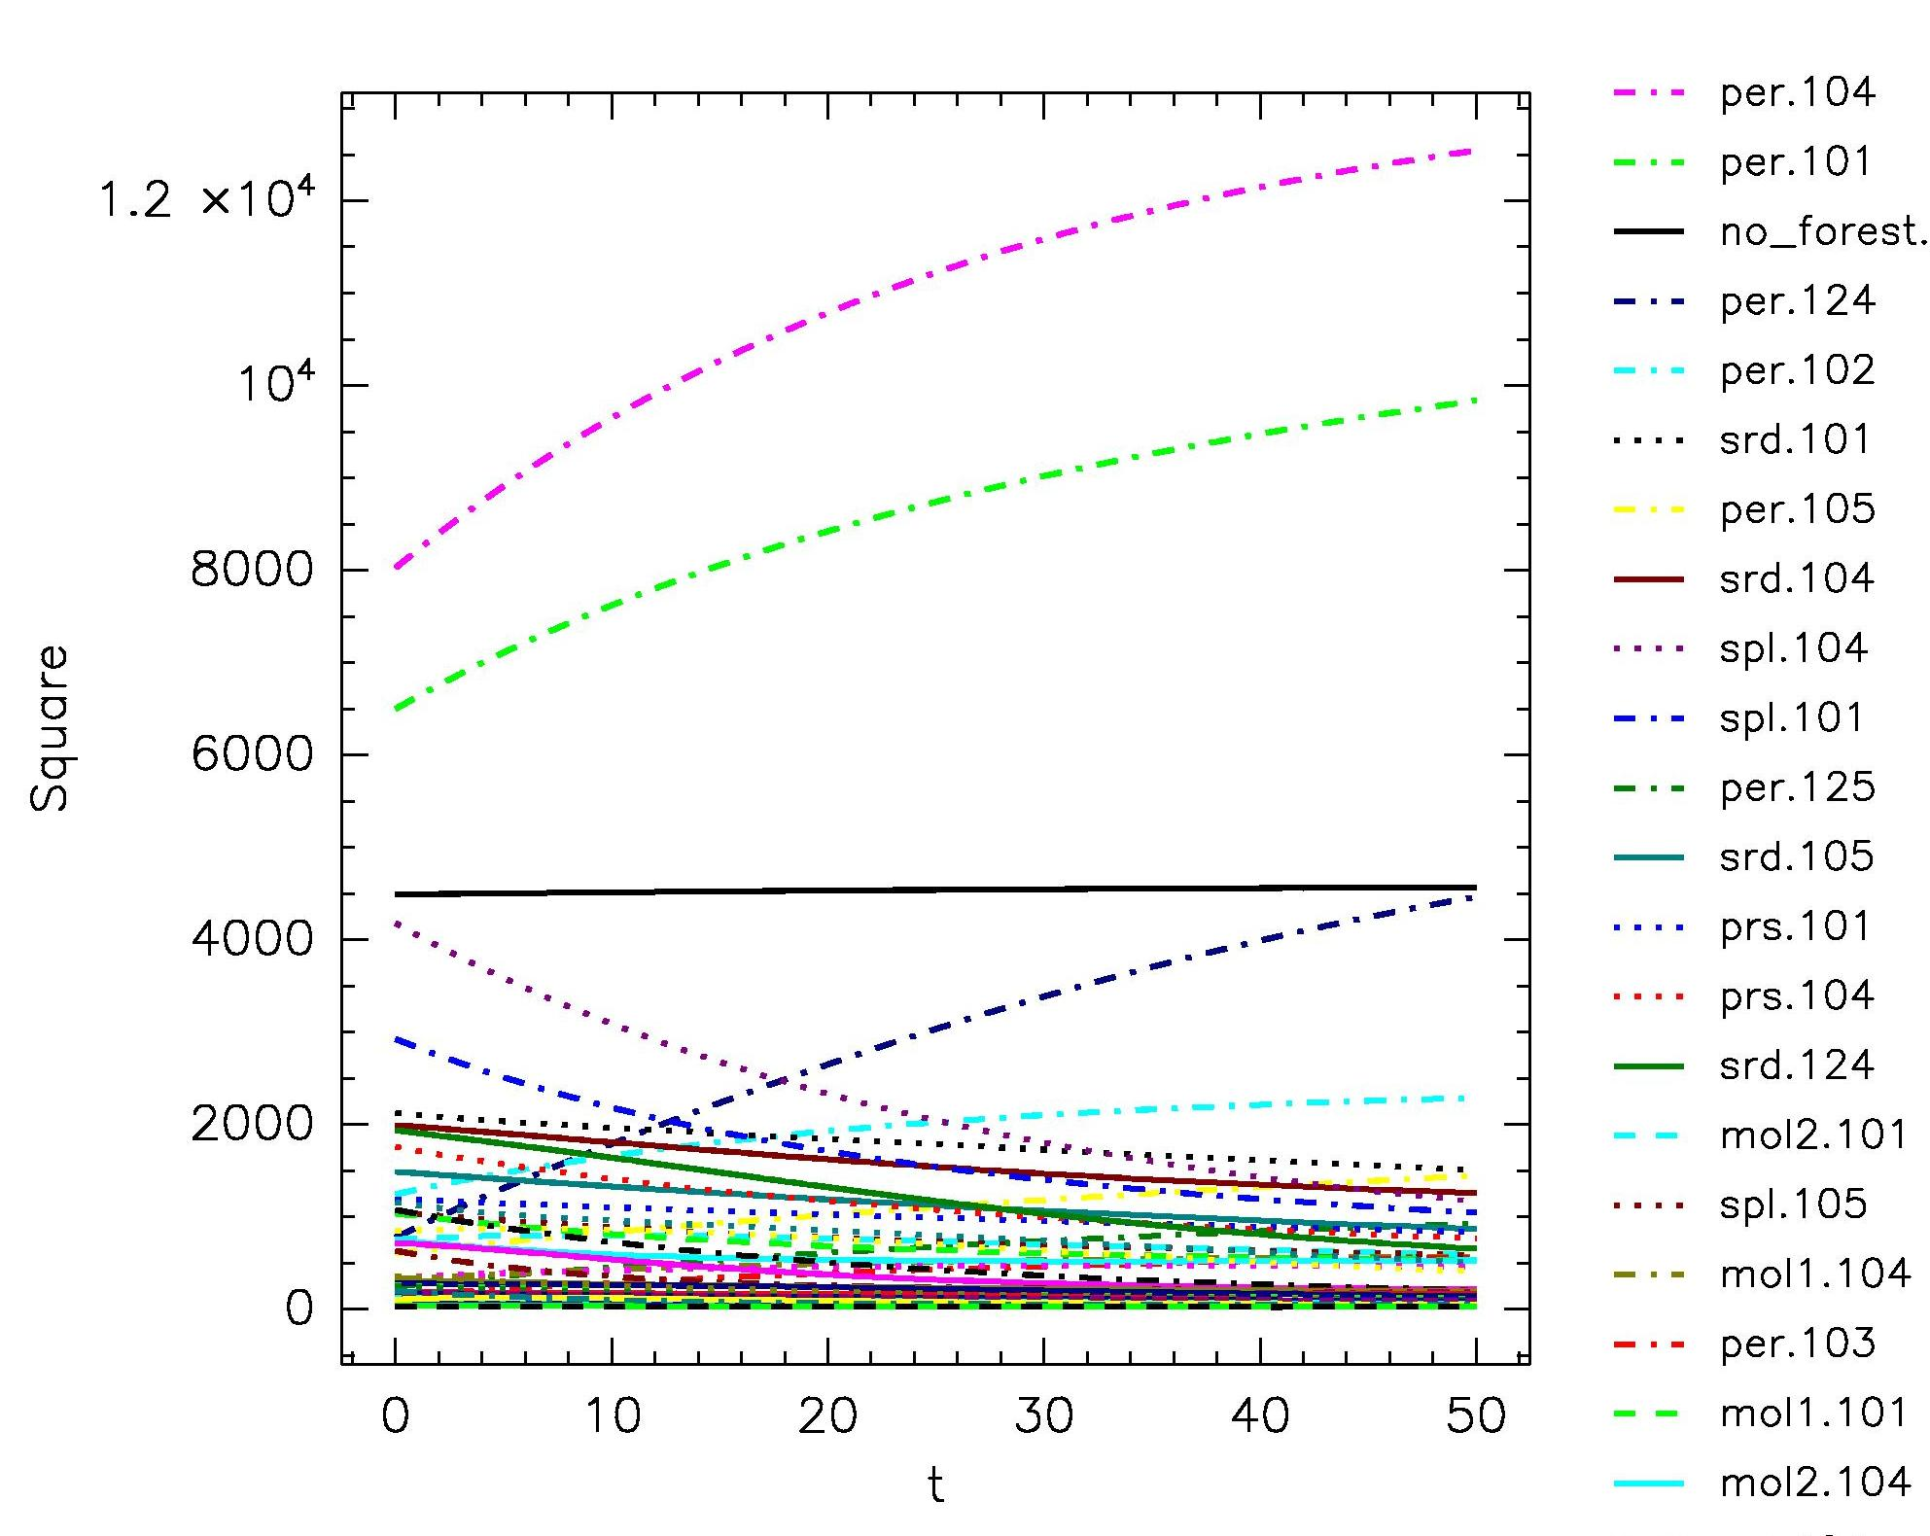
The natural dynamics without reforestation (植樹造林)
Numbers encode wood species.

Slide 12
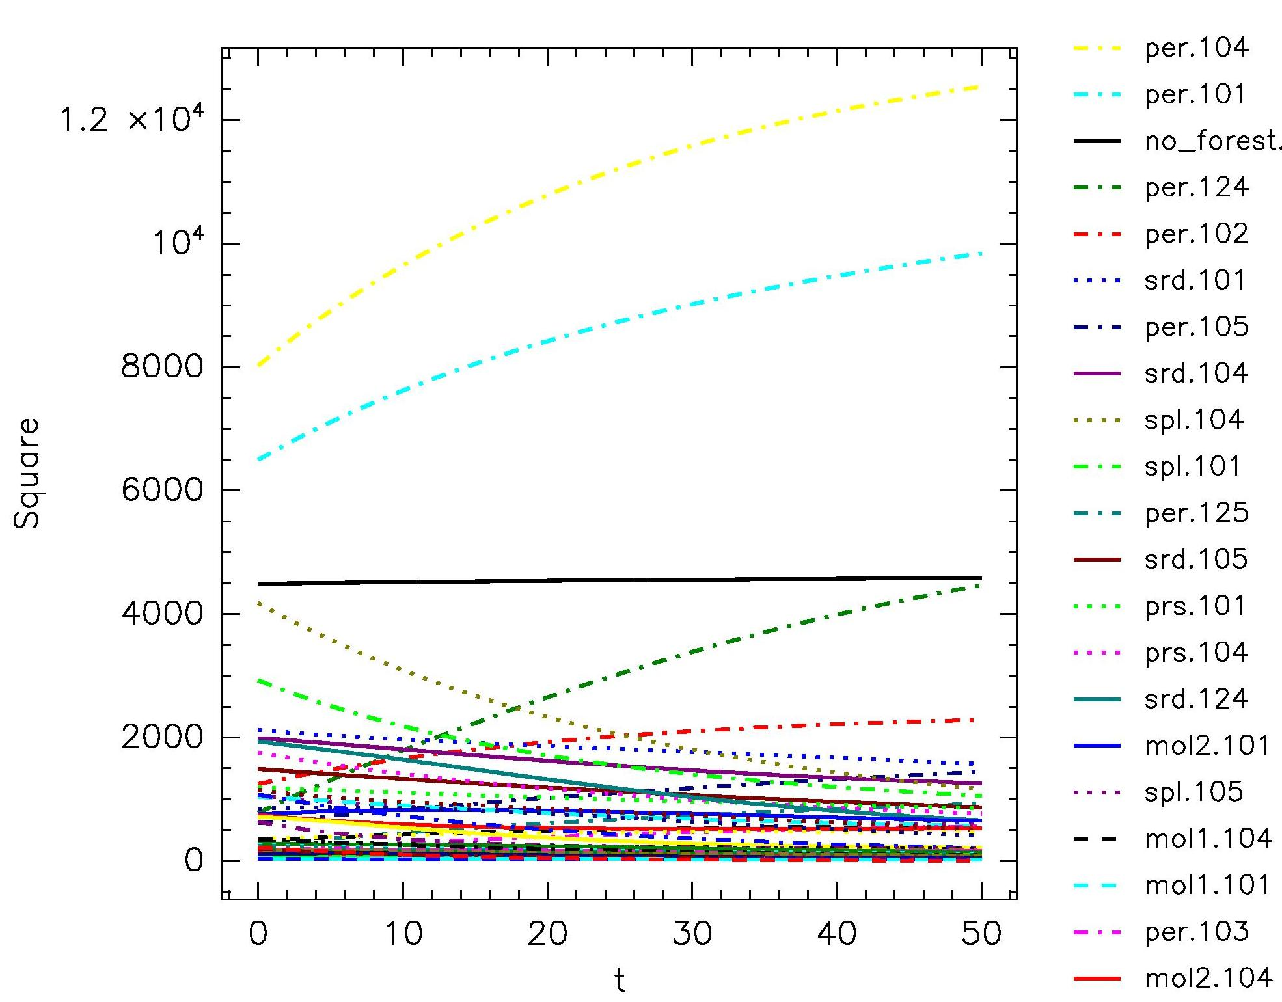
The natural dynamics with reforestation (植樹造林)

Slide 13
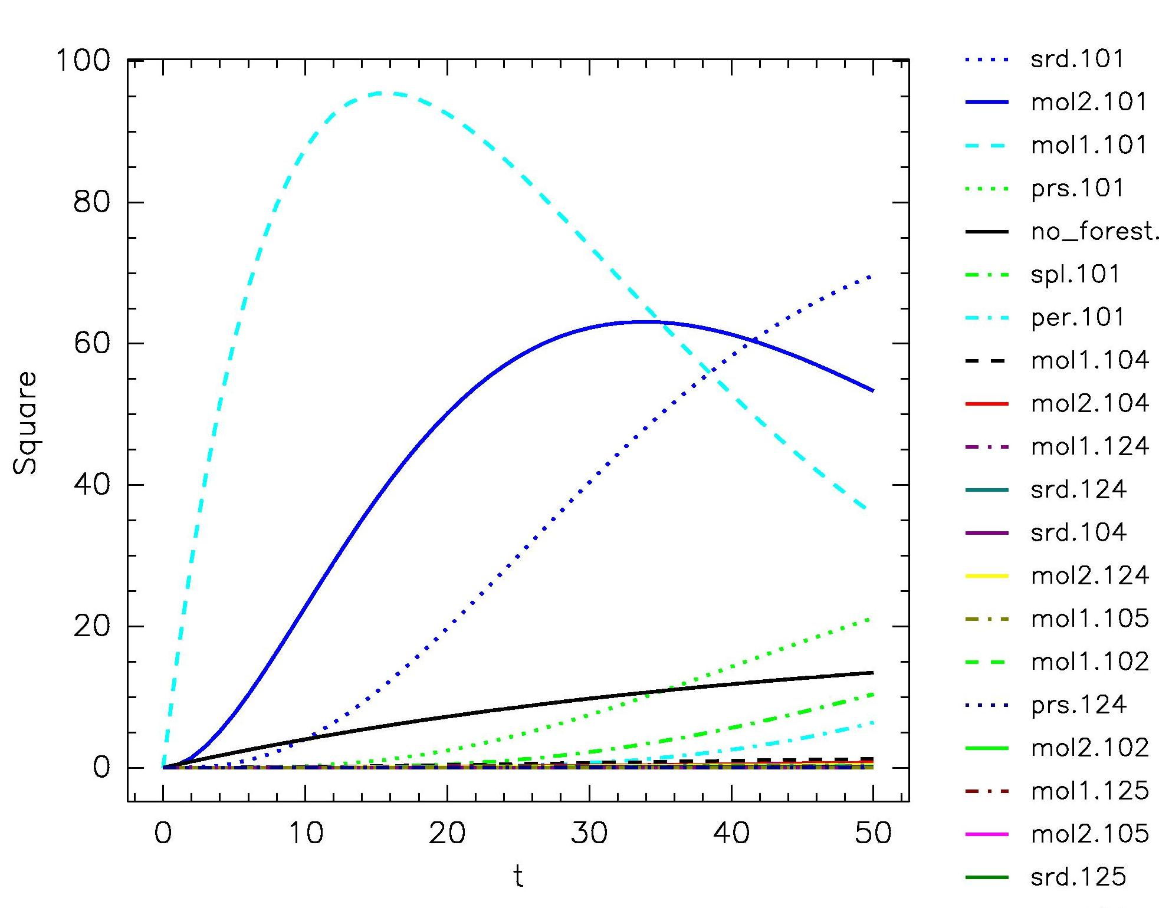
The impact of the reforestation
to the forest dynamics

Slide 14
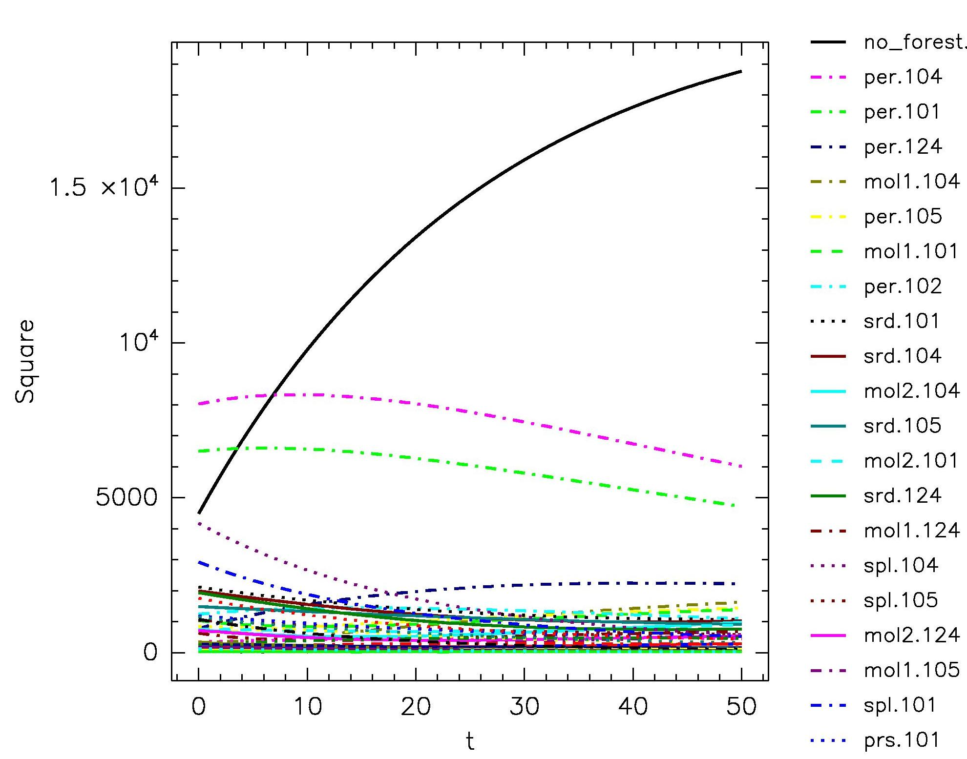
Intense logging (測井) without reforestation

Slide 15
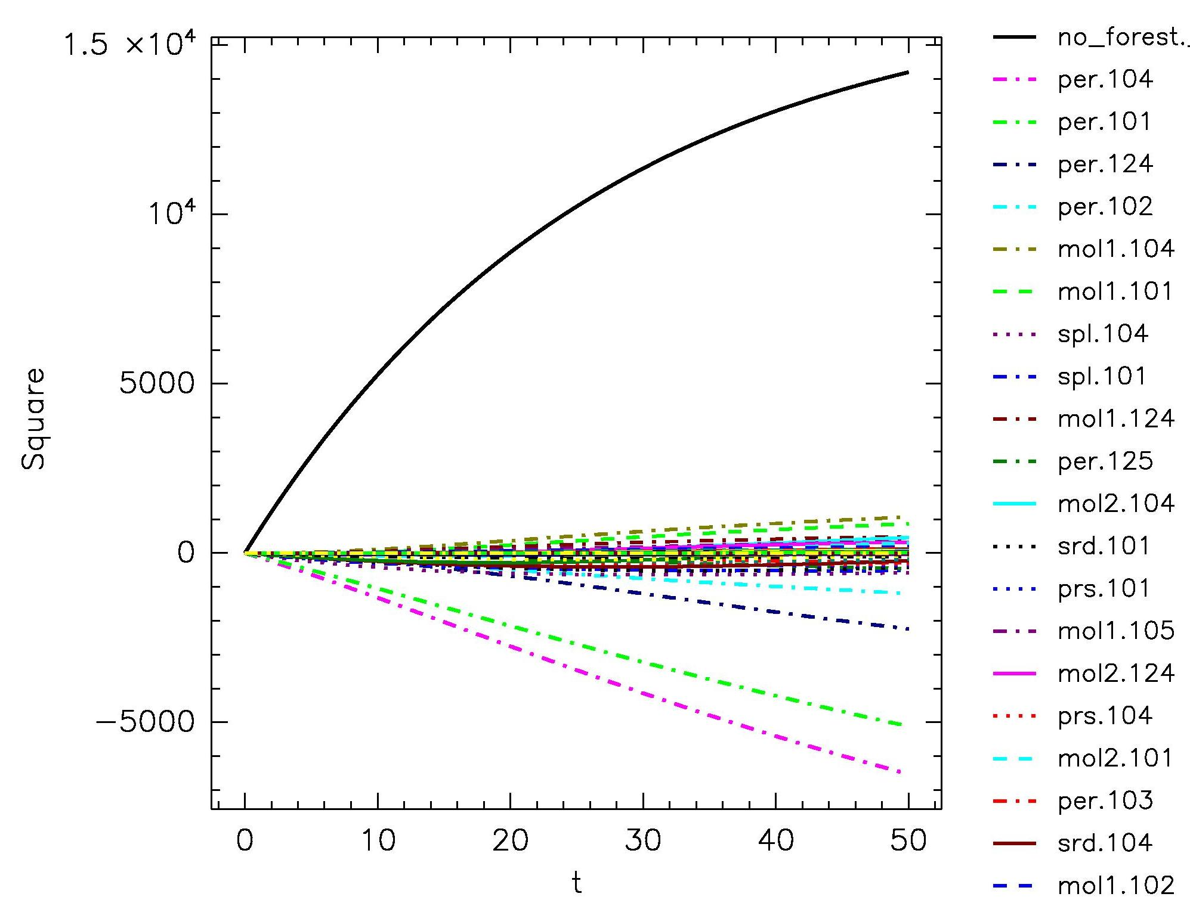
Impact of logging with reforestation to the natural forest dynamics

Slide 16
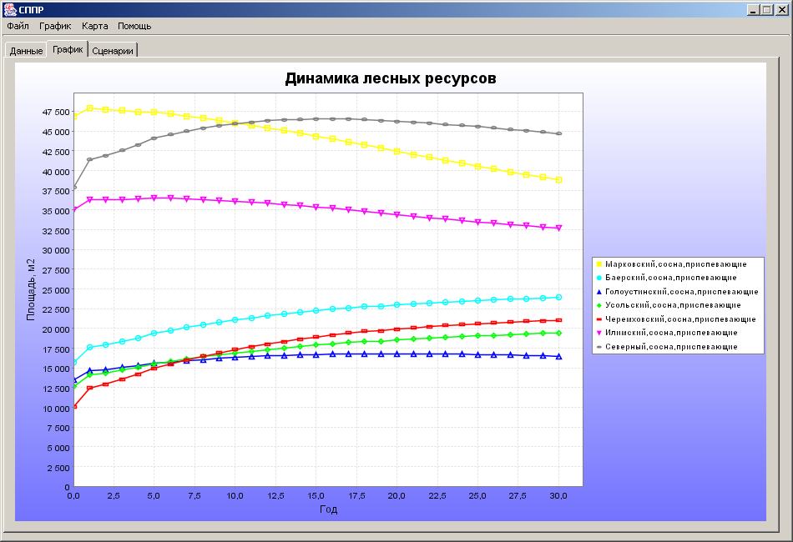
Forest dynamics forecasting for forestries (林業)

Slide 17
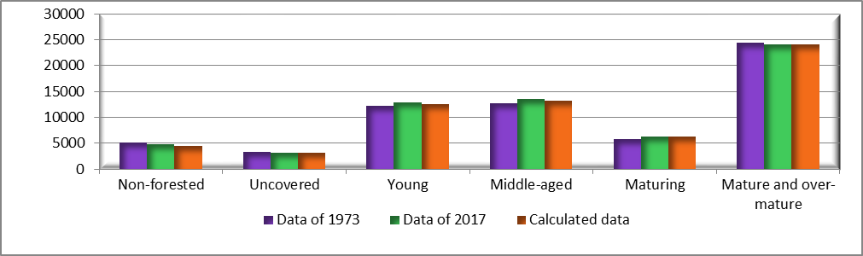
Verification of the model
Verification of the adequacy of the model and coefficients of transition a_{ij} calculation is done on the base of forestry input data of Baikal region for 1973. Input includes natural dynamics – the distribution of forest areas by age categories, anthropogenic use and adverse factors – volumes of cuttings, fires and forest plantations on the territory of 53 forest districts. Computations for the model were conducted for an interval of 45 years. The final results of the simulation were compared with the available data on forest areas for 2017, obtained from the official «Forest Plan of the Irkutsk Region».

Slide 18

Verification of the model
COMPARISON OF REAL AND CALCULATED DATA
Area type | Actual data, years |  | Simulation | Error, %
 | 1973-1985 | 2017
Non-forested | 5108,223 | 4670,194 | 4401,66 | 5,75
Uncovered | 3273,893 | 3032,455 | 3166,37 | 4,42
Young | 12161,067 | 12847,546 | 12044,61 | 6,25
Middle-aged | 12648,814 | 13411,571 | 13137,08 | 2,05
Ripening | 5783,593 | 6170,173 | 6215,15 | 0,73
Mature and overmature | 24444,429 | 24128,406 | 23089,60 | 4,3
Total | 63420,02 | 64260,35 | 62054,47 | 3,43
The formula of the error is as follows: $Е=\frac{|S_{calc}−S_{true}|}{S_{true}}∗100\%$,
where S_{calc} is simulation data, S_{true} is actual data.

Slide 19
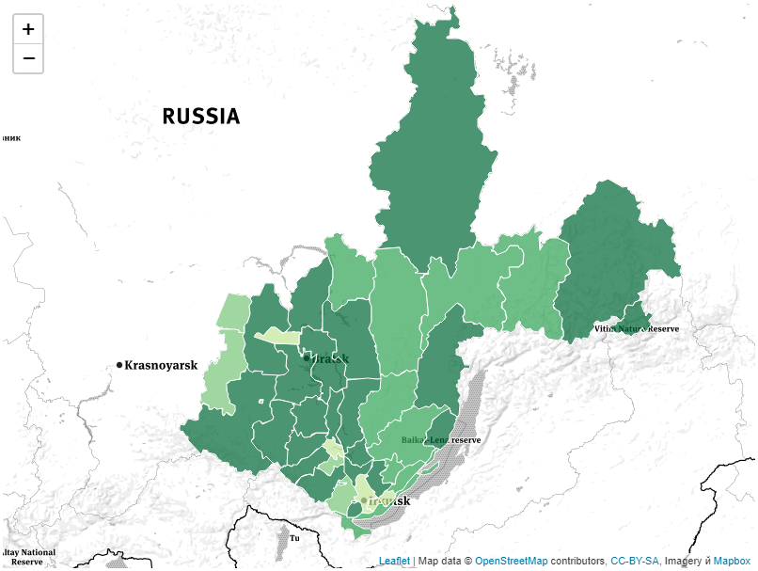
Resulted map
For example, calculations were carried out for a period of 50 years, taking into account the preservation of the current volumes of logging, fires and other adverse factors. The simulation results are shown on the map of the Irkutsk region.
The difference between the forest area for all categories of age at the end and the beginning of the simulation interval was taken as a value. Lighter shades correspond to negative values ​​relative to the initial values, it is a decrease, darker shades is positive values, i.e. their area increases.

Slide 20
Decision support system architecture
Data
Problem description
Decision maker
Decision support system
Solution estimator
Solution generator
Artificial intelligent subsystem
Multivariant forecasting
Mathematical model identification
Inference machine
Knowledge base

Slide 21
Thanks for your attention!

