Slide 1


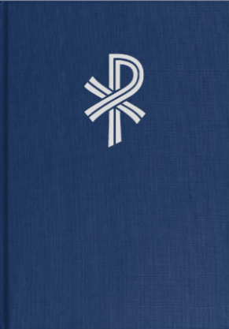
Christian Worship Hymnal
By end of March, more than half of WELS congregations were making use of new resources.
More than 400 were subscribed to Service builder

Slide 2

Resources
The Foundation
Commentaries
Musician’s Resource

Slide 3
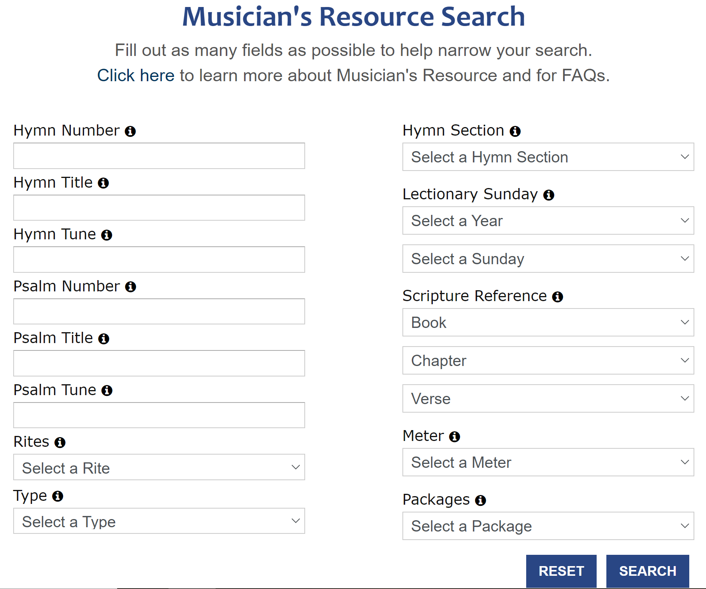

Slide 4
“Just Starting to Explore the New Hymnal”
(https://welscongregationalservices.net/hymnal-introduction-resources/)
connects helpful resources across three websites:
www.christianworship.com
www.welscongregationalservices.net
www.online.nph.net
District Worship Committee

