Slide 1
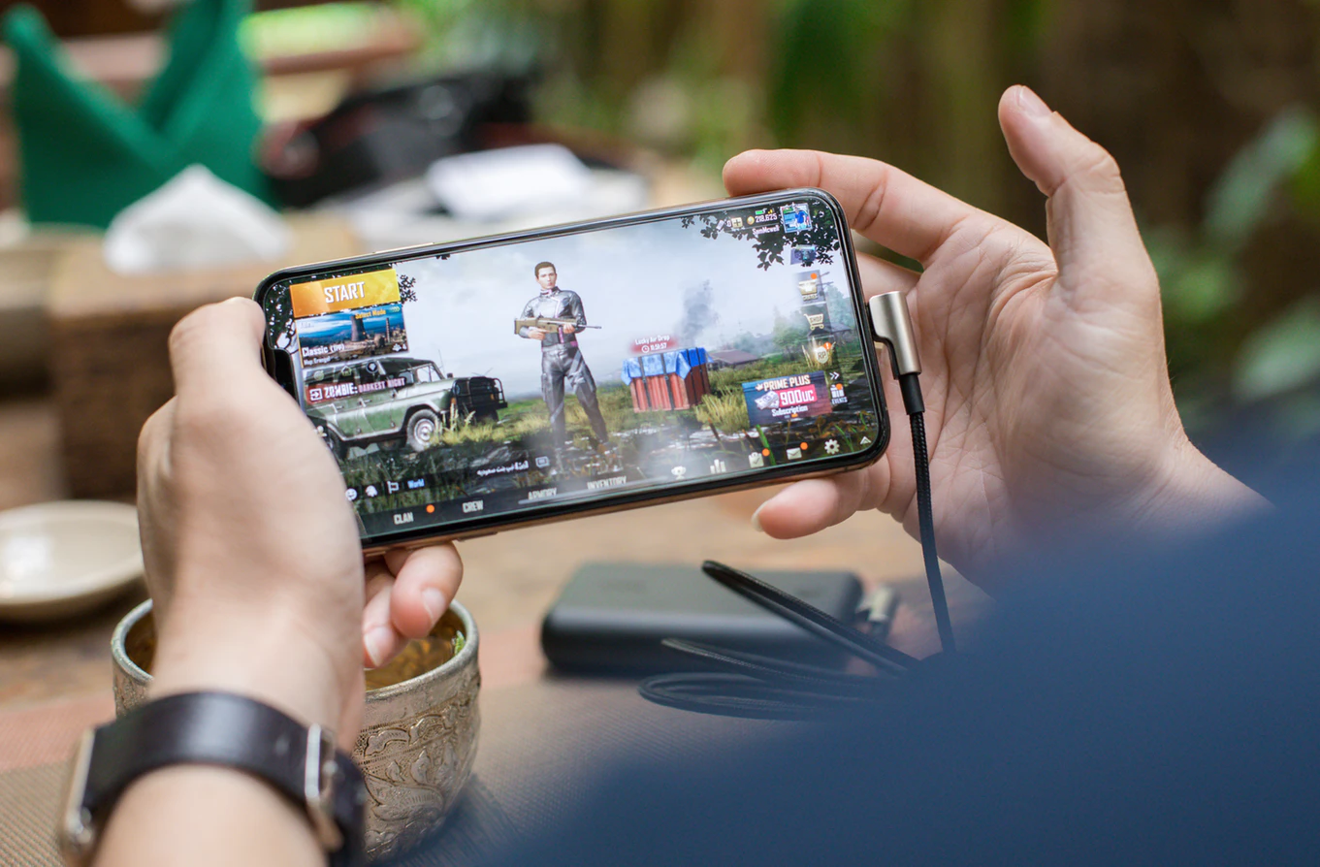

XSplit Mobile Strategy
2020 Onwards

Slide 2
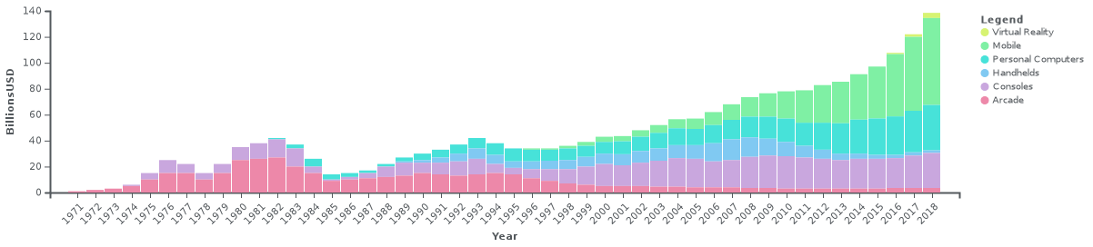
Market Research Video Games
Global revenues of the video game industry from 1971 to 2018
Not adjusted for inflation
Source: Bloomberg

Slide 3
Competitor Analysis Streamlabs: Stream Live
Insert info here
Strengths
Private streaming server for drop protection
Simple overlay editor provides widget layout customization
Support for multiple streaming platforms
Weaknesses
Removing stream watermarks requires a subscription
No advanced overlays / ability to load external websites
Opportunities
Public opinion is split over the OBS vs SLOBS debate and XSplit can capitalize on being the “true” premium software since we are not just a copy.
Streamlabs is currently under pressure to monetize and may not have enough focus on the mobile segment since Logitech is mainly a desktop-oriented company.
Threats
Logitech-funded

Slide 4
Competitor Analysis Omlet Arcade
Insert info here
Strengths
Support for multiple streaming platforms
Has their own social streaming platform
Excellent onboarding experience
Weaknesses
Certain features require a subscription such as streaming to multiple platforms, streaming to an unsupported RTMP server, and removing the watermark at 1080p.
Opportunities
Omlet Arcade can be added as supported streaming platform on our products if it becomes successful.
Threats
Arguably the best mobile streaming experience available right now.

Slide 5
Competitor Analysis Mobcrush
Insert info here
Strengths
Support for multiple streaming platforms
Has their own social streaming platform
Simulcast to multiple platforms for free
Action Replays feature for supported games
Weaknesses
Not much market adaptation
Opportunities
Learn from MobCrush’s mistakes of pushing their own platform without a viable monetization plan.
Threats
None at the moment

Slide 6
Feature Comparison
 | Streamlabs | Omlet Arcade | Mobcrush
Community website |  | / | /
Multistreaming through one endpoint | / | Unlocked with subscription | /
Custom RTMP | / | Unlocked with subscription | /
Social logins for multiple platforms | / | / | /
Privacy Mode |  | Manually triggered, custom image unlocked with subscription
Automatic settings |  | / | /
Manually set >720p, >30 fps, bitrate | / | 1080p has a watermark with no subscription, no >30 fps, bitrate can be manually set during stream
Built-in Overlays | Widgets only | Some overlays are bought
Customizable Overlays | Movable widgets | Can only change profile photo

Slide 7
Why Now?
Mobile game streaming is not new, but it hasn’t been aggressively adopted yet. Why?
Various hardware and software limitations
Front-facing camera can easily be blocked by a gamer’s hands
Sound quality is hampered by restricted system audio capture combined with the built-in microphone
The battery drain when combining gaming and streaming is massive.
Mobile broadband barriers such as coverage, data caps, and speed.
Why start now?
Mobile games have come a long way in the last number of years with more hardcore mobile games hitting the market and getting adoption.
There has been little to no innovation on how mobile gamers can make their streams look good and sound good.
The limitations of mobile broadband will be overcome with the introduction of 5G connectivity and more unlimited data plans.

Slide 8
Software Concepts

Slide 9
Hardware Concepts

Slide 10
Proposed Roadmap

