Slide 1
BPP ActEd
E-Store UI Redesign
1
Notes:
A year ago you asked me to update the estore layout, I explored modernising the current UI while retaining the table layout and FoxPro backend.
After several iterations of prototype, I came across some hurdles that I have difficulties overcoming.

Slide 2
Part 1
 Initial Analysis
 Industry Patterns Research
 Feasibility Study
Part 2
 Demo
2
Notes:
To make it easier to understand the thought process, I make it into 3 parts.
The initial analysis for the issues I came across, researching industry patterns and a feasibility study on what changes are need and how to implement, before showing the new layout.

Slide 3
1. Initial Analysis
3
Notes:
The first item I have problem solving is about the table layout.

Slide 4
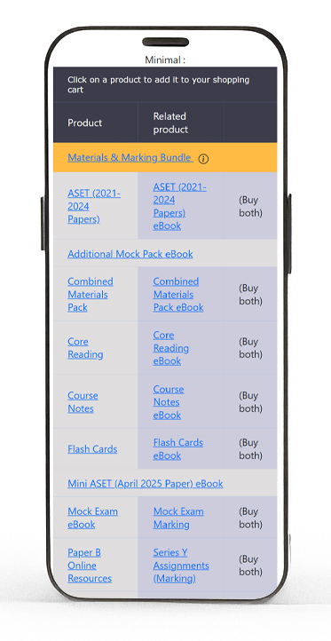
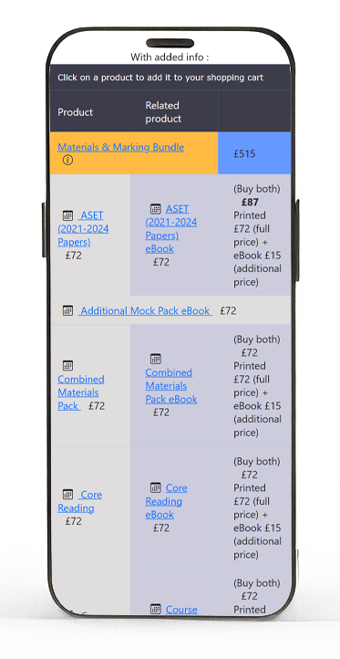
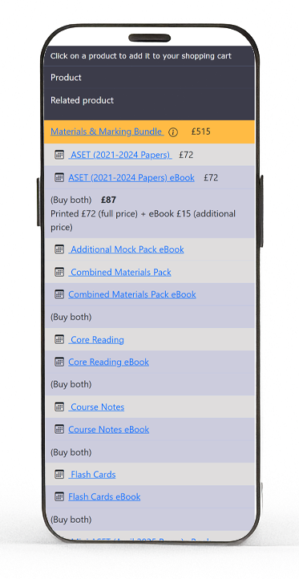
1.1 Table layout vs mobile friendliness
Increase row height for Mobile
Adding more info = worse readability
Flex grid breaks the relationship of Printed, ebook and Buy both
Minimal info
Info Added
Flex Grid
4
Notes:
I had a few attempts redesigning the products table, I could not come up with a design that look decent and works well in mobile.
For table to be responsive, row height need to be increased.
I tried using minimal styling and content but it still feels crowded.
If we need to add more info in the future it will become even less readable.
Another common approach is to use Bootstrap flex grid.
Table cell will wrap to next line when it is over the resolution breakpoint but the wrapping not only breaks the relationship between printed and ebook product but also disassociate the "buy both" button is referring to which two products.

Slide 5
1.2 Relationships and Information/Visual Hierarchy
1.2.1 Information Hierarchy vs Visual Hierarchy in the products table
Relationship
Visual
Primary
Secondary
Info Heirarchy
Remarks
within row
Hierarchy
Spacing
Bundle


Highest
Highest
font weight
colour
Printed
eBook
Same product
🌑Low
🌑Low
Mock Exam /
Marking
Different product
🌑Low
🌑Low
Assignments
ASET / MiniASET


🌑Low
⛅Higher
Spacing
Vault / AMP
Rows for ASET / Mini-ASET / Vault / AMP
Same information heirarchy as other products apart from Bundle
Higher visual heirarchy than other products
5
Notes:
Next issue I came across is about the Information Hierarchy and Visual Hierarchy within products and the relationship of products in the table.
Visual hierarchy is the arrangement to guide user through content in order of importance by fonts, weights, colour, contrast, and negative space.
Whereas Information hierarchy shows the importance of an information in relation to other elements.
In the product table, the row containing the bundle product ranked highest in both visual hierarchy and information hierarchy.
It has more negative space, higher font weight and different background colour.
For rows with printed and ebook version and Mock Exam or Assignments and its corresponding marking product, they ranked lowest in both hierarchy.
However for rows for ASET, Mini-ASET, the Vault and Additional Mock Pack, they should have the same level of information hierarchy, but visually they are more obvious because of more negative space. In this table here, you notice the row with bundles and ASET first.

Slide 6
1.2.2 Relationship within each row in the products table
Primary
Secondary
Relationship within row
Buy Now
Material  Material
Printed
eBook
Same product
standard  additional
Material  Marking
Mock Exam / Assignments
Marking
Different product
standard  standard
Same "Buy Now" trigger different behaviour
6
Notes:
Another thing to note is the behaviour of the "Buy both" button.
For printed material and its corresponding ebook, they are the same product with different format.
The "Buy both" button will add both product to cart with standard and additional rate respectively.
In essence we can call this button "Buy both variations".
Whereas in the row for Mock exam and assignments with its corresponding marking product, they are different products and the "Buy both" button will add the two product with standard price. The "Buy both" button means "Buy with recommended product". In the same table the "Buy Both" button triggers different behaviour.

Slide 7
1.3 Layout controlled by products.dbf table
The layout of the products table is controlled where clause condition:
.NOT. main_product_category
products.addonsale field.
SELECT
*, RECNO() AS
"rec"
, IIF(
"/PB"
$ code .
AND
. .
NOT
.
"/PB&R"
$ code .
AND
. .
NOT
.
"/PBAR"
$ code,
"A"
+fullname,
"Z"
+fullname) AS
"listorder"
FROM
"products"
;
WHERE
","
+AL
LTRIM
(products.webtype)+
","
$
",DISTANCE,PAPER,MARKING,ELECTRONIC,"
;
.
AND
. products.subject == lcSubject ;
.
AND
. .
NOT
. (
"/CC/"
$ products.code) ;
.
AND
. .
NOT
. (
"/CCPR/"
$ products.code) ;
.
AND
. .
NOT
. (
"/CN/"
$ products.code) ;
.
AND
. .
NOT
. (
"/CNPR/"
$ products.code) ;
.
AND
. .
NOT
. (
"/CFC/"
$ products.code) ;
.
AND
. .
NOT
. (
"/MX/"
$ products.code) ;
.
AND
. .
NOT
. (
"/MY/"
$ products.code) ;
.
AND
. .
NOT
. (
"/MM1/"
$ products.code) ;
.
AND
. .
NOT
. (
"/MM2/"
$ products.code) ;
.
AND
. .
NOT
. (
"/CNRB/"
$ products.code) ;
.
AND
. .
NOT
. (
"/CCR/"
$ products.code) ;
.
AND
. products.websale =
"Y"
;
.
AND
. BETWEEN(
DATE
(),products.release,products.expiry) ;
ORDER BY listorder ;
INTO CURSOR tmpQuery READWRITE
7
Notes:
The last difficulty I came across is about how the table layout is rendered.
In the estore_product_list, table is set by the initial where clause of the SQL query. It specified which product NOT to include and use the add_on_sale field to fetch which product should be on the same row.

Slide 8
Imagine 2 scenarios below
 Adding third product variation (e.g. Hub)
"Buy Both" button for ebook or printed
Printed + Hub
eBook + Hub
 Or retiring all printed material in some subjects
Layout restricts flexibility of schema
Form (layout) not following function
8
Notes:
Imagine in the future if we need to add a third variation, for example the Hub.
It requires a "Buy Both" button for either ebook or printed material, so Printed with Hub and ebook with Hub. It will be very challenging to show clearly all three variations with different buy both relationships in a table layout.
Another scenario is if we phase out all printed product in some subjects, the complexity for deciding which product to fetch first and which product to include in the add_on_sale will be hard to maintain.
The table layout is making it less flexibility and less adaptable to change.
Rather than form follows function,
the form, the layout in this case,
is limiting the function, the behaviour of products.
I have created a more in-depth analysis in the wiki.

Slide 9
2 Research : Industry Patterns
2.1 Focus
2.2 Sites studied
Products page layout
IFoA
Mobile Navigation and Menu
ACTEX
Common elements and functionalities
ThinkActuary
Oxford Unibersity Press
Apple
Amazon
various e-commerce online store (e.g. Amazon, ebay,
apple...etc.)
9
Notes:
After identifying the issue of using a table layout, I researched into how other company overcome this issue.
I studies a few companies that provide actuarial education and some other e-commerce stores to see how they handle displaying product. Also, focusing on mobile navigation menu as well as common elements and functionality.
It includes iFOA, Actex, ThinkActuary, Oxford Univeristy Press, Amazon and apple. They shared common pattern.
IFoA uses a horizontal card for products. Each card includes price, availability, and descriptions. It also include login function in the navigation menu on the left. When clicking on the cart button it stays on the same page and opens up the cart preview panel.
On ActEx, They use a larger horizontal tiles to display products with price, descriptions, and buttons for samples. On the navigation menu at the top, you can find the user related functions. When clicking on the cart button it opens up the cart preview panel on the same page without reloading.
Other sites like Oxford Univeristy Press, Amazon and apple all shared similar approach.

Slide 10
 Cart Panel
2.3 Summary
View cart content in collapsible panel
Summaries of common elements and functionalities for on
no postback
the landing page or product page:
 Navigatio Menu
 Products
Mobile: Hamburger menu with drawer
Product card in grid
Layered navigation structure (general category →
pricing and description
specific category)
Filtering and Searching
 User
access to functions thru out
Login/Logout
update profile
password
email
info
10
Notes:
In summary it includes product card layout in grid format. Each card have a fixed height and width and includes product description and prices. ActEx and other e-commerce store have filtering and searching.
User related functions are incorporated into the navigation bar and accessible thru out the site.
Including login logout and profile function.
There is a cart preview panel that opens up when adding product to cart, without the need of page reload.
Navigation menu is accessible by a hamburger icon in mobile. It opens up a drawer in a layered structure menu for general product category to more specific subcategory on each level.

Slide 11
3 Feasibility Study
Summary
Marginal improvement if updating UI but keeping the table layout
Cart panel and login functions possible
Table layout is the main show stopper
Duplicate work, not efficient
Full scale update will provide noticeable improvement
Less work in the long run
More value
Still a long road ahead if goal is a fully modernised online store
11
Notes:
After identifying how others handles the functionality, I did a feasibility study and explore how the features above can be applied to our e-Store.
To keep this demo short, I have created a separate high level documentation about what needs to be changed for each features.
In short, if we update the UI while keeping the table layout and most of foxpro code, we can only make marginal improvement on the products page. We might be able to refactor the cart panel and login functions into the navigation bar.
This approach is safer but it is like going the long way around and we will need to trace our footsteps in each iteration. After we updated the backend, we still need to update a huge portion of the layout.
If we can update the both the layout and backend code, it can provide a more noticible value. It requires less work in the long run but it will have more significant value.
However, it is still a very long road away if our ultimate goal is to have a fully modernised online store.
Therefore, I would like to introduce our new ActEd Online Store.

Slide 12
Part 2
Our new ActEd Online Store
 Technology Stack
 Feature Matrix
i User Management
ii Product
iii Search & Filtering
iv Rules Engine
v Shopping Cart & Checkout
vi Email System
12
Notes:
Therefore, I would like to introduce,
our new ActEd Online Store.
You probably know I am terrible in explaining how things work, it might be better to show you the end product. It is something I have been working on the past year. It is by no means 100% complete, but it is now in a good enough state to illustrate its function.
I will first briefly talk about the tech stack, then I will let you to play around the site while I walk you thru its functions.

Slide 13
1. Technology Stack
Database:
Frontend:
PostgreSQL 18
React 18
React Router
Backend:
React Hooks
Python 3.14
Context API
Django 5.1
Redux Toolkit
ORM
Google Material-UI Component
Django REST Framework
Axios
JWT Authentication
CORS, CSRF protection
GraphQL (Administrate API)
MJML (Email templates)
JsonLogic (Rules engine)
13
Notes:
This application is build with PostgreSQL Database.
Python as the backend programming language with Django as the web framework and Object relational mapper. It uses Json Web Token and Django built in functions for authentication.
GraphQL to communicate to Administrate, MailJet Markup Language for email template and JsonLogic for dynamic rules evaluation between frontend and backend.
In the frontend, it uses ReactJS javascript library and Google's Material Design Component.

Slide 14
3. Implementation Progress: Feature Matrix
Overall Completion: 86%
Category
Completed
In Progress
To Implement
Blocked
User Management
/



Product Catalog
/



Search & Filtering
/



Rules Engine
/



Cart & Checkout
/



Email System
/



Payment
/



Total: 73/83 features (86%)
14
Notes:
And here is the landing page
# Show https://acted-estore-uat.up.railway.app/home
On the top is the navigation bar, it incorporated the searching, cart preview and user related functions.
User can now browse
by Subjects
product Category like core study materials and revision
and specific type of product
# Show https://acted-estore-uat.up.railway.app/styleguide
I have included a style guide on the help icon. It includes all the design elements.
The typography are well defined using Google Material UI system.
The font weights, letter spacing, and line height are carefully designed for each font variant.
Different spacing is specified so they are consistent thru out the site.
It takes reference from the Liftkit CSS framework that is based on the golden ratio it provides a structured approach for spacing elements.
Colour palette is based on BPP tonal palettes and Material UI colour system.
On the third tab is different type of Product Cards.
There are 6 types of product card, Materials, Marking, tutorials, Bundles, Online classroom and Marking Voucher.
Each with its own customized content tailored to the specific product type.
Remember I mentioned the issue with a table layout and the relationship between ebook and printed product.
If a product has two variations, they are listed in the card content.
For example, material product will have ebook and printed. And Online classroom will have UK and India as their variations.
It provides the flexibility to add or remove variations without impacting the layout.
The add to cart button will have 3 different behavior.
The normal add to cart button,
Buy both variations button,
And Buy with recommended product button.
For materials product that has the Buy Both button available for ebook and printed materials, it is replaced with a speed dial button.
When clicking on the button will provide two speed dial action button to add both variation to the cart or only add the current selection.
For Mock Exam or assignments and its marking products, the buy both button will now become the Buy with recommended button.
Bundle product card will have the content listed, and marking product card will shows the marking deadlines information with warnings if any deadlines are expired.
For tutorial product, each card is separated by subjects and location. I will talk about the tutorial product card more when we are ordering tutorial product.
The style guide also showed some common elements like buttons and alert boxes.
# Show https://acted-estore-uat.up.railway.app/home
Let me show you how the application behaves in mobile and tablet resolution. You can see it adapts to different resolution seamlessly.
The navigation menu is smooth. Drawer slides in and out of different levels of navigation links.
# Show https://acted-estore-uat.up.railway.app/products
In the chat, I have send you a link of the new site.
Can you share your screen and I can walk you thru the functions.

Slide 15
3.1 User Management (11 features)
Feature
Type
Status
Notes
Registration Wizard
New
Multistep validation
Dynamic Int'l Phone
New
E format
Validation
Int'l Address Lookup
New
Postcoder API
Int'l Dynamic Address Fields
New
Countryspecific validation
User Login
Revised
Django  JWT
Password Reset
Revised
Emailbased flow
Change Email
Revised
Verification required
Update Profile
Revised
Via wizard
Sign Out
Revised
Token invalidation
Extended User Types
Revised
TBI
Students Marker etc
User Preferences
Revised
TBI
Subject/location prefs
15
Notes:
You can find the login function and user related functions in the navigation menu.
Try Click on the login button, this is the login screen, you can register a new account by clicking on the "Create account" button.
The registration is a step by step process to minimise cognitive load and provide better accessibility to mobile resolution.
After you have entered your name and email.
When you enter a phone number, it uses Google phone number javascript library to provide international validation and auto formatting.
You can try using a UK number and a number from Vietnam. It will standardized the input with space and add zeros at the front.
The next step is home address.
The Home and Work Address also has a similar mechanism.
When you selected a country, it will show the Postcode field if the selected country uses postcode and the address searchbox.
Also it will show the button for manual address entry.
When you enter the postcode and first few character of your address, press enter, it will send a request to postcoder API for address lookup.
At the moment to save credit, i made this textbox to made the api call when user press enter, when it is live, the suggested address should be updated as user types.
If the Country is not supported by the Postcoder service, it will flow to manual address input.
When you select one of the suggested address, it will autofill the address form.
Similar to the phone numbervalidation, it will call the Google address input API to dynamically generate fields according to the selected country and also applied related validation for mandatory fields on the fly.
For example, if you select South Africa, there will be a Suburb field. If you selected US, you will see the state dropdown. If you select Ireland, it uses Eircode instead of postcode.
The phone number and address validation services will minimize input error and more efficient when admin team processing orders.
Then there is the work address, delivery preference and setting your password.
When user successfully registered, they will receive an email for verification of their email address.
User will need to verify before the account is active. This also make sure they have entered their email correctly.
If they changed their email address when user updates their profile, it will also require verification.
Password reset will create an email with a token with expiry window. After the password reset is successful it will trigger an email notification.
with the account setup you are now ready to order. You can logout first so you can see the whole workflow.

Slide 16
3.2 Products (11 features)
Feature
Type
Status
Notes
Product Grid
Revised
Responsive CSS Grid
Material Cards
Revised
With variations
Marking Cards
Revised
Deadline validation
Tutorial Cards
Revised
Session selection
Product Variations
Revised
Printed/eBook/types
Recommended Products
New
Relationships
Tutorial Choice Panel
New
Context Dialog Summary
Tutorial Dates
Revised
In progress
Schedule component
OC India/UK
Revised
In progress
Region variations
Check Availability
Revised
TBI
Realtime API
Tutorial Request
Revised
TBI
Tutorial request submission
16

Slide 17
3.3 Search & Filtering (9 features)
Feature
Type
Status
Technical Implementation
FuzzyWuzzy Levenshtein
Fuzzy Search
New
distance
Filtering
New
Redux state URL sync
Filter Configuration
New
Root of filter trees
Filter Groups
New
Hierarchical tree
Product Groups
New
Mapping tables
Subject Filtering
New
Multiselect Redux
Delivery Mode Filter
New
Printed/eBook/Online
Category Filtering
New
Bundle/Material/Tutorial
Core Study Materials Revision
Product Type Filtering
New
Materials
17

Slide 18
3.4 Rules Engine (24 features) 1/4
Feature
Type
Status
Notes
RuleEngine service with
JSONBbased ActedRule
Rules Engine
New
model Performance
optimization with caching
Rules Entry Point
New
Entry Point for rules execution
Rule conditon action and
Rules Configuration
New
management via Django admin
Rules for displaying Message
Inline Model Message
New
via inline alert or dialog modal
that does not require tracking
MessageTemplate with
Message Templates
New
JSON/HTML content formats
Holiday Messages
New
Easter/Exam message display
18

Slide 19
3.4 Rules Engine (21 features)...cont 2/4
Feature
Type
Status
Notes
Exam session change
Session Change Messages
New
notifications
Tutorial session change
ASET and Vault Message
New
notifications
UK Import Tax Warning
New
Message for nonUK student
Expired Marking Deadlines
Message for marking with
New
Warning
expired deadline
Product List Delivery
Message for delivery
New
Information
information
Rules that requires user
User Acknowledgements Rules
New
acknowledgement when
ordering
19

Slide 20
3.4 Rules Engine (21 features) ...cont 3/4
Feature
Type
Status
Notes
T&C rule enforcement via
Terms and Conditions Rules
New
user_acknowledge actions
Digital Content
digital content enforcement via
New
Acknowledgment
user_acknowledge actions
Tutorial Credit Card
nominal booking fee for tutorial
New
Acknowledgment
order with credit card
Rules that stores user
User Preference Rules
New
preference when ordering
Marketing Preference Rule
New
User preference for marketing
Special Educational Needs
User preference for special
New
Preference Rule
education needs
20

Slide 21
3.4 Rules Engine (21 features) ...cont 4/4
Feature
Type
Status
Notes
Employer Feedback
User preference for sharing
New
Preference Rule
feedback to employer
Health and Safety
Health and safety preference
New
Preference
attending tutorial
Rule for applying changes to
Update Rules
New
orders
Add or remove tutorial booking
Tutorial Booking Fee
New
fee rules
 composite VAT rules for
Dynamic VAT Rules
New
UK/IE/EU/SA/ROW with
productspecific rates
Employerspecific rules not yet
Employer Validation Rules
New
In progress
configured
21

Slide 22
3.5 Shopping Cart & Checkout (11 features)
Feature
Type
Status
Technical Implementation
Add/Update/Empty Cart
Revised
Cart/CartItem models
Cart Panel
New
Slideout component
Checkout Steps
New
Multistep wizard
Invoice Address
Revised
Address management
VAT Calculation
New
Rules enginebased
Terms & Conditions
New
Audit trail
Special Ed Support
New
Accessibility options
Order Notes
Revised
Customer notes
Product Preferences
New
Itemspecific
Credit Card Payment
Revised
Blocked
Gateway integration
Invoice Payment
Revised
In progress
Invoice processing
22

Slide 23
3.6 Email System (16 features) 1/2
Feature
Type
Status
Notes
Email Module
Revised
Email system framework
Email Settings
Revised
Email configuration
MJML Templates
Revised
Responsive email templates
Conditional Email Rendering
Revised
Dynamic email content
Email Attachments
Revised
Attachment support
Content Rules
Revised
Email content rules
Placeholders
Revised
Dynamic content insert
User Registration Emails
Revised
Verify registration Email
23

Slide 24
3.6 Email System (16 features) 2/2
Feature
Type
Status
Notes
Change Emails Verification
Revised
Verify Email change
Reset Password with Time
Reset Password
Revised
restricted token
Reset Password Notification
Revised
Reset Password Notification
Printed material
Order Confirmation Emails
Revised
confirmations
Digital Material Confirmations
Revised
Digital order confirmations
Marking Material
Revised
Marking order confirmations
Confirmations
Tutorial Order Confirmations
Revised
Tutorial confirmations
Tutorial Request Emails
Revised
In progress
Tutorial request notifications
24

Slide 25
Feedback?
25

