Slide 1







Trends of emerging skills
By: Eugene Loh
Date: 130321

Slide 2



OUTLINE
Executive Summary
Introduction
Methodology
Results
Visualization – Charts
Dashboard
Discussion
Findings & Implications
Conclusion
Appendix

Slide 3

EXECUTIVE SUMMARY
Data has been collected from various sources to identify trends for this year’s report on emerging skills
The questions to answer are:
What are the top programming languages in demand?
What are the top database skills in demand?
What are the popular IDEs?
JavaScript, HTML and SQL remain the most in demand programming languages
MySQL, PostgreSQL and MongoDB are the in demand database skills.
React.js, Vue.js and Angular are the in demands web frames to be use.

Slide 4

INTRODUCTION
Technologies are changing, and the IT industry is competitive.
Keeping up with the digital era. Technology can make a great company, make great business owners and ultimately, wealthy.
Base on a report from Fundera, Technology forecasted output growth is 135% per year and that is why it is important to keep up with technology.
Hence, the data analysis on this business problem to help the stakeholders of the IT business consulting services to further provide more quality services.
This report will provide the steps that has been taken through this analysis and the findings.

Slide 5

METHODOLOGY
Research on the web has been done to further understand the business problem
Data sources and the methods that have been used to collect data:
- Using API to access GitHub job postings - Web scraping from IBM.com
GitHub job postings: - use to get the number of job openings - location of where the job openings are
IBM Website:
Study on survey respondents

Slide 6
RESULTS

Slide 7
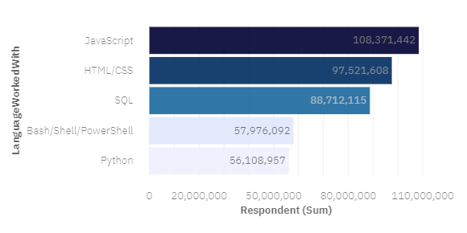
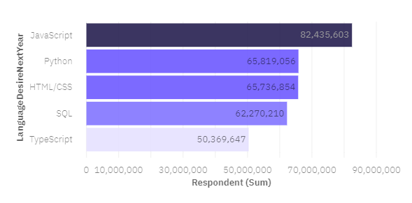
PROGRAMMING LANGUAGE TRENDS
Current Year
Next Year

Slide 8
PROGRAMMING LANGUAGE TRENDS - FINDINGS & IMPLICATIONS
Findings
JavaScript remains the top programming language this year and next year
Python(5th) is the 2nd most desired programming language for next year, up 3 places
PowerShell is out of the top 5 programming languages for next year
Implications
IT companies can continue to use JavaScript and excel in that languages.
IT companies can start to headhunt for people who are good in Python or provide necessary upgrading for employees.
PowerShell can be out of the language used for next year.

Slide 9
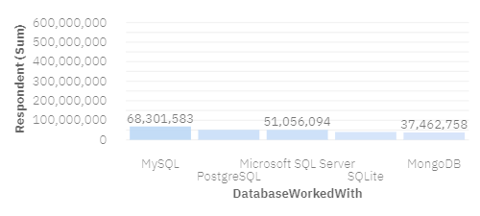
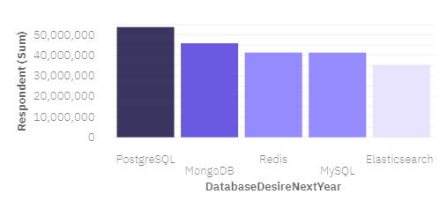
DATABASE TRENDS
Current Year
Next Year

Slide 10
DATABASE TRENDS - FINDINGS & IMPLICATIONS
Findings
MySQL(1st) dropped to the 4th desired database language for next year
PostgreSQL has become the top most desired database language for next year
There have been 2 new emerging database languages (Redis, Elasticsearch) for next year.
Implications
IT companies do not need to place extra emphasis on MySQL for next year.
IT companies can start to emphasis on PostgreSQL.
Further upgrading for employees can be done with the 2 new emerging database languages.

Slide 11

DASHBOARD
https://dataplatform.cloud.ibm.com/dashboards/549de569-379b-4f1b-85b2-216c600793e1/view/6c13f52707b30c9614cbe2e407982f057a372d5ab2bb8601d5877b4959327597f33b4695c82a420bdf450c37a0eb115898

Slide 12
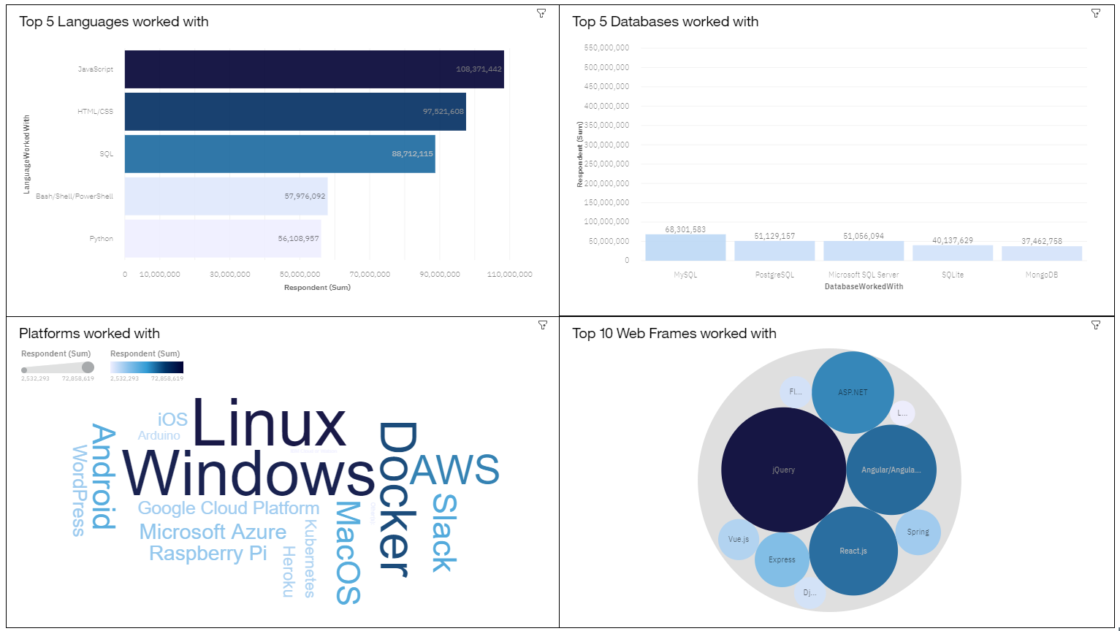
DASHBOARD TAB 1

Slide 13
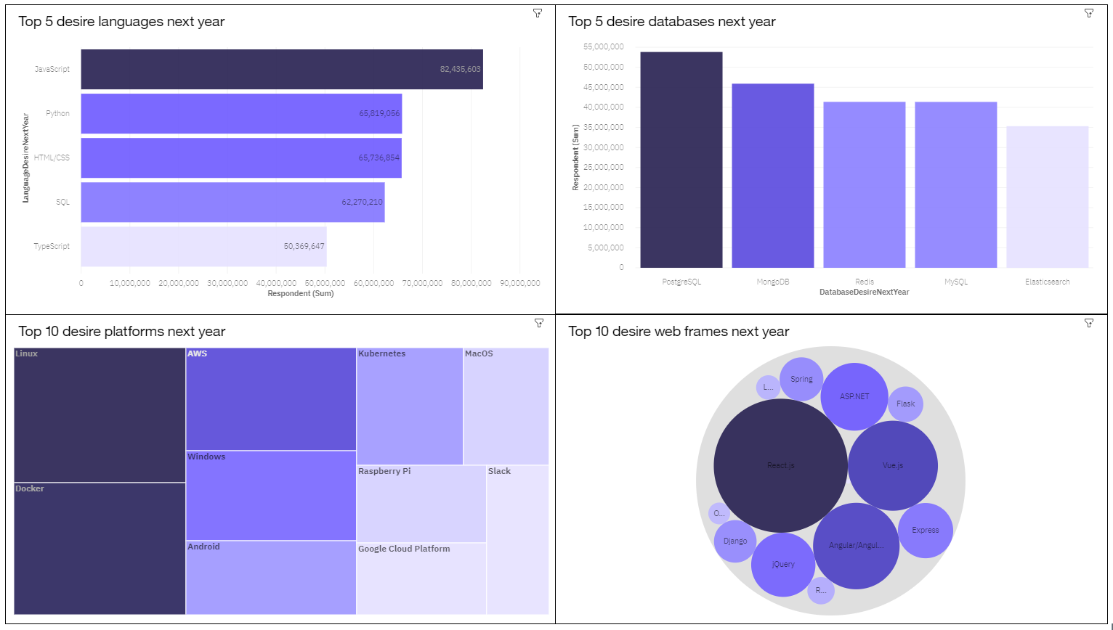
DASHBOARD TAB 2

Slide 14
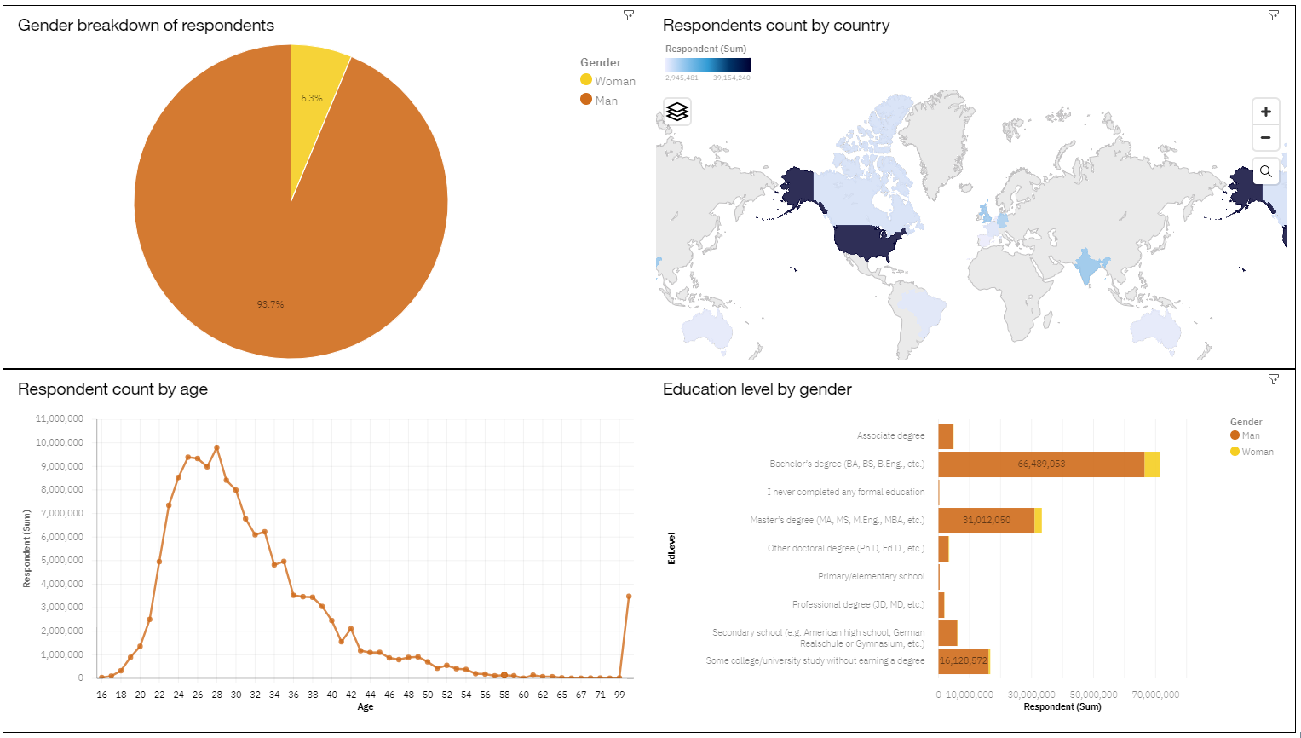
DASHBOARD TAB 3

Slide 15
DISCUSSION

Slide 16
OVERALL FINDINGS & IMPLICATIONS
Findings
There top language for this year and next year might varies.
With regards to using IT languages, there was an overwhelming response from the Males.
The age of the survey respondents were mainly between the 24 to 32 age group.
Implications
IT companies should diligently keep up with the trends in the competitive technology industry.
Large pool of people using the languages are male.
Headhunt efforts or upskilling opportunities can be focus on people within the concentrated age group.

Slide 17

CONCLUSION
Java script and Python are the emerging programming languages for next year
PostgreSQL and MongoDB are the emerging database languages for next year
Most of the survey respondents are Male aged between 24 and 32
This analysis focus mainly on the European and US countries.

Slide 18

APPENDIX

Slide 19
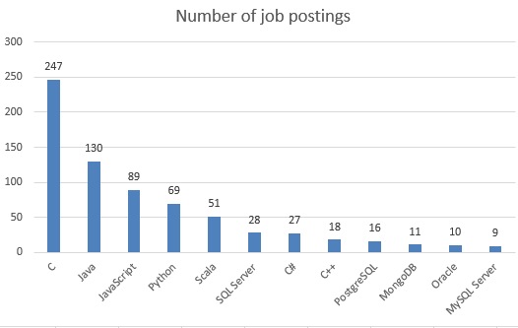
GITHUB JOB POSTINGS

Slide 20
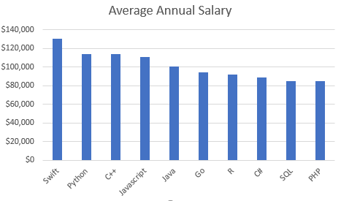
POPULAR LANGUAGES

