Slide 1
<Website Logo>
Login
Not a member? Sign up here
About
Discover
View Map
Planner
This website seeks to…
<insert more details here>
contact us at: abc@gmail.com
Notes:
Index.HTML Homepage

Slide 2
<Website Logo>
Login
Not a member? Sign up here
About
Discover
View Map
Planner
X
Login ID:
We are a bunch of uni kids doing our project….
<insert more details here>
contact us at: 999
Password:
Login
I forgot my password
Notes:
Login screen

Slide 3
<Website Logo>
Login
Not a member? Sign up here
About
Discover
View Map
Planner
Password Recovery
Login ID
Email
Reset
Notes:
Password recovery

Slide 4
<Website Logo>
Login
Not a member? Sign up here
About
Discover
View Map
Planner
Password Recovery
Login ID
Email
Reset
A password recovery is sent to account’s email address
Notes:
Password recovery confirmed

Slide 5
<Website Logo>
Login
Not a member? Sign up here
About
Discover
View Map
Planner
Register Account
First Name
Last Name
Date of Birth
Email
Notes:
Register part 1

Slide 6
<Website Logo>
Login
Not a member? Sign up here
About
Discover
View Map
Planner
LoginID
Password
Register
Notes:
Register part 2

Slide 7
<Website Logo>
Welcome, Jasper Yeo
View Rewards
Logout
About
Discover
View Map
Planner
We are a bunch of uni kids doing our project….
<insert more details here>
contact us at: 999
Notes:
Index.HTML Homepage

Slide 8
<Website Logo>
Welcome, Jasper Yeo
View Rewards
Logout
About
Discover
View Map
Planner
Type of places:
All
V
Soccer
<Insert details here>
Location: <here here here>
Basketball
<Insert details here>
Location: <here here here>
Softball
<Insert details here>
Location: <here here here>
Notes:
Discover main
*dont let them add events from discover or view map

Slide 9
<Website Logo>
Welcome, Jasper Yeo
View Rewards
Logout
About
Discover
View Map
Planner
Type of places:
All
V
Sports Facilities
Water Activities
Gym
Parks
Healthy Eateries
Soccer
<Insert details here>
Location: <here here here>
Basketball
<Insert details here>
Location: <here here here>
Softball
<Insert details here>
Location: <here here here>
Notes:
Discover Drop down

Slide 10
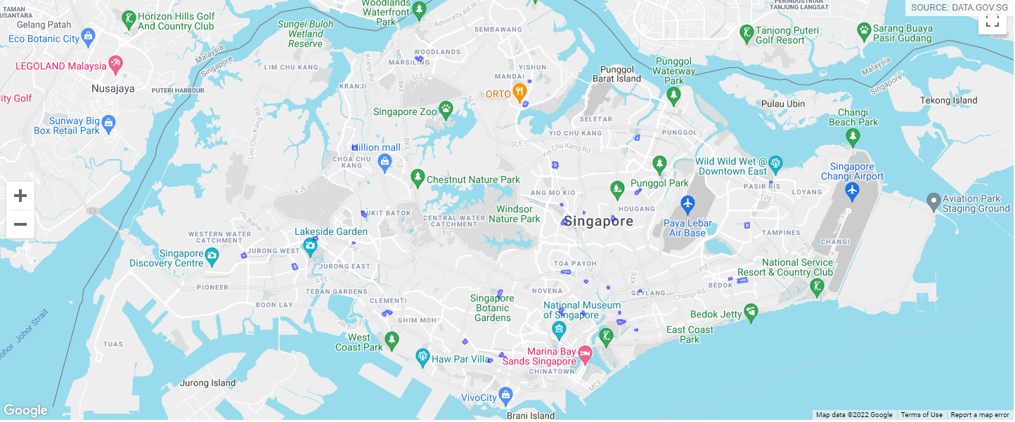
<Website Logo>
Welcome, Jasper Yeo
View Rewards
Logout
About
Discover
View Map
Planner
Type of places:
All
V
Overall
North
South
East
West
Nearby Me
Notes:
View map main

Slide 11
<Website Logo>
Welcome, Jasper Yeo
View Rewards
Logout
About
Discover
View Map
Planner
Type of places:
All
V
Sports Facilities
Water Activities
Gym
Parks
Healthy Eateries
Overall
North
South
East
West
Nearby Me
Notes:
View Map drop down

Slide 12
<Website Logo>
Welcome, Jasper Yeo
View Rewards
Logout
About
Discover
View Map
Planner
Type of places:
All
V
Overall
North
<Name and location of facility>
<Description of facility>
South
East
West
Add to my planner
Nearby Me
Notes:
View Map click on location

Slide 13
<Website Logo>
Welcome, Jasper Yeo
View Rewards
Logout
About
Discover
View Map
Planner
January 2022
Su | Mo | Tu | We | Th | Fr | Sa
26 | 27 | 28 | 29 | 30 | 31 | 1
2 | 3 | 4 | 5 | 6 | 7 | 8
9 | 10 | 11 | 12 | 13 | 14 | 15
16 | 17 | 18 | 19 | 20 | 21 | 22
23 | 24 | 25 | 26 | 27 | 28 | 29
30 | 31 | 1 | 2 | 3 | 4 | 5
Notes:
Planner page

Slide 14

<Website Logo>
Welcome, Jasper Yeo
View Rewards
Logout
About
Discover
View Map
Planner
3 January 2022 (Monday)
Morning Jogging
0900 - 1000
edit
Swimming
1600 - 1700
edit
new
Notes:
Planner page, day

Slide 15
<Website Logo>
Welcome, Jasper Yeo
View Rewards
Logout
About
Discover
View Map
Planner
Morning Jogging 3 January 2022, Monday, 0900 - 1000
Morning Jogging
3
January
2022
09:00
-
10:00
Save
Cancel
Notes:
Edit activities

Slide 16
<Website Logo>
Welcome, Jasper Yeo
View Rewards
Logout
About
Discover
View Map
Planner
New activity
Soccer at <location>
3
January
2022
09:00
-
10:00
Save
Cancel
Notes:
New activities

Slide 17
<Website Logo>
Welcome, Jasper Yeo
View Rewards
Logout
About
Discover
View Map
Planner
You have x points now.
Login everyday to get more points!
Do you know?:
-insert tip of the day here-
Notes:
Rewards page

Slide 18
<Website Logo>
Welcome, Jasper Yeo
View Rewards
Logout
About
Discover
View Map
Planner
My Particulars
Name:
Jasper Yeo
D.O.B:
27/09/1920
Email:
yoyoyoyo@gmail.com
Edit my information
Do you know?:
-insert tip of the day here-
Notes:
Profile Page
** I think we can dump the rewards page here?

Slide 19
<Website Logo>
Welcome, Jasper Yeo
View Rewards
Logout
About
Discover
View Map
Planner
Edit My Particulars
Name:
Jasper Yeo
D.O.B:
27/09/1920
Email:
yoyoyoyo@gmail.com
Do you know?:
-insert tip of the day here-
Save
Cancel
Notes:
Edit particulars page

