Slide 1
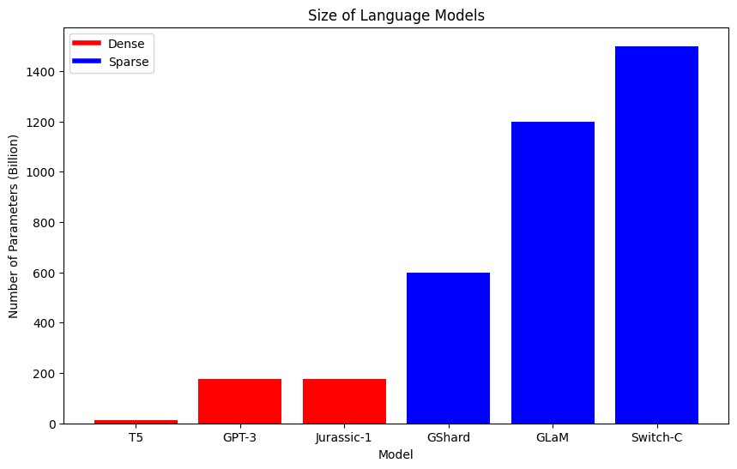
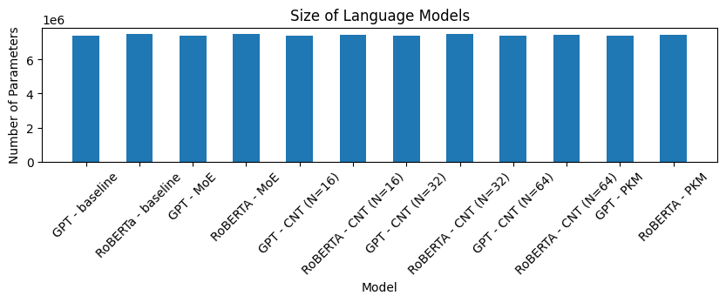
Sparse feedforward network in small language models
Yijun Wu
Y.Wu-55@student.tudelft.nl
Supervisors: Aral de Moor, Mali Izadi
Research question
Method
Results
Languages are getting bigger and better. More parameters leads to higher learning capacity, hence better performance.
Recently transformers scaled pass trillions of parameters thanks to sparsity. However, these giant language models are compared to much smaller baselines [1].
The baselines for this project are GPT-Neo [2] and RoBERTa [3]. This research focuses on small language models (<10M parameters) because they can be trained with university budget.
All models are pre-trained on the TinyStories dataset [4], which teaches small language models the English grammar without too much domain knowledge.
Grammatic knowledge is evaluated using the BabyLM pipeline (BLiMP, SuperGLUE, MSGS) [5].
Coming soon 🤞
Is sparsity just a hack to increase the number of parameters without extra computational cost, or does it intrinsically improve learning capacity?
Conclusion
Limitations
All models are pretrained for just 2 epochs due to limited computing budget. Similarly, hyperparameters search was not conducted. Hyperparameters are chosen for based on training time rather than on performance.
All models studied have around 7.5M parameters, and so it is still unclear how sparsity intrinsically impacts performance for larger models.
Coming soon 🤞
References
[1] N. Du et al., “GLaM: Efficient Scaling of Language Models with Mixture-of-Experts,” ArXiv, vol. abs/2112.06905, 2021.
[2] S. Black, L. Gao, P. Wang, C. Leahy, and S. Biderman, GPT-Neo: Large Scale Autoregressive Language Modeling with Mesh-Tensorflow. Zenodo, 2021. doi: 10.5281/zenodo.5297715.
[3] Y. Liu et al., “RoBERTa: A Robustly Optimized BERT Pretraining Approach,” arXiv preprint arXiv:1907.11692, 2019.
[4] R. Eldan and Y. Li, “TinyStories: How Small Can Language Models Be and Still Speak Coherent English?,” 2023.
[5] Warstadt, A., et al. "Call for Papers – The BabyLM Challenge: Sample-efficient pretraining on a developmentally plausible corpus," in Computing Research Repository, vol. arXiv:2301.11796, 2023.

Slide 2
Research Question
Architectural Decisions for Language Modelling with (Small) Transformers
State of the art transformers are big and sparse.
Are they state of the art because they are big? Or does sparsity also contribute to performance?
If sparse models are more efficient at using their parameters, we can sparsify small language models too..

Slide 3
Quote
So what’ taking me so long?

Slide 4
Stuff done 🤙
Pinpointed the research question.
Literature review.
Implemented all models and pretraining (can run locally)
Set up the work environment on DelftBlue & Ronaldo (but haven’t tested pretraining script yet)
Skeleton/bullet points for the paper up to the results

Slide 5
TODOs 💀
Run pretrain
Suss out the evaluation pipeline dependencies
Run evaluation pipeline
Select interpretability technique
Interpret evaluation results
Write paper

