Slide 1
No weekends (G6-T3) Supervisor Meeting 1
Team Member:
Wilson He (PM), Cristabel Lau, Quek Yew Kit, Ming Kwang, Eugene Tan

Slide 2
Agenda
Progress for past 2 weeks
Who did what?
Current Progress (Iteration 2)
Goal for next 2 weeks
Metrics
Problems Encountered

Slide 3
Progress for past 2 weeks
Iteration 1 (Week 5):
Project Schedule Planning (All Iteration, Manhour breakdown, PM and PP Planning)
Design of all diagrams
- Use Case Diagram
- Logical Diagram
- Class Diagram
- Sequence Diagram
Iteration 1: 20 days, 15 non-programming tasks in total

Slide 4
WHO DID WHAT?
Iteration 1 (Week 5)
Everyone work together to discuss how each functions are going to work. This involved the planning and diagram design of project.
Iteration 2 (Week 6)
Ming Kwang and Eugene Tan
Create database in MySQL, database SQL file and Connection Manager function
Design login UI, student home page and admin page
Coding of Login and Logout Function
Testing and debugging of view all course and search for a course function
Cristabel Lau / Quek Yew Kit
Design View All Course Page
Coding of View All Courses and Search for a course function
Testing and debugging of View All Course and Search for a course function

Slide 5
Current progress (Iteration 2)
Currently on track ☺
5 days, 12 non-programming tasks
Completed 3 programming tasks out of 9 programming tasks
Total number of tasks left: 18 out of 21

Slide 6
CURRENT PROGRESS (Iteration 2)
Tuesday 20 Sept 2016 | Wednesday 21 Sept 2016 | Thursday 22 Sept 2016 | Friday 23 Sept 2016 | Saturday 24 Sept 2016
Completed Create database in MySQL, database SQL file and Connection Manager function Design of login UI, student home page and admin page Coding of login and logout function | To be completed: Design View all courses page Testing and debugging of login / log out function with test cases |  | Search for a course function | Testing and debugging of View All Course function with test case Testing and debugging of Search for a course function with test cases Administration tasks Update metrics, etc Presentation slide for PM Review
 | Coding of View All Courses function

Slide 7
GOAL FOR NEXT 2 weeks
Project Manager: Tan Ming Kwang
Milestone: PM Review (Week 7)
Iteration 3
Design & Coding (Week 7):
Bootstrap
Bidding Cart and Bid for Section
Drop a Bid
Design & Coding (Week 8):
View User Enrolled Courses
Drop a Section
Start / Clearing Rounds
View Bidding Results

Slide 8
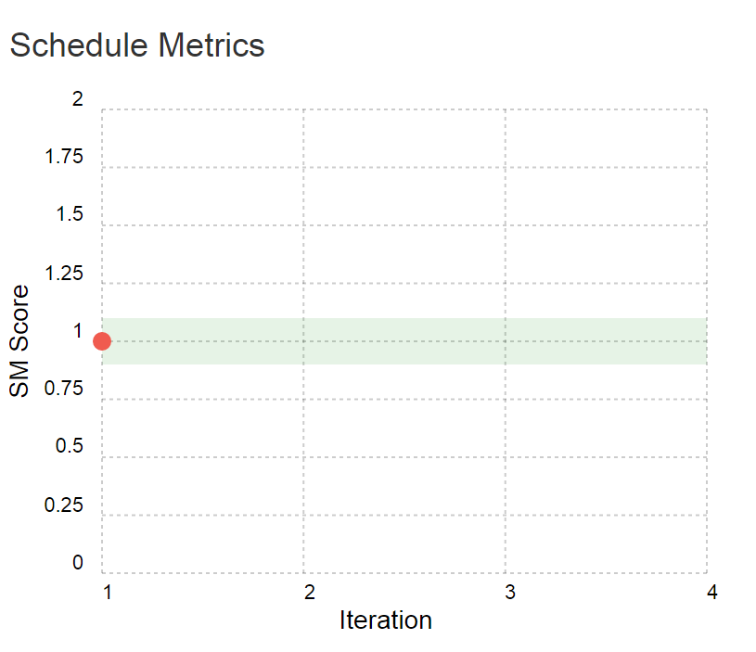
METRICS

Slide 9
METRICS
15 tasks

Slide 10
METRICS
No action required ➔ 50 < PPM <= 150

Slide 11
METRICS
Bug Metrics
Not available because our schedule for testing and debugging is scheduled today after supervisor meeting

Slide 12
Problem ENCOUNTERED
Unfamiliar on how to use PPLog thus causing iteration 1 to be backdated.
Testing and debugging function concerns

Slide 13
THANK YOU ☺

