Slide 1
No weekends (G6-T3) Supervisor Meeting 2
Team Member:
Wilson He , Cristabel Lau, Quek Yew Kit(PM), Ming Kwang, Eugene Tan

Slide 2
Agenda
Progress for past 2 weeks
Current Progress
Goal for Next 2 weeks
Role and Responsibilities
Metrics
Problems / Threats

Slide 3
Progress for past 2 weeks
Iteration 4 (Week 9):
JSON functional requirements
Authenticate Web Service
Delete bid Web Service
Drop Section Web Service
Bootstrap Web Service
Dump User Web Service
Dump Bid Web Service
Testing and debugging all JSON functions
Student timetable function

Slide 4
Progress for past 2 weeks
Iteration 4 (Week 10):
Testing and debugging bulk of the JSON functional requirements
Student timetable function

Slide 5
CURRENT PROGRESS
Completed all the JSON requirements as per schedule
To finish all regression testing by this Saturday, 29 October 2016.
Deployment onto AWS before UAT
Scheduled testing sessions after deployment
Currently on track
-Had to push forward a debugging session for JSON Update bid

Slide 6
GOAL FOR NEXT 2 weeks
Project Manager: Quek Yew Kit
Milestone: PM Review (Week 11)
UAT
Iteration 5
Regression Testing
Debugging JSON Update Bid
Deployment on AWS
Testing of project after AWS

Slide 7
Role and responsibilities
Iteration 5 (Week 11)
Regression testing has been split equally between both programming pairs
Debugging of JSON update bid has been completed
Planned to deploy to AWS together
Iteration 5 (Week 12)
Testing and debugging after UAT together

Slide 8
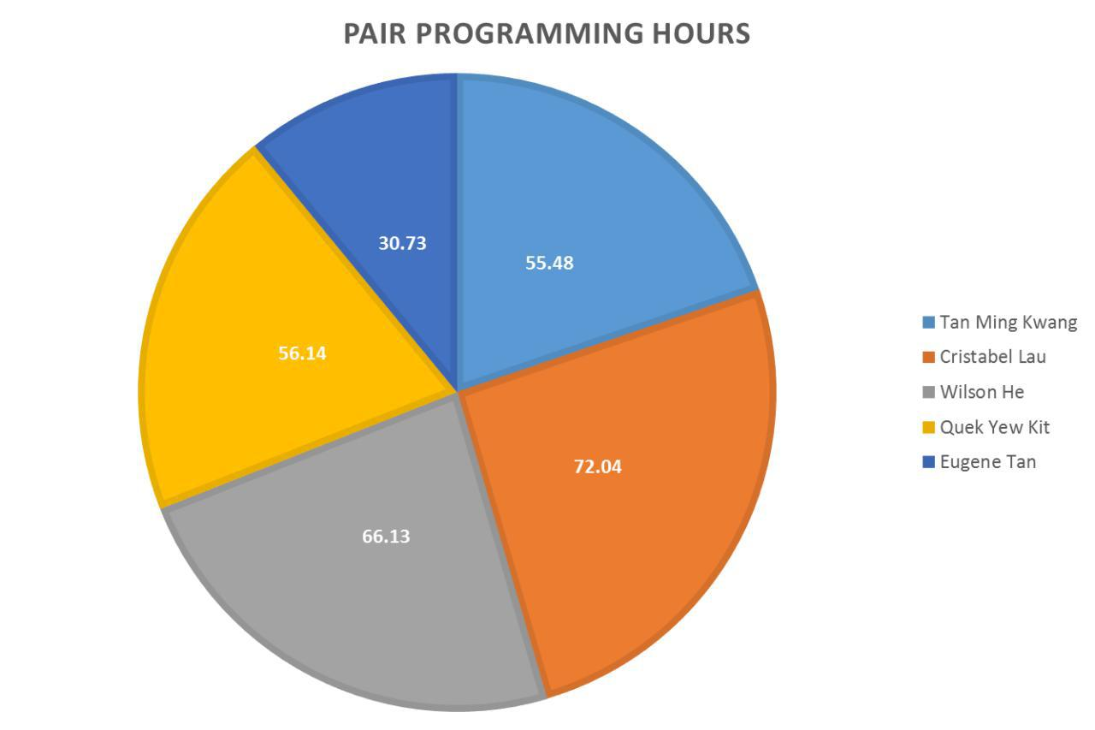
Pair Programming HouRS

Slide 9
COMMITS

Slide 10
METRICS
1.0
0.98

Slide 11
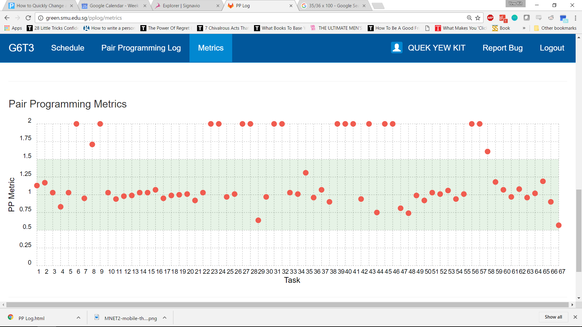
METRICS

Slide 12
Bug METRICS

Slide 13
Mitigation plan
Bug metrics of > 10
Have to be more wary of the requirements for each validation
Schedule more time for debugging depending on the type of JSON function
Number of validations required for each function

Slide 14
THANK YOU ☺

