Slide 1
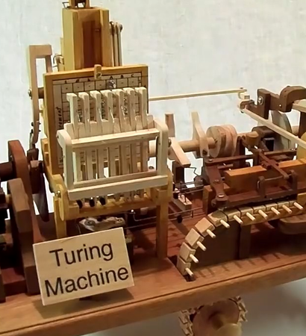

Introduction to
Computer Science Theory
Notes:
Hi, I’m Mark Erickson, and I’ve been working with computers for a long time, performing many different roles throughout my career. I’m pretty deep in the MS stack, which used to be kinda meh but now is kinda cool, largely due to Satya Nadella’s leadership over the last decade.
I moved here in '03 for grad school and never left 'cause Eugene is a powerful vortex. I'm currently at PacificSource Health Plans and am focused on DevOps, APIs: development, management, and security, what makes an API good, Azure / On-prem hybrid infrastructure, process improvement, and, of course, C# and dotnet.
Describe your job poorly:
“I flip bits until the machine does what I want“
I am here today to talk to you about foundational CS Theory

Slide 2
Maths?
Proofs
Contradiction
Induction
The Halting Problem
Machine models and grammars
Finite state automata
Push down automata
Turing Machines
Mr. Alan Turing
Turing Test
ChatGPT
Decidability & Computability
Time (and Space) Complexity
n notation
Big O, Theta
P and NP
Millennium Prize (one million dollars!)
SAT & NP Completeness
What’s Important?
Key Takeaways
There are large numbers of problems that are unsolvable even with a computer with infinite time and memory
SAT is the primary “hard” problem
Everything is a trade-off
Time / Space
Clarity of language / Performance
Understanding when you are trying to do something that is actually hard
Find a good algorithm!
Identifying bottlenecks
Numbers every programmer should know (hint: It’s probably the network)
Why Cryptography works
Cyphers vs Machine Power
Quantum Computers
Still don’t really work
Implications for Cryptography
Molecular Engineering
Notes:
Whoa, that’s a lot.

Slide 3
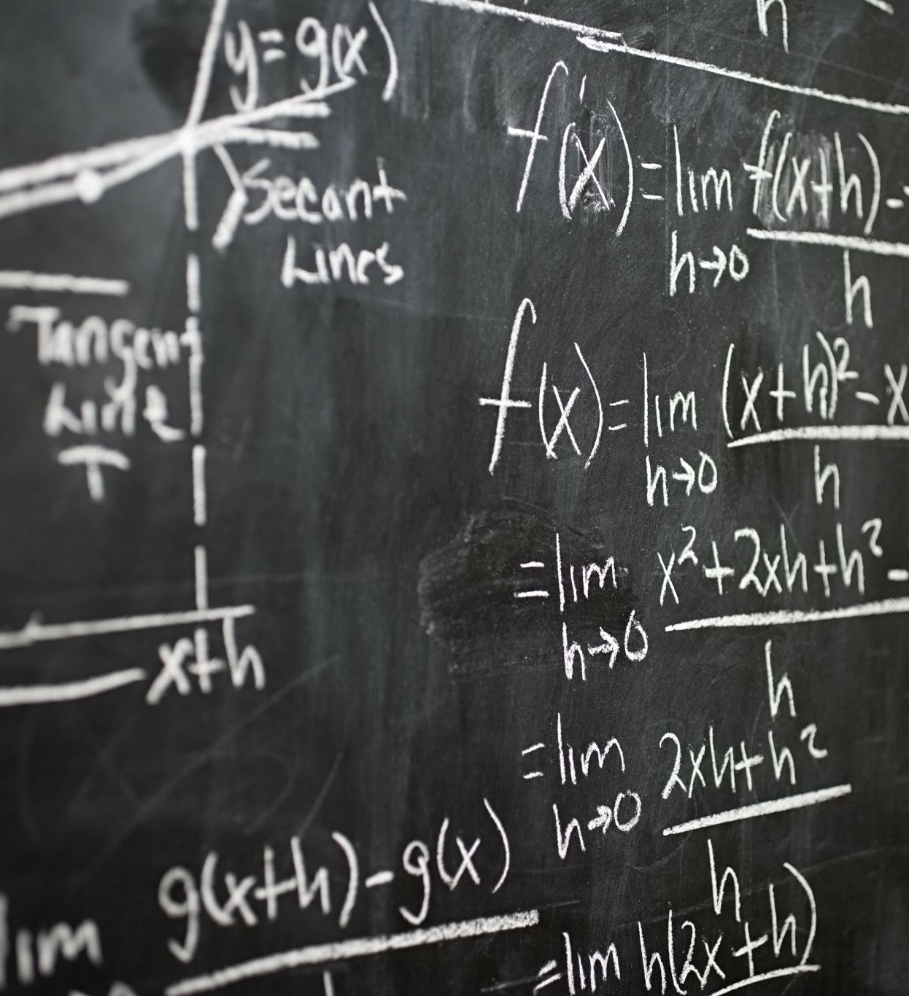
In computational theory,
does P = NP?
Notes:
I ask this of everyone I interview.

Slide 4
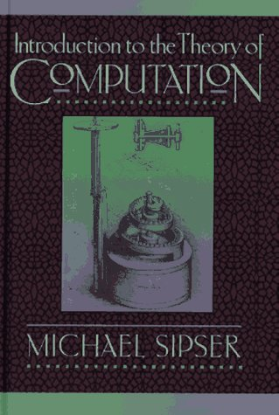
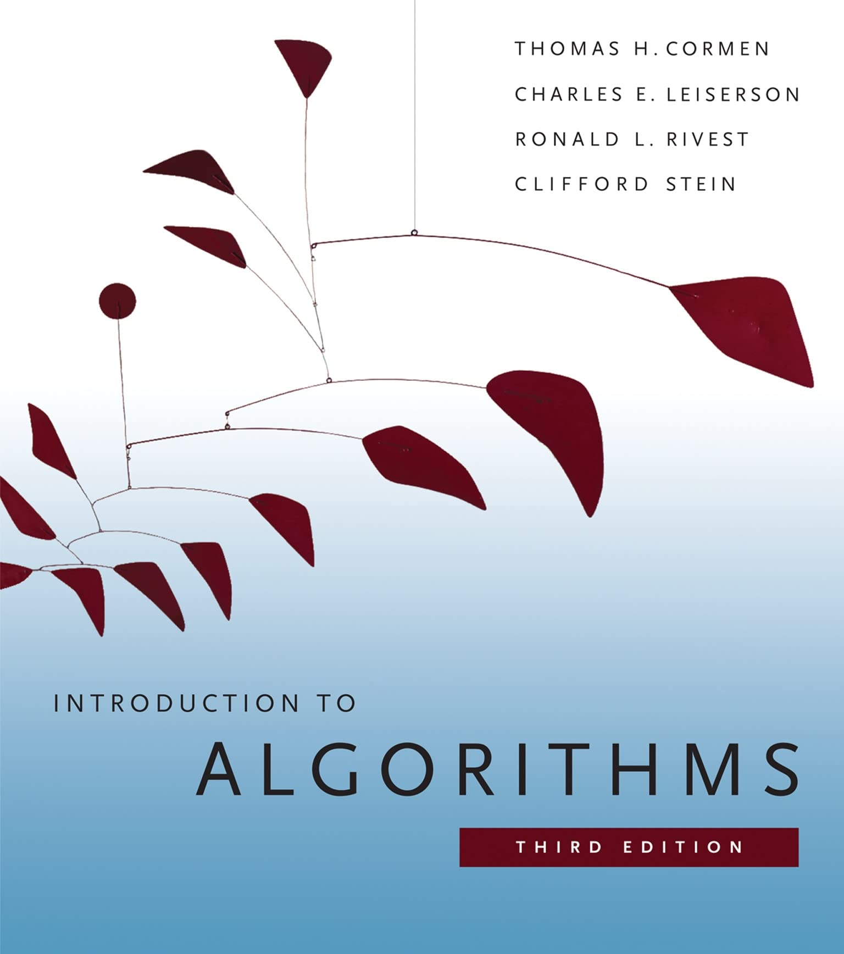
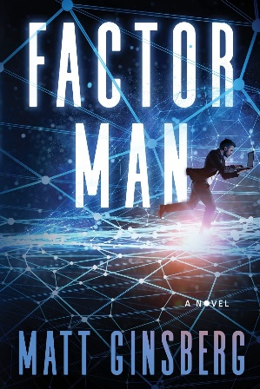
Sources
And a whole lot of gratuitous Wikipedia theft…
Notes:
I swear these two books are most of a formal education in CS.
Professor John Rager @amherst
Professor Eugene Luks @UO
Dr Matt “P=NP” Ginsberg @himself
Most links are to wikipedia

Slide 5
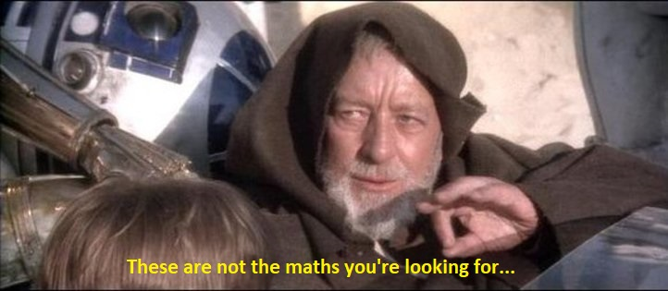
Maths?
Notes:
All theory is math
Grey backed slides we’re waving hands.
Black backed slides are what’s important.

Slide 6
Proofs
Contradiction
The proposition to be proved is P.
We assume P to be false, i.e., we assume ¬P.
It is then shown that ¬P implies falsehood. This is typically accomplished by deriving two mutually contradictory assertions, Q and ¬Q, and appealing to the Law of noncontradiction.
Since assuming P to be false leads to a contradiction, it is concluded that P is in fact true.
Induction
The simplest and most common form of mathematical induction infers that a statement involving a natural number n (that is, an integer n ≥ (0 or 1)) holds for all values of n. The proof consists of two steps:
The base case (or initial case): prove that the statement holds for 0, or 1.
The induction step (or inductive step, or step case): prove that for every n, if the statement holds for n, then it holds for n + 1. In other words, assume that the statement holds for some arbitrary natural number n, and prove that the statement holds for n + 1.
The hypothesis in the induction step, that the statement holds for a particular n, is called the induction hypothesis or inductive hypothesis. To prove the induction step, one assumes the induction hypothesis for n and then uses this assumption to prove that the statement holds for n + 1.
Authors who prefer to define natural numbers to begin at 0 use that value in the base case; those who define natural numbers to begin at 1 use that value.
Notes:
Examples of well-known proofs by contradiction:
Euclid’s Elements
If two angels of a triangle are equal, then the sides opposite are also equal
Infinitude of Prime Numbers
Irrationality of the square root of 2
Examples of proof by induction:
Sum of consecutive natural numbers n > 0 = n(n+1)/2
Fibonacci numbers
Prime factorization – “Every natural number greater than 1 is a product of (one or more) prime numbers.”

Slide 7
The Halting Problem
In computability theory, the halting problem is the problem of determining, from a description of an arbitrary computer program and an input, whether the program will finish running, or continue to run forever. Alan Turing proved in 1936 that a general algorithm to solve the halting problem for all possible program–input pairs cannot exist.
Informal Proof concept
Christopher Strachey outlined a proof by contradiction that the halting problem is not solvable.^{[26][27]} The proof proceeds as follows: Suppose that there exists a total computable function halts(f) that returns true if the subroutine f halts (when run with no inputs) and returns false otherwise. Now consider the following subroutine:
halts(g) must either return true or false, because halts was assumed to be total. If halts(g) returns true, then g will call loop_forever and never halt, which is a contradiction. If halts(g) returns false, then g will halt, because it will not call loop_forever; this is also a contradiction. Overall, g does the opposite of what halts says g should do, so halts(g) can not return a truth value that is consistent with whether g halts. Therefore, the initial assumption that halts is a total computable function must be false.
def g():
if halts(g):
loop_forever()
Notes:
Does a program run forever or not?
You’ve probably accidentally stumbled on this if you’ve done any recursive programming ;)
Informal proof by contradiction
Consider the following while loop:
While (n < 100)
{
n++
}
If n starts less than 100, it will finish. But if n starts > 100, it’ll run forever (until it blows up all available memory).
The critical bit of the halting problem is that it’s generalized – for *all* inputs for a given program
Most general is for all imput program pairs, proved cannot exist by Mr Turing in ‘36

Slide 8
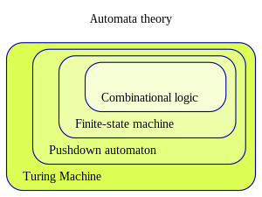
Machine models
Grammars
Machine models are Mathematical Formalizations of what constitutes a computer or a program and what inputs it accepts or recognizes.
Grammars are ways of expressing what a program can “solve.” They are generally represented as a set of possible inputs of letters and numbers, with a corresponding subset that the program recognizes or accepts.
Rather like Regex.
Notes:
The more powerful the memory we have, the more subsets of the input we can identify (solve more problems)

Slide 9
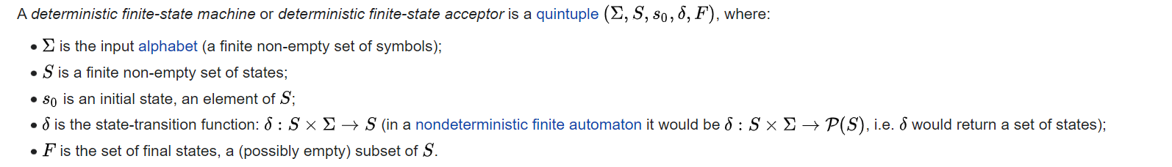
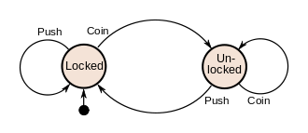
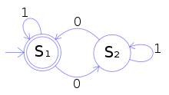

Finite State Automata
A representation of a computing machine with no memory, only state
An example of an accepting state appears in Fig. 5: a deterministic finite automaton (DFA) that detects whether the binary input string contains an even number of 0s.
Notes:
cardinality
Old school traffic lights are another good example

Slide 10
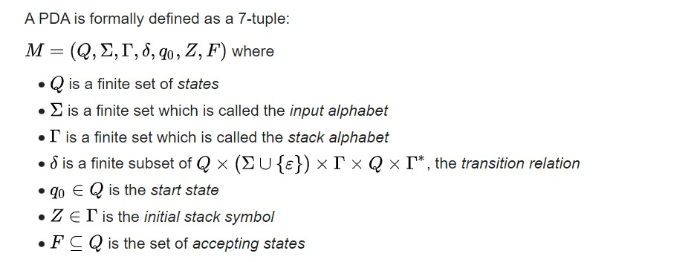
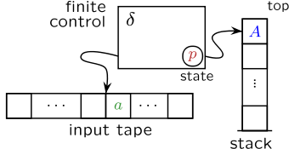
Push Down Automata
A representation of a computing machine with an infinite stack for memory
Notes:
Essentially, an FSA + a stack
It’s not as relevant now, as this isn’t how memory most memory works.
Let you count so it can recognize a string with the same number of 1s and 0s
Memory (or data structures) that can’t seek can’t do as much but are way more efficient.

Slide 11
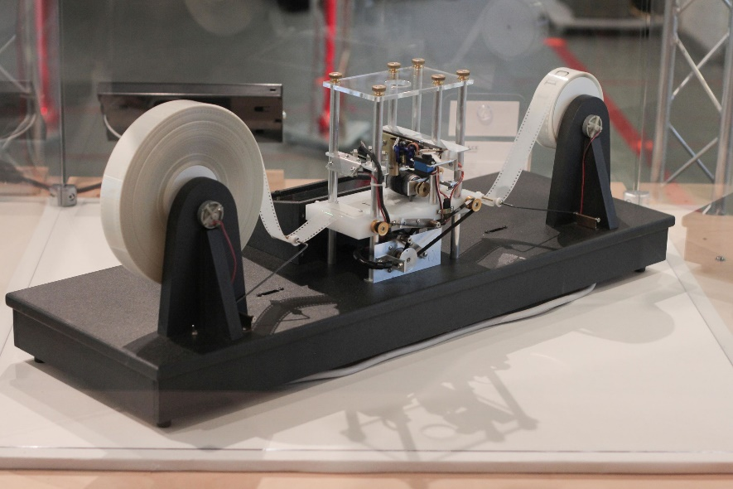
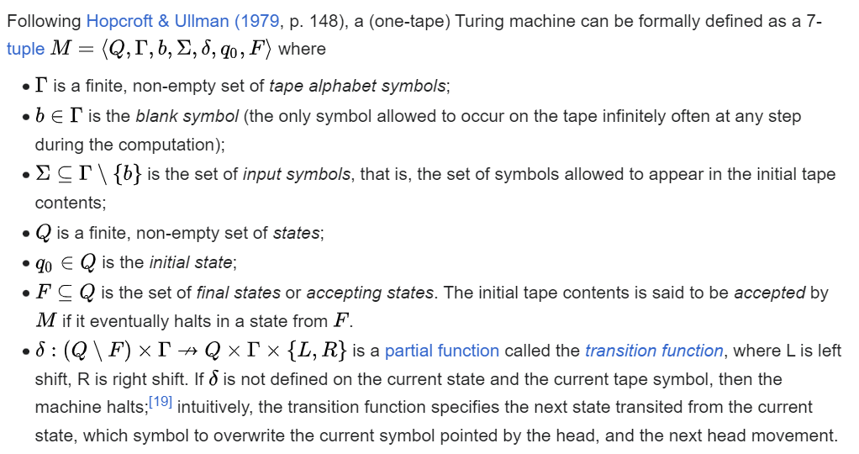
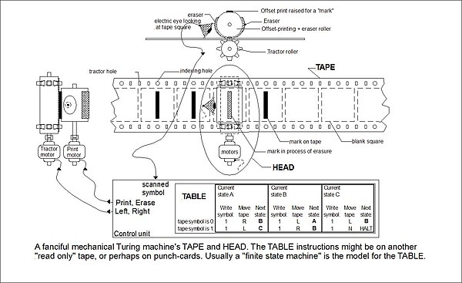
Turing Machine
A representation of a computing machine with an infinite memory tape
...an unlimited memory capacity obtained in the form of an infinite tape marked out into squares, on each of which a symbol could be printed. At any moment there is one symbol in the machine; it is called the scanned symbol. The machine can alter the scanned symbol, and its behavior is in part determined by that symbol, but the symbols on the tape elsewhere do not affect the behavior of the machine. However, the tape can be moved back and forth through the machine, this being one of the elementary operations of the machine. Any symbol on the tape may therefore eventually have an innings — Turing 1948
Notes:
A computing machine with infinite memory and infinite time!
This representation is capable of implementing *any* computer algorithm
Why do we call this a Turing machine…

Slide 12
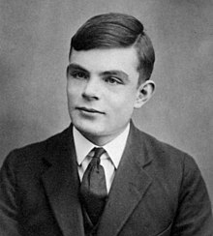
Mr. Alan Turing Legend
Father of essentially all theoretical computer science and artificial intelligence, massive influence in cryptography
Broke the Enigma machine cipher, making him likely the largest personal contributor to the Allied victory in WWII
Designed the Automatic Computing Engine (ACE), which is one of the first designs for a stored-program computer
Some of his work on cryptographic methods wasn’t declassified until 2012!
Formulated what became the Turing Test, which has been the “line” for AI for the last half-century+.
ChatGPT is the first legit pass.
Prosecuted for Homosexual acts in 1952, was “chemically castrated” - forced hormonal treatment
Committed suicide in 1954 by ingesting cyanide
Official public apology in 2009, pardoned in 2013
On the Bank of England’s £50 note since 2021
Notes:
His influence on computer science cannot be overstated.
This guy is to CS like Darwin to Biology. Isaac Newton to classic physics. He’s a Hero of mine.
Proved halting problem in ’36, well before we had computers. Designed a stored program computer before we could build it.
Part of an elite team of code-breakers at Bletchley Park. Cracked the enigma machines with the world’s first programmable digital electronic computers – Colossus. He truly won the war, even more than Oppenheimer, Eisenhower, Churchill, or Patton. D-Day probably would have failed without their efforts.
We knew what the Germans were sending on their “unbreakable” code machine for the most of the war! We even faked missions to go after the wrong targets to protect the fact that we knew what they were saying to each other.
Turing Test
ChatGPT
Do better, humans.

Slide 13
Decidability
Computability
In logic, a true/false decision problem is decidable if there exists an effective method for deriving the correct answer
According to the Church–Turing thesis, computable functions are exactly the functions that can be calculated using a mechanical calculation device given unlimited amounts of time and storage space
Notes:
Decidability ~ the Halting Problem
Computability = what is solvable with infinite time and memory

Slide 14
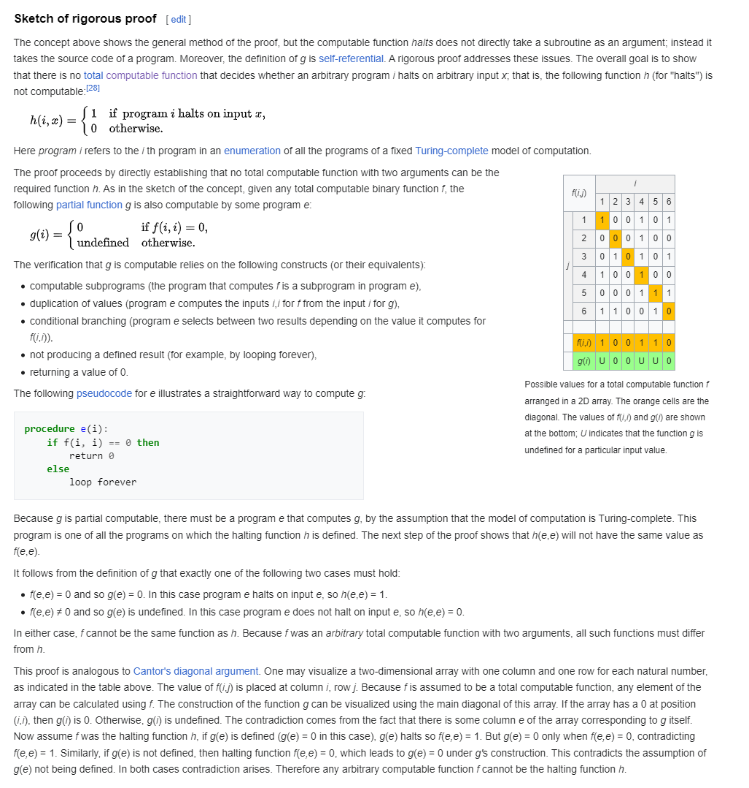
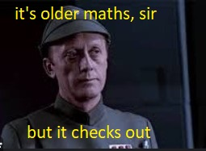
The Halting Problem - Redux
Notes:
Keep in mind, this is what Mr. Turing proved in ‘36 before there were any computers. 90 years ago!
The proof is very similar to Cantor’s diagonal argument, proving that there are way more real numbers than there are natural numbers (e.g., real numbers aren’t countable.)

Slide 15
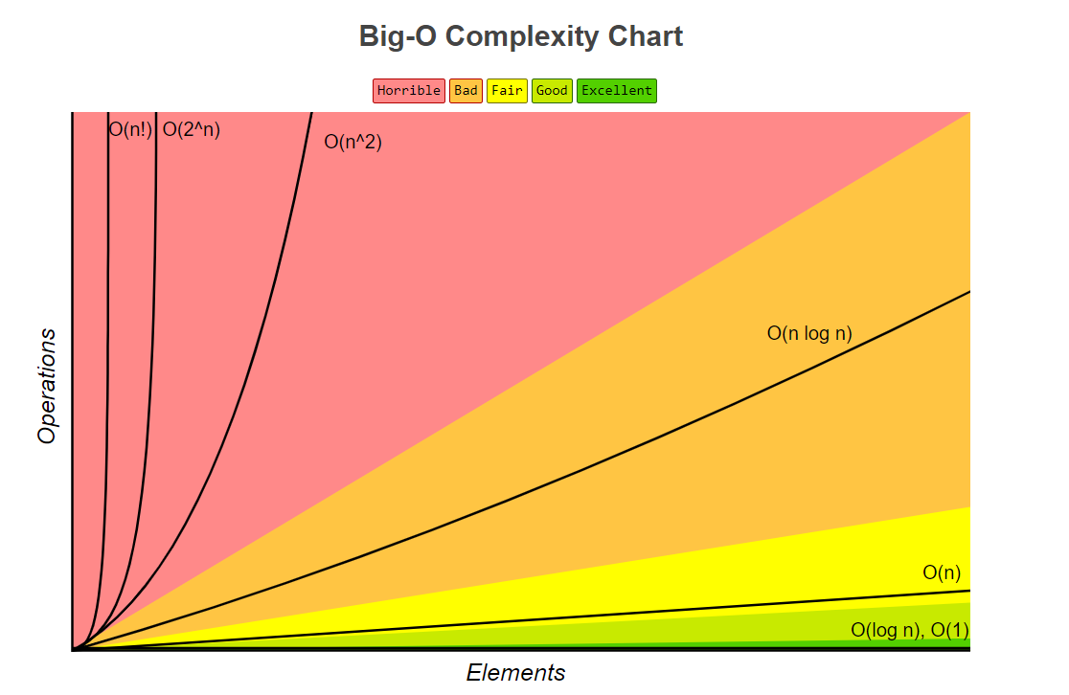
Time (and Space) Complexity
How we measure the performance of an algorithm
Algebraic in relation to the size of the input, which we call “n”
Examples: n!, 2^{n}, n², n log(n), n, log(n), 1
Big O – O(g(n))
Upper Bound
Omega – Ω(g(n))
Lower Bound
Theta – θ(g(n))
Tight Bound
Notes:
Input varies by problem space
Consider sorting algorithms; n is the number of things to sort
https://www.bigocheatsheet.com/

Slide 16
P and NP
The P versus NP problem is a major unsolved problem in theoretical computer science. In informal terms, it asks whether every problem whose solution can be quickly verified can also be quickly solved.
The informal term quickly, used above, means the existence of an algorithm solving the task that runs in polynomial time, such that the time to complete the task varies as a polynomial function on the size of the input to the algorithm (as opposed to, say, exponential time). The general class of questions for which some algorithm can provide an answer in polynomial time is "P" or "class P". For some questions, there is no known way to find an answer quickly, but if one is provided with information showing what the answer is, it is possible to verify the answer quickly. The class of questions for which an answer can be verified in polynomial time is NP, which stands for "nondeterministic polynomial time".
P time complexity:
5n³ + n² + 3n + 1
n³
NP time complexity:
2^{nn}
n!
5^{n} + 5n³ + n² + 3n + 1
2^{n}
Notes:
Sudoku
Graph coloring
Traveling Salesman
First formalized in early 70s

Slide 17
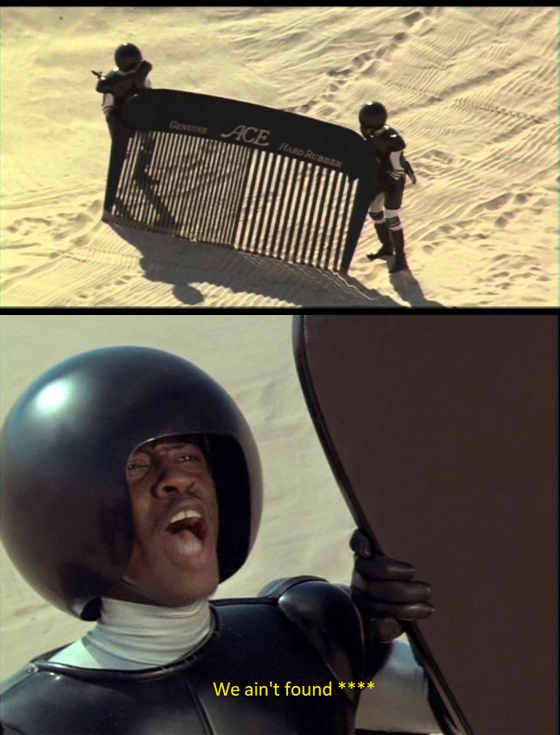
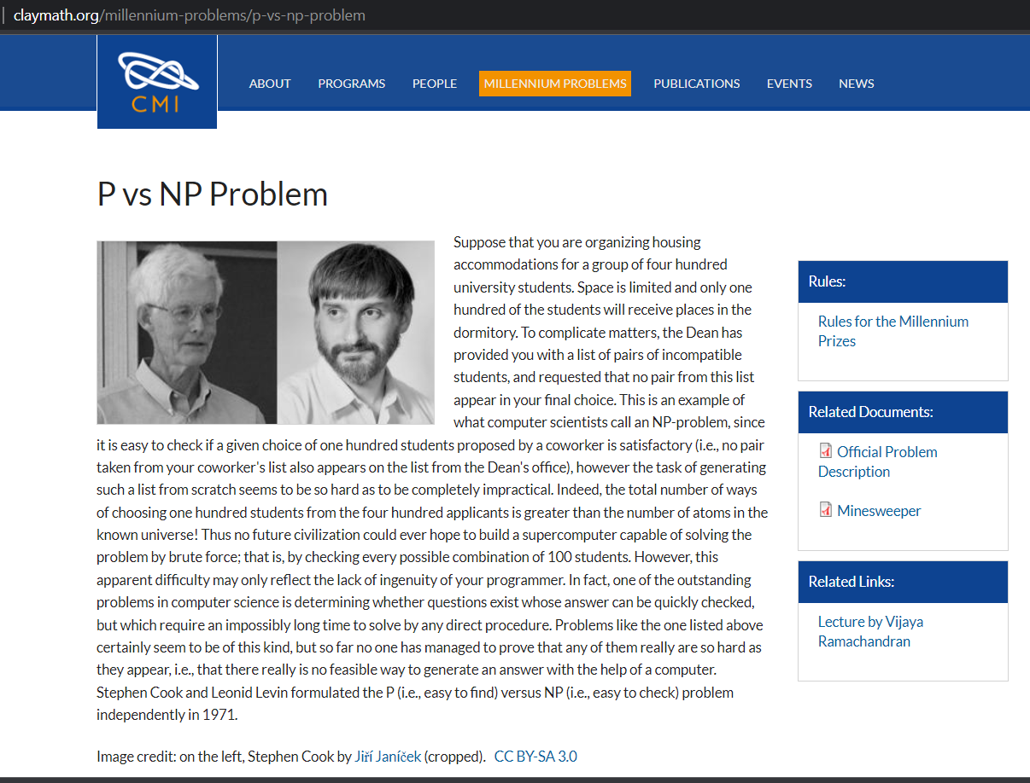
So, how’s it going?
Notes:
One Million Dollars!!
(and you’d toss the world into chaos.)
http://www.claymath.org/millennium-problems/p-vs-np-problem
Why I ask folks I interview this

Slide 18
SAT and NP Complete
Given a Boolean formula, is there an assignment of truth values such that the entire formula is true?
Generally, we talk about 3-SAT in conjunctive normal form:
( A ∨ B ∨ C) ∧ (-A ∨ D ∨ C) ∧ (B ∨ -D ∨ E)………
First NP-Complete problem, which means that any other NP problem can be reduced to SAT
Reducibility: there exists a polynomial time transformation from one NP problem to any known NP-complete problem
Davis-Putnam-Logemann-Loveland (DPLL) algorithm
Time complexity: O(2^{n})
Notes:
A series of OR clauses joined by AND. Can define most constraints (and thus most problems) this way.
Worked on a group theoretical SAT solver in grad school (Heidi Dixon’s PhD)
Reducibility = polynomial time transformation

Slide 19
Intermission
Notes:
Can we play Tool’s intermission here?

Slide 20



Key Takeaways from CS Theory
There are large numbers of problems that are unsolvable even with a computer with infinite time and memory
Generally, things with sub-exponential time are considered solvable or easy
SAT is the key “hard” problem, and a polynomial time solution to it can be generalized to any NP problem
Everything is a trade-off

Slide 21

Everything is a trade-off
Time vs Space
Hashing functions
Look up tables
Chinook, the first master-level checkers program
Clarity of a programming language vs Performance
C#
C
Python
Clean Code vs Tech Debt
You didn’t really think Mark would get through a whole talk without a reference to clean code, did you?

Slide 22
Identify when you are approaching exponential time
If something works well on a small input but grinds on medium / larger inputs, that’s a tell
Takes practice and experience to build good intuition, but an understanding of theory helps
Look for a good algorithm – it’s probably out there
Notes:
Most of the time you don’t need any of this. The vast majority of software is “easy” algorithmically.
Traveling salesman
Sudoku

Slide 23
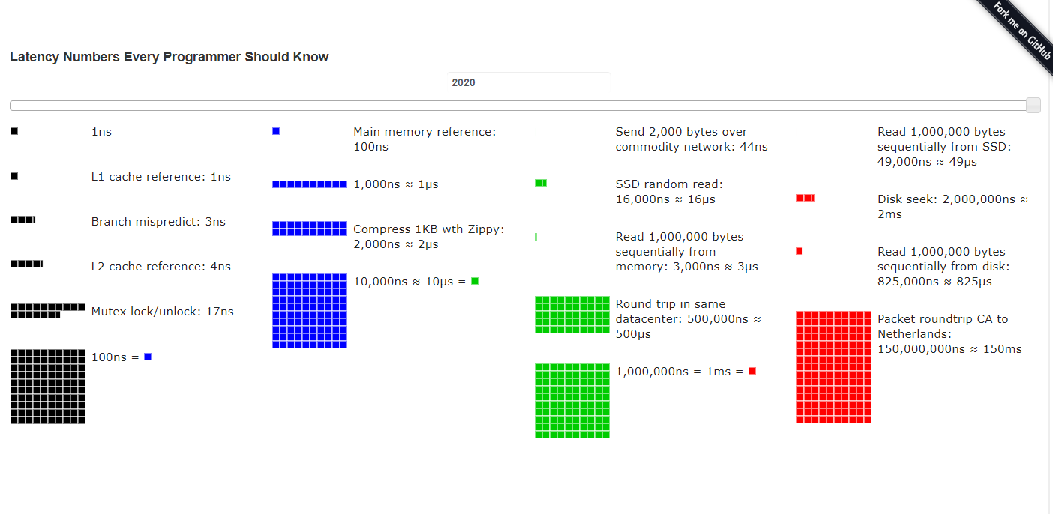
Identifying Bottlenecks (it’s probably the network)
https://colin-scott.github.io/personal_website/research/interactive_latency.html
Notes:
https://colin-scott.github.io/personal_website/research/interactive_latency.html

Slide 24

Cryptography
Most cryptographic keys are based on some “hard” (NP) problem
Prime Number Factorization
NP, but suspected not NP-complete
Time complexity of best-known algorithm:
RSA public key encryption
Discrete Logarithms
Hashes
MD5, SHANP-complete
Notes:
Cryptography is essentially just P != NP: hard to solve, easy to check

Slide 25

Quantum Computing
Uses qubits instead of bits
Not just 0 or 1
Many are in production or built, but they still don’t really work
Google, Microsoft, IBM, USTC
Can solve prime factorization, thus breaking most cryptography
We’ve figured out cryptographically secure methods on quantum computers….
But none of them are in use as they are far too expensive
Still a Turing Machine!
Huge potential for advancements if they ever work
Molecular Engineering
Agriculture
Medicine
Notes:
I have a grasp of the physics of a bit (0/1) computer. I cannot say the same about a quantum computer. Loosely, instead of bits, it has a range of electrons in various orbital states, allowing it to perform calculations on multiple possible inputs at once.

Slide 26
Discussion

