Slide 1
Avocado Price Predictions

Slide 2
List of Content
Business Problem
Data Question
Data Gathering
Data Preparation
Data Insights
Data Modeling
Conclusion
Next Steps

Slide 3
Business Problem
A local fruit smoothie business owner has lamented that the margin from avocado milkshakes is not stable and causes him to lose profits when he runs promotion
The owner wants to know how can they price their product better and also when would it be a better time to run promotion.

Slide 4
Data Question
What are the factors affecting avocado prices
How can we build a model to predict the prices of avocado

Slide 5
Data Gathering
Historical data on avocado prices and sales volume in multiple US markets from 2015-2020 (Kaggle)
The origin of the source data is from Hass Avocado Board

Slide 6
Data Preparation
Data type conversion
Convert date from string to date data type
Removal of records
Records with ‘Total U.S.’ in the geography field
No duplicated rows or null values in data set
Feature engineering
Added month, season field
Converted type field to numerical

Slide 7
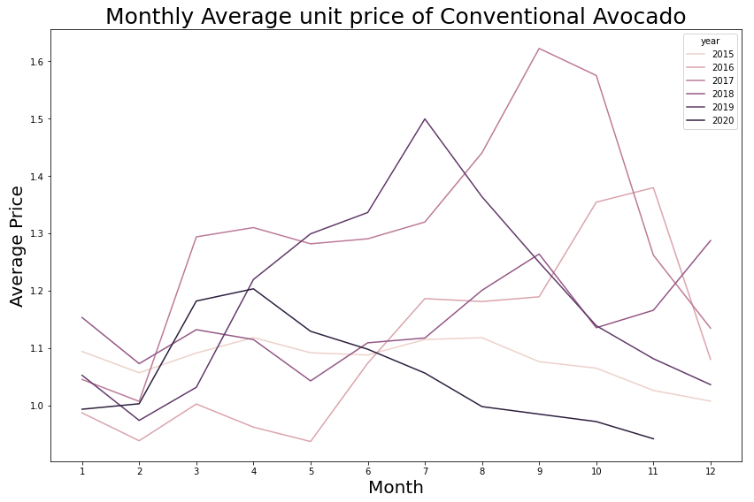
Data Insights – Price Trend

Slide 8
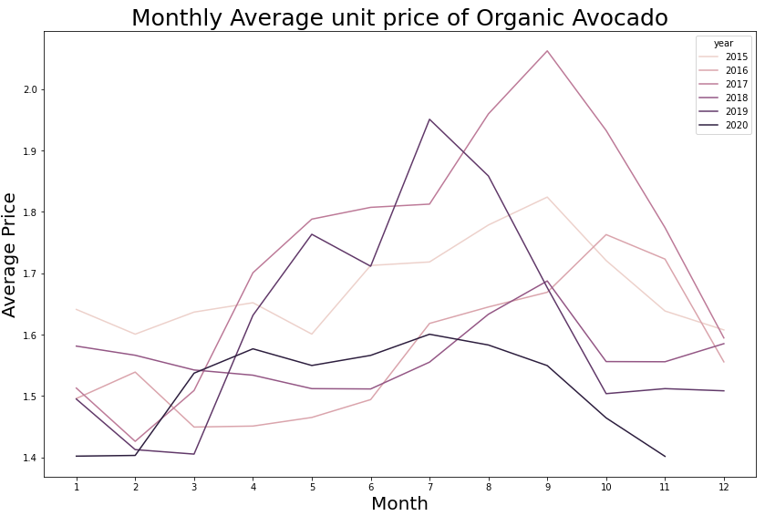
Data Insights – Price Trend

Slide 9
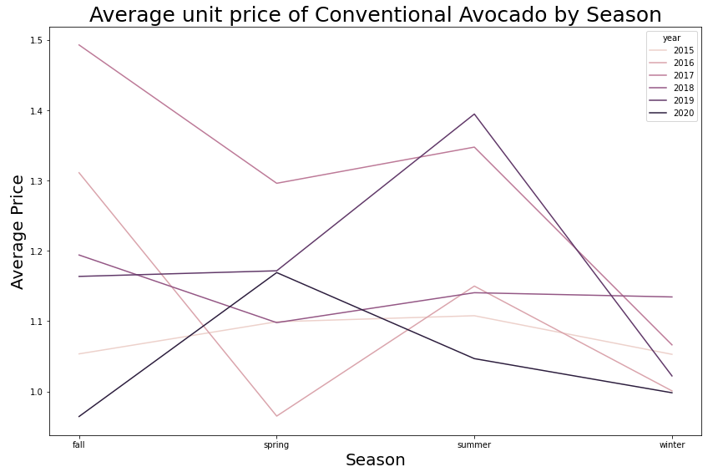
Data Insights – Price Trend

Slide 10
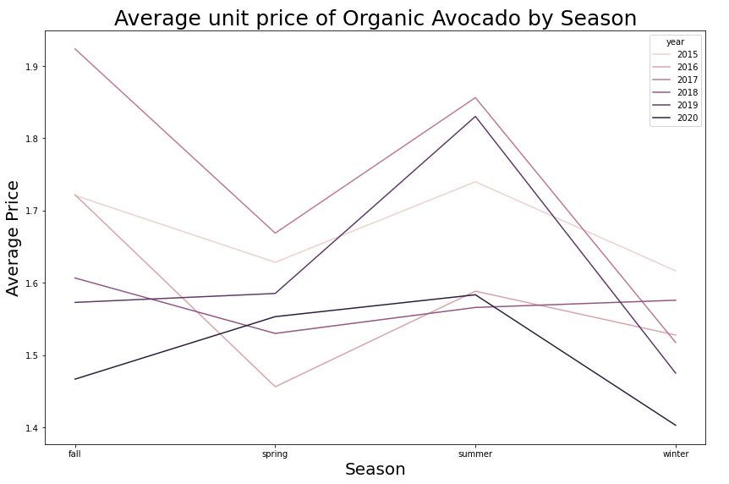
Data Insights – Price Trend

Slide 11
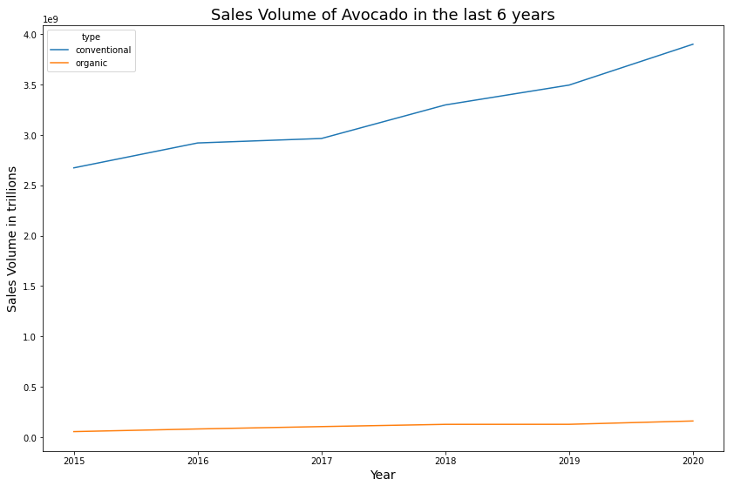
Data Insights – Sales Volume Trend

Slide 12
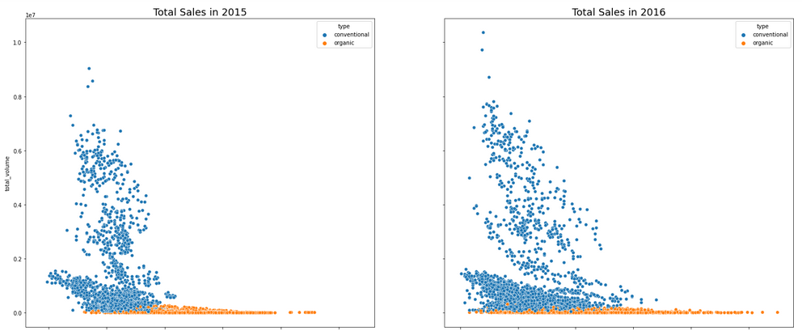
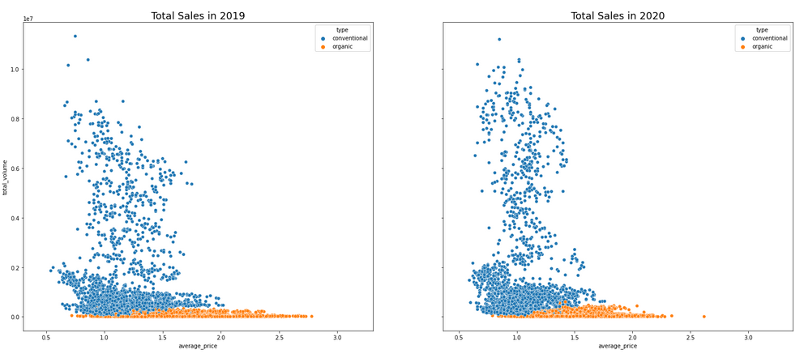
Data Insights – Price vs Volume

Slide 13
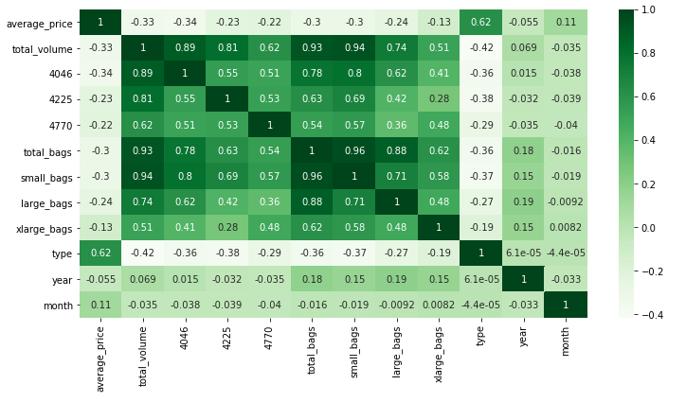
Data Insights – Correlation Mapping

Slide 14
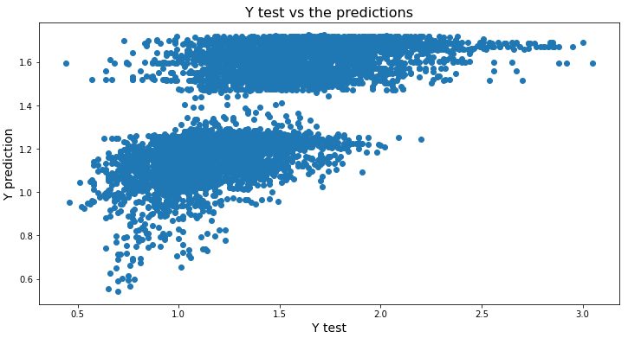
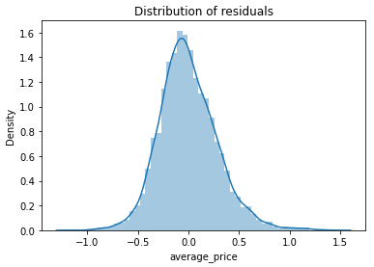
Data Model – Linear Regression
Score – 0.438
MSE – 0.08248

Slide 15
Data Model – Linear Regression
Feature Selection using f_regression
Selected Features: 'total_volume', '4046', '4225', '4770', 'total_bags', 'small_bags','large_bags', 'type’
Score: 0.438

Slide 16
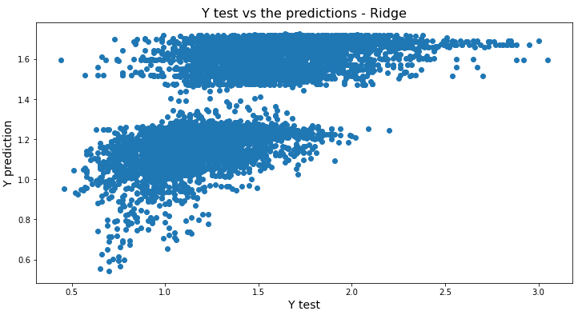
Data Model – Ridge Regression
Score – 0.438
MSE – 0.08248

Slide 17
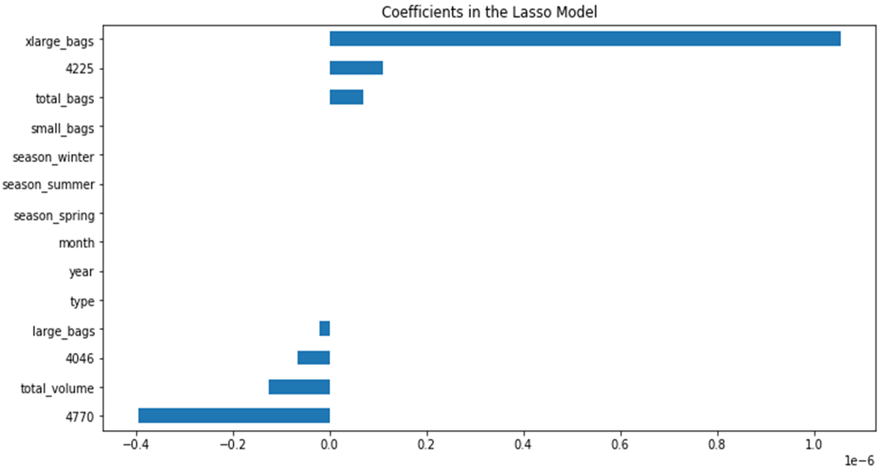
Data Model – Lasso Regression
Score – 0.12599
MSE – 0.128279

Slide 18
Conclusion
At this point in time, ridge and linear regression are predicting better as compared to lasso regression

Slide 19
Next Steps
Optimize the machine learning model
Using cross-validations to check the model
Gather more data that could be relevant to predicting the average price
Use different machine learning models

