Slide 1
Methodological issues in inter-rater agreement in voice quality analysis Paul Foulkes, Peter French, Eugenia San Segundo Philip Harrison & Vincent Hughes

Slide 2

1. Background of our research
sociolinguistics, dialectology, general phonetics
forensic speech analysis
comparison of general phonetic methods, acoustic measures & ASR approaches (AHRC grant, Voice and Identity 2015-19).
critical in forensic work for independent agreement on observations
→ establishing inter-rater agreement in VQ analysis
using modified Laver/Edinburgh VPA protocol within casework

Slide 3

2. Outline
establishing inter-rater agreement in VQ analysis
(San Segundo et al, JIPA 2018)
methods
findings
issues with Edinburgh VPA
outcomes of inter-rater analysis
outlook

Slide 4

3. Methods
recordings: DyViS corpus (Nolan et al 2009)
forensic research
simulated police interview ca. 10 minutes
100 young men, Standard Southern British English (RP)
rather homogeneous, not typical of whole population
#067
#072

Slide 5
3. Methods
3 analysts – ESS, PF, JPF
modified VPA used at J P French
no pathological labels (4-6)
grade 1 = slight (noticeable)
grade 2 = marked
grade 3 = extreme (not pathology)

Slide 6
3. Methods
stage 1: 10 speakers
practice
stage 2: calibration meeting
stage 3: 99 speakers
first 10 redone blind
(1 technical problem)

Slide 7
4. Issues with VPA
our work raised various general issues with VPA conception & protocol (discussed also by others; summary in San Segundo et al 2018)
articulatory labels but perceptual judgments
VQ as ‘an interaction between a listener and a signal’ (Kreiman & Sidtis 2011: 9)
neutral setting as baseline
hypothetical, thus imaginary
difficult to avoid bias to dialect norms
e.g. slight nasality, creak & tongue fronting for SSBE

Slide 8
4. Issues with VPA
independence of 30-40 individual settings
how well can analysts focus on them separately?
physical linkages and perceptual correlations
e.g. lowered larynx & expanded pharynx

Slide 9
4. Issues with VPA
thresholds of permanence
how frequent/widespread must a setting be to count?
VQ = long-term quasi-permanent setting/timbre
but any setting is also tied to key segments
thus by definition any setting is intermittent
we attributed effects as segmental where possible
if limited to 1-2 segments e.g. labiodentalisation of /r/

Slide 10
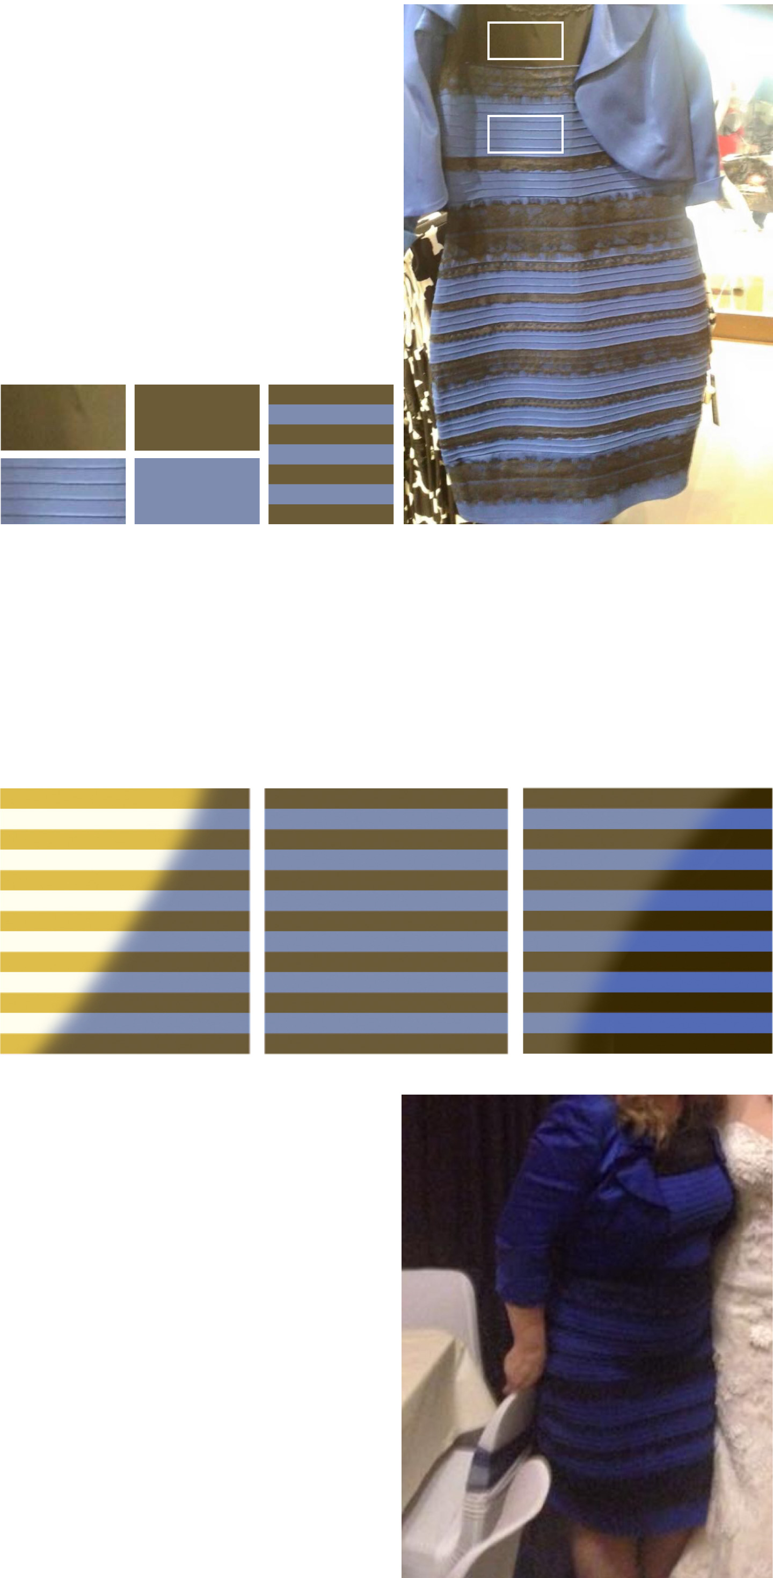
5.1 Outcomes: calibration
calibration meeting: identified disagreement types & problems
true error
analyst missed or mislabelled clear setting
difficulty with distinctions
e.g. breathy~whisper
systematic use of different labels for same percept
harsh phonation – tense larynx
retracted tongue body – constricted pharynx

Slide 11
5.1 Outcomes: calibration
calibration meeting
corrected the true errors
established heuristics to
address systematic differences in scoring
combine perceptually equivalent labels
e.g. constricted pharynx & retracted tongue body
establish perceptual distinctions
e.g. whispery = higher friction, tension, poss. voicelessness
cf. breathy = lower friction, laxness

Slide 12
5.2 Outcomes: full analysis
stage 3: full analysis of 99 speakers
3 analysts worked independently
met to consider 3 versions
agreed on mode rating if all within 1 scalar degree (1-2-2, 2-2-3…)
re-listened collaboratively if:
difference in presence/absence (0-0-1, 0-1-1…)
wider disagreement (1-1-3, 1-3-3…)
apparent error

Slide 13
5.3 Outcomes: agreement
inter-rater agreement
no expectation of 100% agreement!
our VPA has 32 settings * 4 grades
logically 4³² = 1.84e¹⁹ combinations (> humans, < stars!)
two classifications of results
absolute agreement
within 1 grade
Fleiss kappa statistic – quantifies agreement versus chance level

Slide 14
 | absolute (%) | ± 1 grade (%)
Setting | mean | mean | N | Fleiss kappa
Overall agreement | 76 | 82 | 99

Slide 15
 | absolute (%) | ± 1 grade (%)
Setting | mean | mean | N | Fleiss kappa
Overall agreement | 76 | 82 | 99 | (> 0 is good)
fronted tongue body | 36 | 60 | 98 | .01 | slight
tense vocal tract | 55 | 68 | 51 | .22 | fair
lax vocal tract | 59 | 70 | 43 | .29 | fair
lax larynx | 62 | 71 | 37 | .31 | fair
nasal | 43 | 72 | 92 | .13 | slight
advanced tongue tip | 59 | 73 | 56 | .35 | fair
lowered larynx | 67 | 76 | 43 | .41 | moderate
tense larynx | 67 | 76 | 47 | .34 | fair
breathy | 52 | 78 | 73 | .31 | fair
creaky | 46 | 81 | 83 | .31 | fair
raised larynx | 74 | 82 | 34 | .46 | moderate
harsh | 75 | 82 | 31 | .43 | moderate
whispery | 91 | 96 | 10 | .53 | moderate

Slide 16
5.3 Outcomes: agreement
all other settings 91-100% agreement
but N < 10 speakers
thus largely 0 scores
NB: more frequent settings → lower agreement scores
easier to agree on absence than presence

Slide 17
5.3 Outcomes: agreement
analyst pairwise ratings
no striking differences between any pair of analysts
we each acknowledged strengths, weaknesses, biases
e.g. PF: lax larynx, tense larynx, murmur
team approach has clear benefit in addressing such issues

Slide 18
5.4 Outcomes: correlations
positively correlated VPA settings |  | Spearman’s r | C
*raised larynx | tense larynx | .62 | .58
*harsh | tense larynx | .36 | .57
*lax larynx | lowered larynx | .57 | .52
creaky | lax larynx | .46 | .45
advanced tongue tip | fronted tongue body | .38 | .41
creaky | lowered larynx | .35 | .35
C = contingency coefficient, range 0-1
*noted by e.g. Beck (2007), but also predicted: lax lx ⬄ lowered lx ⬄ breathy/whispery

Slide 19
5.4 Outcomes: correlations
negatively correlated VPA settings |  | Spearman’s r | C
creaky | whispery | -.36 | .37
lowered larynx | tense larynx | -.47 | .46
creaky | raised larynx | -.43 | .44
lax larynx | raised larynx | -.51 | .47
lowered larynx | raised larynx | -.55 | .51
lax larynx | tense larynx | -.66 | .57
lax vocal tract | tense vocal tract | -.73 | .61
C = contingency coefficient, range 0-1
NB opposites, but they do occur… forensically very valuable

Slide 20
6. Summary & outlook
team approach is not only possible but valuable
agreement level overall is good, between each pair & all 3
counters idiosyncrasies and biases
calibration really helps
focus on clearly notable features rather than exhaustive 32*4 grading

Slide 21
6. Summary & outlook
supplementary settings in Beck (2007) potentially very helpful
not used here as ~acoustic or quantifiable
holistic patterns
liveliness (wide f0 range + fast)
brightness, monotony, resonance
inconsistency in phonation
#009

Slide 22

thank you, tack så mycket
questions?

Slide 24
Setting | absolute agreement (%) |  |  |  | agreement within 1 scalar degree (%)
 | ES-PF | ES-JPF | JPF-PF | mean | ES-PF | ES-JPF | JPF-PF | mean
Overall rate |  |  |  | 76 |  |  |  | 82
nasal | 43 | 36 | 49 | 43 | 66 | 75 | 75 | 72
denasal | 90 | 87 | 92 | 90 | 91 | 88 | 93 | 91
raised larynx | 78 | 73 | 71 | 74 | 85 | 84 | 79 | 82
lowered larynx | 62 | 70 | 71 | 67 | 72 | 79 | 79 | 76
tense vocal tract | 53 | 55 | 59 | 55 | 75 | 65 | 66 | 68
lax vocal tract | 66 | 55 | 58 | 59 | 76 | 65 | 71 | 70
tense larynx | 69 | 66 | 68 | 67 | 74 | 80 | 74 | 76
lax larynx | 66 | 69 | 51 | 62 | 71 | 85 | 58 | 71
falsetto | 100 | 100 | 100 | 100 | 100 | 100 | 100 | 100
creaky | 42 | 37 | 59 | 46 | 80 | 79 | 85 | 81
whispery | 90 | 94 | 88 | 91 | 95 | 98 | 95 | 96
breathy | 49 | 42 | 64 | 52 | 72 | 77 | 85 | 78
murmur | 99 | 100 | 99 | 99 | 100 | 100 | 100 | 100
harsh | 75 | 74 | 76 | 75 | 84 | 80 | 84 | 82
tremor | 100 | 100 | 100 | 100 | 100 | 100 | 100 | 100

Slide 25
Setting | absolute agreement (%) |  |  |  | agreement within 1 scalar degree (%)
 | ES-PF | ES-JPF | JPF-PF | mean | ES-PF | ES-JPF | JPF-PF | mean
lip rounding | 96 | 96 | 100 | 97 | 96 | 96 | 100 | 97
lip spreading | 94 | 95 | 95 | 95 | 94 | 95 | 95 | 95
labio-dentalisation | 98 | 100 | 98 | 99 | 98 | 100 | 98 | 99
extensive labial range | 100 | 100 | 100 | 100 | 100 | 100 | 100 | 100
minimised labial range | 100 | 100 | 100 | 100 | 100 | 100 | 100 | 100
close jaw | 96 | 96 | 100 | 97 | 96 | 96 | 100 | 97
open jaw | 100 | 100 | 100 | 100 | 100 | 100 | 100 | 100
ext. mandibular range | 99 | 99 | 100 | 99 | 99 | 99 | 100 | 99
min. mandibular range | 96 | 96 | 98 | 97 | 98 | 98 | 98 | 98
advanced tongue tip | 55 | 56 | 66 | 59 | 69 | 73 | 78 | 73
retracted tongue tip | 92 | 99 | 92 | 94 | 93 | 99 | 92 | 95
fronted tongue body | 33 | 43 | 31 | 36 | 51 | 69 | 62 | 60
backed tongue body | 97 | 97 | 100 | 98 | 97 | 97 | 100 | 98
ext. lingual range | 98 | 99 | 99 | 99 | 100 | 100 | 100 | 100
min. lingual range | 98 | 98 | 100 | 99 | 99 | 99 | 100 | 99
pharyngeal constriction | 97 | 95 | 98 | 97 | 98 | 97 | 99 | 98
pharyngeal expansion | 97 | 98 | 97 | 97 | 99 | 100 | 99 | 99

