Slide 1
Temporal Context Memory Experiment
This PPT contains a demo of a trial for this experiment.
Play PPT.
Click through the first slides to view menu and instructions.
Clicking menu the second time, sequences will play automatically.

Slide 2
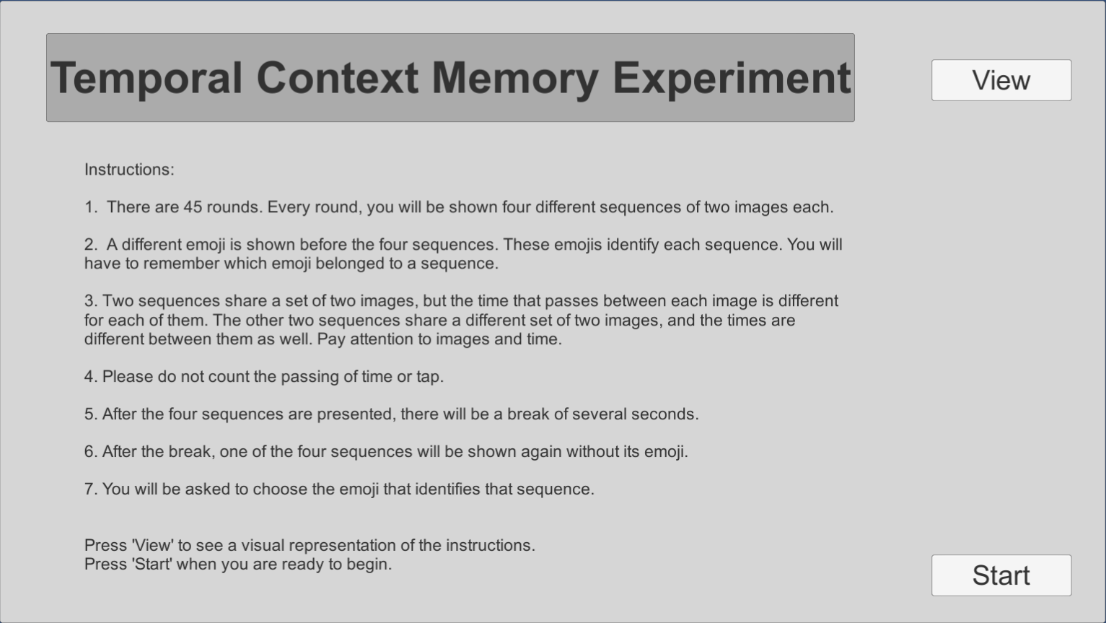

Slide 3
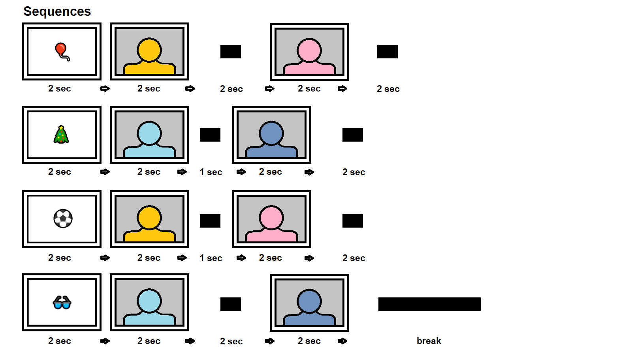

Slide 4
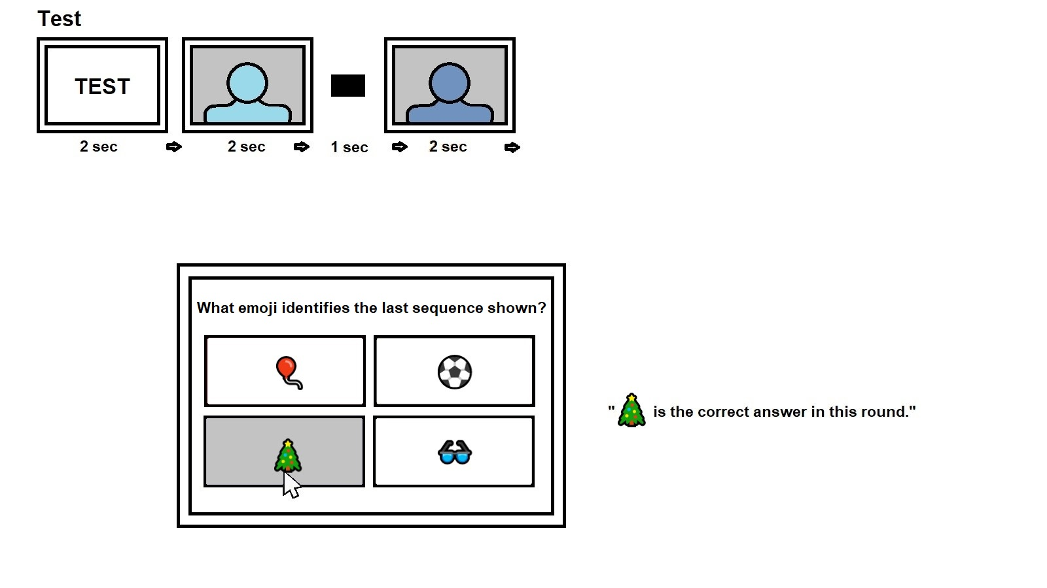

Slide 6


Slide 7


Slide 8
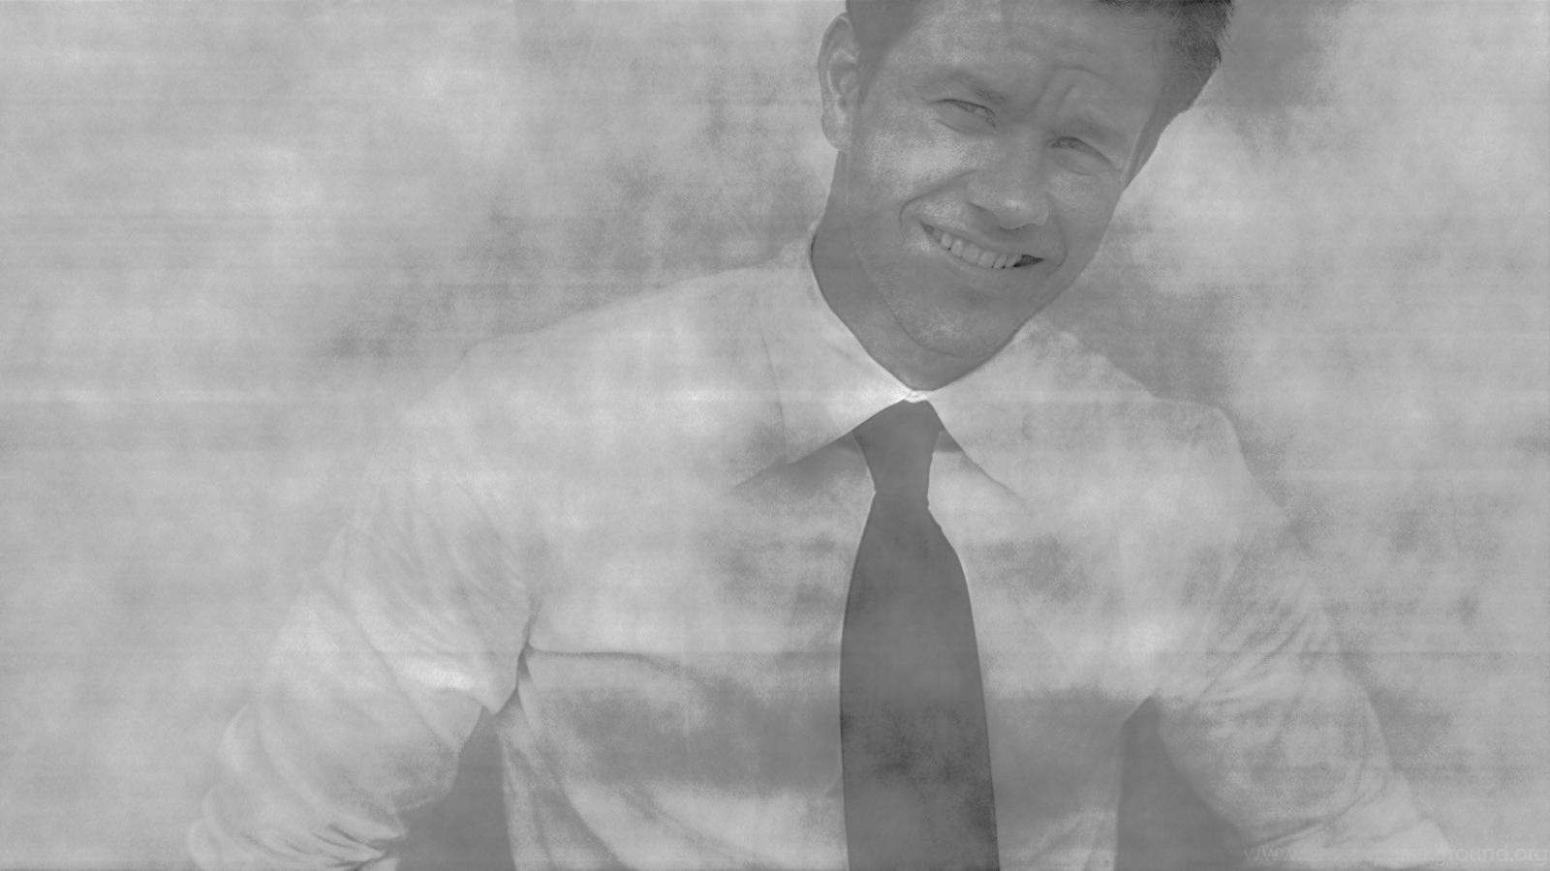

Slide 9


Slide 10
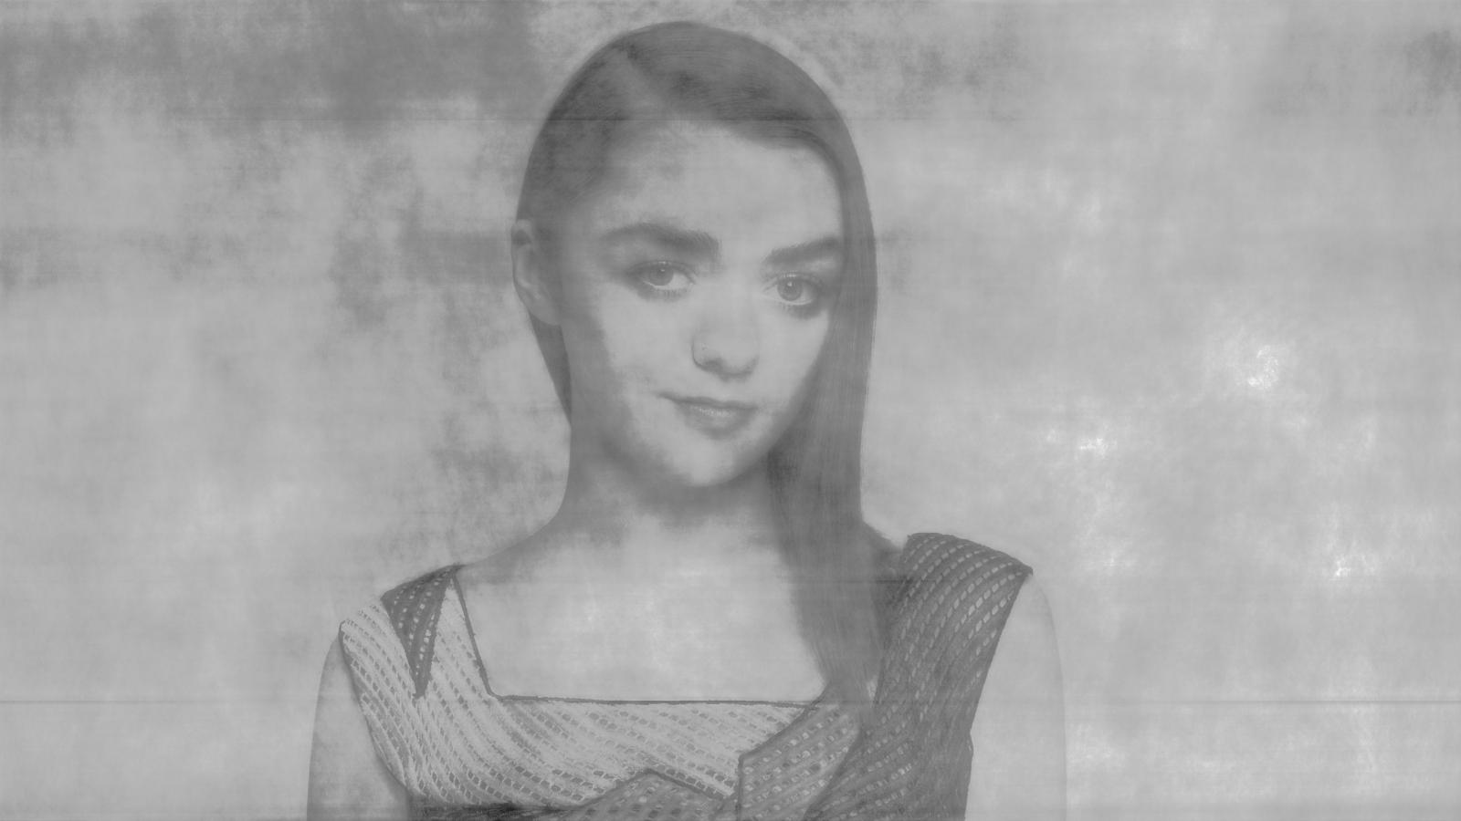

Slide 12


Slide 13
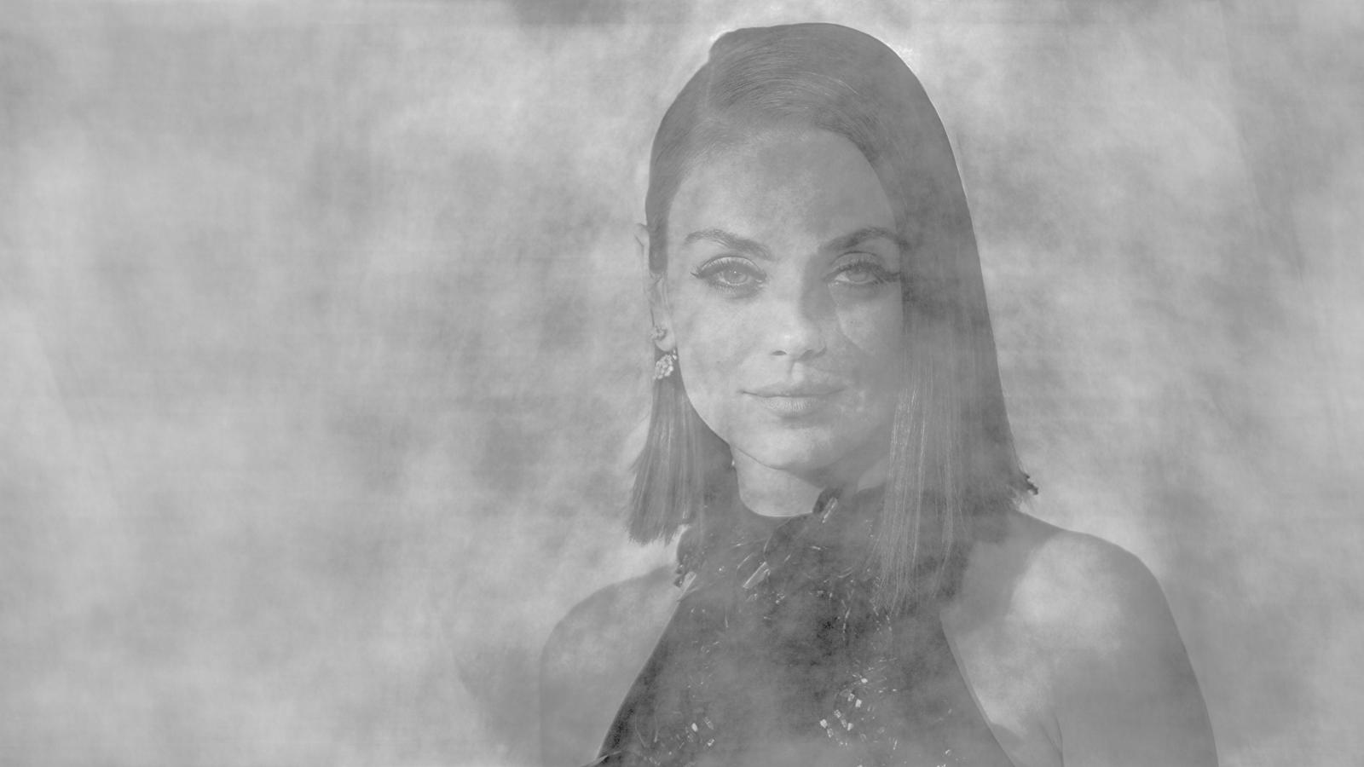

Slide 15
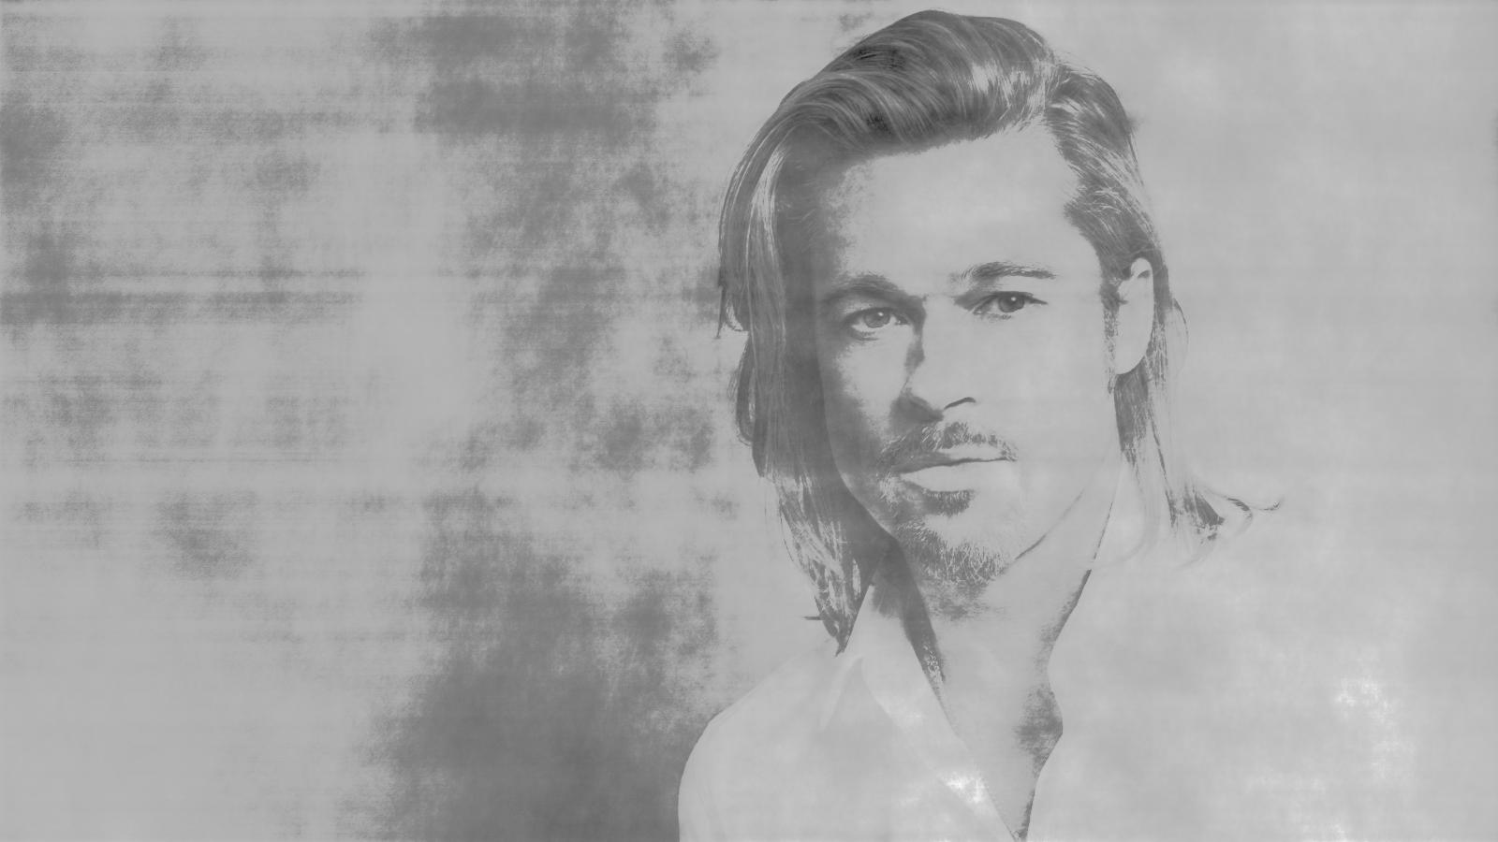

Slide 17


Slide 22


Slide 27


Slide 32
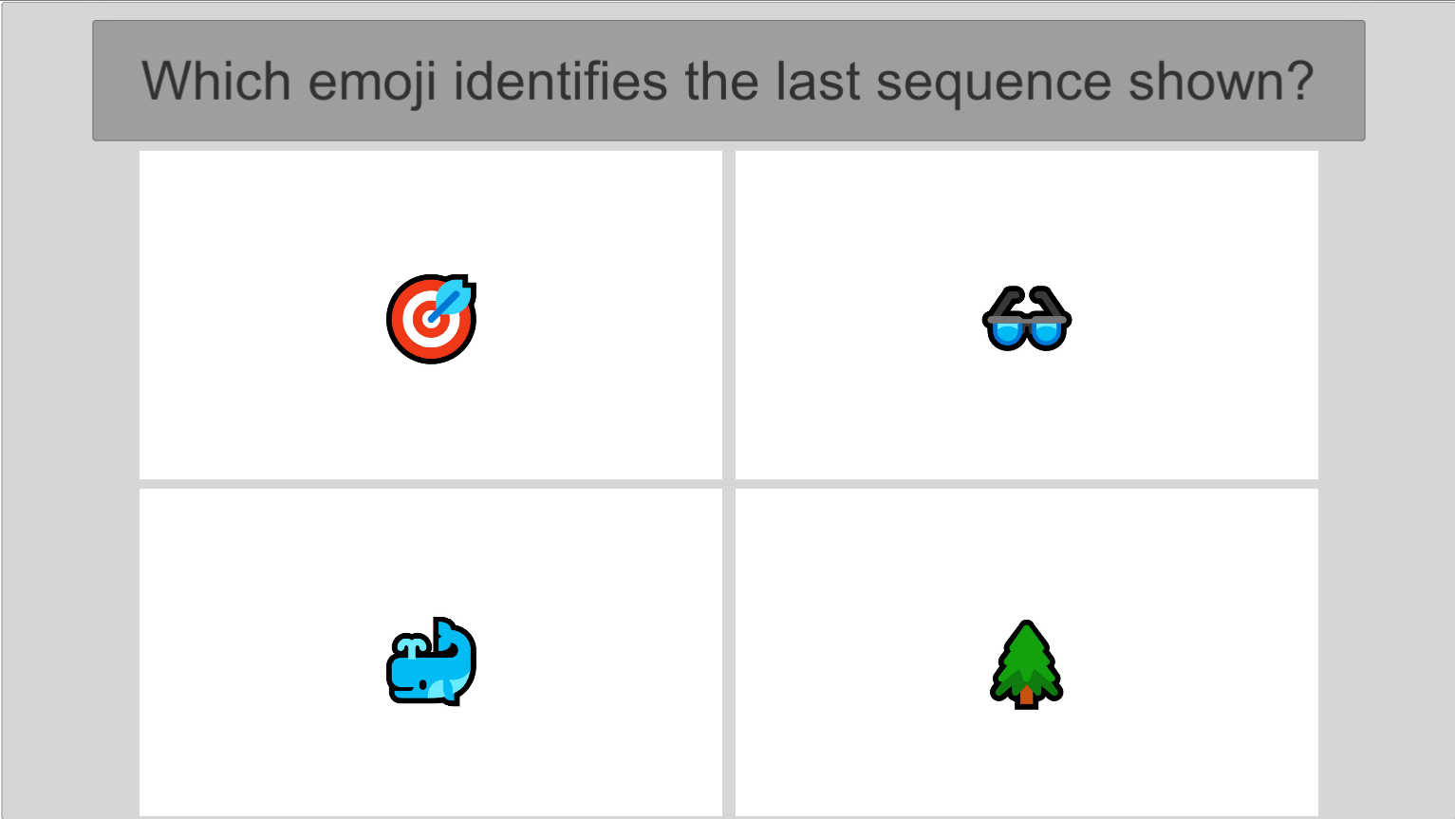

Slide 33
The correct answer was 🐳
Next round begins.

Slide 34
Thank you

