Slide 1
Optimizing the Optimizer
A Comprehensive Study of Self-Scaled Quasi-Newton Methods for Physics-Informed Neural Networks
Eugenio D. Macias & Don Wong
Brown University • Division of Applied Mathematics Directed Research Project • April 2026

Slide 2
Motivation
PINNs: mesh-free PDE solvers via neural networks
Loss = PDE residual + IC + BC — no labeled data needed
The optimization bottleneck:
Adam stagnates on stiff PDEs (flat loss plateaus)
BFGS uses curvature info → faster convergence
But Hessian scaling matters enormously
Our question:
Can self-scaled quasi-Newton methods
systematically outperform standard optimizers?
This Study
6 quasi-Newton variants compared
43 unique configurations
80+ seeded experiments
8 ablation groups (A–H)
Oscar HPC cluster @ Brown
Best L² = 0.258
Macias & Wong • Optimizing the Optimizer • Brown University

Slide 3
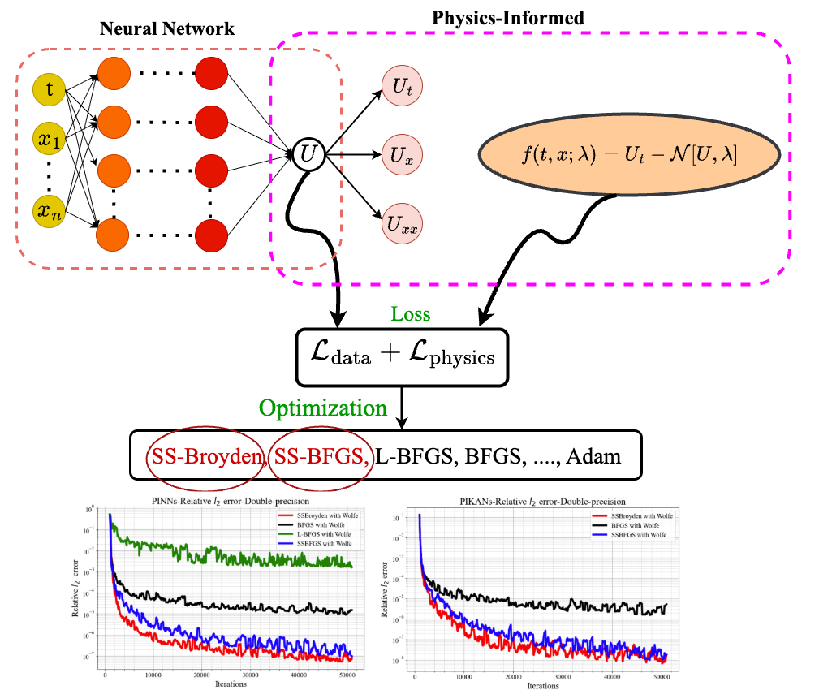

What are PINNs?
Physics-Informed Neural Networks
Network u_θ(t, x, y) approximates
the PDE solution
Loss function encodes physics:
PDE residual (auto-diff derivatives)
Initial conditions
Boundary conditions
No labeled data required
Physics IS the supervision signal
Derivatives computed exactly via
automatic differentiation
Macias & Wong • Optimizing the Optimizer • Brown University

Slide 4

The Cahn–Hilliard Equation
Setup
U(t,x,y) = order parameter (phase concentration)
Domain: [0, 128]² × [0, 10]
D = 1.0, a₂ = 1.0, a₄ = 1.0
Periodic boundary conditions
Random smoothed initial condition
Mass conservation: ∫ U dx = const
Why is CH Hard for PINNs?
Biharmonic operator ∇⁴ requires
4th-order derivatives through network
Cubic nonlinearity ∇²(U³) →
complex mixed derivative terms
Multiscale dynamics: rapid phase
separation → slow coarsening
Macias & Wong • Optimizing the Optimizer • Brown University

Slide 5
Research Question
Can self-scaled quasi-Newton methods —
which automatically adjust the Hessian approximation
at each iteration —
systematically and significantly outperform
standard optimizers for training PINNs
on stiff, high-order PDEs?
Macias & Wong • Optimizing the Optimizer • Brown University

Slide 6
Network Architecture & Loss Function
Network Architecture
Fully-connected: [3, 20, 20, 20, 20, 1]
Input: (t, x, y) → Output: U(t, x, y)
1,361 trainable parameters
Activation: tanh
Precision: float64 (essential!)
Why so small?
Dense BFGS stores full p×p Hessian
1,361² ≈ 1.85M entries in memory
float64 required for QN stability
Loss Function
PDE residual: 10,000 collocation points
→ 4th-order derivatives via auto-diff
IC loss: 1,000 initial-condition points
BC loss: 500 periodic-boundary points
Loss weights:
λ_pde = 1.0 λ_ic = 5.0 λ_bc = 5.0
IC/BC emphasis prevents trivial solutions
Macias & Wong • Optimizing the Optimizer • Brown University

Slide 7
Two-Phase Training Pipeline
Phase 1: Adam Warmup
500–1000 epochs (optimal: 500)
Learning rate: 10⁻³ with exp decay
β₁ = 0.99, β₂ = 0.999
Purpose:
Navigate rough loss landscape
Reach stable basin of attraction
Initialize Hessian approximation
Phase 2: Quasi-Newton
50,000 BFGS iterations
Full Hessian approximation (p×p)
Collocation resampling every N_change
Key advantage:
Curvature information → faster
convergence in smooth regions
2 OOM lower loss than Adam alone
→
Total budget: ~51K iterations • Wall time: 6–11 hours per run • Without warmup → divergence (L² = 1.66)
Macias & Wong • Optimizing the Optimizer • Brown University

Slide 8
Six Quasi-Newton Variants
From standard BFGS to self-scaled Broyden class
BFGS
Standard
Full Hessian approx, B₀ = I
Baseline quasi-Newton method
L-BFGS-B
Limited Memory
Stores m=20 vector pairs instead of p×p
Reduces O(p²) → O(mp) storage
SSBFGS-OL
Oren–Luenberger
Self-scaled: τₖ = sₖᵀsₖ / yₖᵀsₖ
Can over-scale → worst results
SSBFGS-AB
Al-Baali
Conservative self-scaling variant
Lowest final loss, moderate L²
SSBroyden1
Broyden Class 1
Convex combination of BFGS + DFP
with φₖ ∈ [0,1] + self-scaling
SSBroyden2
Broyden Class 2
BFGS-direction update + self-scaling
Best overall performance ★
Macias & Wong • Optimizing the Optimizer • Brown University

Slide 9
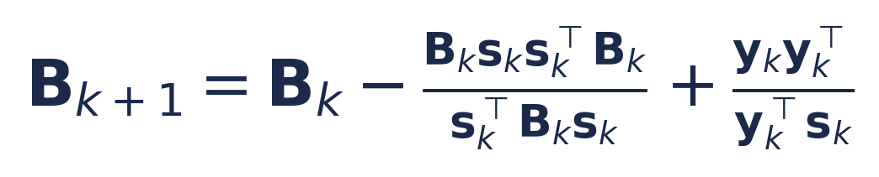
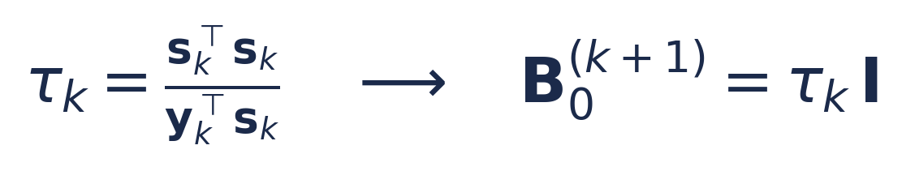
The Self-Scaling Mechanism
Automatic Hessian initialization at each iteration
Standard BFGS Update:
Key Insight
Standard BFGS: B₀ = I always
→ Poor initial curvature estimate
Self-scaled: B₀ = τₖ · I
→ Automatic scale adaptation
→ τₖ matches local curvature
SSBroyden class extends this:
Broyden = convex combination
of BFGS and DFP updates
SSBroyden2: BFGS direction
+ automatic self-scaling
= Best of both worlds
Self-Scaling (Oren–Luenberger):
Macias & Wong • Optimizing the Optimizer • Brown University

Slide 10
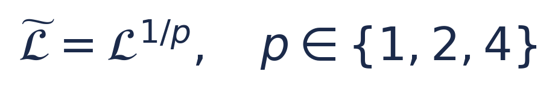
Additional Techniques
Power transforms, RAD sampling, spectral reference
Loss Power Transform
RAD Sampling
Residual-Adaptive Distribution
k₁ controls residual sensitivity
k₂ controls baseline probability
Best: k₁=1.0, k₂=0.5 (mean L² = 0.962)
k₁ > 1.0 → unstable (6× variance!)
Flattens high-loss regions, amplifies near minimum
p=4 achieves L² = 0.945 (2nd best on 128²)
Reference Solution: ETDRK4 Spectral Solver
4th-order exponential time-differencing Runge-Kutta
128×128 and 64×64 Fourier spectral grids • Δt = 0.01 • Exact for periodic domains
All L² errors computed against this high-fidelity reference at 21 time points
Macias & Wong • Optimizing the Optimizer • Brown University

Slide 11
Experimental Design
43 configurations • 8 ablation groups • 80+ runs on Oscar HPC
A
Optimizer
6 QN methods
B
Warmup
0 / 500 / 1K / 5K epochs
C
Architecture
4×20 / 8×20 / 5×30
D
Adam-only
51K epochs, 3 LRs
E
RAdam
RAdam warmup variant
F
Resampling
N_change ∈ {200, 500, 1K}
G
Loss Transform
Power p ∈ {1, 2, 4}
H
RAD Params
k₁, k₂ ∈ {0.5, 1.0, 2.0}
Each configuration run with 3 random seeds • 6–11 hours wall time per run • Evaluation: relative L² error against spectral reference at 21 time points
Macias & Wong • Optimizing the Optimizer • Brown University

Slide 12
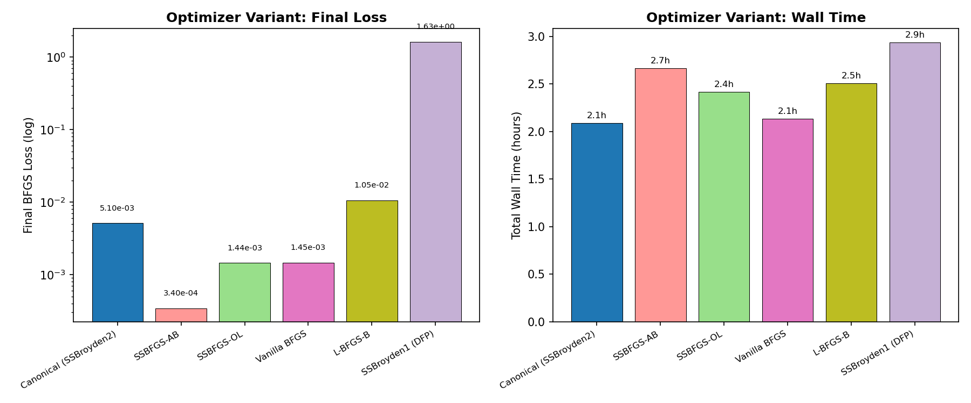
Results: Core Optimizer Comparison (Group A)
1K Adam warmup + 50K BFGS, identical settings
Key Findings
BFGS: L² = 0.975
L-BFGS-B: L² = 1.062
SSBFGS-OL: L² = 1.349
(over-scaling → worst)
SSBFGS-AB: L² = 1.071
(lowest loss, moderate L²)
With optimized resampling:
SSBroyden2: L² = 0.854 ★
Loss ≠ Error
SSBFGS-AB: lowest loss
but only mediocre L² error
Macias & Wong • Optimizing the Optimizer • Brown University

Slide 13
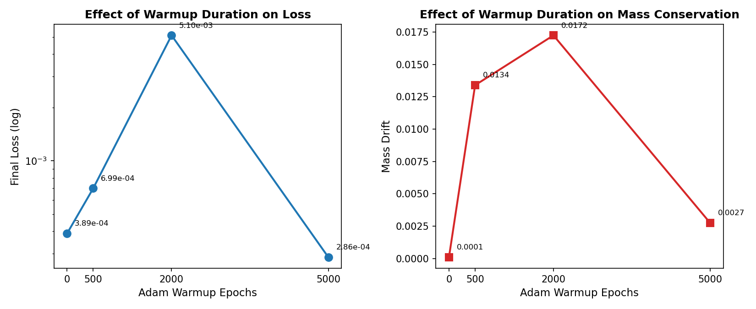
Results: Warmup Duration (Group B)
How many Adam epochs before switching to BFGS?
U-Shaped Relationship
0 epochs → L² = 1.659
BFGS diverges from random init
500 epochs → L² = 0.949 ★ OPTIMAL
1000 epochs → L² = 1.078
(canonical, slightly overshoots)
5000 epochs → L² = 1.194
Wastes budget on inefficient Adam
Takeaway:
Short warmup is essential but
too much is counterproductive
Macias & Wong • Optimizing the Optimizer • Brown University

Slide 14
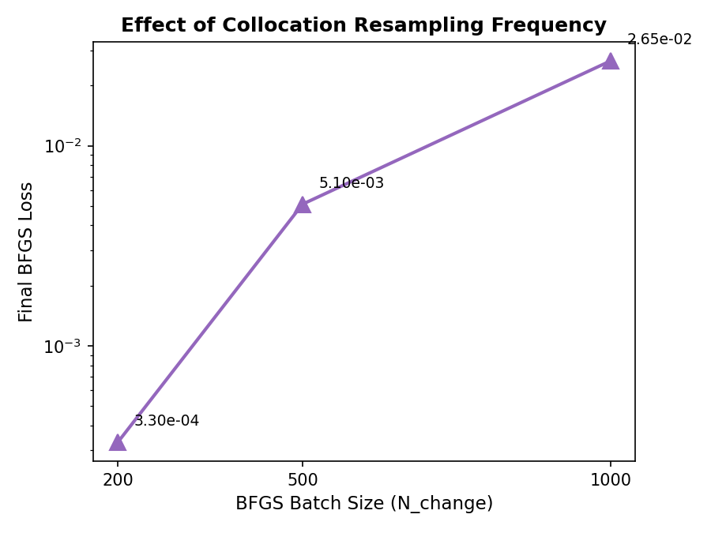
Results: Resampling Frequency (Group F)
The single most impactful hyperparameter
21% Improvement!
N_change = 200 → L² = 0.854
★ Best result in entire study
N_change = 500 → L² = 1.078
(canonical setting)
N_change = 1000 → L² = 1.178
Why it matters:
QN optimizer overfits to fixed
collocation points very quickly
Frequent resampling forces global
accuracy, not just local fitting
Macias & Wong • Optimizing the Optimizer • Brown University

Slide 15
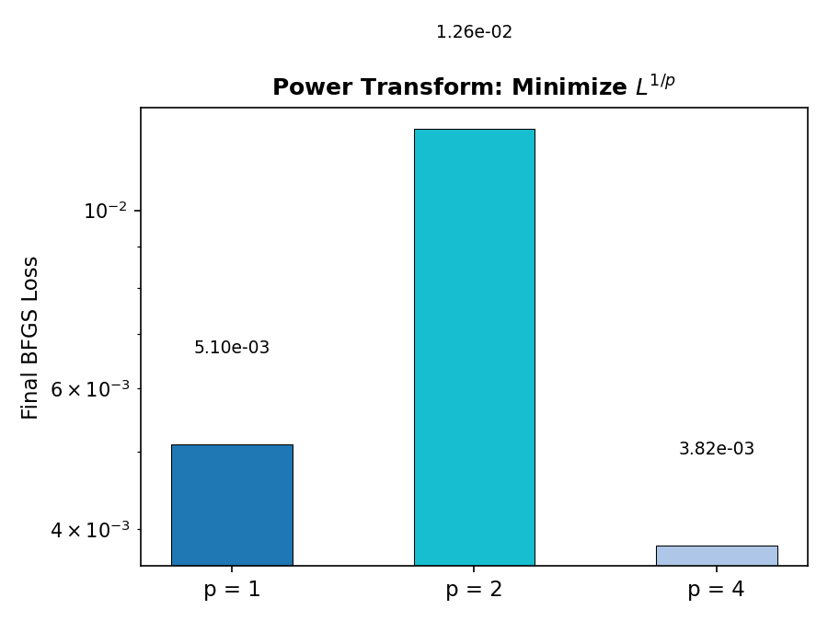
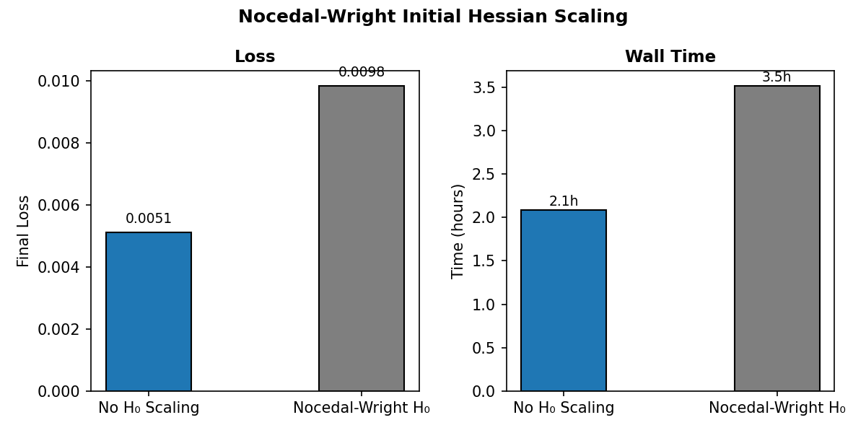
Results: Loss Transforms & RAD Sensitivity
Groups G and H ablations
Power transform p=4: L² = 0.945 — flattens loss landscape for smoother QN convergence
RAD k₂=0.5: mean L² = 0.962 ± 0.224 — focuses collocation points on high-residual regions
RAD k₁=2.0: mean L² = 2.13 ± 1.26 — too aggressive → 6× variance, catastrophic in some seeds
Macias & Wong • Optimizing the Optimizer • Brown University

Slide 16
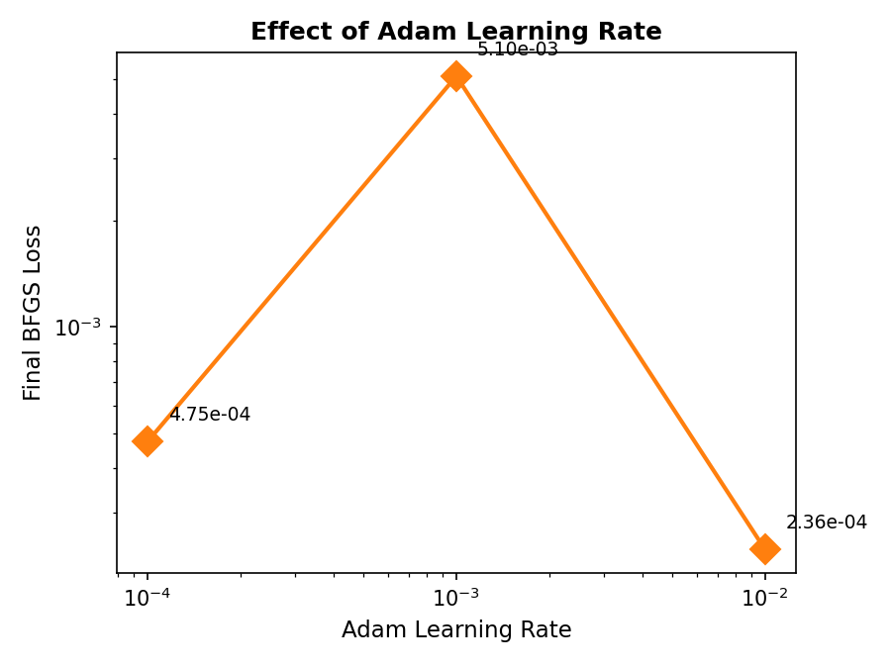
Results: Adam-Only Baseline (Group D)
Can first-order optimization alone solve CH?
Answer: No.
51K Adam epochs:
L² = 1.000
Final loss = 0.027
Best hybrid (SSBroyden2):
L² = 0.854
Final loss = 3.3×10⁻⁴
2 orders of magnitude
lower loss with QN methods
Adam hits a "flat plateau"
typical of stiff PDE landscapes
Macias & Wong • Optimizing the Optimizer • Brown University

Slide 17
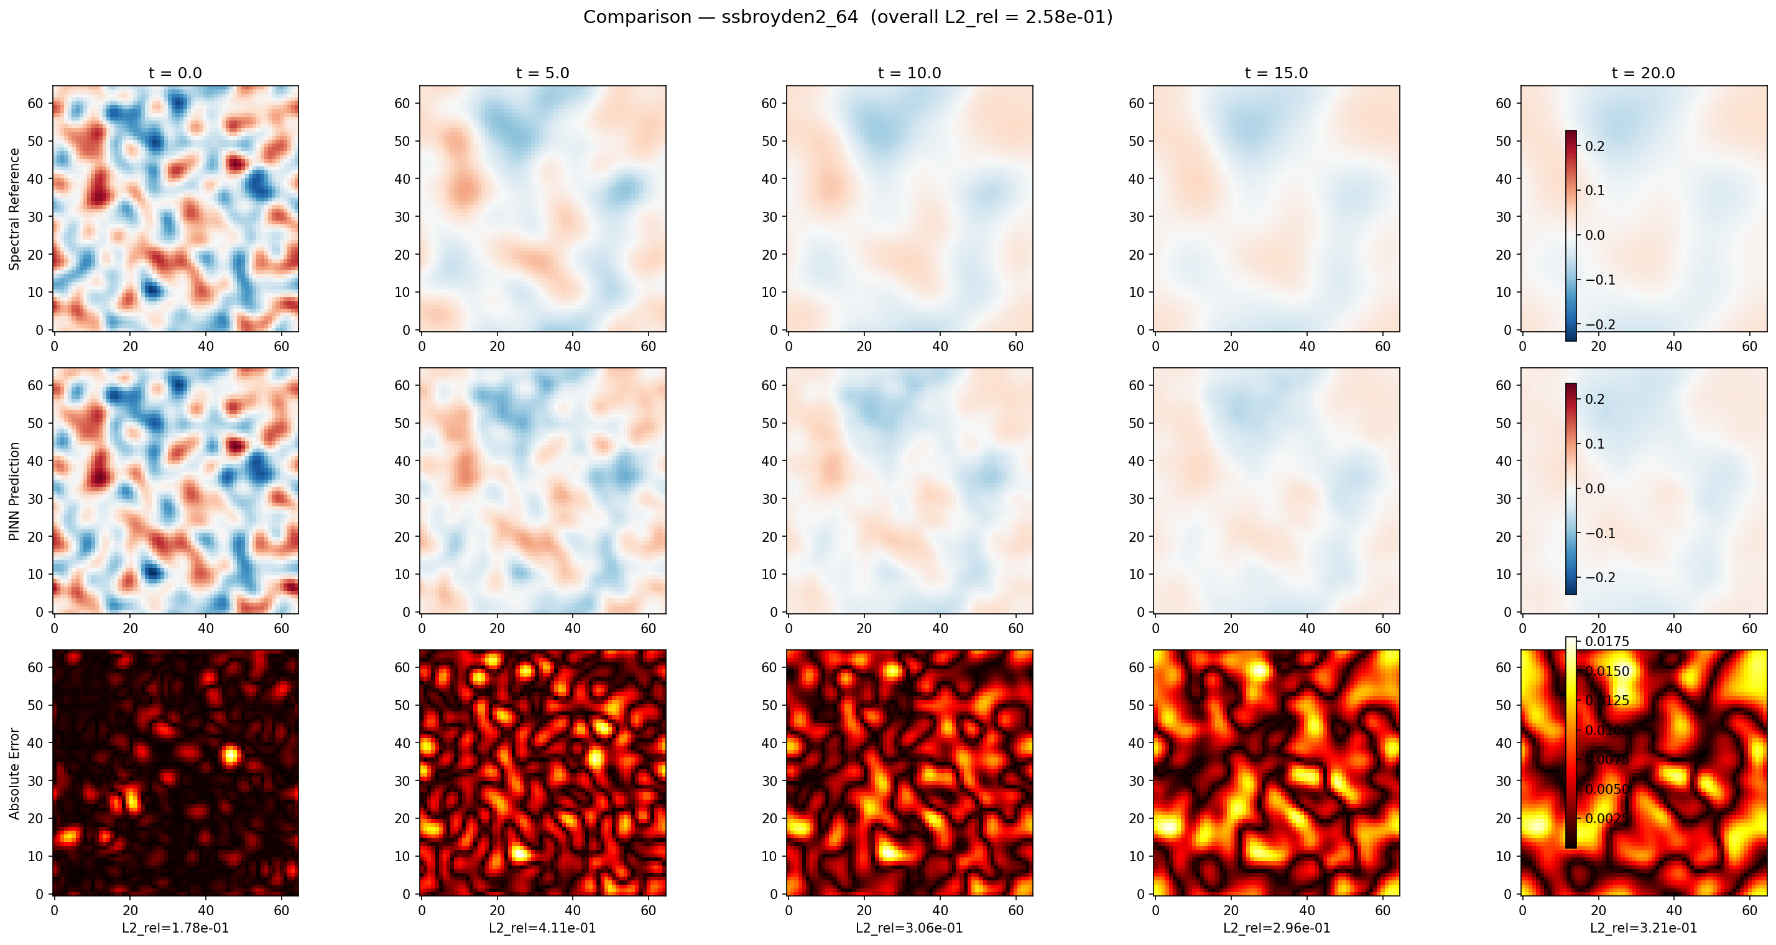
Best Result: SSBroyden2 on 64×64 Domain
L² = 0.258
Macias & Wong • Optimizing the Optimizer • Brown University

Slide 18
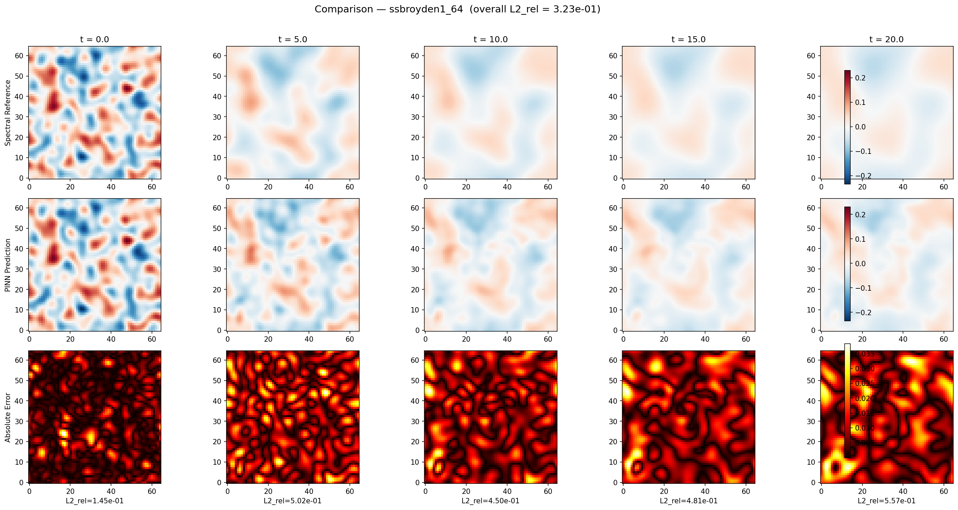
Second Best: SSBroyden1 on 64×64 Domain
L² = 0.323
Macias & Wong • Optimizing the Optimizer • Brown University

Slide 19
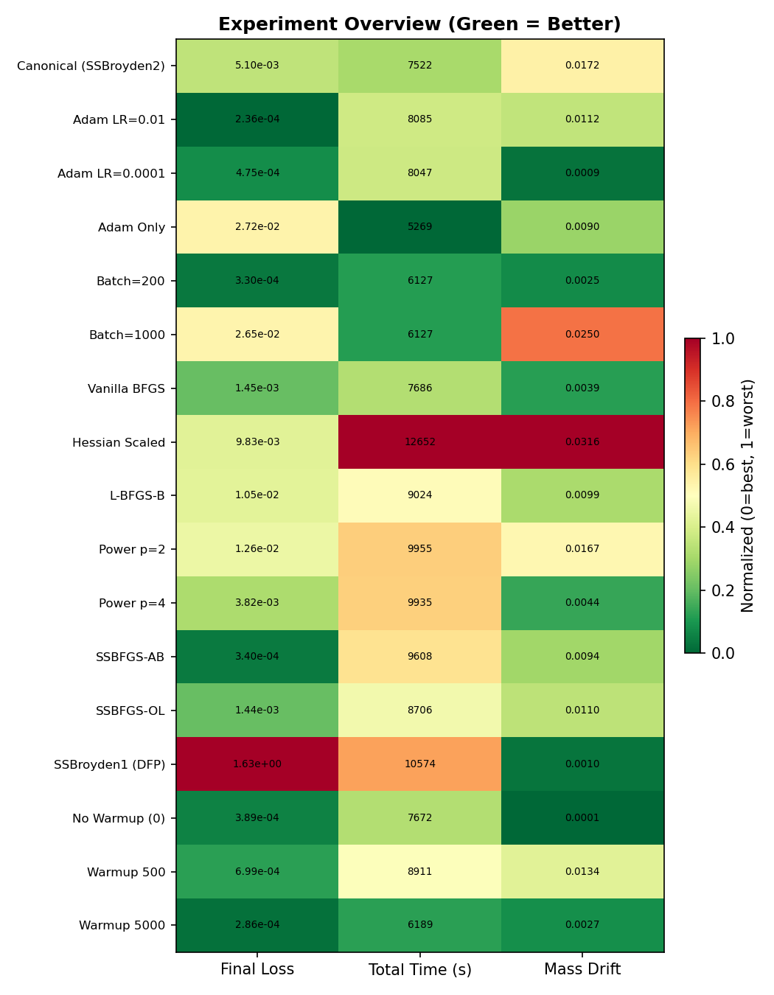
Analysis: Performance Overview
Normalized heatmap across all experiments
Reading the Heatmap
Green = better performance
Red = worse performance
Metrics: L² error, final loss,
training time, mass drift
Top performers:
bfgs_batch_200 (L² = 0.854)
power_4 (L² = 0.945)
warmup_500 (L² = 0.949)
Worst:
warmup_0 (L² = 1.659)
adam_lr_low (L² = 1.680)
Macias & Wong • Optimizing the Optimizer • Brown University

Slide 20
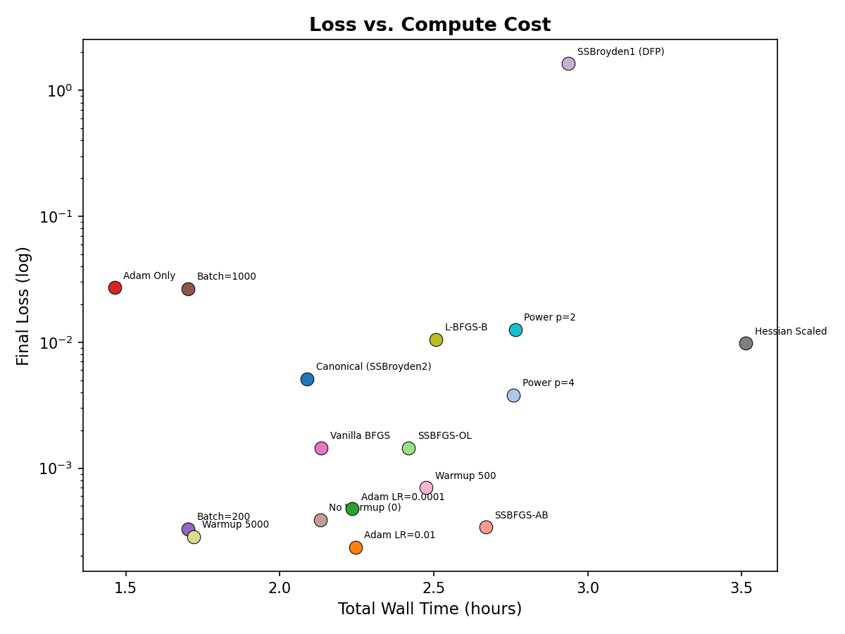
Analysis: Accuracy vs. Computational Cost
Pareto front of L² error vs. training time
Trade-offs
Adam: fast but
inaccurate (L²=1.0)
QN methods: more
compute, much better
accuracy
SSBroyden2 dominates
the Pareto front
Macias & Wong • Optimizing the Optimizer • Brown University

Slide 21
Failure Mode Analysis
Failure Mode 1
Insufficient Warmup
warmup_0: L² = 1.659
BFGS diverges from random init
Loss never stabilizes
Fix: ≥ 500 Adam epochs
Failure Mode 2
Aggressive RAD
H2 (k₁=2.0): L² = 2.13 ± 1.26
6× typical variance
Seed 2 diverges: L² = 3.92
Fix: Keep k₁ ≤ 1.0
Failure Mode 3
Infrequent Resampling
N_change ≥ 1000: overfitting
Loss → 10⁹ in some seeds
Hessian corrupted on resample
Fix: N_change ≤ 500 (200 best)
Macias & Wong • Optimizing the Optimizer • Brown University

Slide 22
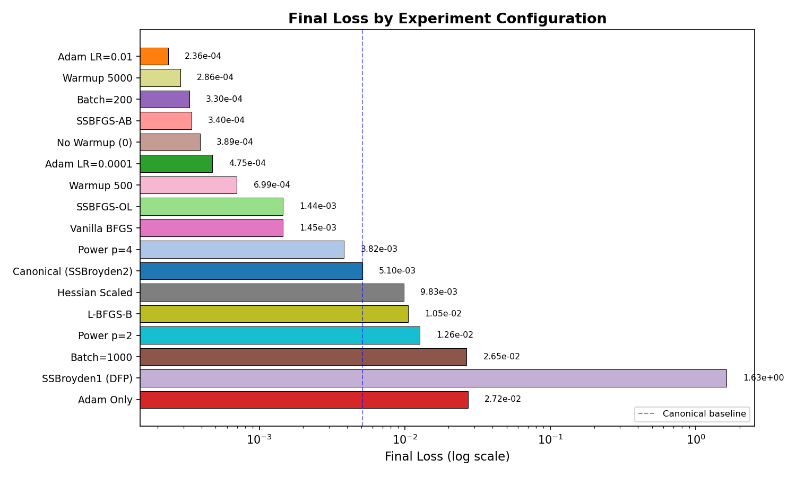
Key Insight: Low Loss ≠ Low Error
The collocation overfitting problem
The Disconnect
SSBFGS-AB:
Lowest loss: 3.4×10⁻⁴
But L² = 1.071 (mediocre!)
Why?
Loss: evaluated at N_int points
L² error: global accuracy on
full reference grid
Optimizer memorizes collocation
points instead of learning physics
→ Frequent resampling
is the solution
Macias & Wong • Optimizing the Optimizer • Brown University

Slide 23
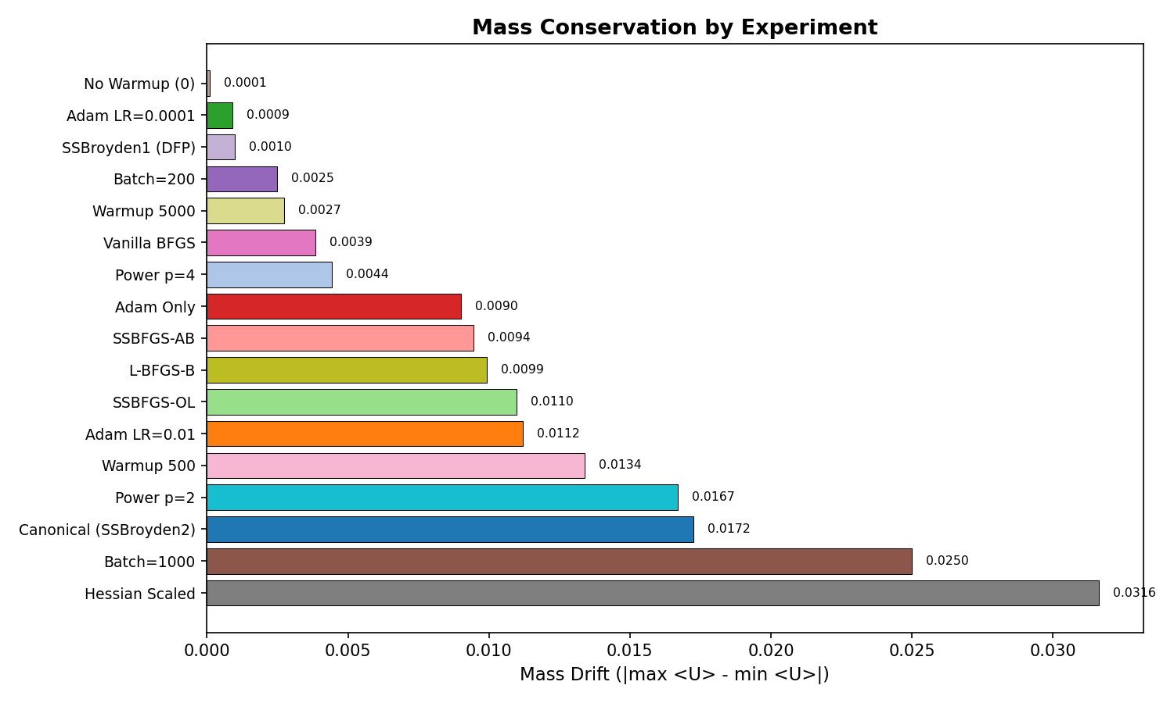
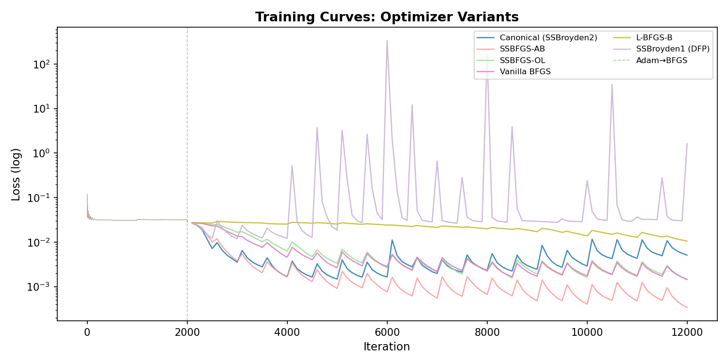
Diagnostics: Mass Conservation & Loss Curves
Mass conservation drift < 0.002 for successful runs — a useful "canary" for training health
Large drift (> 0.1) exclusively correlates with BFGS divergence (e.g., H2 seed_2: Δm = 0.19, L² = 3.92)
Macias & Wong • Optimizing the Optimizer • Brown University

Slide 24
Key Takeaways & Recommended Configuration
1. Self-scaled QN > standard optimizers
SSBroyden2 achieves L² = 0.854 (vs Adam 1.000)
2. Adam warmup is essential
500 epochs optimal; 0 → divergence
3. Frequent resampling prevents overfitting
N_change=200 → 21% improvement (best single change)
4. Power transforms help
p=4 → L² = 0.945
5. RAD k₂=0.5 improves sampling
But k₁>1.0 is dangerous
6. float64 is non-negotiable
Hessian corrupts rapidly in float32
7. Low loss ≠ low error
Global accuracy requires point diversity
Recommended Config
Optimizer:
SSBroyden2
Adam warmup:
500 epochs
BFGS iters:
50,000
N_change:
200
Power:
p = 4
RAD k₁:
1.0
RAD k₂:
0.5
Network:
4×20, tanh
Precision:
float64
Loss weights:
PDE:1, IC:5, BC:5
Macias & Wong • Optimizing the Optimizer • Brown University

Slide 25
Thank You
Eugenio D. Macias & Don Wong
Brown University • Division of Applied Mathematics
Acknowledgments: Oscar HPC Cluster at Brown University Based on Kiyani et al. (2025), Computer Methods in Applied Mechanics and Engineering
Questions?

