Slide 1
Parking Citations Summary of Findings
By eugene brink

Slide 2

Motivation
want to see if there was a correlation between rainy days and the distribution of parking citations or tickets
If there is, is it in a particular area
if so, what would be the reason for this adverse distribution
When are tickets most likely to be issued
Any seasonality

Slide 3
Question and data
The question:
Does rain effect the number of parking citations issued in the city of los angeles
The data
City of Los Angeles department of transportation
Reviewed years of 2016, 2017, 2018, and 2019
Over 6.75m citations issued
6.5m after cleaning
Weather wunderground
Reviewed years of 2016, 2017, 2018, and 2019
1118 datasets
No cleaning necessary

Slide 4
Data cleanup and exploration
City of Los Angeles Data
Reduced citation dataset from 6.75m to 6,541,378 lines of data
Reviewed
Date, time, citation reason, plate state, make of vehicle
Weather data
Data was clean
Reviewed
Date, precipitation, high temp, low temp
PROBLEM
LA Has little precipitation – stopped analysis
2016
3.172in
35 days
2017
8.38in
35 days
2018
1.77in
26 days

Slide 5
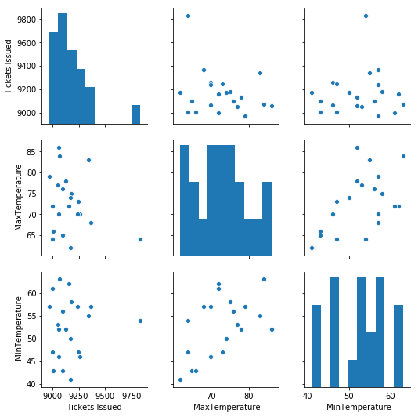
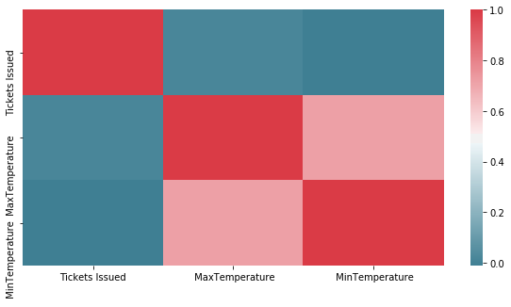
Data analysis – Any Correlation temperature and tickets issued

Slide 6
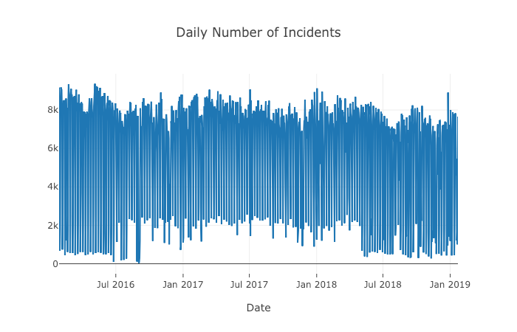
Data alnalysis

Slide 7
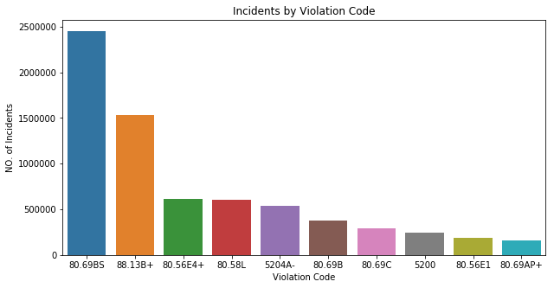
Data analysis

Slide 8
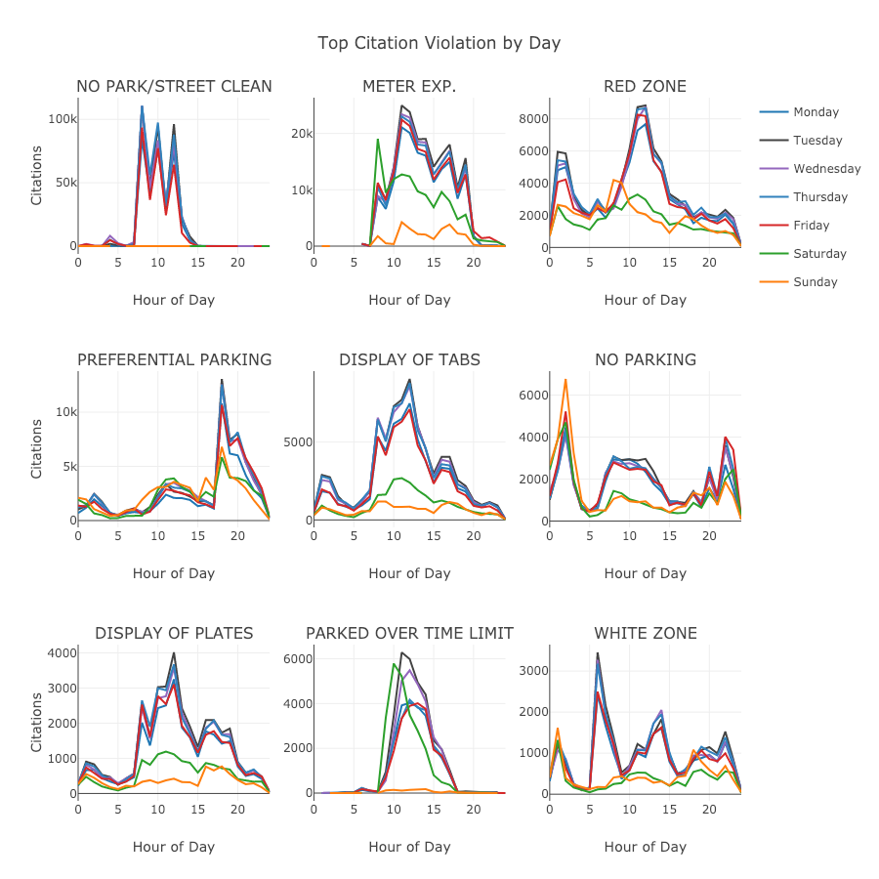
Data analysis

Slide 9
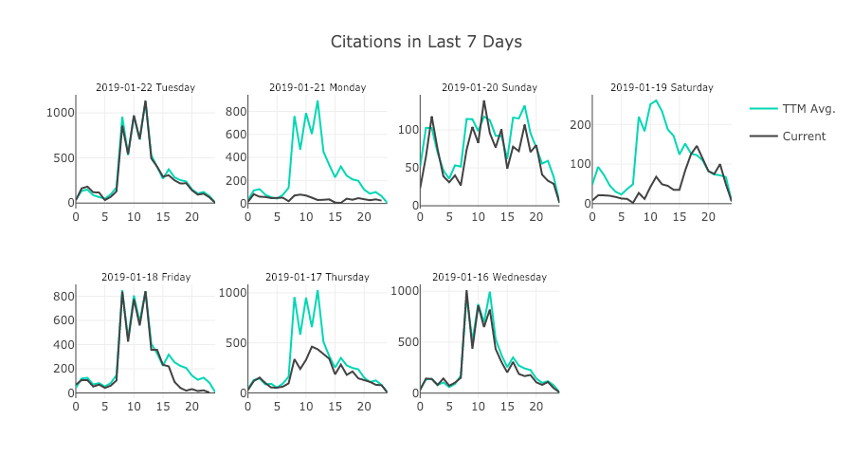
Data analysis

Slide 10
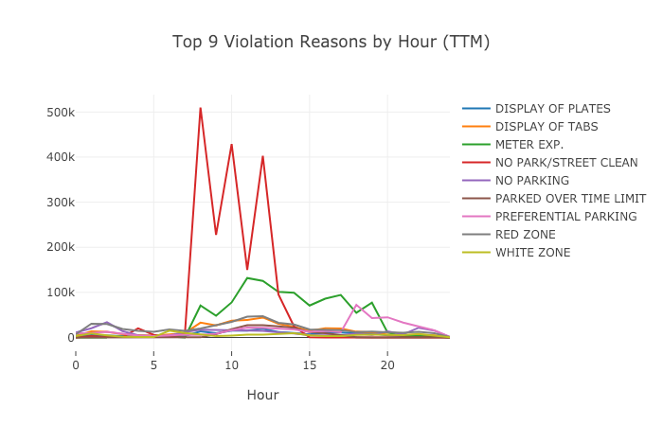
Data analysis

Slide 11
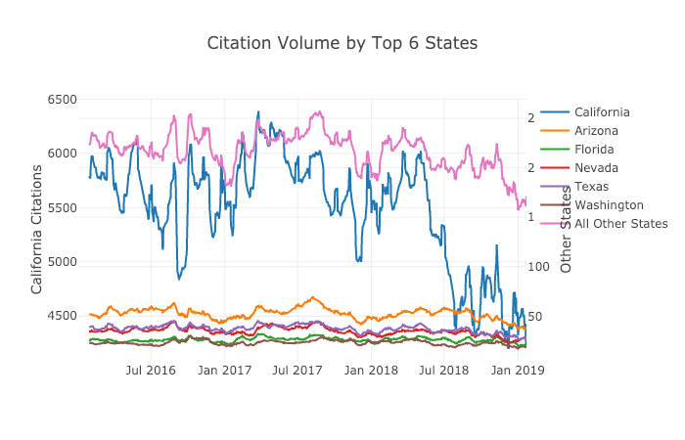
Data analysis

Slide 12
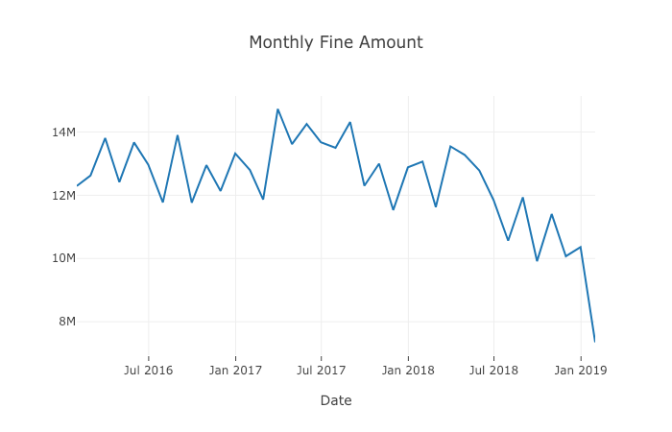
Data analysis

Slide 13
discussion
Interesting points to me
Most tickets issued between 7am and 1pm
Q: number of officers on the clock
Major offenders
CA
AZ
TX
Why are the minimums between 8/17 to 3/18 higher
Number of officers
Monthly fines (income) going down since 3/17
Number of officers

Slide 14
Looking back
Some additional things I would like to take a look at which may be correlated to citation volumes
Population
Increase
Decline
Area attractions
What is the rate of contestation
Map the locations of all tickets
Where are most ticket written
What are the most common years types of cars to be ticketed

Slide 15

questions

