Slide 1
Honey Bee Health Analyses of reasons and preventions for high risk colony losses
Nonparametric Statistics Project
TEAM MEMBERS
Marta Cerri
Luca Mainini
Lupo Marsigli
Eugenio Varetti

Slide 2
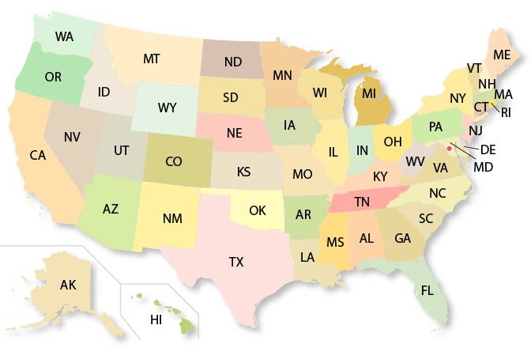
Dataset Description
Number of colonies
Number of colonies at the beginning of the quarter
Q1: January - March
Max number of colonies
Colonies plus all colonies moved into that state during the quarter
For each state in US:
Colony lost
Percentage and absolute values of colony lost
Q2: April - June
YEAR
from 2015 to 2022
Colony added
Colony that was either created or purchased
Q3: July - September
Colony renovated
Number of surviving colonies that were renewed
Stressors
Percentage of colonies affected by different types of stressors (1 feature each)
Q4: October - December
Diseases
Pesticides
Other
Varroa mites

Slide 3
Goals of the project
North American apiarists saw a dramatic decline in their honey bee colonies in last decade. When this phenomenon is particularly intense, we refer to it as “Colony Collapse Disorder”. Numerous causes for CCD have been proposed, but no single stressor alone seems to be responsible for the malady*.
Our objective is to understand possible precautions that would allow beekeepers to reduce future bee losses, as acting on stressors interactions or moving the colonies to new states depending on the season.
* Honeybee Veterinary Medicine, Vidal-Naquet, 2018
Notes:
Large-scale losses have occurred in previous years and the entity of lost seemed to be .

Slide 4
Tentative analytical workflow
Nonparametric Test
02
01
03
Exploratory DA
Modeling
ANOVA
Is there any difference among clusters?
PERMUTATIONAL TEST
Is the behaviour of losses different winter/summer?
Test if the differences found in the previous step have a statistical significance
FUNCTIONAL
Is there any difference
between stressors trend?
Divide US in regions, through cluster techniques and physical knowledge
Plot data in space and time to investigate possible patterns
Semiparametric regression
and nonparametric forecasting

