Slide 1
Honey Bee Health Analyses of reasons and preventions for high risk colony losses
Nonparametric Statistics Project
TEAM MEMBERS
Marta Cerri
Luca Mainini
Lupo Marsigli
Eugenio Varetti

Slide 2
Goals of the project
North American apiarists saw a dramatic decline in their honey bee colonies in last decade. When this phenomenon is particularly intense, we refer to it as “Colony Collapse Disorder”. Numerous causes for CCD have been proposed, but no single stressor alone seems to be responsible for the malady*.
Our objective is to understand possible precautions that would allow beekeepers to reduce future bee losses, as acting on stressors interactions or moving the colonies to new states depending on the season.
* Honeybee Veterinary Medicine, Vidal-Naquet, 2018
Notes:
Large-scale losses have occurred in previous years and the entity of lost seemed to be .

Slide 3
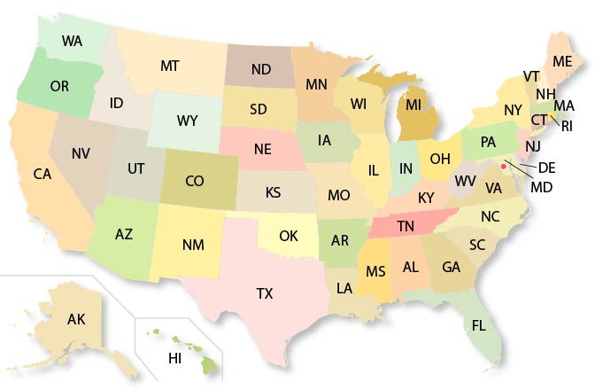
Dataset Description
Number of colonies
Number of colonies at the beginning of the quarter
Q1: January - March
Max number of colonies
Colonies plus all colonies moved into that state during the quarter
For each state in US:
Colony lost
Percentage and absolute values of colony lost
Q2: April - June
YEAR
from 2015 to 2022
Colony added
Colony that was either created or purchased
Q3: July - September
Colony renovated
Number of surviving colonies that were renewed
Stressors
Percentage of colonies affected by different types of stressors (1 feature each)
Q4: October - December
Diseases
Pesticides
Other
Varroa mites
x

Slide 4
Understanding the data
Assuming no colonies were moved out of state
Max colonies – Lost Colonies + Added Colonies = Beginning Inventory of next quarter
If no colonies are moved out of state, then the calculation above should be within 2% of the starting inventory of the following quarter. These small differences are mainly due to memory errors or miss of precision in filling out the survey.
Pollinating colonies are moved from state to state throughout the year following the crops that need to be pollinated. Therefore, the maximum number of colonies in a state can vary widely during a quarter and throughout the year.
x
Notes:
Data are obtained through a survey
While some colonies in the U.S. are primarily honey producing colonies and usually remain in one state, other colonies are primarily used for pollination purposes. Pollinating colonies are moved from state to state throughout the year following the crops that need to be pollinated. Therefore, the maximum number of colonies in a state can vary widely during a quarter and throughout the year. For example, on an individual record level an operation could not have any colonies in North Dakota at the beginning of a quarter because all of their colonies are in California for almond pollination. But during the middle of the quarter the almond pollination season ends and the colonies are moved back to North Dakota.

Slide 5
Additional Data
Average
Maximum
Temperature
Minimum
Drought
PDSI
Possible explanatory factors
Precipitation
PM 10
Pollution
PM 2.5
Air Quality Index

Slide 6
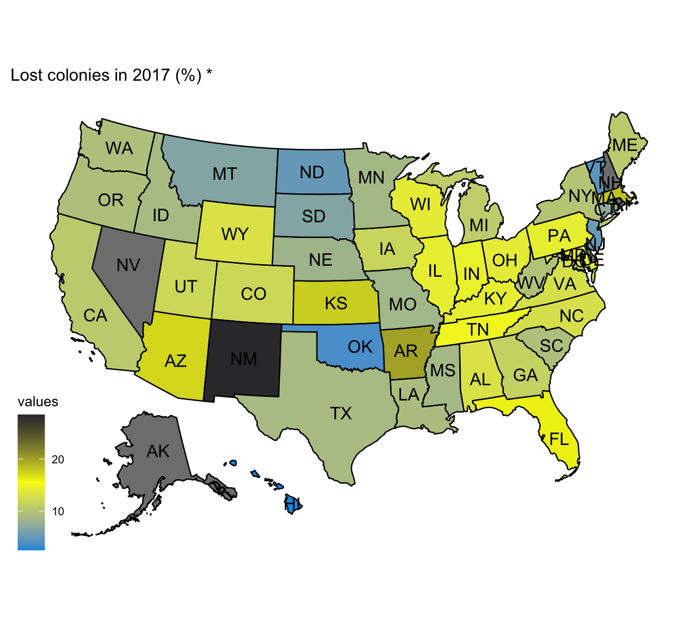
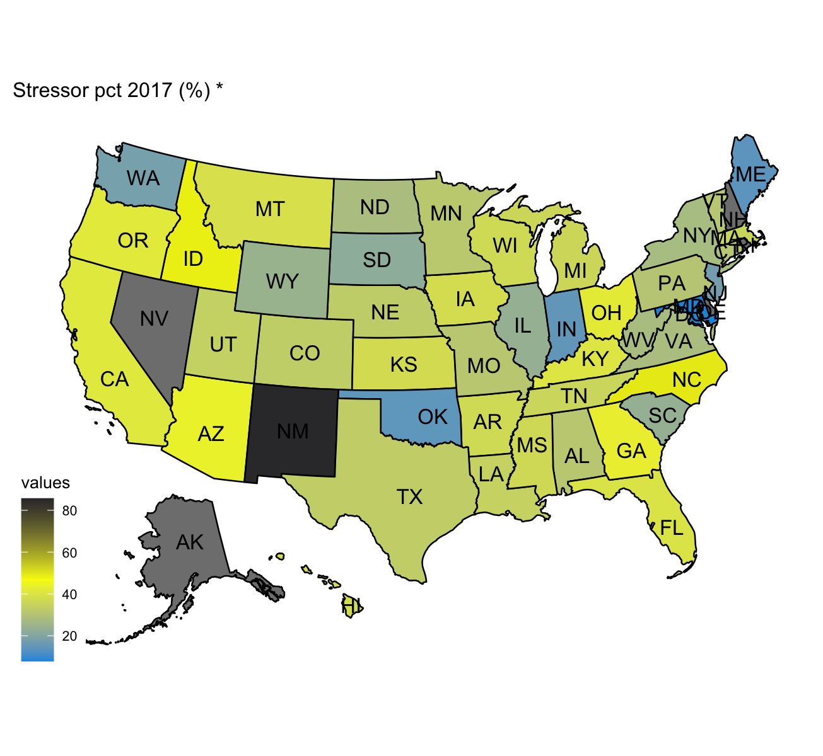

Slide 7
Tentative analytical workflow
Nonparametric Test
02
01
03
Exploratory DA
Modeling
ANOVA
Is there any difference among clusters?
PERMUTATIONAL TEST
Is the behaviour of losses different winter/summer?
Test if the differences found in the previous step have a statistical significance
FUNCTIONAL
Is there any difference
between stressors trend?
Divide US in regions, through cluster techniques and physical knowledge
Plot data in space and time to investigate possible patterns
Semiparametric regression
and nonparametric forecasting

