Slide 1



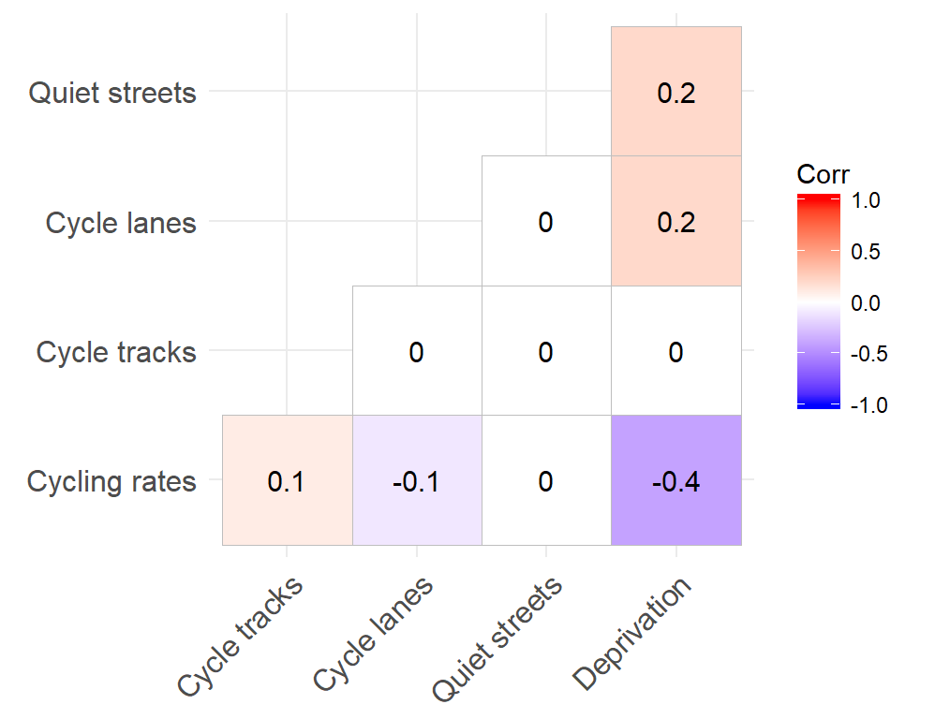
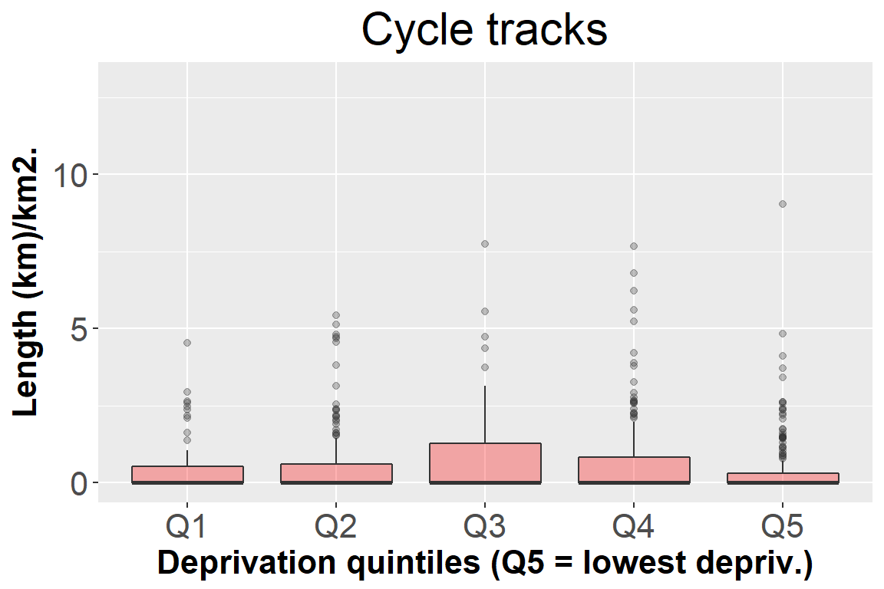
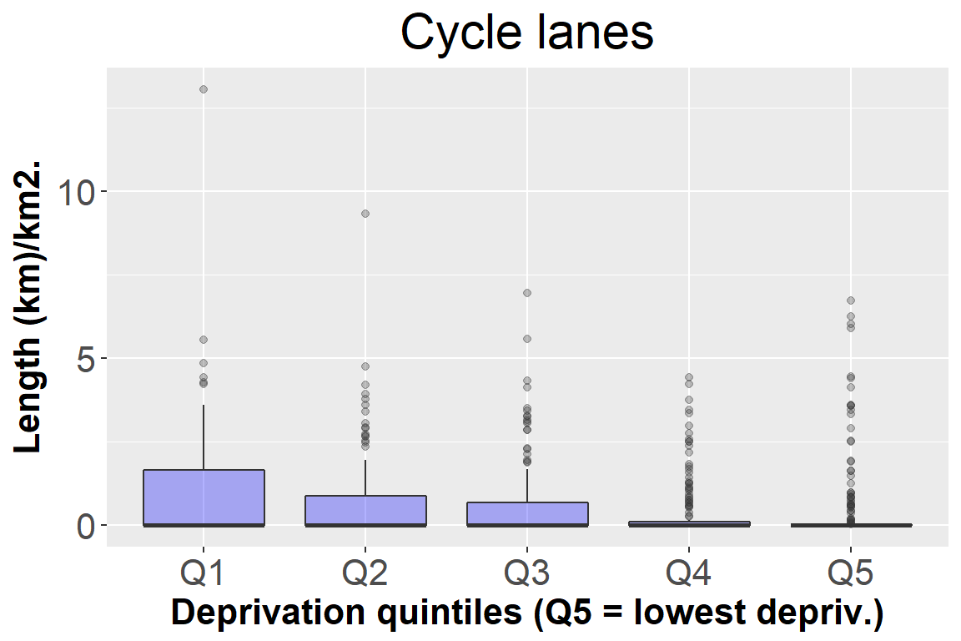
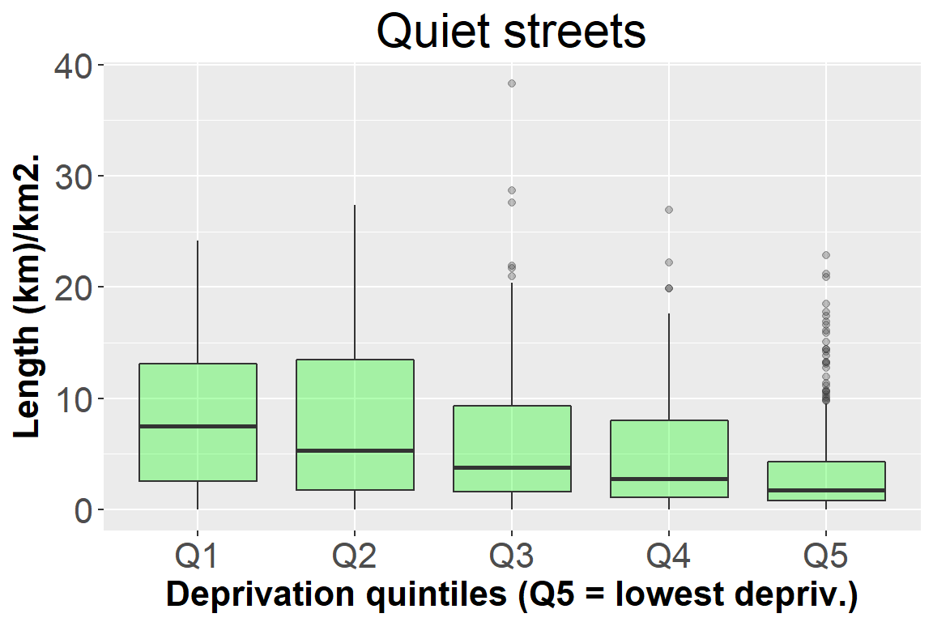
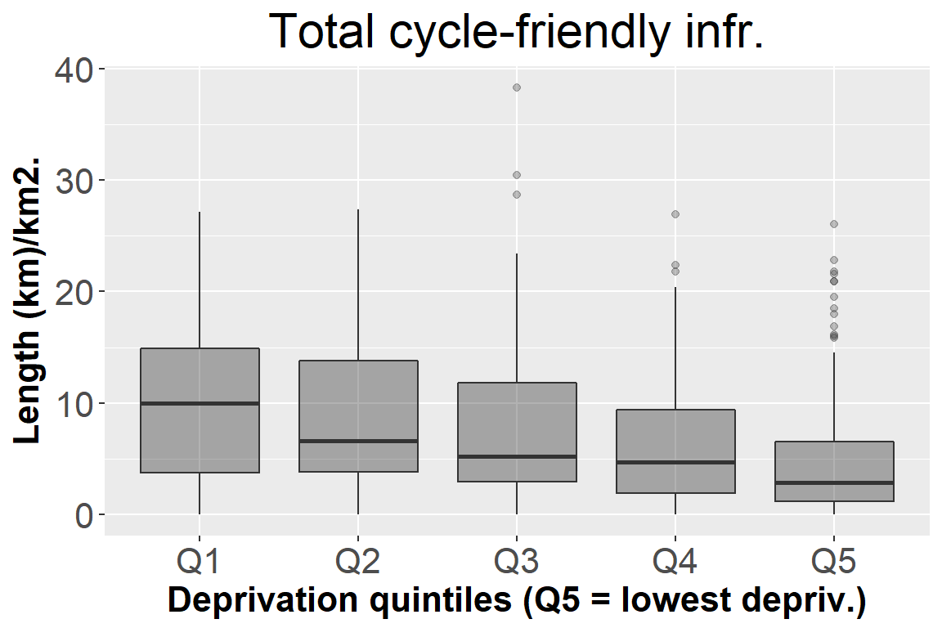
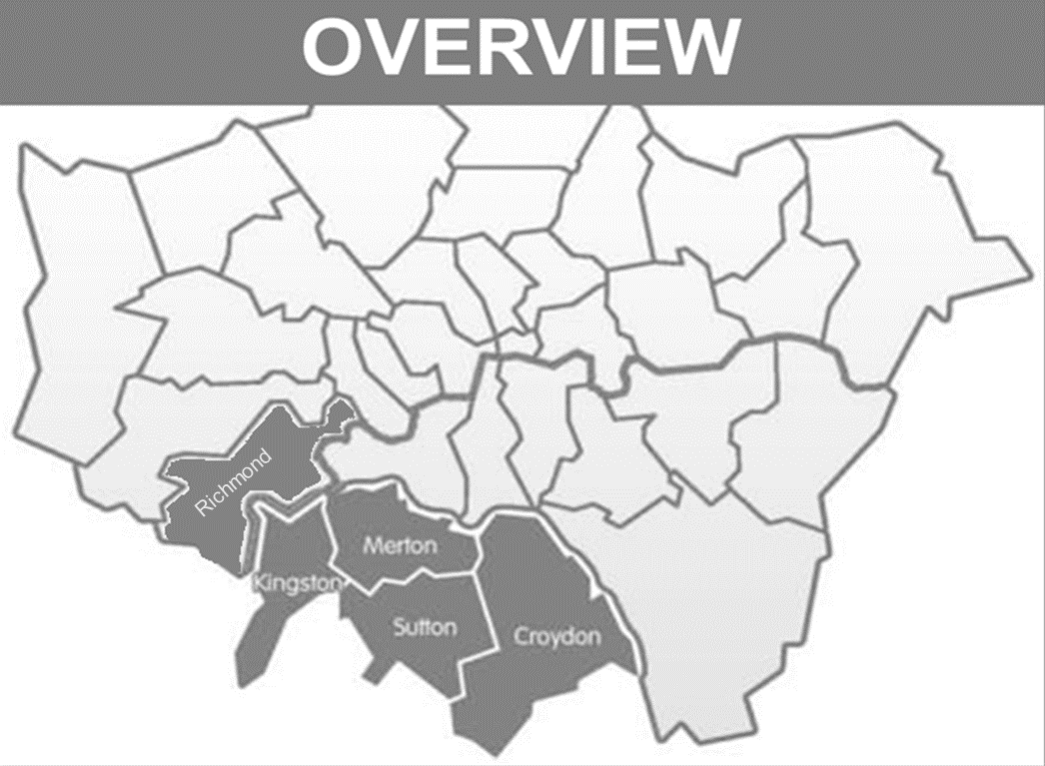
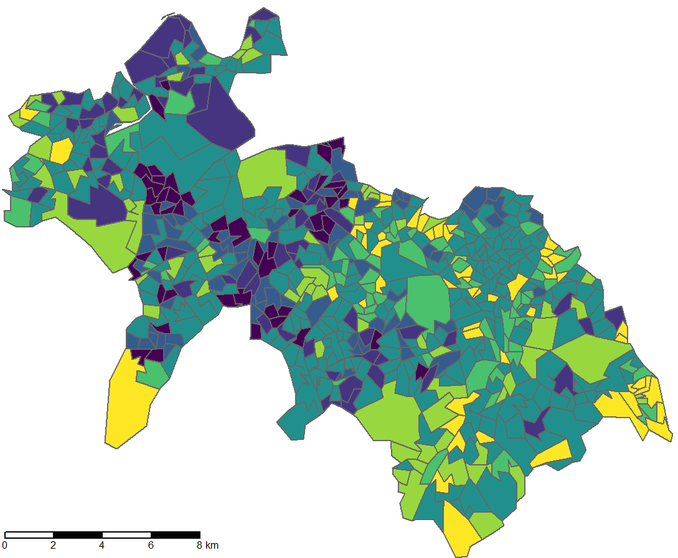
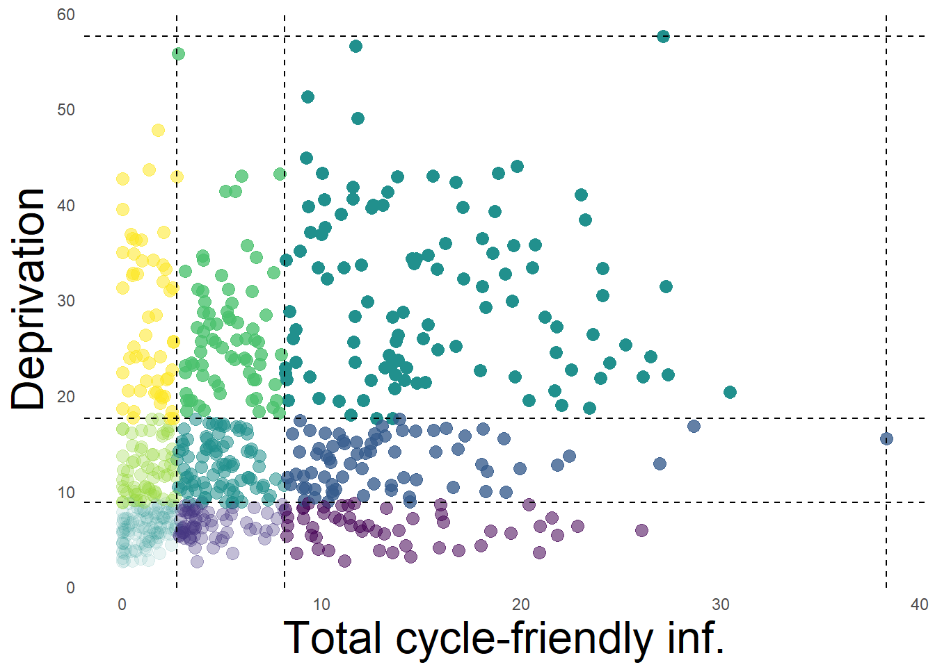
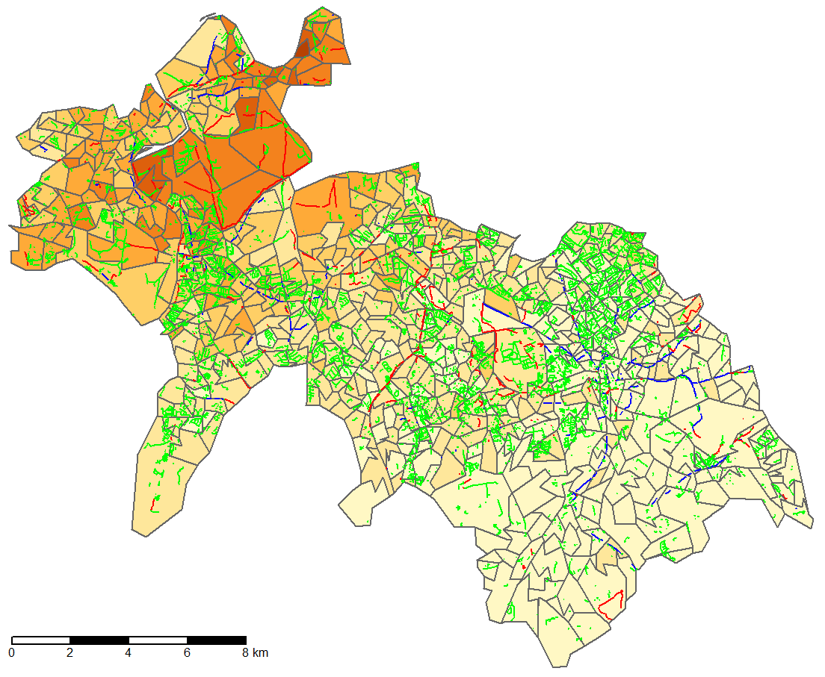
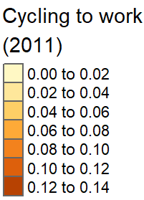
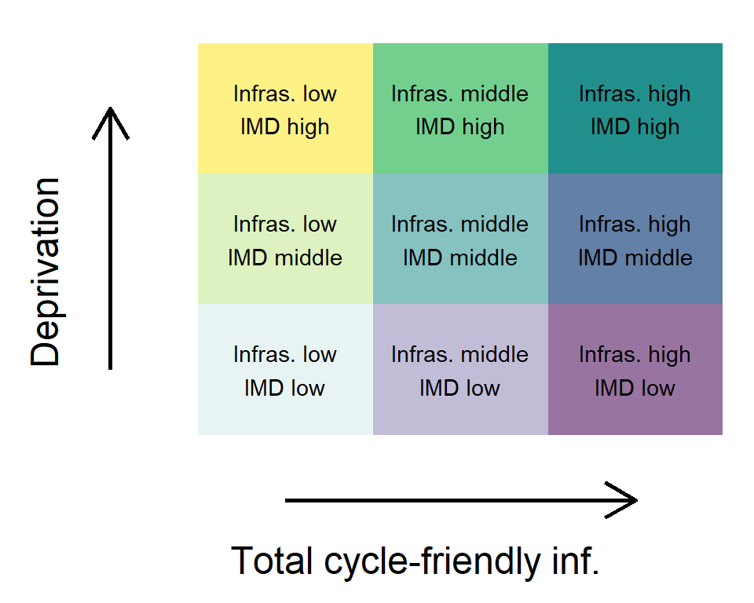
CYCLING RATES, CYCLE-FRIENDLY INFRASTRUCTURE AND DEPRIVATION IN THE SOUTH LONDON PARTNERSHIP AREA
Eugeni Vidal Tortosa¹, Robin Lovelace^{1,2}, Eva Heinen², Richard Mann³, and Claudia Peñaranda Fuentes⁴ ¹Leeds Institute for Data Analytics, University of Leeds, ²Institute for Transport Studies, University of Leeds, ³School of Mathematics, University of Leeds, and ⁴Transport for London.
INTRODUCTION
The benefits of cycling are widely recognised: cycling is healthy, affordable and often faster than travelling by car or public transport (Heinen et al 2010; Handy et al 2014). Therefore, it should be facilitated for everyone.
However, recent research shows that cycling infrastructure is not always well distributed, with the poorest and most disadvantaged areas often least benefited by investment (Teunissen et al 2015; Tucker and Manaugh 2017), although this is not always the case (Dill and Haggerty 2009; Winters et al 2017).
Guaranteeing the access of disadvantaged communities to cycling should be a priority, as it could help them to overcome daily barriers such as health deprivation, economic difficulties or social exclusion.
This study aims to gain knowledge on the relationship between cycling rates, cycle-friendly infrastructure and deprivation in the South London Partnership (SLP) area, so that its policymakers and practitioners can consider it when planning.
RESULTS
1. Cycling rates, cycle-friendly infrastructure and deprivation link
The only cycle-friendly infrastructure positively correlated with cycle rates is cycle tracks, although very weakly (+0.1). A negative link between cycling rates and deprivation has been also found (-0.4).
2. Assessment of equity in cycle-friendly infrastructure distribution
OBJECTIVES
Analyse the link between cycling rates, cycle-friendly infrastructure and deprivation in the SLP area.
Assess if the cycle-friendly infrastructure is equally distributed among its areas.
Identify areas in which future investment in infrastructure could help to increase cycling among the population living in deprived areas.
METHOD
3. Identification of areas to increase cycle-friendly infrastructure provision
Unit of analysis: Layer Super Output Areas (LSOA) - 678.
Setting: The SLP area - London boroughs of Croydon, Kingston, Merton, Richmond and Sutton.
Cycle track s (1)
Cycle lanes (2)
Quiet streets (3)
% cycle to work (2011)
0%-2%
2%-4%
4%-6%
6%-8%
8%-10%
10%-12%
12%-14%
Variables:
Cycling rates: % cycle to work based on census data (2011).
Cycle tracks : paths for cyclists on separated right of ways(km)/km2.
Cycle lanes: lanes for cyclists marked on the carriageways (km)/km2.
Quiet streets : 20mph roads shared with motorised vehicles (km)/km2.
Total cycle-friendly inf.: The sum of the 3 previous variables.
All the infrastructure data is based on OpenStreetMap.
Deprivation: IMD score based on the English indices of deprivation 2015.
* In yellow areas with high deprivation and low provision of total cycle-friendly infrastructure.
CONCLUSIONS
This study reveals that the only cycle-friendly infrastructure positively correlated with cycle rates in the SLP area is cycle tracks (the safest one), although very weakly. In addition, a clear negative correlation between cycling rates and deprivation has been found: the more deprivation, the less cycling participation.
Contrary to expectations, the analyses show that highly deprived areas have a greater density of cycle lanes and quiet streets than non-deprived ones in the SLP area. However, cycle tracks are particularly low in the areas that are either most deprived or least deprived.
Finally, we identified small clusters of spatial areas in which future investment in infrastructure should be considered to improve equity. To increase cycling among the most deprived populations in the SLP area, investment in behaviour-change programmes might be also needed.
Procedure: Setting objectives -> Data collection -> Data preparation -> Non-spatial analysis (correlogram and box diagrams) and spatial Data analysis (bivariate choropleth map) -> Data interpretation.
Software used: R (programming language).
Email: ts16evt@leeds.ac.uk Website: https://eugenividal.github.io/
Digital report: https://eugenividal.github.io/docs/CyclingDeprivedAreasSLP-Report.html
Digital poster: https://eugenividal.github.io/docs/CyclingDeprivedAreasSLP-Poster.pptx

