Slide 1
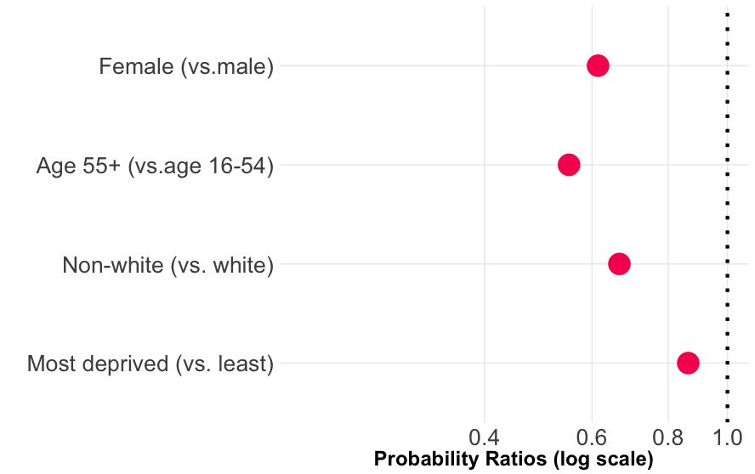
less likely
more likely
Females are 0.61 as likely as males to cycle

