Slide 1
DIAGNOSING ALZHEIMER’S DISEASE WITH MACHINE LEARNING
By Eugene Fong
Spring 2023
Prof. Chaojie Wang’s
Capstone in Data Science class
DATA 606 @UMBC

Slide 2
OVERVIEW
PHASE 1 – Proposal & Planning
  Literature Search: Alzheimer’s disease
  Diagnosing Alzheimer’s is hard!
  OASIS dataset
PHASE 2 – Data prep, EDA, & Data Viz
  Stats
  Data viz
  Filtering
PHASE 3 – Model training & Deployment
  Data cleansing & transformation
  Stratified train/test split
  Model training
  Prediction evaluation

Slide 3
PHASE 1
Proposal & Planning

Slide 4
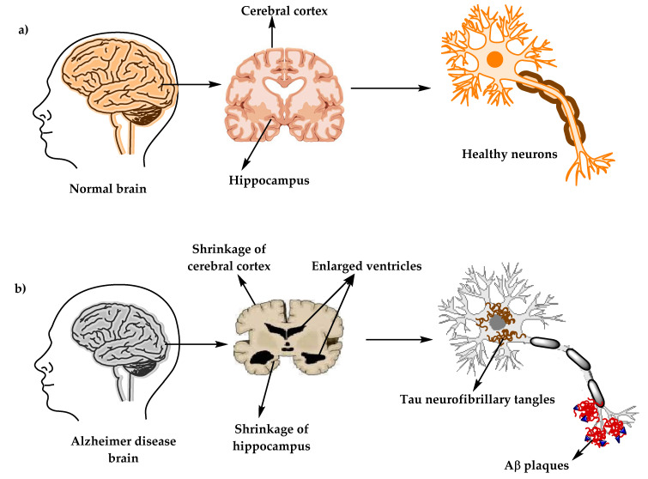
LITERATURE SEARCH:
Alzheimer’s disease (AD)
Quick facts:
  AD is most common form of dementia
  Slow progressive neurodegeneration
  Decline in cognitive functions of:
    Memory
    Language
    Motor skills
    Perception
Current drug treatments:
  NO CURE
  Some treatments can slow progression or treat specific symptoms
Notes:
AD is creeping up the list of top biological causes of death, approaching CVD, diabetes, cancers
SOURCES:
- Breijyeh 2020

Slide 5
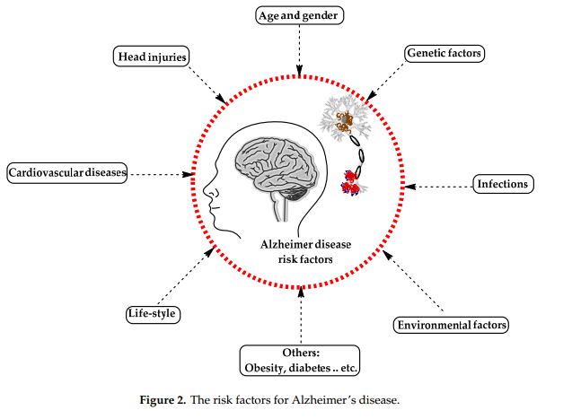
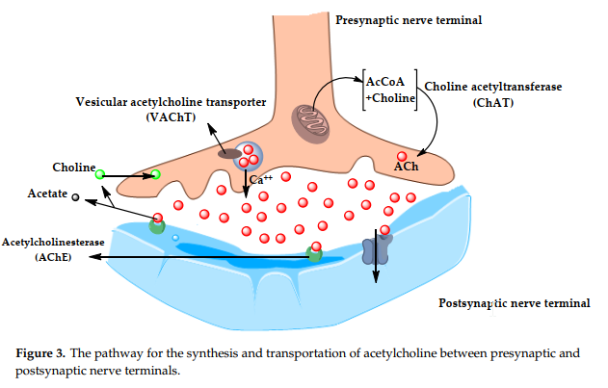
POSSIBLE CAUSES
Notes:
AD is multi-factorial
Macro causes (environmental):
- 2 copies of the recessive Apoe4 gene is a genetic risk for early-onset AD (BUT not guaranteed)
- Infections were recently confirmed to contribute to AD
Microbiological causes: Acetylcholine (ACh)
Deficits in AD pt’s
Neurotransmitter that’s used for:
memory, attention, sensory information, learning
Possibly being interfered with by AB plaques?
3-pronged attack:
1) reduced presynaptic cholinergic markers
2) severe neurodegradation in nucleus basalis of Meynart (NBM) in basal forebrain, the source of Ach
3) cholinergic antagonist activity (meaning: have opposite effect) to agonist ratio
SOURCES:
- Breijyeh 2020

Slide 6
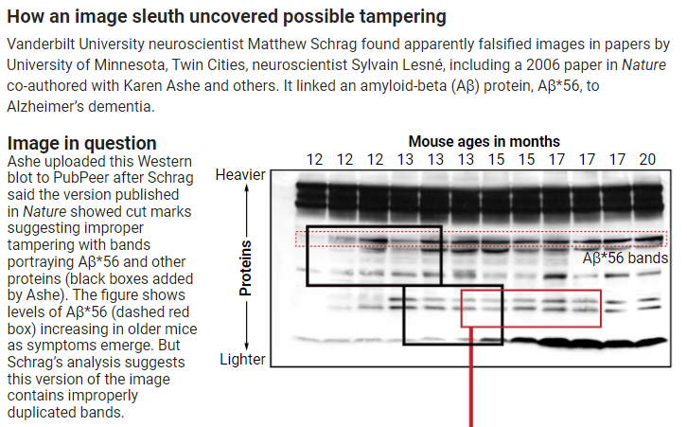
CONTROVERSY
In 2021, Schrag investigated the results of a landmark 2006 Nature paper by Lesne claiming to have found Amyloid-beta (AB) plaques cause AD:
  AB plaques might not be primary cause of AD?
  Possibly faked data
  >100s failed drug trials targeting AB plaques over the last few decades
Since 2003, only been 3 new FDA-approved drugs for AD. All of which target AB plaques, slowing AD progression by :
  Donanemab (5/2023): 35%
  Lecanemab (1/2023): 27%
  Aducanumab (7/2021): ???
Avg lifespan after diagnosis: 4 – 8 yrs (some up to 20 yrs)
  These drugs amount to 1 – 3 yrs avg extension, maybe 7 max
Notes:
SOURCES:
https://www.science.org/content/article/potential-fabrication-research-images-threatens-key-theory-alzheimers-disease
https://www.nature.com/articles/d41586-023-01537-5
https://www.yalemedicine.org/news/lecanemab-leqembi-new-alzheimers-drug

Slide 7
DIAGNOSING ALZHEIMER’S IS HARD!
METHOD | YEAR | SENSITIVITY = (TP) | SPECIFICITY = (TN) | USES | NOTES
MMSE | 1973 | 23% - 76% | 40% - 90% | Questionaire | For MCI --> general dementia pt's
NIA-Reagan | 1984 | / | / | Autopsy: plaques + tangles | 18% of dementia pt's can't be classified at all. AD Probability ranges of low, med, high. Only 3 combos classified as dementia
CERAD | 1991 | 70.9% - 87.3% | 44.3% - 70.8% | Autopsy: plaques, tangles, Lewy bodies, region, density, pathology OR Biopsy/brain scan | 25 possible combos of AD, improved over NIA-Reagan
MAN
VS_______________
MACHINE____________________
METHOD | YEAR | ACCURACY = (TP + TN) / (TP + FP + TN + FN) | RECALL = TP / (TP + FN) | AUC | USES
ML on speech | 2018 | 56% - 79% | / | / | Speech transcription + analysis
ML on OASIS longitudinal | 2022 | 76% - 86% | 65% - 80% | 76% - 87% | MMSE + clinical data
Notes:
NIA-Reagan = National Institute on Aging and the Reagan Institute Working Group on Diagnostic Criteria for the Neuropathological Assessment of Alzheimer’s Disease
CERAD = Consortium to Establish a Registry for Alzheimer's Disease
Most studies have high sensitivity, low specificity
- Hard to distinguish from other dementias
SOURCES:
Beach 2012
Buckner 2004
Folstein 1973
MMSE
Deva 2022

Slide 8

There are currently 4 OSASIS datasets with differing:
Years:
  2007 – 2020
Brain scans:
  CT
  MRI
  PET
Biomarkers:
  Tau
Patient cohorts being studied:
  Cross-sectional VS Longitudinal
  Dementia VS non-demented
“[OASIS] is… aimed at making neuroimaging data sets of the brain freely available to the scientific community”
Usually with the warning that you should NOT combine the different OASIS datasets
Notes:
SOURCES:
- https://www.oasis-brains.org/

Slide 9
MY DATASET: OASIS-1
CHARACTERISTIC | DESCRIPTION
TYPE | Cross-sectional data a slice in time, 1 single observation of each patient
YEAR | 2007
# OF PATIENTS | 416
GENDERS | M/F
COHORT | Dementia VS non-demented 100 pts > 60 yo diagnosed with AD 20 nondemented subjects also underwent follow-up within 90 days (for reliability comparison)
MRI | I will NOT be using any of the brain scan images Computer Vision (CV) analysis would probably take longer than a class period to run once on my laptop
Notes:
SOURCES:
- https://www.oasis-brains.org/

Slide 10
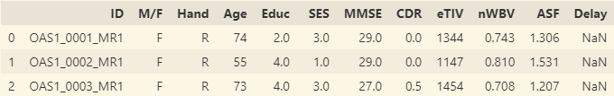
BUT WHAT DO THESE COLUMNS
MEAN???

Slide 11
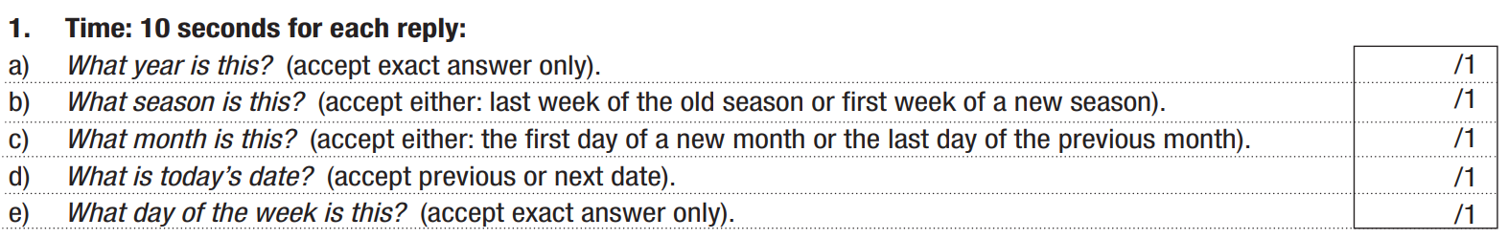
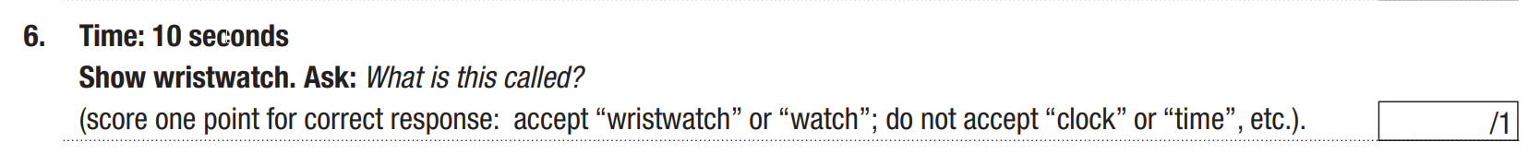
Mini-Mental State Exam (MMSE)
Notes:
Simple questionnaire style evaluation
Speed, memory, language, perception, writing
Test PDF provided in my GitHub in case you want to check yourselves/family/friends for Alzheimers
SOURCES:
https://www.dementiacarecentral.com/mini-mental-state-exam/
MMSE.pdf

Slide 12
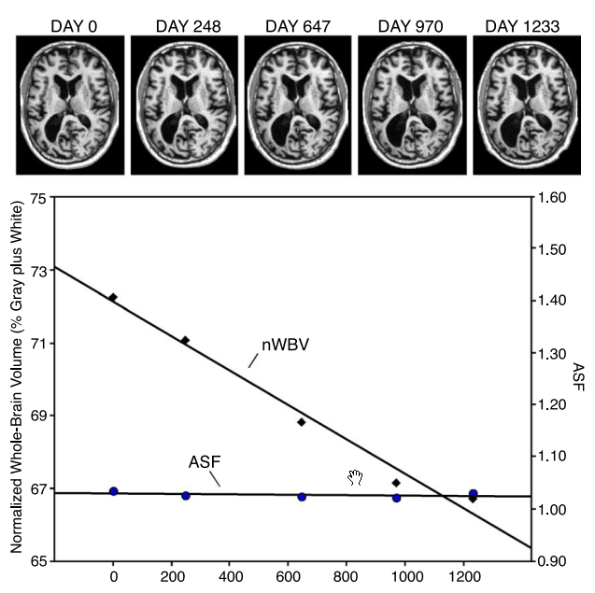
ASF VS nWBV
Atlas Scaling Factor (ASF) =
  A merged standardized representation of the human skull and brain used as template for comparisons across individuals
  This should be fairly stable over long time periods
Normalized Whole Brain Volume (nWBV) =
  Uses automated segmentation to ID the internal parts of the brain (white/gray matter, cerebrospinal fluid (CSF)) and then normalize that across individuals
Notes:
SOURCES:
- Buckner 2004

Slide 13
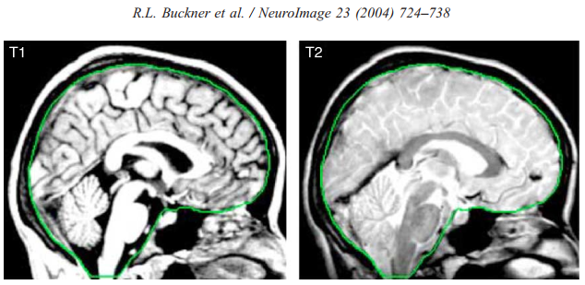
ESTIMATED INTRACRANIAL VOLUME (eTIV)
Green line is a trace showing the internal area considered for eTIV
  Includes all internal brain structures
  Can be automated
  Matched to the atlas
Notes:
SOURCES:
- Buckner 2004

Slide 14
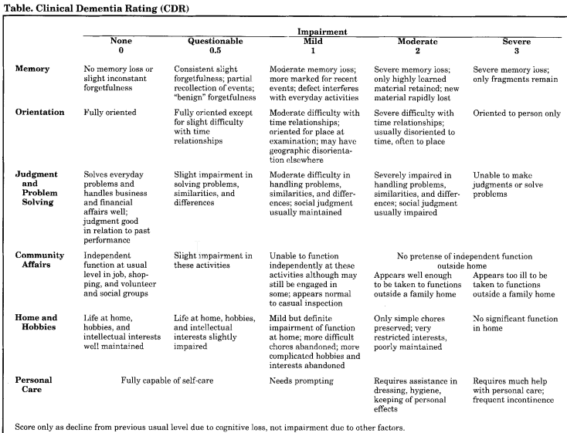
Clinical Dementia Rating (CDR)
TARGET!!!
Notes:
SOURCES:
- Morris 1993

Slide 15
PHASE 2
Data prep, EDA & Data Viz

Slide 16
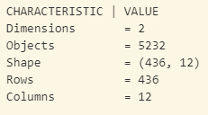
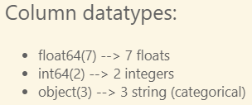
EXPLORATORY DATA ANALYSIS (EDA)
& DATA VIZ
Notes:
Datatypes
Mostly numerical (9 total)
Dimensions
436 rows = 416 pt’s + 20 returned after a DELAY (remove them)

Slide 17
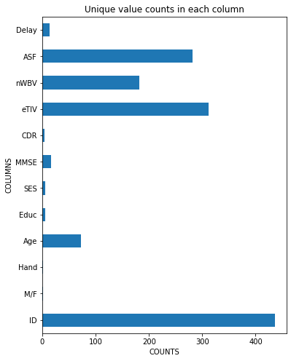
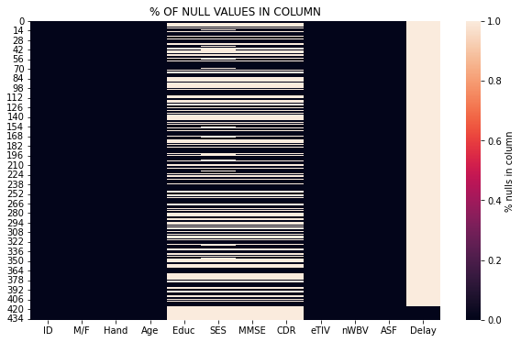
Notes:
Nulls
Most are NOT null
Almost all of Delay is null
Concerning that ½ the rows are ½ null
Unique counts:
ID is just about 100% unique
A few others around ½ unique

Slide 18
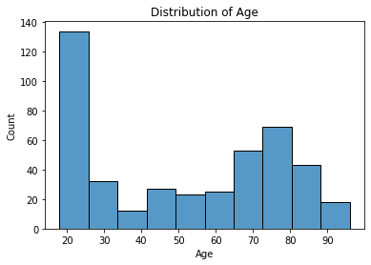
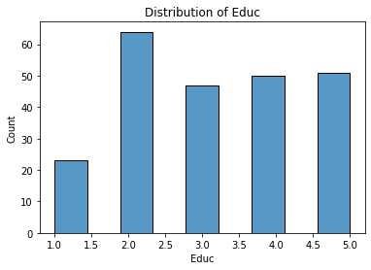
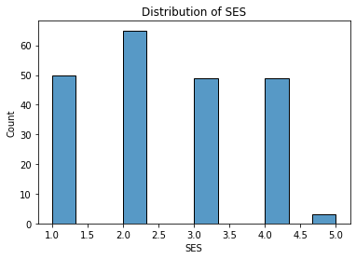
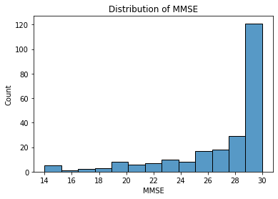
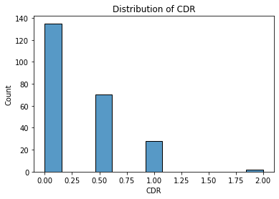
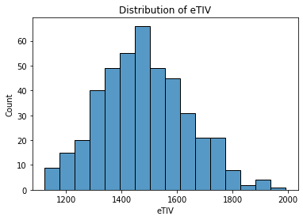
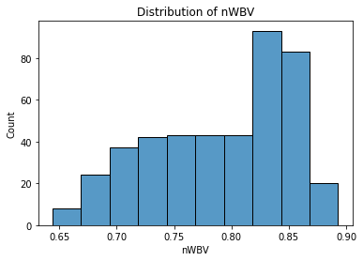
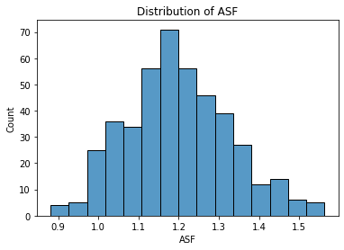
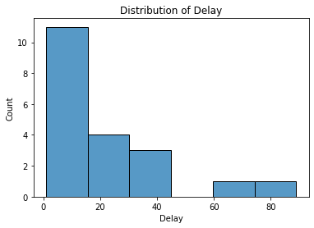
Notes:
Histograms showing the distribution of my numerical data ONLY
Most are NOT normal distributions
EXCEPTIONS: eTIV + ASF → already normalized

Slide 19
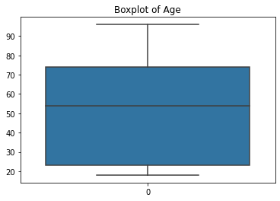
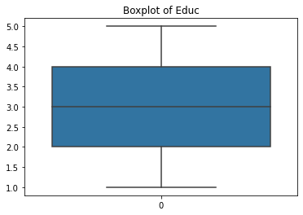
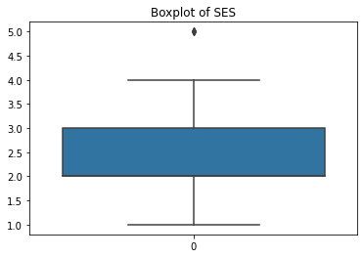
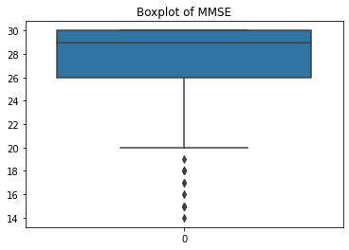
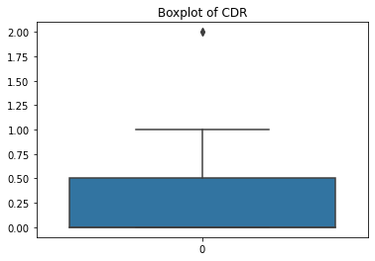
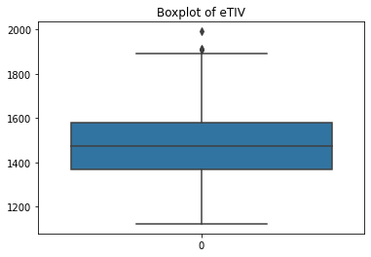
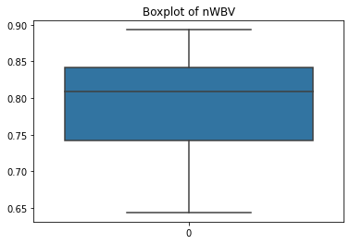
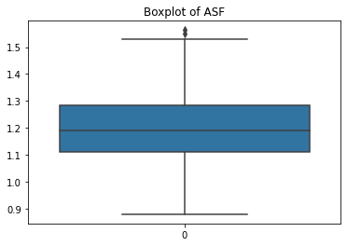
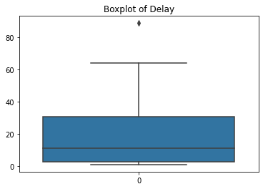
Notes:
Boxplots showing the distribution of my numerical data ONLY
Notable outliers/skewing:
MMSE → but Prof suggested that I should keep them
Delay → very few pt’s did the follow-up, deleting anyway
Notable columns within the center 50% (or 2 quartiles of IQR):
Age, Educ, SES
Already normalized?
eTIV, nWBW, ASF

Slide 20
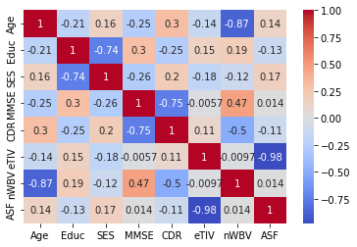
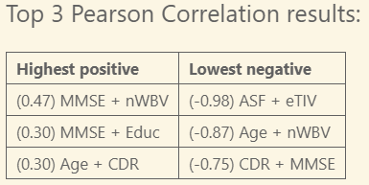
PEARSON CORRELATION

Slide 21
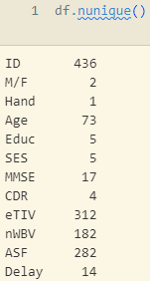
DATA CLEANSING & TRANSFORMATION
ID → 100% unique, REMOVE!
M/F → CONVERT into dummy variables
Hand → all right-handed, REMOVE!

Slide 22
 |  | CATEGORY
 |  | (N/A)
 |  | Demographics
 |  | Demographics
 |  | Demographics
 |  | Demographics
 |  | Demographics
 |  | Clinical
 |  | Clinical
 |  | Derived anatomic values
 |  | Derived anatomic values
 |  | Derived anatomic values
 |  | /
 | DATA TYPE
 | object
 | object
 | object
 | int64
 | float64
 | float64
 | float64
 | float64
 | int64
 | float64
 | float64
 | float64
COLUMN
ID
M/F
Hand
Age
Educ
SES
MMSE
CDR
eTIV
nWBV
ASF
Delay
 |  |  | DESCRIPTION
 |  |  | Patient identifier
 |  |  | Gender: male/female
 |  |  | Handedness: all right-handed (remove???)
 |  |  | Age: 18 - 96
 |  |  | Education codes: 1 = less than high school grad, 2 = high school grad, 3 = some college, 4 = college grad, 5 = beyond college
 |  |  | Socioeconomic status (SES) → ???
 |  |  | Mini-Mental State Examination
 |  |  | Clinical Dementia Rating (CDR): 0 = nondemented, 0.5 = very mild dementia, 1 = mild dementia, 2 = moderate dementia
 |  |  | Estimated total intracranial volume (mm^3)
 |  |  | Normalized whole brain volume (nWBV)
 |  |  | Atlas scaling factor
 |  |  | This may be for the longitudinal follow-up dataset, wherein patients returned <90 days later for follow-up scans
Notes:
SOURCES:
- https://www.oasis-brains.org/

Slide 23

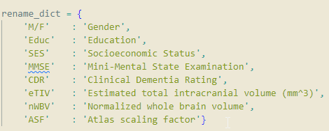

COLUMN | DATA TYPE | CATEGORY | DESCRIPTION
ID | object | (N/A) | Patient identifier
M/F | object | Demographics | Gender: male/female
Hand | object | Demographics | Handedness: all right-handed (remove???)
Age | int64 | Demographics | Age: 18 - 96
Educ | float64 | Demographics | Education codes: 1 = less than high school grad, 2 = high school grad, 3 = some college, 4 = college grad, 5 = beyond college
SES | float64 | Demographics | Socioeconomic status (SES) → ???
MMSE | float64 | Clinical | Mini-Mental State Examination
CDR | float64 | Clinical | Clinical Dementia Rating (CDR): 0 = nondemented, 0.5 = very mild dementia, 1 = mild dementia, 2 = moderate dementia
eTIV | int64 | Derived anatomic values | Estimated total intracranial volume (mm^3)
nWBV | float64 | Derived anatomic values | Normalized whole brain volume (nWBV)
ASF | float64 | Derived anatomic values | Atlas scaling factor
Delay | float64 | / | This may be for the longitudinal follow-up dataset, wherein patients returned <90 days later for follow-up scans
COLUMN | DATA TYPE | CATEGORY | DESCRIPTION
ID | object | (N/A) | Patient identifier
M/F | object | Demographics | Gender: male/female
Hand | object | Demographics | Handedness: all right-handed (remove???)
Age | int64 | Demographics | Age: 18 - 96
Educ | float64 | Demographics | Education codes: 1 = less than high school grad, 2 = high school grad, 3 = some college, 4 = college grad, 5 = beyond college
SES | float64 | Demographics | Socioeconomic status (SES) → ???
MMSE | float64 | Clinical | Mini-Mental State Examination
CDR | float64 | Clinical | Clinical Dementia Rating (CDR): 0 = nondemented, 0.5 = very mild dementia, 1 = mild dementia, 2 = moderate dementia
eTIV | int64 | Derived anatomic values | Estimated total intracranial volume (mm^3)
nWBV | float64 | Derived anatomic values | Normalized whole brain volume (nWBV)
ASF | float64 | Derived anatomic values | Atlas scaling factor
Delay | float64 | / | This may be for the longitudinal follow-up dataset, wherein patients returned <90 days later for follow-up scans
COLUMN | DATA TYPE | CATEGORY | DESCRIPTION
ID | object | (N/A) | Patient identifier
M/F | object | Demographics | Gender: male/female
Hand | object | Demographics | Handedness: all right-handed (remove???)
Age | int64 | Demographics | Age: 18 - 96
Educ | float64 | Demographics | Education codes: 1 = less than high school grad, 2 = high school grad, 3 = some college, 4 = college grad, 5 = beyond college
SES | float64 | Demographics | Socioeconomic status (SES) → ???
MMSE | float64 | Clinical | Mini-Mental State Examination
CDR | float64 | Clinical | Clinical Dementia Rating (CDR): 0 = nondemented, 0.5 = very mild dementia, 1 = mild dementia, 2 = moderate dementia
eTIV | int64 | Derived anatomic values | Estimated total intracranial volume (mm^3)
nWBV | float64 | Derived anatomic values | Normalized whole brain volume (nWBV)
ASF | float64 | Derived anatomic values | Atlas scaling factor
Delay | float64 | / | This may be for the longitudinal follow-up dataset, wherein patients returned <90 days later for follow-up scans
COLUMN | DATA TYPE | CATEGORY | DESCRIPTION
ID | object | (N/A) | Patient identifier
M/F | object | Demographics | Gender: male/female
Hand | object | Demographics | Handedness: all right-handed (remove???)
Age | int64 | Demographics | Age: 18 - 96
Educ | float64 | Demographics | Education codes: 1 = less than high school grad, 2 = high school grad, 3 = some college, 4 = college grad, 5 = beyond college
SES | float64 | Demographics | Socioeconomic status (SES) → ???
MMSE | float64 | Clinical | Mini-Mental State Examination
CDR | float64 | Clinical | Clinical Dementia Rating (CDR): 0 = nondemented, 0.5 = very mild dementia, 1 = mild dementia, 2 = moderate dementia
eTIV | int64 | Derived anatomic values | Estimated total intracranial volume (mm^3)
nWBV | float64 | Derived anatomic values | Normalized whole brain volume (nWBV)
ASF | float64 | Derived anatomic values | Atlas scaling factor
Delay | float64 | / | This may be for the longitudinal follow-up dataset, wherein patients returned <90 days later for follow-up scans
COLUMN | DATA TYPE | CATEGORY | DESCRIPTION
ID | object | (N/A) | Patient identifier
M/F | object | Demographics | Gender: male/female
Hand | object | Demographics | Handedness: all right-handed (remove???)
Age | int64 | Demographics | Age: 18 - 96
Educ | float64 | Demographics | Education codes: 1 = less than high school grad, 2 = high school grad, 3 = some college, 4 = college grad, 5 = beyond college
SES | float64 | Demographics | Socioeconomic status (SES) → ???
MMSE | float64 | Clinical | Mini-Mental State Examination
CDR | float64 | Clinical | Clinical Dementia Rating (CDR): 0 = nondemented, 0.5 = very mild dementia, 1 = mild dementia, 2 = moderate dementia
eTIV | int64 | Derived anatomic values | Estimated total intracranial volume (mm^3)
nWBV | float64 | Derived anatomic values | Normalized whole brain volume (nWBV)
ASF | float64 | Derived anatomic values | Atlas scaling factor
Delay | float64 | / | This may be for the longitudinal follow-up dataset, wherein patients returned <90 days later for follow-up scans
COLUMN | DATA TYPE | CATEGORY | DESCRIPTION
ID | object | (N/A) | Patient identifier
COLUMN | DATA TYPE | CATEGORY | DESCRIPTION
ID | object | (N/A) | Patient identifier
M/F | object | Demographics | Gender: male/female
Hand | object | Demographics | Handedness: all right-handed (remove???)
Age | int64 | Demographics | Age: 18 - 96
Educ | float64 | Demographics | Education codes: 1 = less than high school grad, 2 = high school grad, 3 = some college, 4 = college grad, 5 = beyond college
SES | float64 | Demographics | Socioeconomic status (SES) → ???
COLUMN | DATA TYPE | CATEGORY | DESCRIPTION
ID | object | (N/A) | Patient identifier
M/F | object | Demographics | Gender: male/female
Hand | object | Demographics | Handedness: all right-handed (remove???)
Age | int64 | Demographics | Age: 18 - 96
Educ | float64 | Demographics | Education codes: 1 = less than high school grad, 2 = high school grad, 3 = some college, 4 = college grad, 5 = beyond college
SES | float64 | Demographics | Socioeconomic status (SES) → ???
MMSE | float64 | Clinical | Mini-Mental State Examination
CDR | float64 | Clinical | Clinical Dementia Rating (CDR): 0 = nondemented, 0.5 = very mild dementia, 1 = mild dementia, 2 = moderate dementia
COLUMN | DATA TYPE | CATEGORY | DESCRIPTION
ID | object | (N/A) | Patient identifier
M/F | object | Demographics | Gender: male/female
Hand | object | Demographics | Handedness: all right-handed (remove???)
Age | int64 | Demographics | Age: 18 - 96
Educ | float64 | Demographics | Education codes: 1 = less than high school grad, 2 = high school grad, 3 = some college, 4 = college grad, 5 = beyond college
SES | float64 | Demographics | Socioeconomic status (SES) → ???
MMSE | float64 | Clinical | Mini-Mental State Examination
CDR | float64 | Clinical | Clinical Dementia Rating (CDR): 0 = nondemented, 0.5 = very mild dementia, 1 = mild dementia, 2 = moderate dementia
eTIV | int64 | Derived anatomic values | Estimated total intracranial volume (mm^3)
nWBV | float64 | Derived anatomic values | Normalized whole brain volume (nWBV)
ASF | float64 | Derived anatomic values | Atlas scaling factor
COLUMN | DATA TYPE | CATEGORY | DESCRIPTION
ID | object | (N/A) | Patient identifier
M/F | object | Demographics | Gender: male/female
Hand | object | Demographics | Handedness: all right-handed (remove???)
Age | int64 | Demographics | Age: 18 - 96
Educ | float64 | Demographics | Education codes: 1 = less than high school grad, 2 = high school grad, 3 = some college, 4 = college grad, 5 = beyond college
SES | float64 | Demographics | Socioeconomic status (SES) → ???
MMSE | float64 | Clinical | Mini-Mental State Examination
CDR | float64 | Clinical | Clinical Dementia Rating (CDR): 0 = nondemented, 0.5 = very mild dementia, 1 = mild dementia, 2 = moderate dementia
eTIV | int64 | Derived anatomic values | Estimated total intracranial volume (mm^3)
nWBV | float64 | Derived anatomic values | Normalized whole brain volume (nWBV)
ASF | float64 | Derived anatomic values | Atlas scaling factor
Delay | float64 | / | This may be for the longitudinal follow-up dataset, wherein patients returned <90 days later for follow-up scans
Notes:
Category column:
Based on the provided metadata
Remove columns:
Patient ID
Delay
CDR
Can be regrouped into 2 groups for binary classification: nondemented VS demented
Hand
Removing since all right-handed, not useful distinguishing info
SES
Cannot find any info on how this was binned anywhere and there are multiple papers using this same system without defining it
SOURCES:
- https://www.oasis-brains.org/

Slide 24
PHASE 3
Model training & Deployment

Slide 25

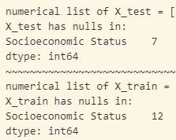

MACHINE LEARNING (ML) PIPELINE
1) Define data/target variables
X = data → everything else
y = target → CDR col (demented VS non-demented)
3) Impute missing values + normalize
Non-normal distributions and discrete numerical instead of continuous numerical values
Strategy: median
Impute train/test SEPARATELY!
2) Stratified train/test split (80/20)
Maintain same ratio of demented to non-demented

Slide 26
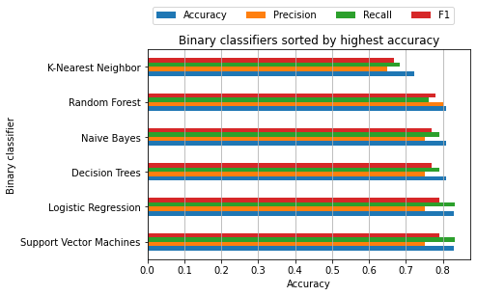
ML PIPELINE
4) Fit data by training with:
Decision trees
K-Nearest Neighbors (KNN)
Logistic Regression
Naïve Bayes
Random Forest
Support Vector Machines (SVM)
MODELS (sorted by Accuracy) | ACCURACY | PRECISION | RECALL | F1
SVM | 83.0% | 75.0% | 83.3% | 78.9%
Logistic Regression | 83.0% | 75.0% | 83.3% | 78.9%
Decision Trees | 80.9% | 75.0% | 78.9% | 76.9%
Naive Bayes | 80.9% | 75.0% | 78.9% | 76.9%
Random Forest | 80.9% | 80.0% | 76.2% | 78.0%
KNN | 72.3% | 65.0% | 68.4% | 66.7%
5) Make predictions on test data
Confusion matrix (CM) for evaluation
  Accuracy
  Precision
  Recall
  F1
Notes:
Fit data using:
Decision trees
K-nearest neighbors
Logistic regression
Naïve Bayes
Random forest
Support Vector Machines

Slide 27
DIAGNOSING ALZHEIMER’S IS HARD!
METHOD | YEAR | SENSITIVITY = (TP) | SPECIFICITY = (TN) | USES | NOTES
MMSE | 1973 | 23% - 76% | 40% - 90% | Questionaire | For MCI --> general dementia pt's
NIA-Reagan | 1984 | / | / | Autopsy: plaques + tangles | 18% of dementia pt's can't be classified at all. AD Probability ranges of low, med, high. Only 3 combos classified as dementia
CERAD | 1991 | 70.9% - 87.3% | 44.3% - 70.8% | Autopsy: plaques, tangles, Lewy bodies, region, density, pathology OR Biopsy/brain scan | 25 possible combos of AD, improved over NIA-Reagan
METHOD | YEAR | SENSITIVITY = (TP) | SPECIFICITY = (TN) | USES | NOTES
MMSE | 1973 | 23% - 76% | 40% - 90% | Questionaire | For MCI --> general dementia pt's
NIA-Reagan | 1984 | / | / | Autopsy: plaques + tangles | 18% of dementia pt's can't be classified at all. AD Probability ranges of low, med, high. Only 3 combos classified as dementia
CERAD | 1991 | 70.9% - 87.3% | 44.3% - 70.8% | Autopsy: plaques, tangles, Lewy bodies, region, density, pathology OR Biopsy/brain scan | 25 possible combos of AD, improved over NIA-Reagan
MAN
VS_______________
MACHINE____________________
METHOD | YEAR | ACCURACY = (TP + TN) / (TP + FP + TN + FN) | RECALL = TP / (TP + FN) | AUC | USES
ML on speech | 2018 | 56% - 79% | / | / | Speech transcription + analysis
ML on OASIS longitudinal | 2022 | 76% - 86% | 65% - 80% | 76% - 87% | MMSE + clinical data
ML on OASIS cross-section | 2023 | 72% - 83% | 65% - 70% | / | MMSE + clinical data
METHOD | YEAR | ACCURACY = (TP + TN) / (TP + FP + TN + FN) | RECALL = TP / (TP + FN) | AUC | USES
ML on speech | 2018 | 56% - 79% | / | / | Speech transcription + analysis
ML on OASIS longitudinal | 2022 | 76% - 86% | 65% - 80% | 76% - 87% | MMSE + clinical data
Notes:
CAVEAT:
- ML is good, but the best trained doctors can still diagnose better in certain scenarios
Most studies have high sensitivity, low specificity
- Hard to distinguish from other dementias
SOURCES:
Beach 2012
Buckner 2004
Folstein 1973
MMSE
Deva 2022

Slide 28
CONCLUSION
Machine Learning attempts to take over doctor jobs… has FAILED
  Currently approaches/matches upper range of human doctor accuracy, but doesn’t surpass it
But it could be a good assistant!
  With improvements like:
    More carefully massaged data
    Larger datasets
    Hypertuning
  It could start to surpass human accuracy
But the goal was just diagnosing Alzheimer’s with ML and that does seem to be achieved with multiple ML methods
  Despite setting random_state = 1…
  I’m still getting different results every run and the top models shuffle a bit, but the top of the ranges are still in the 70s – 80s % area

Slide 29
FUTURE DIRECTIONS
With current data
Streamlit web app
Different ML approaches or a combination of approaches?
  Adaboost
  Column transformer
  Hypertuning
  Multi-class classification
With NEW data
Meta-analysis with other AD studies
The other 3 OASIS datasets
  Longitudinal datasets may be able to pinpoint exact time when patient crosses over from normal aging into dementia
Computer Vision (CV) approaches on brain scans combined with textual data
… ChatGPT ???

Slide 30
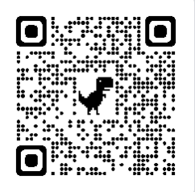
Q&A??? (& LINKS)
SITE | LINK
GitHub | https://github.com/eugf/eugene_data606
Youtube vid | (TBD)
Streamlit web app | (TBD)

Slide 31
REFERENCES
OASIS-1: Cross-Sectional: https://doi.org/10.1162/jocn.2007.19.9.1498
Arevalo-Rodriguez, I., Smailagic, N., Roqué-Figuls, M., Ciapponi, A., Sanchez-Perez, E., Giannakou, A., Pedraza, O. L., Bonfill Cosp, X., & Cullum, S. (2021). Mini-Mental State Examination (MMSE) for the early detection of dementia in people with mild cognitive impairment (MCI). Cochrane Database of Systematic Reviews, 2021(7). https://doi.org/10.1002/14651858.CD010783.pub3
Beach, T. G., Monsell, S. E., Phillips, L. E., & Kukull, W. (2012). Accuracy of the Clinical Diagnosis of Alzheimer Disease at National Institute on Aging Alzheimer Disease Centers, 2005Y2010. J Neuropathol Exp Neurol, 71(4).
Ben Ammar, R., & Ben Ayed, Y. (2018). Speech Processing for Early Alzheimer Disease Diagnosis: Machine Learning Based Approach. 2018 IEEE/ACS 15th International Conference on Computer Systems and Applications (AICCSA), 1–8. https://doi.org/10.1109/AICCSA.2018.8612831
Breijyeh, Z., & Karaman, R. (2020). Comprehensive Review on Alzheimer’s Disease: Causes and Treatment. Molecules, 25(24), 5789. https://doi.org/10.3390/molecules25245789
Buckner, R. L., Head, D., Parker, J., Fotenos, A. F., Marcus, D., Morris, J. C., & Snyder, A. Z. (2004). A unified approach for morphometric and functional data analysis in young, old, and demented adults using automated atlas-based head size normalization: Reliability and validation against manual measurement of total intracranial volume. NeuroImage, 23(2), 724–738. https://doi.org/10.1016/j.neuroimage.2004.06.018
Diagnosis Of Alzheimer’s Disease Using Machine Learning. (n.d.). International Journal of Engineering Technology and Management Sciences.
Folstein, M. F., Folstein, S. E., & McHugh, P. R. (1975). “Mini-mental state.” Journal of Psychiatric Research, 12(3), 189–198. https://doi.org/10.1016/0022-3956(75)90026-6
Penn, R. D., & Mangieri, E. A. (1993). Stiff‐man syndrome treated with intrathecal baclofen. Neurology, 43(11), 2412.1-2412. https://doi.org/10.1212/WNL.43.11.2412
Rubin, E. H., Storandt, M., Miller, J. P., Kinscherf, D. A., Grant, E. A., Morris, J. C., & Berg, L. (1998). A Prospective Study of Cognitive Function and Onset of Dementia in Cognitively Healthy Elders. Archives of Neurology, 55(3), 395. https://doi.org/10.1001/archneur.55.3.395

