Slide 1

ToonDo
Notes:
Concept: Eugene
Requirements: Jason
UML Diagrams: AJ
Mockup + Components: Sergio
Sequence Diagram: Czavier

Slide 2
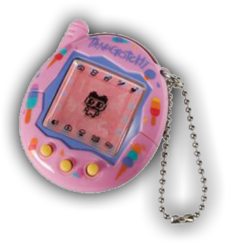
Concept
A to-do list done right
Continued completion of tasks is rewarded; failure is punished
“Toon” pixel avatar whose status relies on your completion of tasks
Tamagotchi-inspired

Slide 3
Key Functional Requirements
Task List
Keep track of tasks
User can check a task complete and add new tasks
Toons
Interactive pixel avatar
“Toon” status corresponds to task list completion
Customization
Profile Page
Displays user profile, basic information
Link to different mates and task lists
Sharing to social media
Map
Overview of all the toon (one per task list)
Gives a more personal attachment in seeing the fruits of your labor

Slide 4
Key Nonfunctional Requirements
MERN stack
Web and mobile framework
Using React
Non-relational database
Using MongoDB
REST API
Using Express.js and Node.js
Privacy
Task lists are kept private
Only toon status can be shared on social media

Slide 5
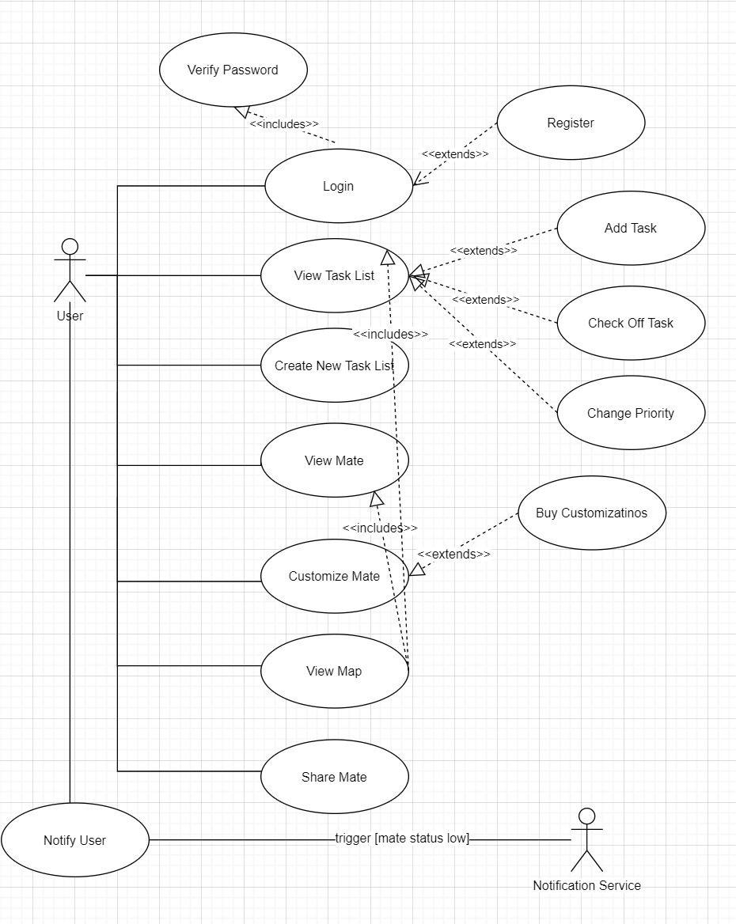
UML Use Case Diagram
Notes:
“Toons” not “mate”

Slide 6
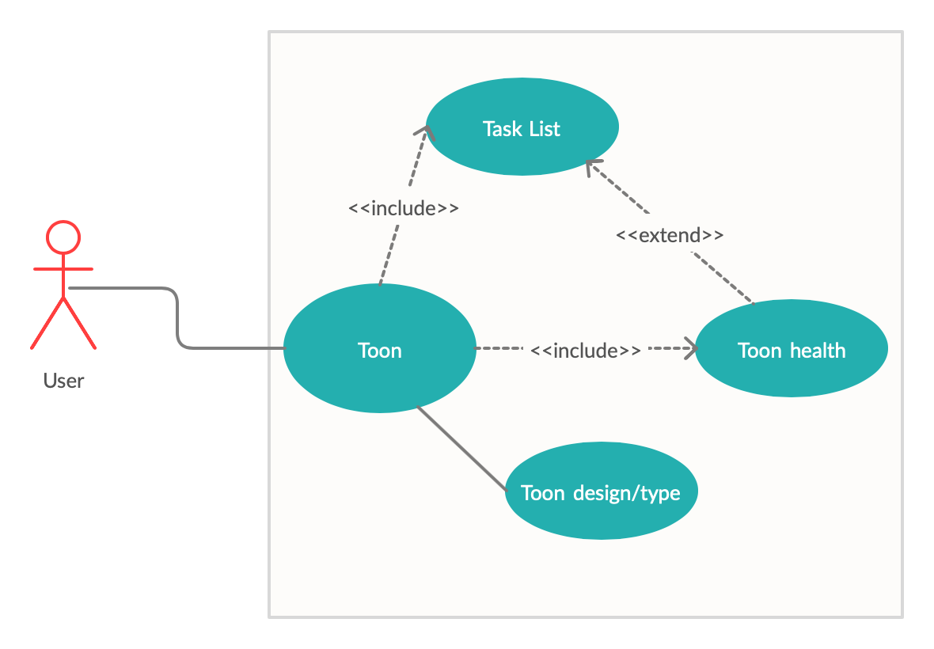
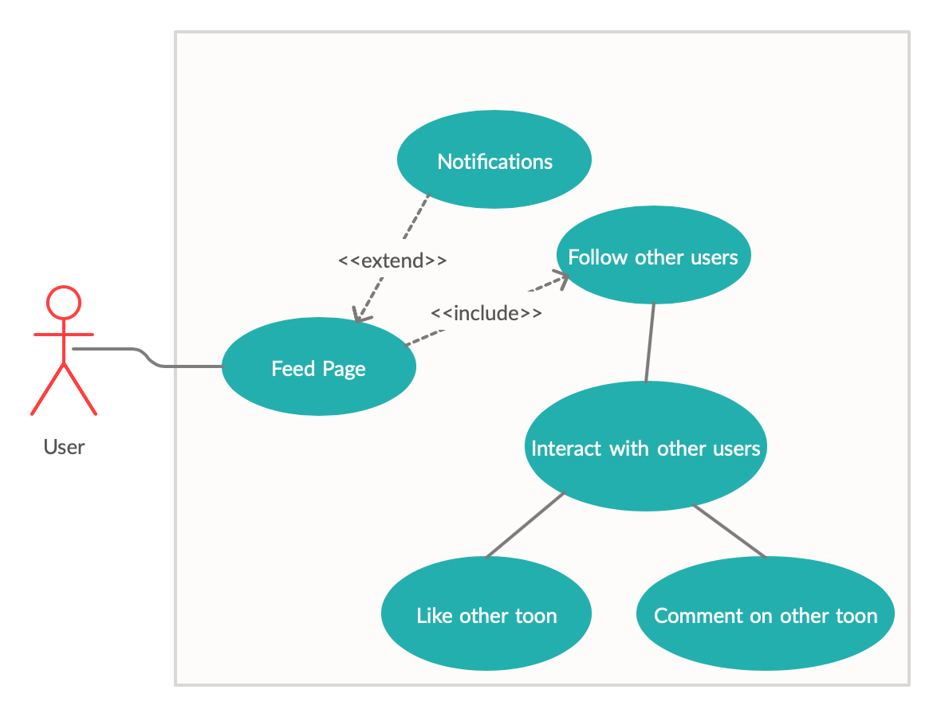

Slide 7
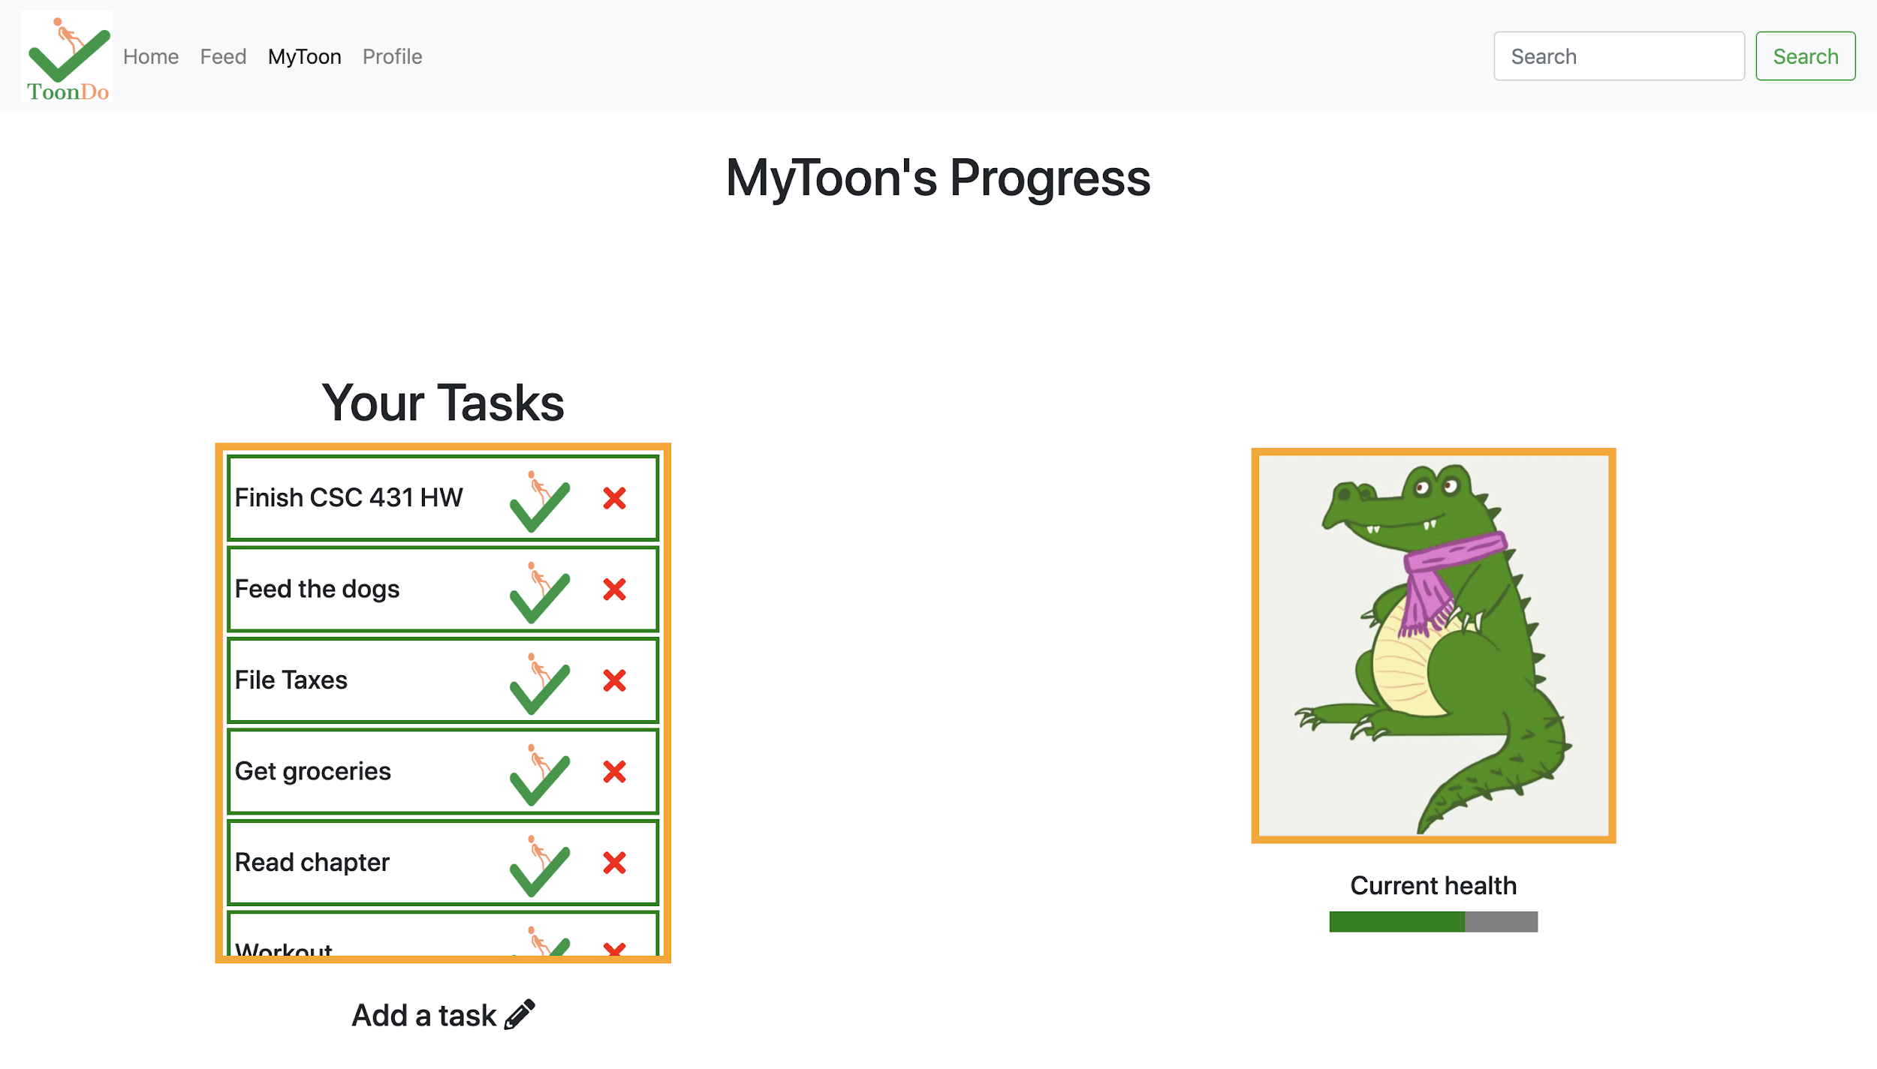
Mockup

Slide 8
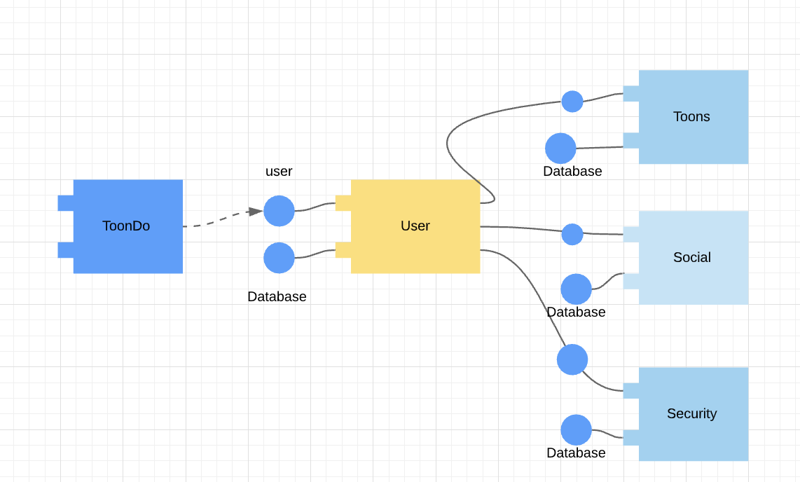
Component Level System Description
Technologies Used:
MERN Stack Application
MongoDB
Express.js
React
Node.js
Aseprite
Animations
Pixel art

Slide 9
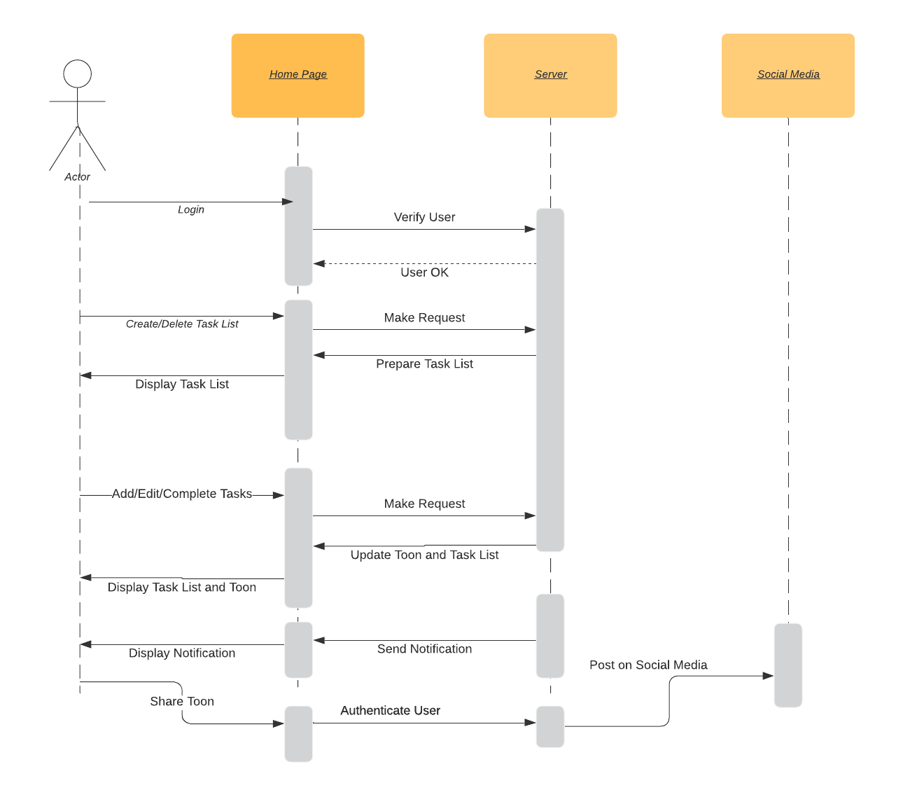
Sequence Diagram

