Slide 1
Aushang
DIGITIZING THE PAPER NOTICE BOARD · WITHOUT CHANGING THE PROCESS
An AI reads the board. Personal data is masked first. A human decides.
It reads the photographed board, masks every name, parent and phone number locally , and suggests a structured post — in German, English or Russian. An admin confirms before anything publishes, and a super-admin can remove any post at any time.
Eugen Müller · AI Consulting Bootcamp — Ironhack Berlin · June 2026
Live · in real-world testing
kita-connect.cloud
Notes:
Aushang digitizes the paper notice board without changing the process. An AI reads the photographed board, masks personal data locally, suggests a structured post in German, English or Russian; an admin confirms before anything publishes, and a super-admin can remove any post. Live at kita-connect.cloud, a first Kita is testing it now.

Slide 2
THE PROBLEM
Three traps of the paper board
01
02
03
Information is trapped
Every app is a second system
The data is sensitive
Miss the board, miss the closure, the Thursday trip, the lice warning. No feed, no calendar, no digest — the information dies in a hallway.
The off-the-shelf answer makes staff retype every notice into a new tool. One overworked admin won't maintain it — so they stay on paper.
Notices name children, parents, phone numbers. Pushing a board photo into a generic cloud tool is a privacy problem these orgs are rightly nervous about.
Aushang's answer
It changes none of this process — it enhances it. Staff keep their paper board; one photo feeds the AI and the automation does the rest. No retyping, no second system.
Notes:
Small orgs run on a paper board. Three traps: information is trapped — miss the board, miss the closure; off-the-shelf apps mean a second system the admin must retype into, so they stay on paper; the data is sensitive — children, parents, phones. The orgs least able to adopt software are the ones whose members most need reachable information. Aushang changes none of this process — it enhances it.

Slide 3
THE CORE IDEA
Two principles, enforced by architecture
01
Privacy by construction
02
The AI advises, a human decides
Every child's name, parent, phone number and address is detected and masked locally — on our own infrastructure — before any external AI call is made. Redaction is fail-closed : when the system is unsure, it masks.
The AI only suggests — a content type and the fields it can read from the redacted text. Every suggestion is checked against a strict schema; anything malformed routes to a manual path and never auto-publishes.
Raw photographs never leave the organization's infrastructure, and no un-redacted personal data ever reaches the AI. This is enforced at the architecture layer — not by a written promise.
An admin reviews and confirms before a post reaches a single member — and the system routes only on the confirmed value, never on the AI's raw guess.
Together, these two principles are what keep Aushang out of EU AI Act High-risk.
Notes:
This slide carries the project. Two principles, enforced by architecture not policy. One: privacy by construction — PII is detected and masked locally, fail-closed, before any external AI call; raw photos never leave our infra; no un-redacted PII ever reaches the AI. Two: the AI advises, a human decides — it only suggests, output is schema-validated, failures route to manual, an admin confirms before anything is visible, and routing reads only the confirmed value. Together these keep Aushang out of EU AI Act High-risk.

Slide 4
THE PIPELINE
From photograph to published post
01
02
03
04
05
06
07
Photograph or upload
OCR
Local redact
AI suggests
Validate
Admin confirms
Fan-out
→
OpenCV + Tesseract (DE)
→
Presidio + spaCy · fail-closed
→
Claude — redacted text only
→
Strict JSON · fail → manual
→
→
Feed · calendar · ICS · email · push
Admin shoots the board — or picks an image
Reviews, corrects, publishes
The only text that crosses to the AI is redacted . The only path to a member's screen is an admin publish.
ICS — the standard calendar feed (.ics). Members subscribe once; closures and dates sync to their own phone calendar, no app install needed.
Notes:
How it works mechanically, with arrows. Photograph or upload, OCR with Tesseract, local redaction with Presidio, Claude suggests on redacted text only, strict schema validation, admin confirms, then fan-out to feed, calendar, ICS, email and push. The only text that crosses to the AI is redacted; the only path to a member's screen is an admin publish. ICS is the standard calendar feed — members subscribe once and dates sync to their own phone, no app needed.

Slide 5
PROOF OF CONCEPT · NO-CODE
Proven before a line of app code
01 · Redaction boundary
02 · Extract & validate
Proves a Code node owns masking — Claude only ever sees redacted text.
Proves malformed AI output routes to manual — it never auto-publishes.
52
assertions · all green
0
03 · Confirm, route, publish
04 · Double-gated consent
Proves a clear photo releases only on member opt-in and admin release.
lines of application code
Proves routing reads the admin's confirmed value — flip the type, the route changes.
Every workflow imports straight into n8n and runs on mock data.
Notes:
Before building the product, the entire pattern was validated in no-code: four importable n8n workflows running on mock data, plus a 52-assertion simulation harness, all green. Each workflow proves one guarantee. A Code node owns every decision; Claude only advises. This is the method, not a re-statement of the boundary.

Slide 6
PRIVACY · ENFORCEMENT
Six mechanisms, not one promise
1
Local fail-closed redaction
2
Database column REVOKE
3
Double-gated photo consent
Presidio + spaCy + German regex before any external call. On uncertainty, it masks.
Raw-PII columns are revoked at the DB layer — even an admin's browser cannot read them.
A clear photo is released only on member opt-in and admin release, via short-TTL signed URLs.
4
Reflection photo deleted at publish
5
Build-blocking secret scan
6
Adversarial security review
Rückblick originals — most likely to show children — are deleted from storage at publish.
A leaked service-role or LLM key blocks the build before deploy. No key ships to the browser.
A four-layer model — middleware, helpers, security-definer RPCs, RLS — reviewed adversarially.
No raw image and no un-redacted PII is ever sent to the AI — redaction sits upstream of every external call, by architecture.
Notes:
Privacy is not a promise — it is six concrete mechanisms across the stack: local fail-closed redaction, database column REVOKE so even an admin's browser can't read raw PII, double-gated photo consent via short-TTL signed URLs, reflection-photo deletion at publish, a build-blocking secret scan in CI, and an adversarial four-layer security review. No raw image and no un-redacted PII is ever sent to the AI.

Slide 7
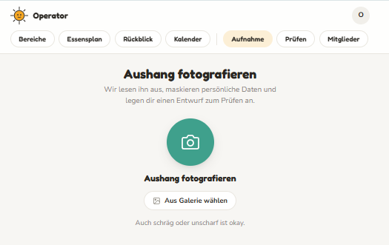
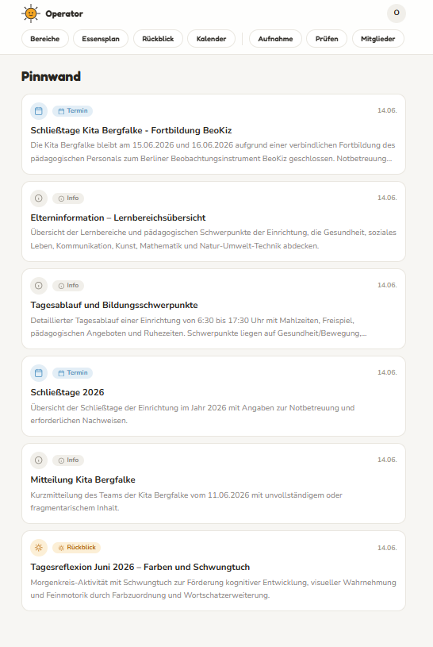
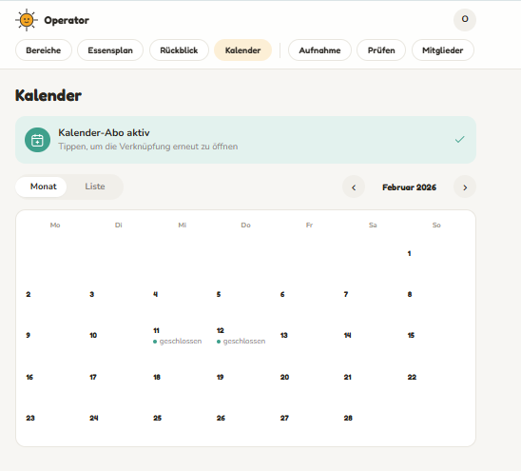
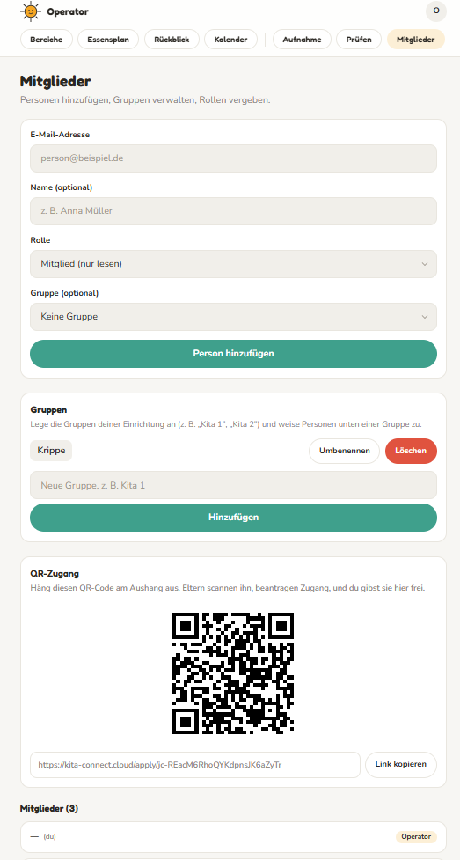
THE LIVE SYSTEM · NOT A MOCKUP
A real Kita, today
Private feed
Calendar + ICS
Capture
Typed posts — Termin, Info, Rückblick.
Subscribe once; dates sync to the phone.
Members
Photograph the board, or upload.
Invite-only, groups, QR onboarding.
kita-connect.cloud · invite-only
German UI today · English & Russian in product · Android shell builds in CI
Notes:
This is the live system, not a mockup. Four real screens from production with a German UI: capture — photograph the board or upload; the private feed of typed posts; the shared calendar with an ICS subscription; and member management with groups and a QR onboarding poster. Live at kita-connect.cloud, invite-only by design, with a first Kita testing it now.

Slide 8
ROI
Pricing, break-even, and the honest read
€15/mo
~15orgs
+177%
−80%
per org — covers infra, nothing more
cash break-even on infra
12-mo cash ROI · 20 orgs
36-mo all-in · incl. €35k build
How the money works
App-store line
Cash infra / year
≈ €1.300
A one-time €6 app purchase on Apple & Google — incremental revenue and a credibility signal for the channel.
LLM (Claude Haiku, once per capture)
≈ €60
20 orgs × €15/mo revenue
€3.600
Net (12-mo, cash)
+€2.300
The honest read
The first Kita — my own child's — runs the pilot at cost. Every additional Kita pays €15/mo just to cover infrastructure.
Cheap to run, feature proven. The lever is a channel , not technology: €25/org × 150 Kitas via an association ≈ €45k/yr — the build repays inside year 1.
Notes:
Honest ROI. Cash infra is about 1,300 euro a year; the LLM is about 60 euro a year — called once per capture on cheap, redacted text. The first Kita, my own child's, runs the pilot at cost. Each additional Kita pays 15 euro a month, just to cover infrastructure: break-even on cash infra is about 15 orgs. At 20 orgs the 12-month cash ROI is plus 177 percent. On a 36-month all-in basis including the 35k build it is minus 80 percent — so the lever is a channel, not technology. App-store presence adds a one-time six-euro purchase on Apple and Google as incremental revenue and a credibility signal.

Slide 9
RISK · LIKELIHOOD × IMPACT
Eight risks, scored and mitigated
R1
R6
R7
R4
R4 · Low adoption / distribution
16
R8
R5
R2
No-process-change design + a channel (association / Träger) is the make-or-break.
R3
R1 · PII leak to the AI
15
IMPACT →
Local fail-closed redaction + DB column REVOKE + double-gated consent — the core thesis.
1
2
3
4
5
LIKELIHOOD →
R2 · LLM hallucination
12
Schema-validate + manual fallback + admin confirms every publish.
R3 over-redaction · R5 infra failure · R6 surveillance creep · R7 AI-Act misclassification · R8 LLM residency — all scored ≤ 9, each degrades to a safe manual path.
Notes:
Eight risks, scored as likelihood times impact on a five-by-five grid. The two highest are R4, adoption and distribution at 16, mitigated by no process change plus a channel strategy; and R1, a PII leak at 15, the project's core thesis, engineered against with local fail-closed redaction, DB column REVOKE and double-gated consent. The rest cluster lower and all degrade to a safe manual path.

Slide 10
COMPLIANCE
EU AI Act + GDPR
EU AI Act
LIMITED RISK
GDPR
RESIDUAL LOW–MED
Makes no decision about a person — it classifies a notice, not a learner. No Annex III area.
Only locally-redacted text reaches the AI — no PII, no raw image.
✓
100% of posts need explicit admin confirmation (human oversight).
✓
Raw photos stay in EU infrastructure (Supabase EU).
✓
DPIA completed on the highest-risk activity.
✓
AI suggestions are labelled before confirm (Art. 50 transparency).
✓
Data-subject rights: access, erasure, rectification, portability.
✓
Schema-validated, fail-closed, with a manual path (robustness).
Open before scale model card · redaction-recall metric · retention schedule · AI-incident runbook
Notes:
EU AI Act: Limited risk. It makes no decision about a person — it classifies a notice, not a learner — so there is no Annex III area; transparency and human oversight are met. GDPR: residual risk low to medium. The key property is that only locally-redacted text reaches the AI — no PII, no raw image; raw photos stay in EU infra; a DPIA is done; data-subject rights are supported. Open items before scale: model card, redaction-recall metric, retention schedule, AI-incident runbook.

Slide 11
STRATEGY
Roadmap and go-to-market
Done
Done
Live now
In progress
Planned
Build
→
POC
→
Pilot
→
Hardening
→
Channel scale
Full stack + pipeline
4 n8n workflows
One real Kita
TLS · Google Play
One sale = many orgs
APP STORES
1st
Google Play
In progress
2nd
Apple App Store
Planned
Closed test → public listing
iOS shell follows the channel
NOW · BOTTOM-UP
SCALE · CHANNEL
WHY WE WIN
Start where it's real
Then sell through associations
No process change — just photograph the board.
The pilot runs in my own child's Kita. Every additional Kita pays €15/mo just to cover infra — break-even around 15 orgs. Cheap, honest, and it builds the reference.
A Kita-association or Träger represents dozens of orgs. One sale onboards many at €15–25/org/mo — this is what repays the build. The DPO-ready privacy story makes the sale.
Privacy by construction — the DPO says yes.
A live, compliant reference build — not a mockup.
Notes:
Roadmap: build and POC are done; the pilot is live now in one real Kita — my own child's; hardening and the Android build are in progress; channel scale is planned. Go-to-market is bottom-up first: the pilot proves it, every additional Kita pays 15 euro a month just to cover infrastructure, break-even around 15 orgs. Then scale through a channel — associations or Träger — where one sale is dozens of orgs and the build repays. Differentiators: no process change, privacy by construction, a live compliant reference build.

Slide 12
AI advises. PII is masked first. A human decides.
Proven on a live, GDPR-by-construction build.
Verdict — ship & validate, then pursue the channel
Q & A
Does a child's name reach the AI?
Why Limited risk, not High?
No — masked locally, fail-closed, before the call.
No Annex III area — no decision about a person.
What if the AI mis-reads?
US-hosted LLM — GDPR issue?
Schema-validate routes to manual; admin confirms.
Only redacted text crosses; EU swap is one module.
Will small Kitas adopt it?
Is it really live?
No process change — just photograph the board.
Yes — kita-connect.cloud, first Kita testing now.
kita-connect.cloud
github.com/eugnmueller-87/final-project-eugen
Notes:
Closing line: AI advises, PII is masked first, a human decides — proven on a live, GDPR-by-construction build. Verdict: ship and validate, then pursue the channel. Q&A prepared: no child's name reaches the AI; Limited risk because it makes no decision about a person; mis-reads route to manual; only redacted text crosses for residency; no process change drives adoption; and yes, it is genuinely live.

