Slide 1
Oracle Mv2Adb Tooling
Overview
Eugene Simos
Senior PreSales Solutions Specialist
OCI Platform Services and Security Group
November, 2020

Slide 3
Oracle Mv2ADB Tooling
Introduction
Architecture

Slide 4
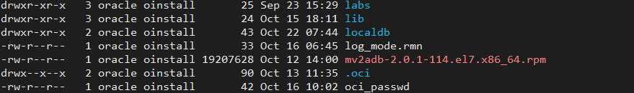
Oracle Mv2ADB Tooling
Available on Oracle Support (Doc ID 2463574.1)
Oracle support solution tool to move data to autonomous databases
Requires:
HTTP connectivity between the source databases and the Oracle Object Storage
SQL*Net connectivity between source databases and Oracle Cloud autonomous Databases
Autonomous wallet
Instant client to support impdp Autonomous cloud Operations
Java , Perl, perl-Data-Dumper
Rpm distribution of the tool

Slide 5
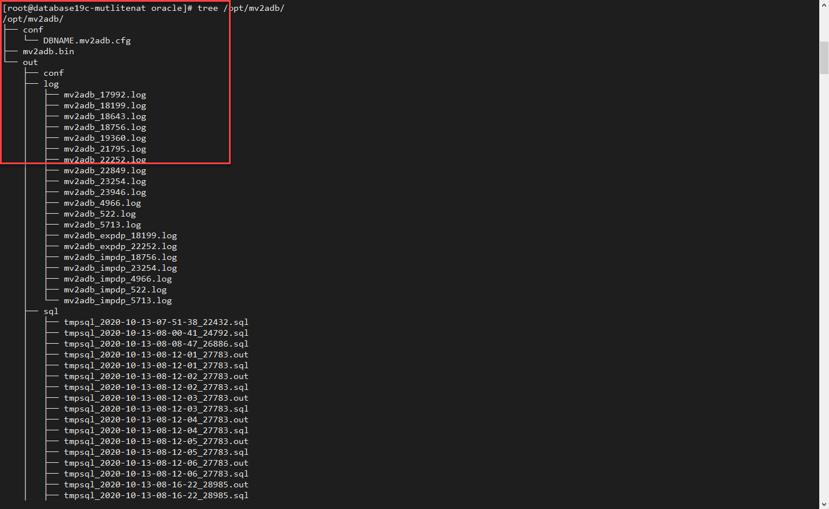
Oracle Mv2ADB Tooling
Server-side (source database) installation
As root :
# rpm -i mv2adb-2.0.1-X.x86_64.rpm

Slide 6
Oracle Mv2ADB Tooling
Server Side (source database)
Install and configure the oci cli
Download the wallet Automomous file
Create passwords to be used by the tool
Check connectivity from sql*net ( source, and autonomous)
Create mv2adb configuration file
Oracle Cloud
Create target bucket for the exported database dump
Create Auth token for the autonomous database access to the Storage bucket
Configure autonomous database to use the Auth Token as a credential

Slide 7
Oracle Mv2ADB Tooling
Configuration Flow for the Tooling
1-Install the tool
2-Configure the tool
3-Run the tool
4-Verify the content of the Autonomous DB

Slide 8
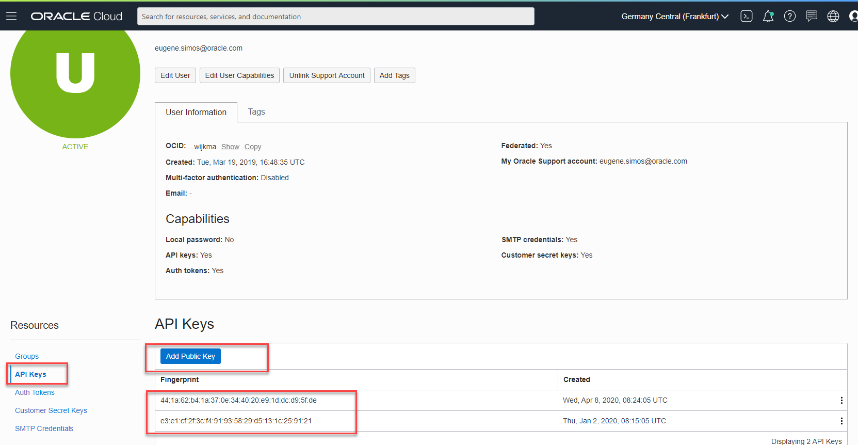
Oracle Mv2ADB Tooling
Create and upload Keys in PEM format

Slide 9

Oracle Mv2ADB Tooling
Oci cli installation and configuration
Tool installation:
bash -c "$(curl -L https://raw.githubusercontent.com/oracle/oci-cli/master/scripts/install/install.sh)"
…
Tool Configuration:
Create a configuration file ~/.oci/config
https://github.com/oracle/weblogic-deploy-tooling

Slide 10
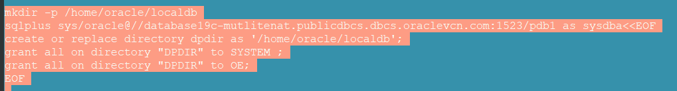
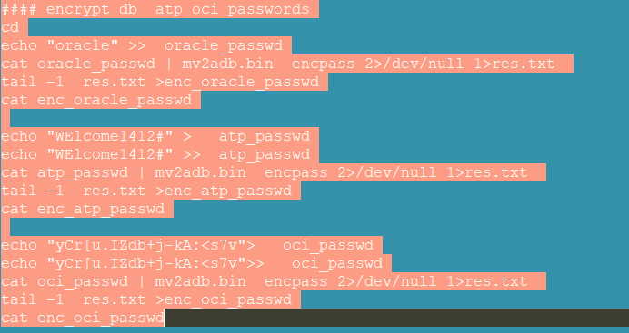
Oracle Mv2ADB Tooling
On the source database server :
Create the export directory
Encrypt passwords

Slide 11
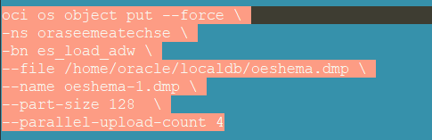
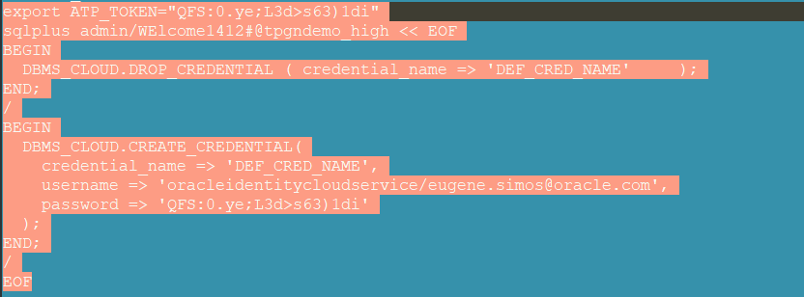
Oracle Mv2ADB Tooling
On the source database server :
Upload the dump to the Object Storage
Create the credentials for the Autonomous

Slide 12
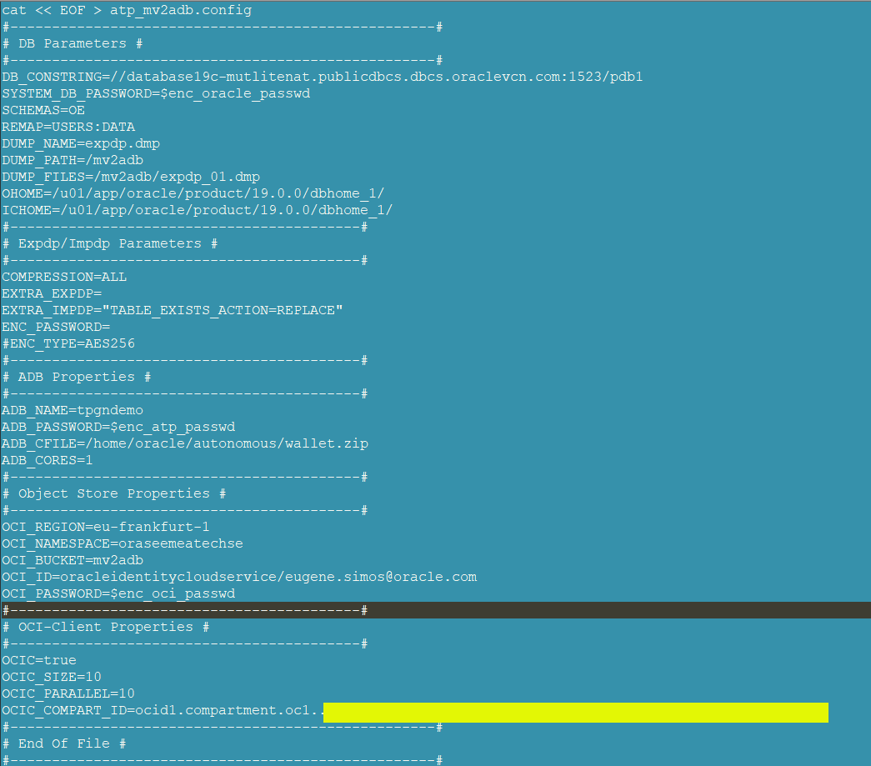
Oracle Mv2ADB Tooling
Create the mv2adb configuration file

Slide 13
Oracle Mv2ADB Tooling
Execute the advisor
sudo /opt/mv2adb/mv2adb.bin advisor -conf atp_mv2adb.config
Execute the export from the source
sudo /opt/mv2adb/mv2adb.bin expdp -conf atp_mv2adb.config
Move the export to the object storage bucket
sudo /opt/mv2adb/mv2adb.bin putdump -conf atp_mv2adb.config
Import the data to the autonomous
sudo /opt/mv2adb/mv2adb.bin impdp -conf atp_mv2adb.config
Get the report of the operation
sudo /opt/mv2adb/mv2adb.bin report -conf atp_mv2adb.config

Slide 14
Thank you

Slide 16
Our mission is to help people see data in new ways, discover insights, unlock endless possibilities.

