Slide 1
Beyond CTG repeats: one predictor per drug
Covariate modelling versus machine learning for treatment-response stratification in myotonic dystrophy type 1
Team 1 · Euibeom Shin, Wenzhe Ma, Leo Vuong, Bei Zhao, Ming Gao, Izumi Hamada
ACoP 2026 Hackathon · 14 October 2026
Notes:
[30 s]
Good morning. We are Team 1. Our question was the organizers' question: in a simulated DM1 trial with three treatment arms, which baseline covariates predict response, and does machine learning find anything that covariate modelling misses?
Our answer in one line: each drug has one dominant predictor, it is the measure closest to the drug's site of action, and machine learning found nothing beyond it.
Direction reminder, said once: for mexiletine a lower change in myotonia is better; for the other two arms higher is better.

Slide 2
Each arm has one dominant baseline predictor: the measure closest to the drug's site of action
Treatment | Site of action | Dominant predictor | Test patients who responded: above cut-off vs below
Mexiletine | Symptomatic: muscle sodium channel | Myotonia severity | 10 of 21 (48%) vs 2 of 20 (10%)
Antisense oligonucleotide | Disease-modifying: toxic DMPK transcript | CTG repeat length | 10 of 17 (59%) vs 8 of 26 (31%)
Tideglusib | Multisystem: GSK3β signalling, incl. CNS | Cognitive function | 17 of 23 (74%) vs 3 of 18 (17%)
Selected by all five methods in every arm. Machine learning added no predictor. A pure-noise control covariate was never selected.
Notes:
[45 s]
This is the whole result. One row per arm.
Mexiletine blocks muscle sodium channels; it treats the symptom. Its predictor is the symptom: baseline myotonia severity. Among held-out test patients, 48% above the cut-off responded versus 10% below.
The antisense oligonucleotide degrades the toxic DMPK transcript; it acts on the cause. Its predictor is the amount of cause: CTG repeat length. 59% versus 31%.
Tideglusib inhibits GSK3β and acts across several systems including the brain; the endpoint is a composite with a cognitive domain. Its predictor is baseline cognitive function. 74% versus 17%.
Three points of evidence behind every row: stepwise selection, LASSO, elastic net, random forest and XGBoost all picked the same covariate; LASSO kept it in 90 to 100% of 200 bootstrap resamples; and a column of pure random numbers that we added as a negative control was never selected by any method in any arm.
Machine learning, meaning random forest and XGBoost, ranked the same covariates first. It did not add a predictor.

Slide 3
The three drugs act at different points of the DM1 cascade, so each arm was analysed separately
CTG repeat expansion in DMPK
Toxic CUG-repeat RNA
MBNL1 sequestration, GSK3β activation: mis-splicing
Multisystem involvement: muscle, CNS, heart, eye
Clinical phenotype: myotonia, weakness
Antisense oligonucleotide
Tideglusib
Mexiletine
Dataset
Workflow, per arm
500 simulated patients, one treatment each; n = 161 / 170 / 169
18 baseline covariates, some pure noise by design
Albumin constant in the mexiletine arm: excluded there. No patients excluded
75/25 split, stratified by response and onset; test set scored once
5-fold cross-validation within training for every choice
Stepwise (BIC), LASSO, elastic net vs random forest, XGBoost
Noise control: pure-noise covariate, 200 bootstrap resamples, 5-method agreement
Notes:
[50 s]
The cascade, left to right: an expanded CTG repeat in DMPK makes a toxic RNA; the RNA sequesters MBNL1 and activates GSK3β, which mis-splices dozens of genes; that damages muscle, brain, heart and eye; and the patient presents with myotonia and weakness.
The three drugs sit at three different points. The antisense oligonucleotide degrades the RNA, at the cause. Tideglusib inhibits GSK3β, in the middle. Mexiletine blocks sodium channels, at the symptom. Different mechanism, different endpoint, so three separate analyses.
The dataset: 500 simulated patients, one drug each, about 165 per arm, 18 baseline covariates covering genetic burden, disease stage, muscle, CNS, cardiac, eye, metabolic and demographic domains. Some are noise by design.
Data review found no missing values, but albumin was a single imputed constant for every mexiletine patient, so it is excluded in that arm. The CK floor at 50 and mosaicism index at zero were retained as observed. No patient was excluded.
Workflow, per arm: split first, 75/25, stratified by responder status and onset phenotype, fixed seed, test set scored once at the end. Every model choice by 5-fold cross-validation inside training. Three covariate models and two machine-learning models. And three noise controls: a pure-noise covariate, selection stability over 200 bootstrap resamples, and agreement across the five methods.

Slide 4
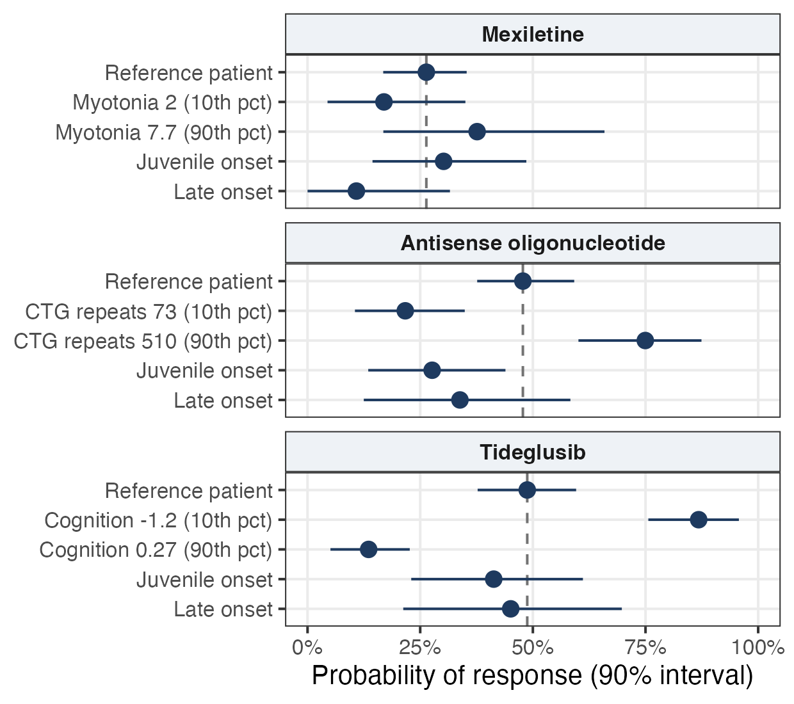
Across the dominant covariate's range, predicted response spans 15% to 85%; onset phenotype adds little
Mexiletine · myotonia severity
17% → 38%. Symptomatic drug: effect scales with symptom burden.
Antisense oligonucleotide · CTG repeats
22% → 75%. Target-engaging drug: effect scales with target amount.
Tideglusib · cognitive function
87% → 14%, as a threshold near z = -0.5. Composite endpoint: ceiling effect.
Independently replicated: three implementations, 20 repeated splits, same three covariates.
Notes:
[80 s]
This is the covariate forest plot, in the standard pharmacometric format. For each arm, the reference patient has median covariates and adult onset; the dashed line is that patient's predicted probability of response. The rows show the dominant covariate at its 10th and 90th percentile, then each onset phenotype with everything else at reference. Lines are 90% bootstrap intervals, from training patients only.
Mexiletine: from mild to severe myotonia, predicted response rises from 17% to 38%. A symptomatic drug: the effect scales with the symptom present. Late-onset patients respond less because their baseline myotonia is mild; there is little to treat.
The oligonucleotide: from short to long repeats, 22% to 75%. The only predictor in the arm. A target-engaging drug: the effect scales with the amount of target transcript. Note that individual prediction stays poor, test R-squared under 0.1: we know the direction, not the person.
Tideglusib: from impaired to intact cognition, 87% down to 14%, and it is a threshold near minus 0.5, not a gradient. The composite endpoint has a cognitive domain, so a patient with intact cognition has no room for measurable gain. A ceiling effect.
Onset phenotype adds little once the dominant covariate is in the model: the phenotype rows straddle the reference line.
Replication: three team members built three independent implementations, two in R and one in Python, with different splits, up to 30 methods, and 20 repeated splits. All found the same three covariates. CTG repeat length behaves like a prognostic marker across arms; cognitive function is specific to tideglusib.
If asked what was noise: sex, BMI, smoking, cataracts, CK, PR interval and albumin in every arm; disease duration borderline everywhere.

Slide 5
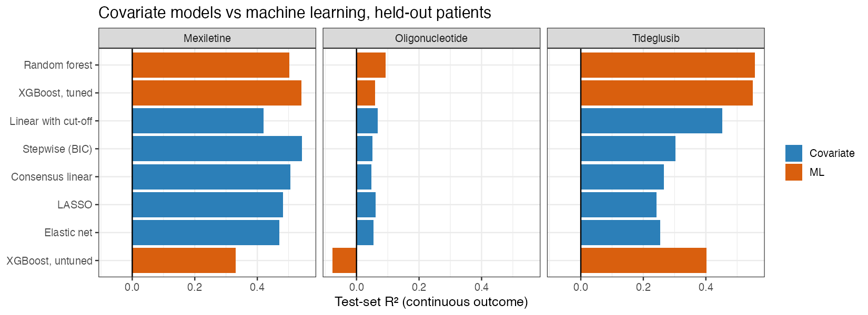
Covariate models match machine learning in two arms; tree ensembles lead in the third because the effect is a threshold
Mexiletine
Oligonucleotide
Tideglusib
Equivalent: R² 0.47 to 0.54 for every method
Low predictability: R² < 0.1 for every method
Tree ensembles 0.55 vs linear 0.24 to 0.30; one threshold brings linear to 0.45
Notes:
[60 s]
The scoreboard. Blue bars are covariate models, orange bars are machine learning, test-set R-squared for the continuous endpoint, about 41 held-out patients per arm.
Mexiletine: every method lands between 0.47 and 0.54. Equivalent. Across 20 repeated splits the top rank alternates between stepwise selection and tuned XGBoost.
Oligonucleotide: every method is under 0.1, on every split. The repeat-length effect is consistent but between-patient variability dominates. We report that as it is.
Tideglusib: random forest and tuned XGBoost reach 0.55; the straight-line models 0.24 to 0.30, on 19 of 20 splits. We know why: the effect is a threshold, and a straight line cannot draw a step. A linear model given that single threshold on cognition reaches 0.45. Tuned XGBoost chose depth-one trees in every arm, so there are no interactions to find.
Intervals overlap within each arm, so we do not rank methods inside an arm. Machine learning was the check that nothing was missed: by permutation importance and SHAP it found the same leaders.

Slide 6
Stratify on the measure closest to the drug's target: one baseline assessment per arm separates response two- to five-fold
Treatment | Measure at baseline | Cut-off | Test patients who responded: above vs below cut-off | Trial design
Mexiletine | Myotonia severity | ≥ about 5 | 10 of 21 (48%) vs 2 of 20 (10%) | Enrol on symptom severity, not diagnosis alone
Antisense oligonucleotide | CTG repeat length | ≥ about 350 | 10 of 17 (59%) vs 8 of 26 (31%) | Stratify randomisation on repeat length
Tideglusib | Cognitive function | < about -0.5 | 17 of 23 (74%) vs 3 of 18 (17%) | Enrich for cognitive impairment: 48% → 74% responders
Limitations
AI disclosure
No placebo arm: prognostic within treated patients, not effect modification
About 41 test patients per arm: cut-offs approximate; no ranking within an arm
Cross-sectional endpoint; next step is a longitudinal disease-progression model
Claude (via Claude Code) and Codex drafted code, documentation and slides. All decisions and interpretations were reviewed by the team, which is accountable for the results.
Notes:
[40 s]
What a clinician or a trialist does with this: measure the organ the drug acts on. Myotonia severity before mexiletine, repeat length before the antisense drug, cognitive function before tideglusib. One routine baseline assessment per drug, and response rates differ two- to five-fold between the groups it defines. Cut-offs are approximate: about 5, about 350, about minus 0.5.
Trial design: for mexiletine, enrol on baseline myotonia severity rather than diagnosis alone, because mild cases dilute the effect, which is what the 2021 placebo-controlled trial found on walking distance. For the oligonucleotide, stratify randomisation on repeat length, a prognostic factor. For tideglusib, enrich for cognitive impairment: expected responder rate goes from 48% to 74%, which reduces the sample size needed to show an effect.
Limitations we state ourselves: no placebo arm, so these are prognostic predictors within treated patients, not demonstrated effect modifiers. About 41 test patients per arm, so we give ranges and do not rank methods within an arm. One time point per patient; the natural next step is a longitudinal disease-progression model with these covariates on progression rate and drug effect.
AI disclosure: Claude through Claude Code, and Codex, drafted code, documentation and these slides, as noted in the code headers. Every analysis decision and interpretation was reviewed by the team, and the team is accountable for the results.
Robustness, if time: we repeated the split 20 times and the pattern held in every arm. Thank you.

Slide 7
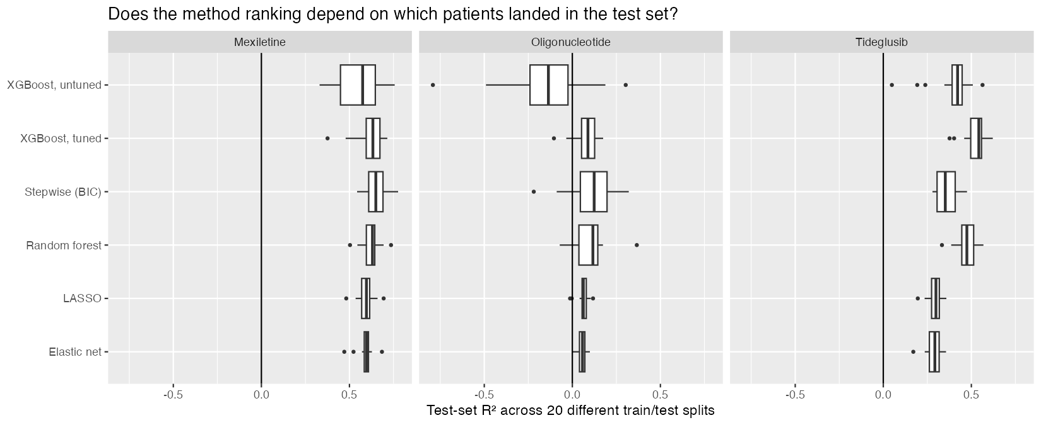
Backup: results are robust to the train/test split (20 seeds)
Test-set R², continuous endpoint, 20 random splits. Tideglusib: a tree ensemble ranked first in 19 of 20; a linear model never did.
Notes:
Mexiletine: methods equivalent, median about 0.6. Oligonucleotide: all weak, medians 0.06 to 0.12. Absolute R² varies by up to 0.15 between splits, hence ranges rather than point estimates.

Slide 8
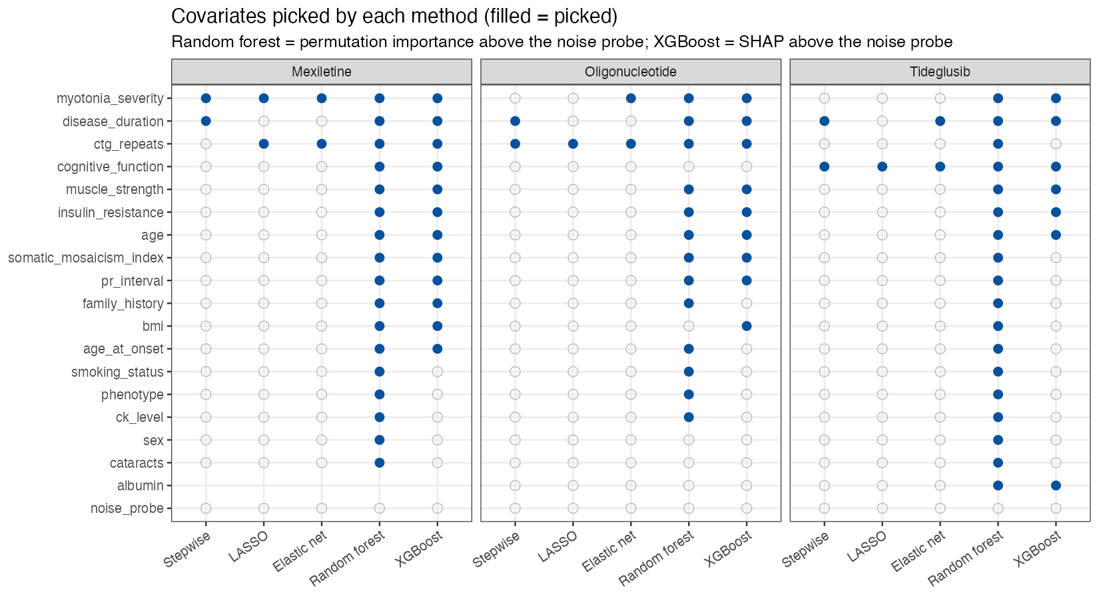
Backup: covariate selection by method and arm
Filled dot = selected. Final call requires 4 of 5 methods and LASSO bootstrap stability ≥ 60% (signal); 2 votes and ≥ 20% (uncertain).
Notes:
The three covariate-model columns agree on one covariate per arm. The ML columns are fuller because their criterion, importance above the noise covariate, is permissive; that is why the final call also requires bootstrap stability.

Slide 9
Backup: the dominant covariate holds within each onset phenotype
Arm, covariate (slope per unit) | Adult onset | Juvenile onset | Late onset | Interaction p
Mexiletine, myotonia severity | -0.51 (n 71) | -0.66 (n 28) | -0.25 (n 21) | 0.03
Oligonucleotide, CTG repeats | 0.005 (n 78) | 0.006 (n 23) | 0.014 (n 26) | 0.50
Tideglusib, cognitive function | -3.1 (n 83) | -4.4 (n 24) | -1.3 (n 21) | 0.16
Treatment allocation by covariate profile (exploratory)
Each arm's responder model applied to all training patients, relative to that arm's average patient
Highest relative likelihood: mexiletine 12% (severe myotonia), tideglusib 35% (cognitive impairment), oligonucleotide the remainder
Hypothesis-generating only: extrapolation across arms, no outcome information crosses arms
Notes:
Same direction within every onset phenotype in every arm, training set. Only the mexiletine slope differs by phenotype: attenuated in late onset, where baseline myotonia is mild. The data dictionary states arm assignment was weighted by patient fit; observed arm matches the predicted best arm for 41% of patients versus 33% by chance, so the weighting was mild.

Slide 10
Backup: references
1. Morales F et al. Hum Mol Genet 2012;21:3558-67. Somatic instability of the CTG repeat as a modifier of DM1 severity.
2. Cumming SA et al. Neurology 2019;93:e995-e1009. Genetic determinants of severity, OPTIMISTIC cohort.
3. De Antonio M et al. Rev Neurol (Paris) 2016;172:572-80. DM1 clinical spectrum and onset-based classification.
4. Okkersen K et al. Neurology 2017;89:960-9. Brain imaging in DM1: systematic review.
5. Logigian EL et al. Neurology 2010;74:1441-8. Mexiletine as antimyotonia treatment in DM1.
6. Heatwole C et al. Neurology 2021;96:e228-e240. Mexiletine in DM1: randomized placebo-controlled trial.
7. Thornton CA et al. Lancet Neurol 2023;22:218-28. Antisense oligonucleotide targeting DMPK: phase 1/2a trial.
8. Jones K et al. J Clin Invest 2012;122:4461-72. GSK3β mediates muscle pathology in DM1.
9. Horrigan J et al. Pediatr Neurol 2020;112:84-93. Phase 2 study of tideglusib in congenital and childhood-onset DM1.
10. Hutmacher MM, Kowalski KG. Br J Clin Pharmacol 2015;79:132-47. Covariate selection in pharmacometric analyses.

