Slide 1
ACoP 2026 hackathon · simulated data · rehearsal, Mon 12 Oct 2026
DM1 covariate analysis
— who responds, and is it real?
“scores move, covariates don’t”
Mexiletine · Oligonucleotide · Tideglusib
Held-out scoring traces to outputs/report/slide_tables.md and the files it cites. Marginal ρ from results/tables/outcome_associations.csv; the Mexiletine responder-prevalence enrichment is an in-sample descriptive statistic from the raw dataset (flagged on slides 6–7). The locked fold 1 (n = 101, sha256 8b3fb2cb…, seed 2026) is not opened.
Notes:
Cover · total 4:45 (≤ 5:00)
Pace ~145 wpm to hold 4:45 (≤ 5:00); slides 5 then 7 are the pinch — keep them brisk and rehearse against a timer to land ≤ 4:50. Total budget 4:45. Rehearsal, Mon 12 Oct 2026 — fold 5 pseudo-test; locked fold 1 not opened. Keys: ←/→ or Space navigate · N toggles these notes · F fullscreen · Cmd/Ctrl-P → “Save as PDF” prints one slide per page.

Slide 2
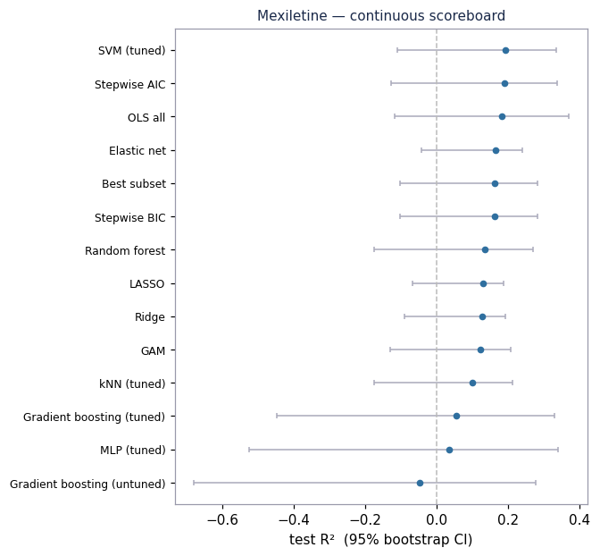
The hard part isn’t which covariate predicts response — it’s telling real signal from a lucky split
500 simulated DM1 patients, 3 therapies (Mexiletine, Oligonucleotide, Tideglusib), 18 baseline covariates each.
One question per arm: which baseline covariates predict who responds? — asked on two endpoints, a continuous improvement score and a binary responder label.
The trap: on data this size, a single train/test split can crown a different “answer” every time. The real question is which signals are real versus an artifact of who landed in the test set.
Our claim: ask it the right way and the answer is reproducible; trust one leaderboard and it is misleading.
Mexiletine, continuous endpoint: all 14 methods’ 95% bootstrap CIs cross zero — none is distinguishable from no-skill. Which of these, if any, is real?
Rehearsal · scores on fold 5 · locked fold 1 (n=101, sha256 8b3fb2cb…) sealed
Notes:
Slide 1 · 0:30 · [0:00–0:30]
Here’s the problem. Five hundred simulated DM1 patients, three therapies, eighteen baseline covariates each. For each arm: which baseline covariates predict who responds? On data this size, a single split can hand you a different answer every time. So the real question isn’t only which covariates predict response — it’s which signals are real, and which are just the luck of who landed in the test set. That’s the whole talk.

Slide 3
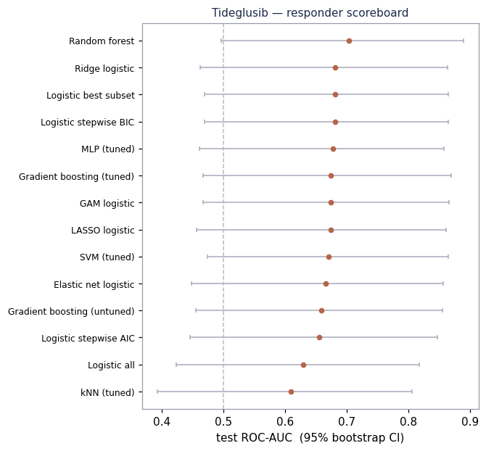
Same held-out patients for all 14 models — so a score gap is the method, not the sample
14 models × 2 endpoints × 3 arms · one locked pipeline
14 methods per task — 8 inference (OLS/logistic, stepwise AIC, stepwise BIC, best subset, LASSO, elastic net, ridge, GAM) + 6 prediction (random forest, gradient boosting untuned/tuned, SVM, kNN, MLP).
Gradient boosting = scikit-learn HistGradientBoosting, filling XGBoost’s role (no OpenMP runtime here) — same job, fully reproducible (docs/LOG.md).
All 14 scored on the same held-out rows, so a score gap is the method, not the sample.
The real test set — fold 1, 101 patients, sha256 8b3fb2cb…, hash recorded Oct 11 — opens exactly once at the final run (G3). Everything today is rehearsal on fold 5; the discipline was fixed before we looked (docs/hypothesis_sheet.md).
The second endpoint (binary), 14 methods — all CIs overlap. The ranking is a tie.
Rehearsal · scores on fold 5 · locked fold 1 (n=101, sha256 8b3fb2cb…) sealed
Notes:
Slide 2 · 0:40 · [0:30–1:10]
Our method is rigor. Fourteen models per task — eight inference methods, from OLS and stepwise through LASSO, elastic net, and a spline GAM, plus six prediction methods: random forest, gradient boosting, SVM, kNN, and an MLP. Gradient boosting is scikit-learn’s HistGradientBoosting standing in for XGBoost — same role, no native dependency. Every one is scored on the exact same held-out patients — two endpoints, three arms, one pipeline. And the real test set — fold one, 101 patients, hash recorded October 11th — stays sealed until the final run. Everything today is rehearsal.

Slide 4
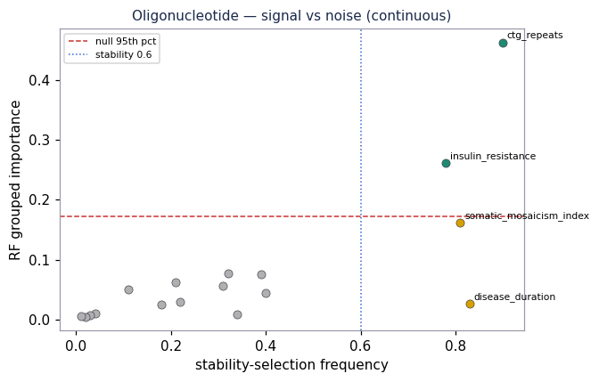
The honest headline: the train/test split moves the scores, not the covariates
Across 20 reseeded splits, the median per-method test-R² SD is 0.131 (compare/verdict.md) — any ranking inside that band is a tie, not a winner.
Same arm, different split, the leading R² swings: Tideglusib +0.26 / +0.30 / +0.35; Mexiletine +0.19 / −0.01 / +0.14 (fold5 / single80 / single75).
Yet the covariates barely move: across all 20 seeds, Tideglusib cognition 100%, Oligonucleotide CTG repeats 90%, Mexiletine myotonia 85%.
So we never crown a model. We identify the covariate signal that survives resampling — that is the reproducible object.
CTG repeats (top-right): stable in ~90% of 100 half-subsamples (x-axis) and above the shuffled-RF null (dashed). insulin_resistance also clears here but fails cross-seed (17%) — see slide 4.
Rehearsal · scores on fold 5 · locked fold 1 (n=101, sha256 8b3fb2cb…) sealed
Notes:
Slide 3 · 0:45 · [1:10–1:55]
Now the honest headline. We reran the whole thing across twenty reseeded splits. The median per-method test-R-squared standard deviation is 0.131 — that’s large, so any ranking inside that band is a tie, not a winner. The top score swings with the split — Tideglusib runs point-two-six to point-three-five — yet the covariates barely move: across all twenty seeds, Tideglusib cognition is selected 100%, Oligo CTG repeats 90%, Mexiletine myotonia 85%. So we never crown a model — we find the covariate signal that survives.

Slide 5
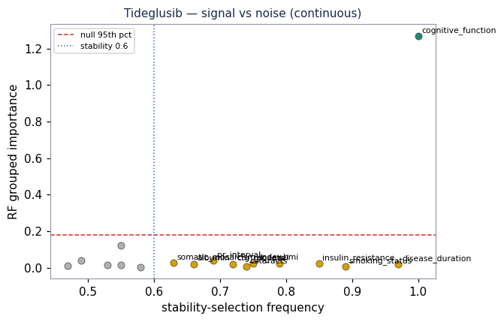
A shuffled-outcome null plus stability selection separates real signal from a field of noise
Pre-registered bar, fixed before scoring: a covariate is “real signal” only if stable in ≥60% of 100 half-subsamples AND beats the 95th percentile of a shuffled-outcome RF null (docs/hypothesis_sheet.md).
Replicating real signals: Tideglusib cognition (both endpoints) and Oligonucleotide CTG repeats (both endpoints).
Honesty on display: Mexiletine’s severity trio (myotonia, CTG, duration) is stable but inside the RF null on the relative target → “suggestive,” not real (slide_tables.md).
A flag we kept, not hid: Oligo insulin_resistance met the real-signal bar on fold 5 (stable 0.78, beats the null 0.262 > 0.172) — but we override it: it holds in only 17% of cross-seed splits (and q = 0.075 under FDR). Downgraded, not claimed.
Only cognition (green) clears the dashed null; all 17 other covariates sit inside it — the overlapping labels along the bottom are all “suggestive” or noise.
Rehearsal · scores on fold 5 · locked fold 1 (n=101, sha256 8b3fb2cb…) sealed
Notes:
Slide 4 · 0:40 · [1:55–2:35]
How do we separate signal from noise? We fixed the bar before we looked: a covariate counts as real only if it’s stable in at least sixty percent of a hundred half-subsamples and beats a shuffled-outcome null. Two signals replicate cleanly on both endpoints — Tideglusib cognition, and Oligonucleotide CTG repeats. And here’s the honesty judges should want: Mexiletine’s severity trio is stable but sits inside the null on the relative target, so we call it suggestive — not real. And one Oligo covariate, insulin_resistance, met the bar on a single fold but failed cross-seed — 17% — so we downgraded it.

Slide 6
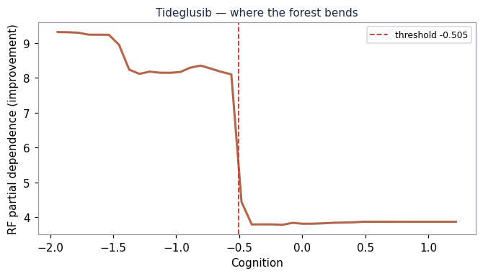
Tideglusib is the showcase: ML found a cognition threshold, a one-term rule captures it, and biology explains it
ML found it: random forest’s 20-seed mean R² = 0.491 vs ~0.29 (OLS) – 0.36 (LASSO) for the linear models (compare/repeat20_r2.csv) — a nonlinearity linear fits miss.
It’s a step, not a slope: partial dependence holds a high plateau (~8) for low baseline cognition, then cliffs ~4 points to a ~3.8 floor and flattens — a spline GAM (R² 0.119) underfits it.
One term captures it: the data-chosen cut 1[cognitive_function ≤ −0.505] lifts single-term test R² from +0.233 (linear) to +0.377 (indicator) (rule.txt) — one held-out fold (~34 pts), so it corroborates the 20-seed + cross-seed evidence; re-estimated on fold 1.
Biology explains it: a cognition-weighted composite + GSK-3β target → a head-room/floor effect. In-sample (48/102) the rule enriches mean improvement 3.46 → 8.28 (2.4×), keeping ~47% — but with no placebo arm this is on-treatment response, i.e. prognostic enrichment to confirm against a control, not yet separable from regression-to-the-mean / floor. Marginal ρ −0.647 (q = 4e-16; outcome_associations.csv); the pre-registered step near z ≈ −0.5 landed on −0.505.
RF partial dependence: a ~4-point cliff (≈8 → ≈3.8) at the data-chosen cut cognition = −0.505 (dashed) — a step, not a slope.
Rehearsal · scores on fold 5 · locked fold 1 (n=101, sha256 8b3fb2cb…) sealed
Notes:
Slide 5 · 0:55 · [2:35–3:30]
This is the showcase — Tideglusib. Machine learning found it: random forest’s twenty-seed mean R-squared is point-four-nine, versus roughly point-two-nine to point-three-six for the linear models — a nonlinearity. The shape is a step, not a slope: a high plateau near eight at low baseline cognition, then a four-point cliff, then flat. So we let the data pick one threshold — cognitive function at or below minus zero-point-five-oh-five — and that single indicator lifts held-out R-squared from point-two-three to point-three-eight, beating even the spline. One fold, so it corroborates the twenty-seed and cross-seed evidence rather than standing alone. Biology explains it: the composite is cognition-weighted, so impaired patients have the most head-room. In-sample the rule enriches mean improvement to eight-point-three versus three-point-five — but with no placebo arm, that’s on-treatment, prognostic enrichment, to confirm against a control.

Slide 7
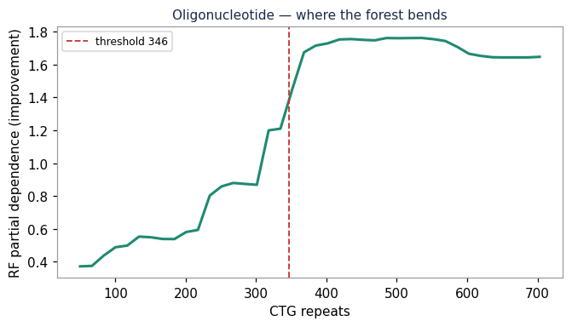
Both other arms, told honestly: the label/axis is real; the per-patient magnitude isn’t
Mexiletine — label yes, magnitude no
The responder label is cleanly separable (stepwise logistic ROC-AUC 0.773, CI 0.587–0.928), even though improvement magnitude is not (best R² ≈ 0.19, CI through 0). The relative target divides severity back out.
Enrichment (prognostic): CTG > 448 ~doubles responder prevalence, 0.289 → 0.543 — an in-sample descriptive stat over folds 2–5 (N=128; enriched n=35, wide CI), from the raw dataset (interpretation_Mexiletine.md §6), not held-out scoring.
Oligonucleotide — axis yes, prediction no
CTG repeats is a real, stable axis (90% on the continuous endpoint — half-subsample + cross-seed; 76% binary) but per-patient QMT change is unpredictable out-of-sample (R² 0.057, CI [−0.29, +0.25]). Use CTG to stratify, not predict individuals.
Flag for the locked run: repeat-burden direction is positive here (ρ +0.42, q = 6e-6; outcome_associations.csv), opposite the mechanistic ceiling prior — pre-specify the sign, confirm on fold 1.
AUC 0.773
Mexiletine responder label — top stepwise logistic, 95% CI 0.587–0.928; clears 0.5 (no-skill). The label is separable even though improvement magnitude is not.
Oligonucleotide: CTG partial dependence rises monotonically (0.38 → 1.76) — no exploitable step.
Rehearsal · scores on fold 5 · locked fold 1 (n=101, sha256 8b3fb2cb…) sealed
Notes:
Slide 6 · 0:45 · [3:30–4:15]
The other two arms, honestly. Mexiletine: we can’t predict improvement magnitude — best R-squared about point-one-nine, CI through zero. But the responder label is predictable: stepwise logistic hits ROC-AUC point-seven-seven, CI point-five-nine to point-nine-three. And a CTG cut above four-forty-eight roughly doubles responder prevalence, point-two-nine to point-five-four — a prognostic cut to pre-specify, in-sample over folds 2–5, not held-out. Oligonucleotide: CTG repeats is a real, stable axis — ninety percent — but per-patient QMT change is unpredictable out of sample, R-squared point-oh-six, CI through zero. So use CTG to stratify, not predict individuals. And we flagged a direction surprise for the locked run.

Slide 8
The deliverable is three pre-registered enrichment rules — and the discipline that makes them trustworthy before the locked run
Arm | Rule (data-chosen) | Effect (in-sample, on-treatment) | Status
Tideglusib | enroll cognition z ≤ −0.5 | 8.28 vs 3.46, keeps ~47% (48/102) | Adopted (prognostic) — step beats the linear term out-of-sample (+0.377 > +0.233); backed by 20-seed + 100% cross-seed. On-treatment, no placebo → confirm against a control on fold 1.
Mexiletine | CTG > 448 | responder prevalence 0.289 → 0.543 (folds 2–5, N=128; n=35 enriched) | Prognostic on the label — the magnitude cut does not beat the linear term (+0.138 < +0.163), so we don’t claim it there. Pre-specify; confirm on fold 1.
Oligonucleotide | CTG as stratifier only | orders patients 2.03 vs 0.38 (41/102) | No magnitude threshold — indicator R² went negative OOS (−0.071). Stratify, don’t threshold.
Nothing here rests on a single lucky split: held-out scores carry bootstrap CIs and a 20-seed SD (0.131); signals carry a cross-seed frequency. (The enrichment effect sizes above are in-sample/training point estimates — wide CI, re-estimated on fold 1.)
Next (G3): open the locked fold 1 once, confirm hash 8b3fb2cb…, refresh every number. The rules and the honesty are already pre-registered.
Callback to slide 5 — the one rule we would pre-register today: enroll cognition z ≤ −0.5.
Rehearsal · scores on fold 5 · locked fold 1 (n=101, sha256 8b3fb2cb…) sealed
Notes:
Slide 7 · 0:30 · [4:15–4:45]
So what do you walk away with? Three pre-registered enrichment rules. Tideglusib — enroll cognition z below minus zero-point-five: adopted as prognostic enrichment, to confirm against a control. Mexiletine — CTG above four-forty-eight, a prognostic cut. Oligonucleotide — CTG to stratify only; no magnitude threshold survived. Every score carries a bootstrap interval; every signal a cross-seed frequency. Nothing rests on one lucky split. Tomorrow the locked fold opens once and refreshes every number. Thank you.

