Slide 1

Chapter 10
Operating Systems

Slide 2
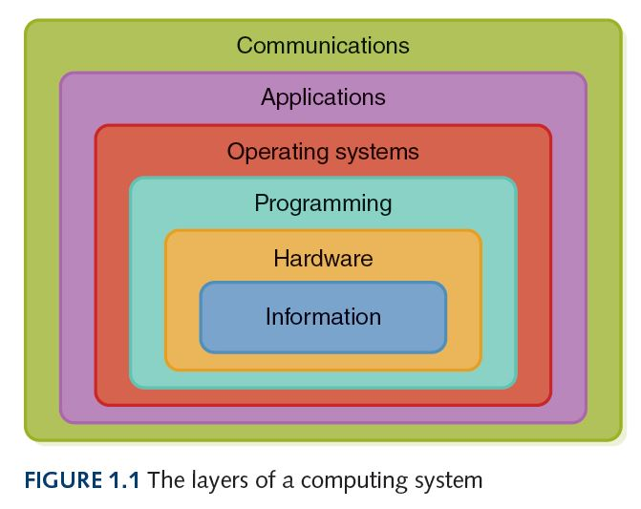
Reminder

Slide 3
CPU Scheduling
The action of determining which process in the ready state should be moved to the running state
Many processes may be in the ready state
Only one process can be in the running state (having access to the CPU), making progress at any one time
Which process has the chance to move from ready to running?
This is CPU scheduling concept.

Slide 4
CPU Scheduling Algorithms
1- First-Come, First-Served (FCFS)
Processes are moved to the CPU in the order in which they arrive in the ready state
2- Shortest Job Next (SJN)
Process with shortest estimated running time in the ready state is moved into the running state first
3- Round Robin (RR)
Each process runs for a specified time slice and moves from the running state to the ready state to await its next turn if not finished

Slide 5
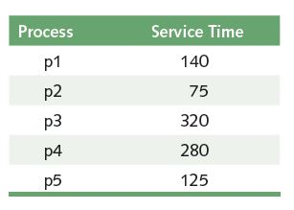
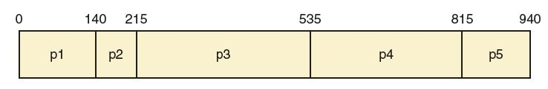
First-Come, First-Served
What is the average turnaround time?
(140+215+535+815+940)/5 = 529
Turnaround time: amount of time between when a process
arrives in the ready state and when it exits the running sate
for the last time
To keep it easy, suppose processes arrive in the ready state at
essentially the same time but in the above order

Slide 6
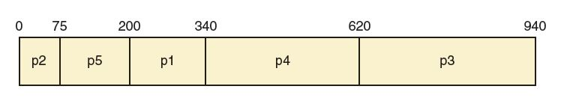
Shortest Job Next
This algorithm looks at all processes in the ready state and
dispatches the one with the smallest service time
What is the average turnaround
time? (75+200+340+620+940)/5 = 435
Gantt Chart

Slide 7
Round Robin
Every process is treated the same!
Time slice (quantum)
Each process is given a certain amount of time (a time slice) before being retuned to the ready state to allow another process its turn
Round Robin is non-preemptive (FCFS and SJN are preemptive policies)

Slide 8
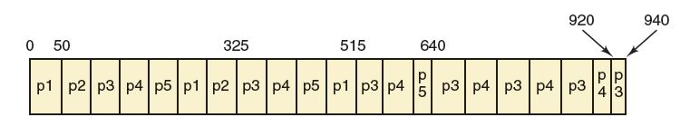
Round Robin
Suppose the time slice is 50
(515+325+940+920+640)/5 = 668
First come, first serve = 529
Shortest job next = 435
Does that mean the round robin is not as good other options? No. We can say only one algorithm is better than another for that specific set of processes

