Slide 1
OPENING SLIDE WITH TITLE
Giuseppe Spatafora

Slide 2
TRUST

Slide 3
What happened?

Slide 4
What happened?

Slide 5
About us
The European Union Institute for Security Studies (EUISS) is the Union’s Agency analysing foreign, security and defence policy issues. Its core mission is to assist the EU and its member states in the implementation of the Common Foreign and Security Policy (CFSP), including the Common Security and Defence Policy (CSDP) as well as other external action of the Union.
The Institute was set up in January 2002 as an autonomous agency under Council Joint Action 2001/554 [now regulated by Council Decision 2014/75/CFSP] to strengthen the EU’s analysis, foresight, and networking capacity in external action. The Institute also acts as an interface between the EU institutions and external experts – including security actors – to develop the EU’s strategic thinking. The EUISS is now an integral part of the structures that underpin the further development of the CFSP/CSDP.

Slide 6
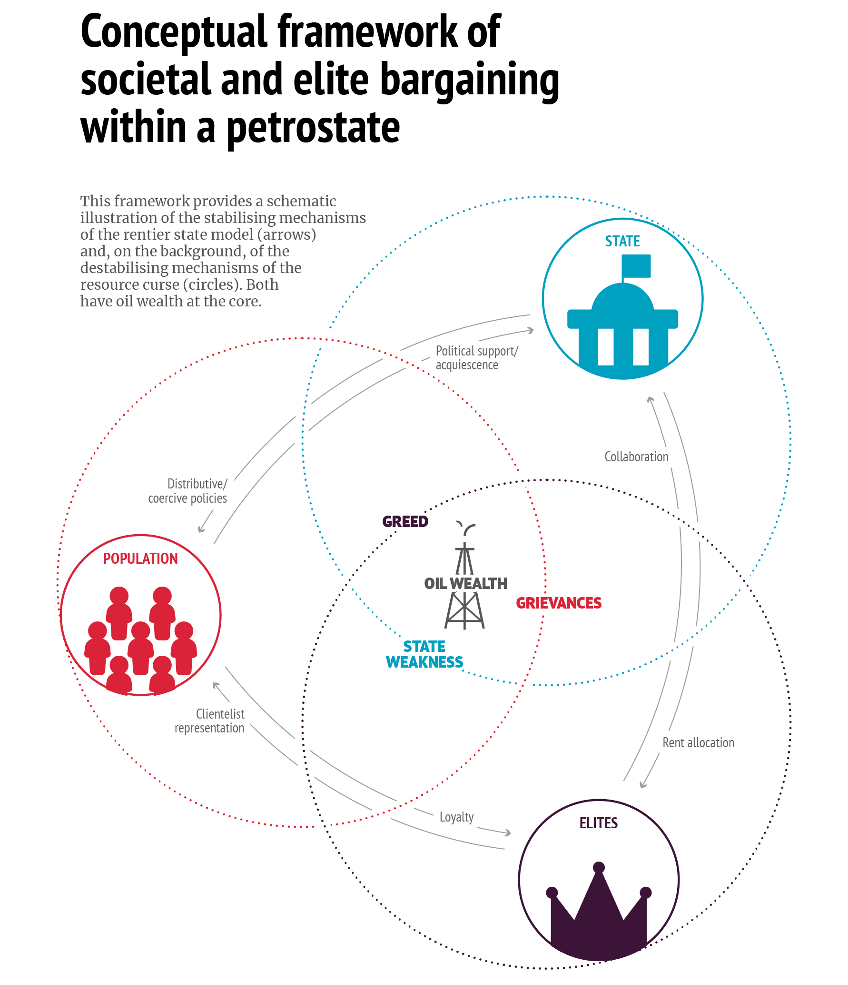
An image
With some additional text…

Slide 7
Table title
 | width | height | bottom | top | left
CD/DVD | 120 | 120 | 12,1 | 40,0 | 25,4
A6 | 105 | 148 | 10,5 | 49,3 | 22,1
Leaflet | 105 | 210 | 10,5 | 70,0 | 22,1
A5 | 148 | 210 | 14,8 | 70,0 | 31,1
B5 | 176 | 250 | 17,6 | 83,3 | 37,0
A4 | 210 | 297 | 21,0 | 99,0 | 44,1
A3 | 297 | 420 | 29,7 | 140,0 | 62,4
A2 | 420 | 594 | 42,0 | 198,0 | 88,2
TOTAL | 594 | 841 | 59,4 | 280,3 | 124,7

