Slide 1


Global Mental Health EDA
Term Project by Eula Fullerton

Slide 2
Question and Hypothesis
Question: "How do mental health disorder rates compare across countries. Is there a trend in these rates over time?"
Hypothesis: "There is considerable variability in mental health disorder rates across countries."

Slide 3
Variables
1. Year: Year that the data was collected
2. Entity: Unique identifier for each country or region included in the data set.
3. % Schizophrenia: Percentage of people with schizophrenia in that country/region during that year.
4. % Bipolar Disorder: Percentage of people with bipolar disorder in that country/region during that year.
5. % Eating Disorders: Percentage of people with bipolar disorder in that country/region during that year.
6. % Anxiety Disorders: Percentage of people with anxiety disorders in that country/region during that year.
7. % Drug Use Disorders: Percentage of people with drug use disorders in that country/region during that year.
8. % Depression Disorders: Percentage of people with depression in that country/region during that year.
9. % Alcohol Use disorders: Percentage of people with alcohol use disorders in that country/region during that year These are my variables.

Slide 4
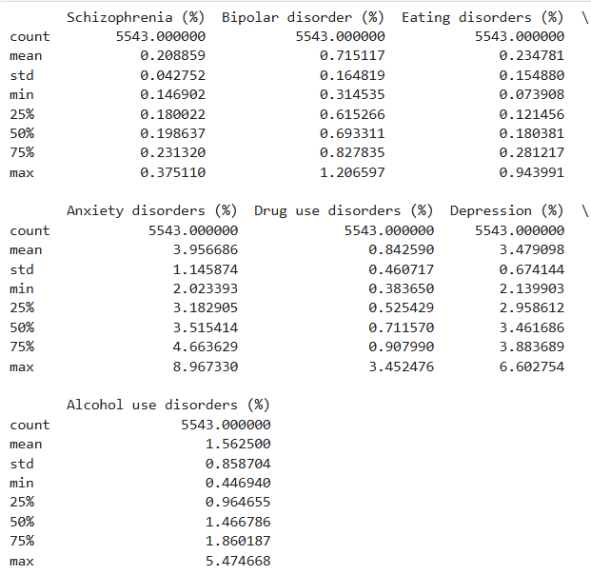
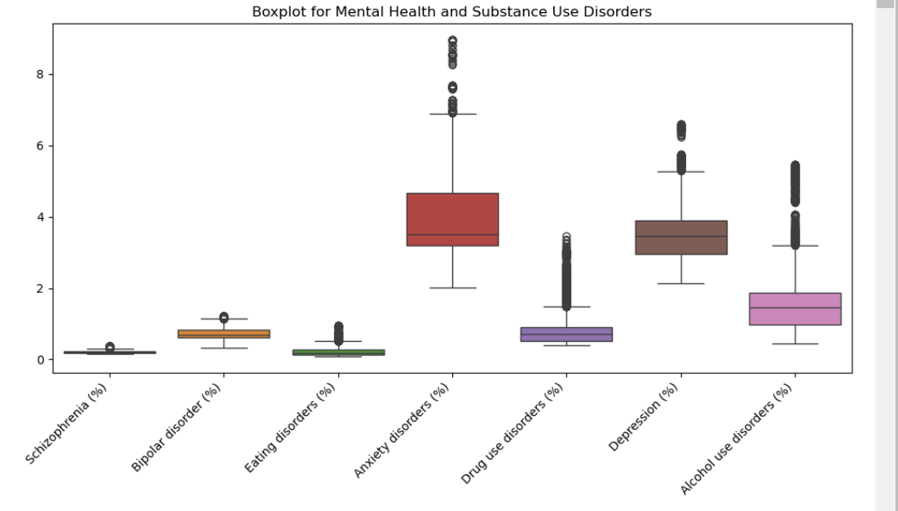
Overall Picture of Variables (Descriptive Statistics & Boxplots)

Slide 5
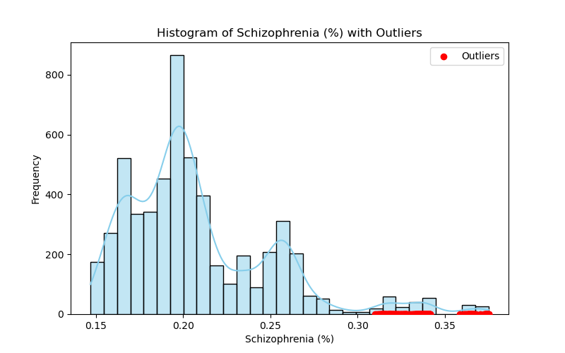
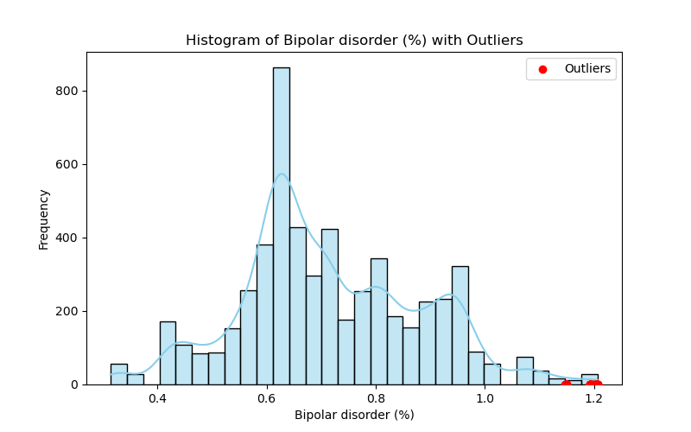
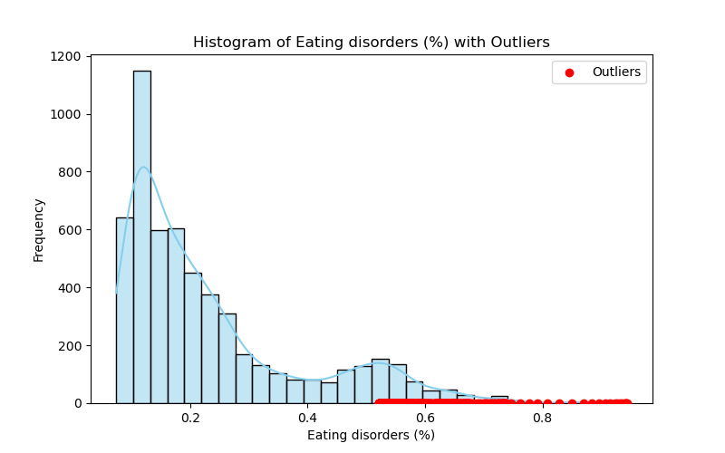
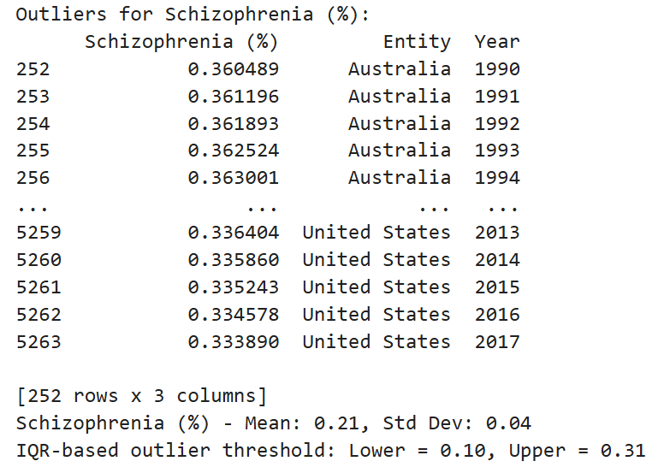
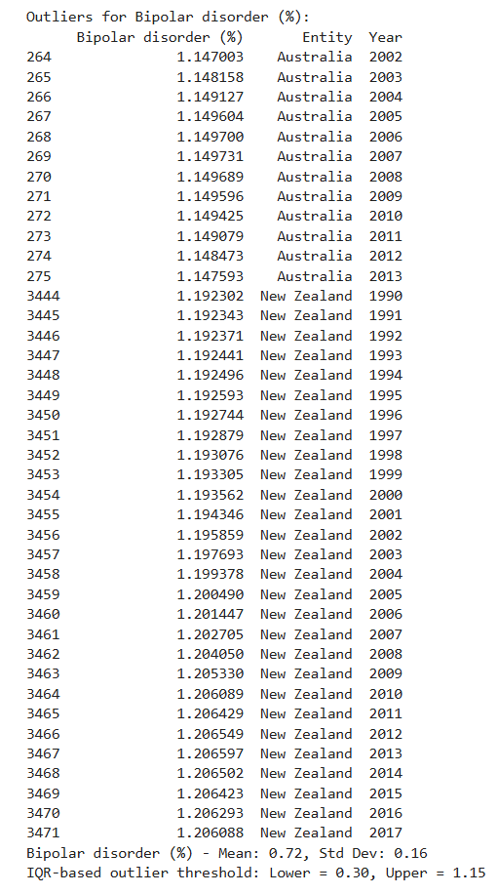
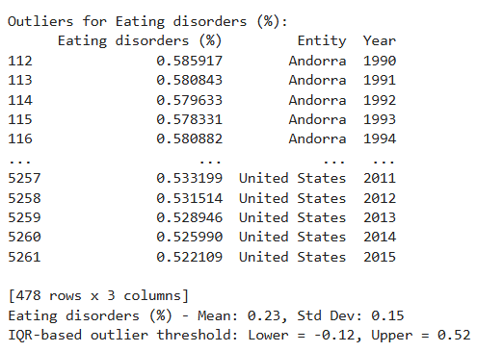
Histogram with outliers And Descriptive Statistics…

Slide 6
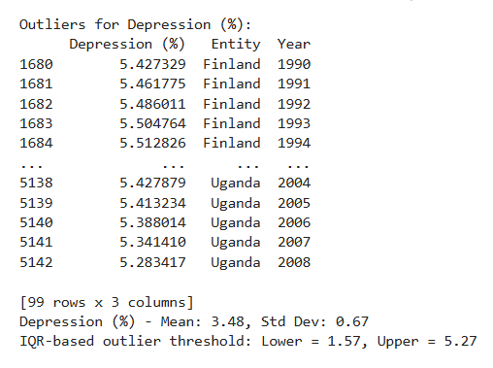
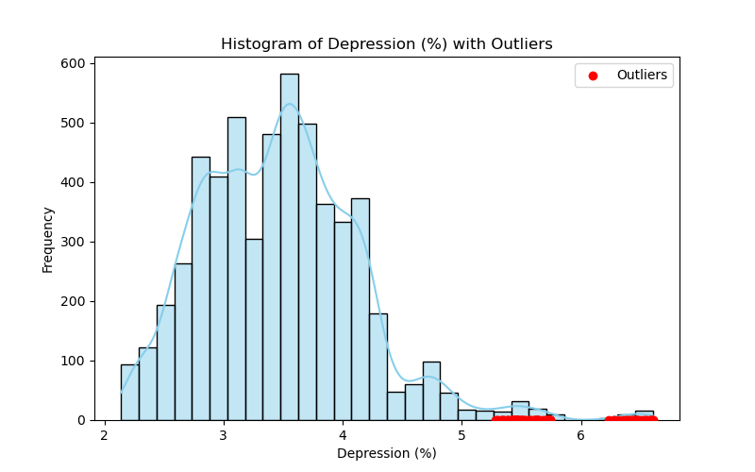
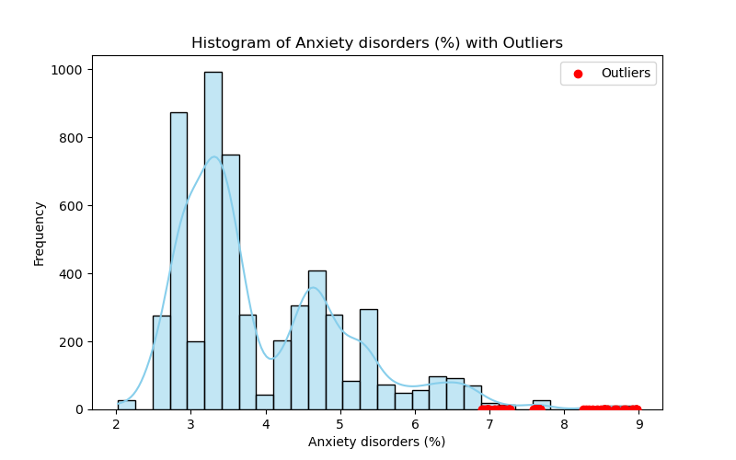
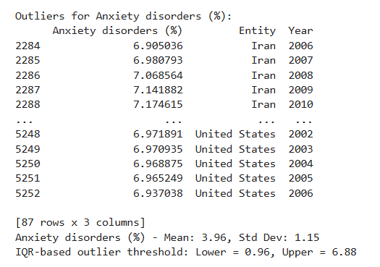
Depression and Anxiety…

Slide 7
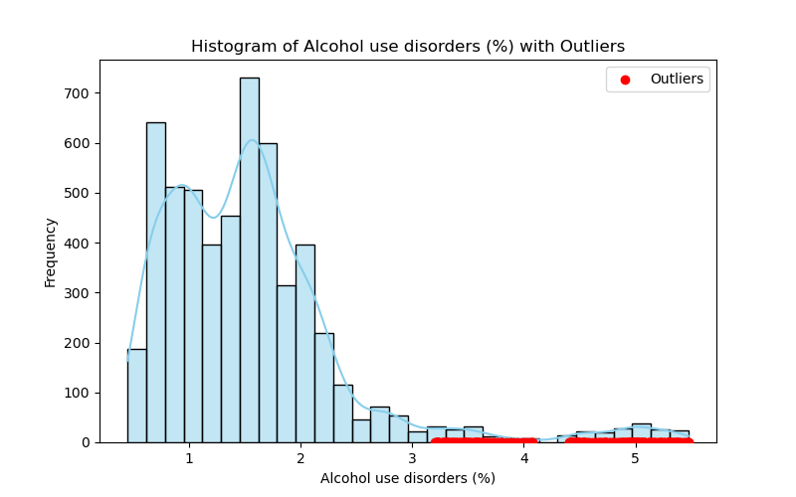
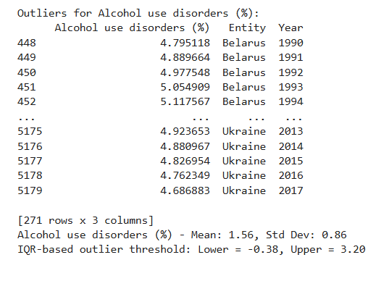
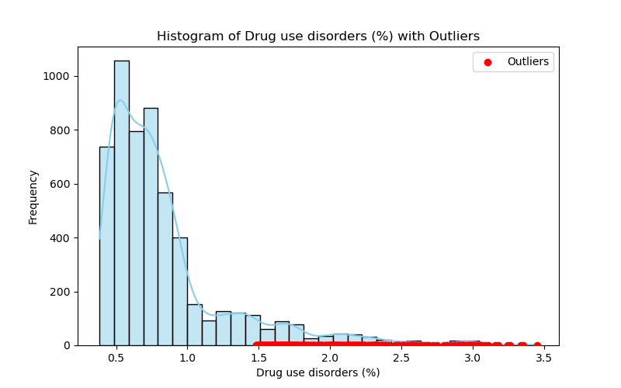
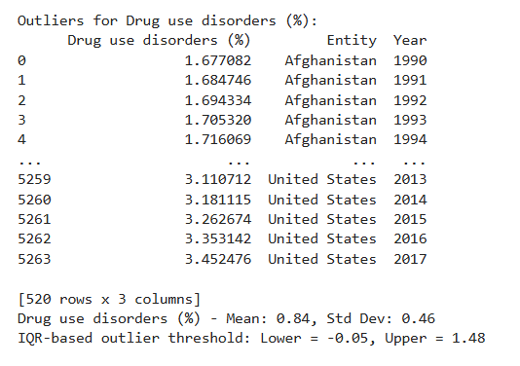
Drugs and Alcohol…

Slide 8

Outliers
Due to the nature of the project with the purpose of global comparisons and trend analysis. Outliers were kept as numerous outlier points were found within each histogram, which removing would greatly impact the study.

Slide 9
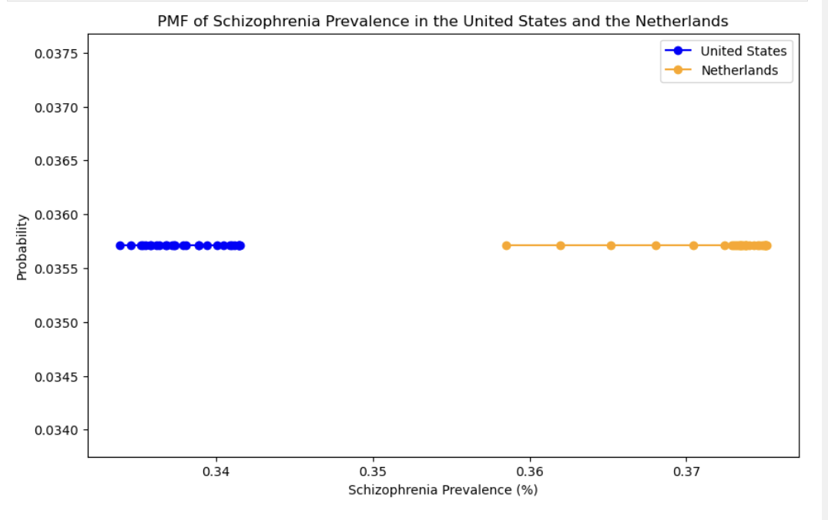
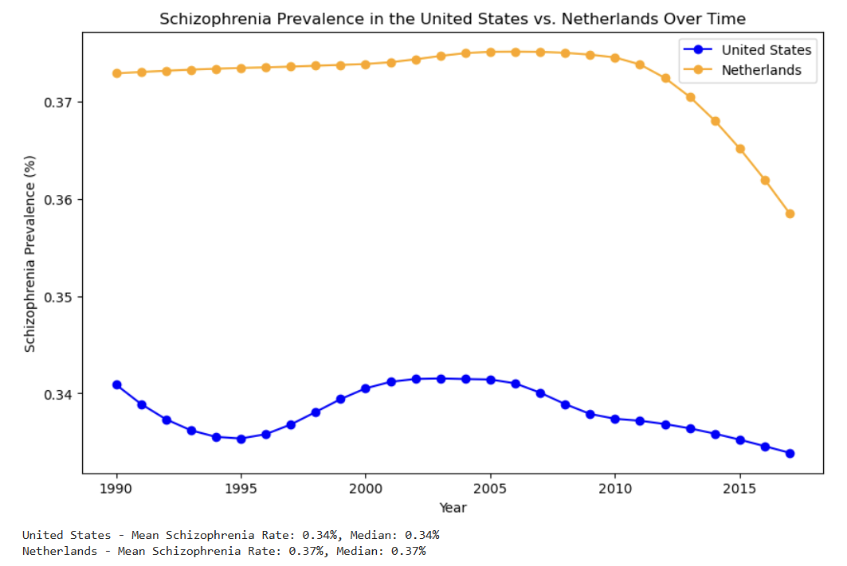
PMF
Compares United States to the Netherlands, which was found to have the highest incidence of schizophrenia.
The PMF suggests that the schizophrenia prevalence rates are relatively stable over time for both countries, with the Netherlands showing a marginally higher prevalence than the United States. The probabilities for each value are very close, showing that prevalence is consistent within each country.

Slide 10
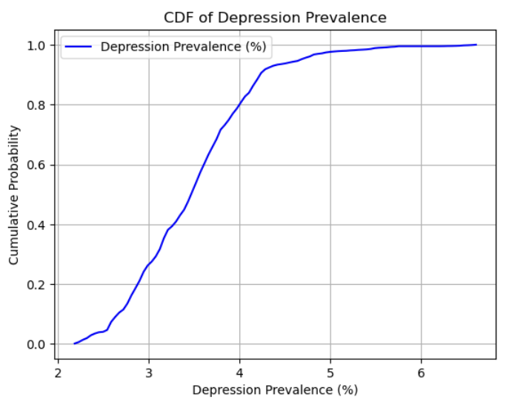
CDF
This cdf helps identify how depression prevalence is distributed across multiple countries.
Observing the right ward shift of the cdf curve over the years could answer how mental health disorders rates are changing globally

Slide 11
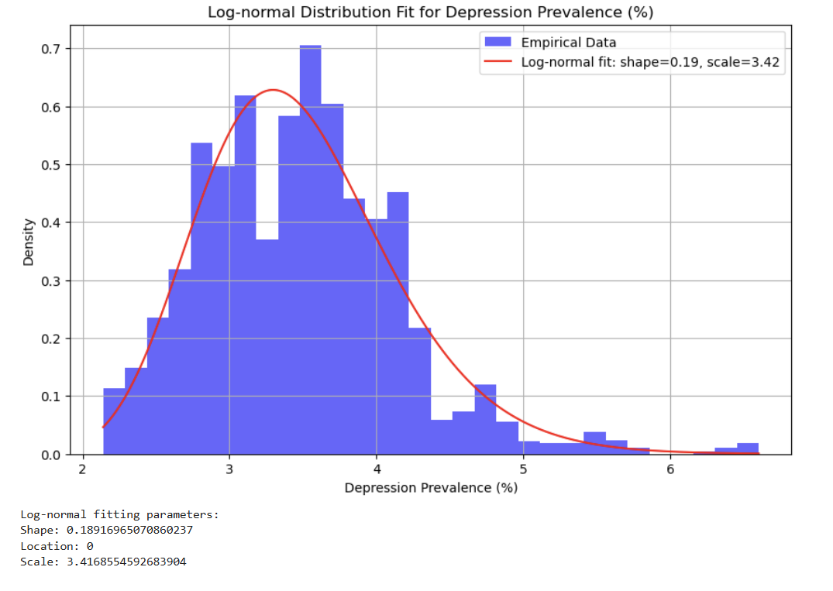
Analytical Distribution
The log-normal fit reflects the positively skewed nature of mental health disorder rates.
Most countries have moderate levels of depression prevalence, but a few have significantly higher rates, represented by the tail of the distribution.
This supports the hypothesis that there is considerable variability across countries, with certain nations experiencing higher rates due to factors such as socioeconomic conditions, healthcare access, and cultural attitudes toward mental health.
It shows peaks around 3-4% indicating most countries have depression rates in this range

Slide 12
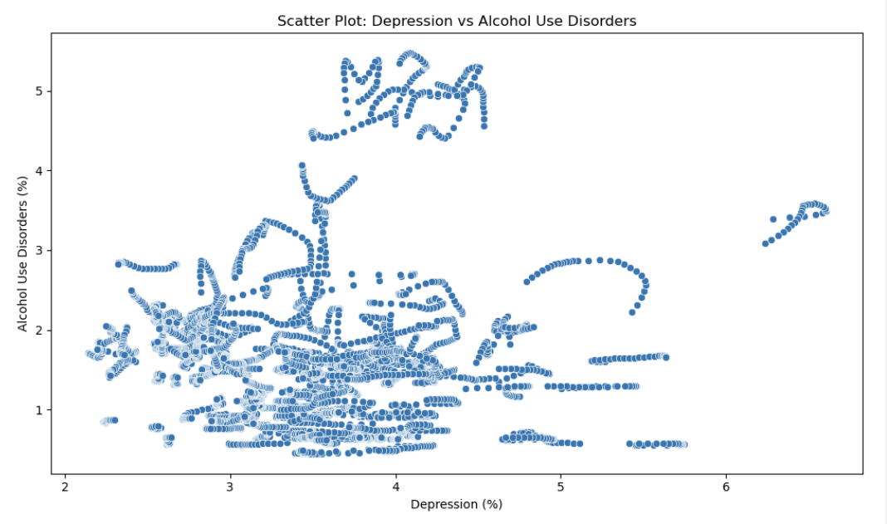
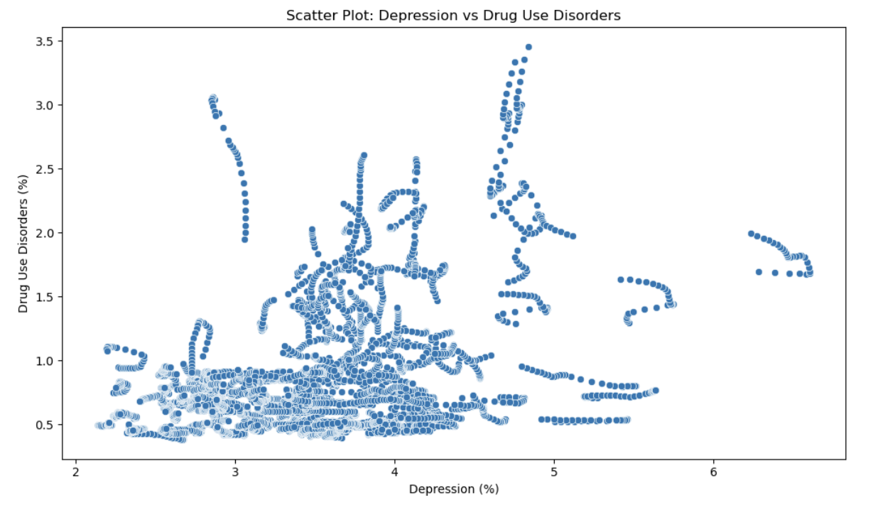
Scatter Plot: Comparing Depression rates with Drug and Alcohol USE Disorders
These two scatter plots show that populations with lower depression percentages also have lower drug and alcohol use disorder percentages. However, there is variable drug and alcohol use disorder percentages at higher depression rates. The relationship weakens with higher depression percentages.

Slide 13
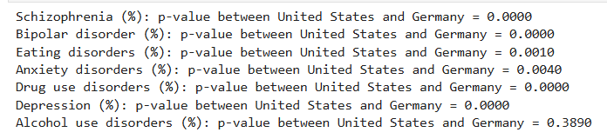
Testing Hypothesis: comparison of mental health disorders between united states and germany
Low p-values (e.g., < 0.05) indicate that there is a statistically significant difference between the United States and Germany for mental health disorders, suggesting strong evidence that the difference in means between the two countries is not due to random chance.
This can be found in all cases, except for Alcohol use disorders, where the p-value is 0.3890, meaning there is insufficient evidence to reject the null hypothesis that the difference in means is due to chance.

Slide 14
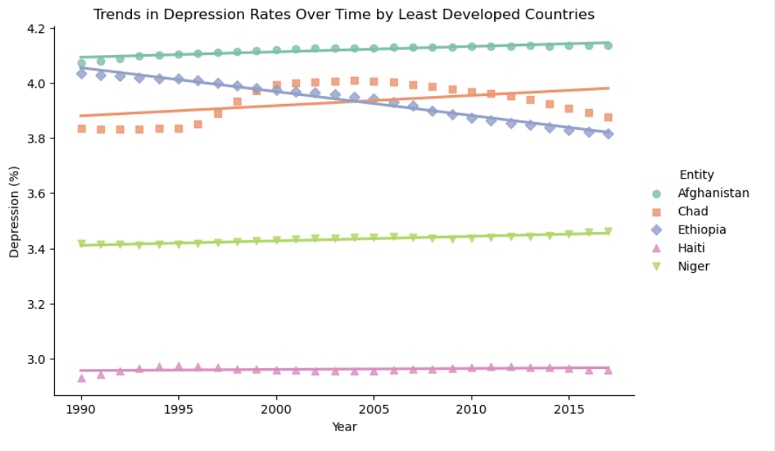
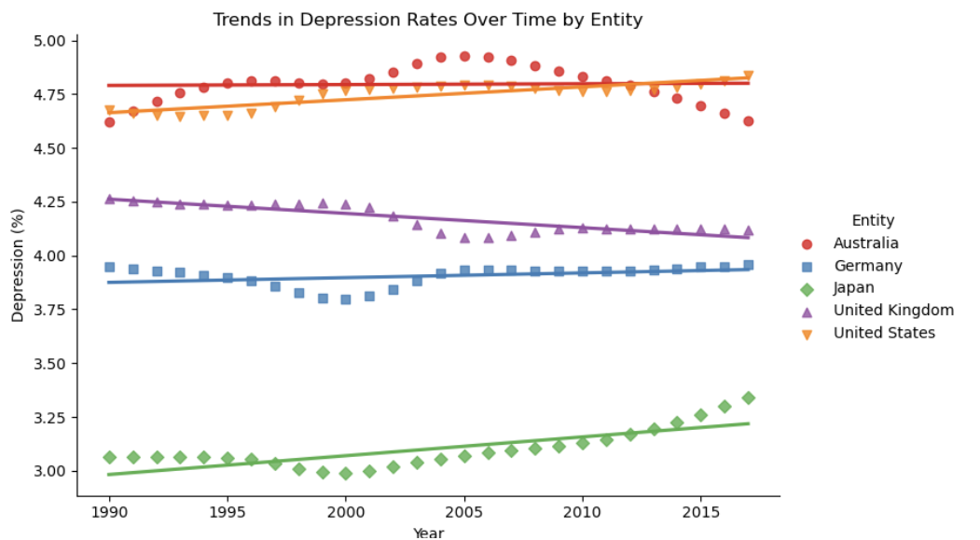
Regression analysis of most developed countries vs least developed
 | Least Developed Countries | Most Developed Countries
General Trend | Least developed countries show overall lower depression rates with relatively stable or show minor trends with no dramatic changes | Depression rates have shown slight increases or remained fairly steady over the years. Suggests depression rates are persistent over time with some gradual trends rather than dramatic shifts.
Implications | The lower and more stable rates in the least developed countries may reflect a range of factors, including culture attitudes, lower diagnosis/reporting rates, or different stresssors. | Steady increase in some countries (US) may warrant further investigation into possible contributing factors such as changes in economic conditions, healthcare policies, or cultural attitudes toward mental health

Slide 15

Conclusion
The variability observed across different countries strongly supports my Hypothesis. Mental health disorder rates are not uniform globally but are shaped by variable circumstances such as cultural, socioeconomic, and healthcare factors unique to each country. These findings emphasize the need to consider country-specific factors when address mental health issues and designing polices or interventions

