Slide 1

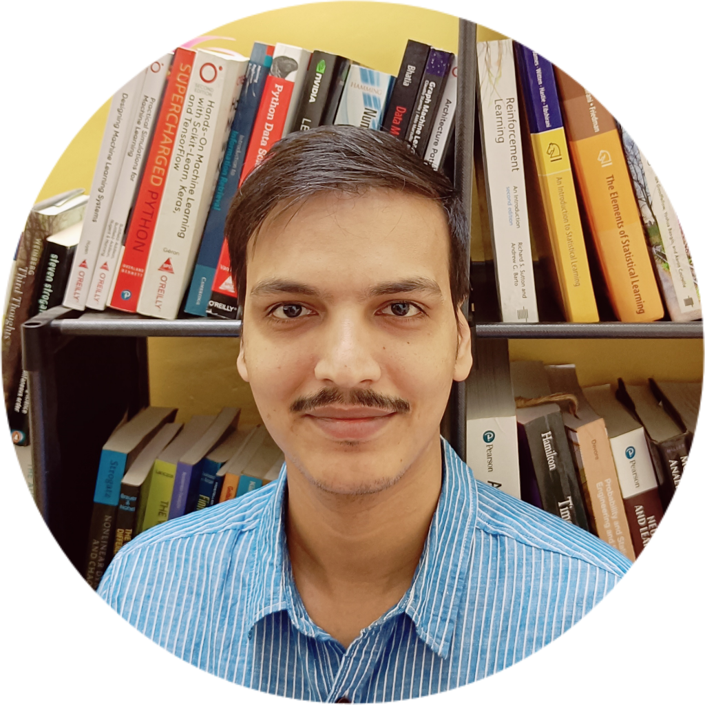
WELCOME ABOARD
Dream Place
Berlin
Favorite Place
Chamba, Himachal Pradesh
Favorite Food
Sev Tamatar
Favorite Sport
Chess
Favorite Actor
Irrfan
Himanshu
Senior Data Analyst
Hobbies
Reach out at
himanshu@mresult.com
Reading

