Slide 1
Machine learning classification of aneurysms using imaging and simulation data /Machine learning and Deep learning method for predicting aneurysms rupture risk
- By Wenjie

Slide 2
Motivation
Intracranial aneurysms(IA) is a cerebrovascular disease that mainly occurs in the cerebral artery, it is distinguished by pathological dilation of blood vessels
A rupture of IA can cause instantly death

Slide 3
Aim
Predict risk of rupture Intracranial aneurysms(IA) using Machine learning and Deep learning methods
Train the models by feed the parameters or other form of data that contain the information of the IA
Database
AneuX morphology database

Slide 4
AneuX morphology database
750 aneurysm domes (surface meshes)
668 vessel trees (surface meshes)
3 different data sources (AneuX, @neurIST, Aneurisk)
3 different mesh resolutions (original resolution, 0.01mm² and 0.05mm² target cell area)
4 different cut configurations (including cut1, cut2, planar and ninja)
5 clinical parameters (aneurysm rupture status, location and side; patient age and sex)
170 pre-computed morphometric indices for each of the aneurysm domes

Slide 5
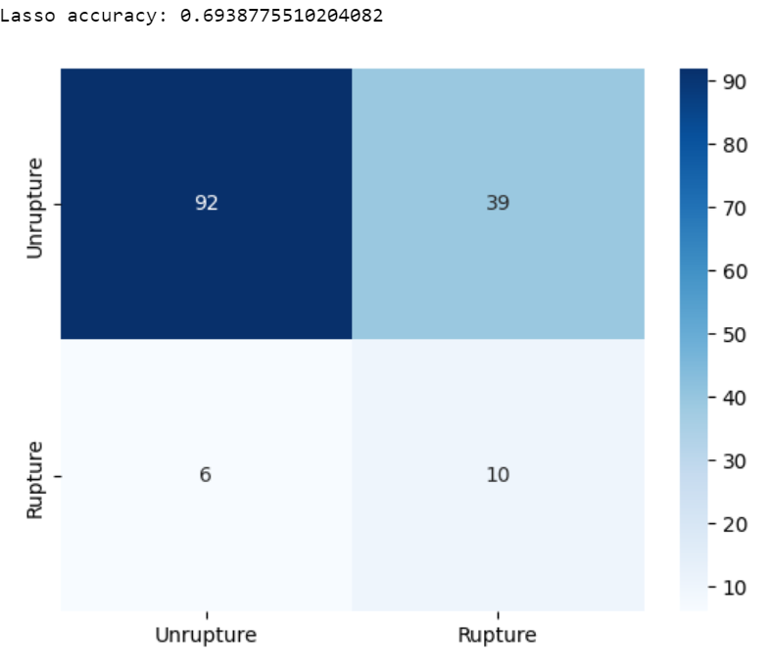
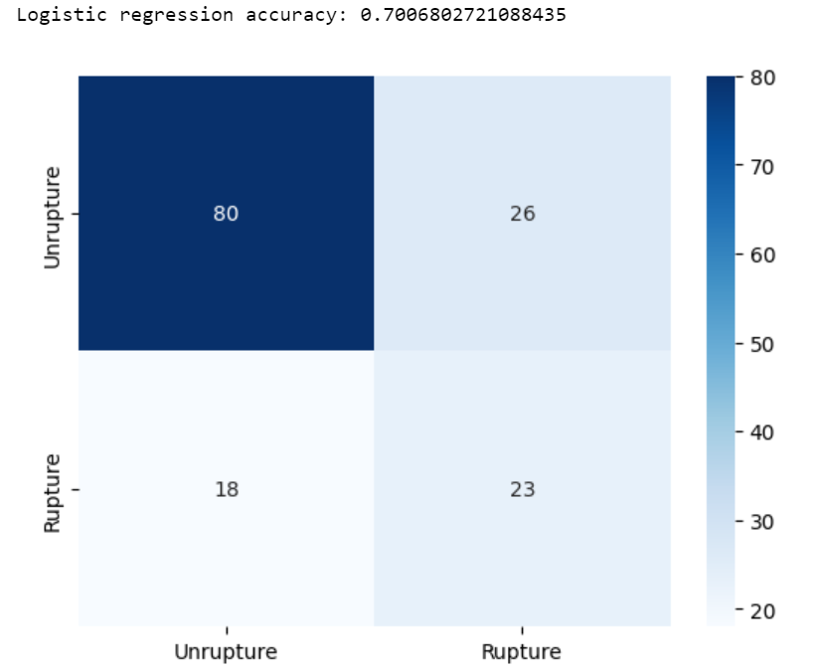
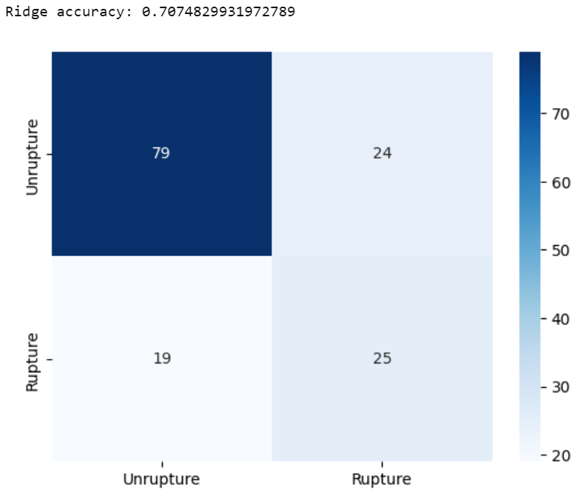
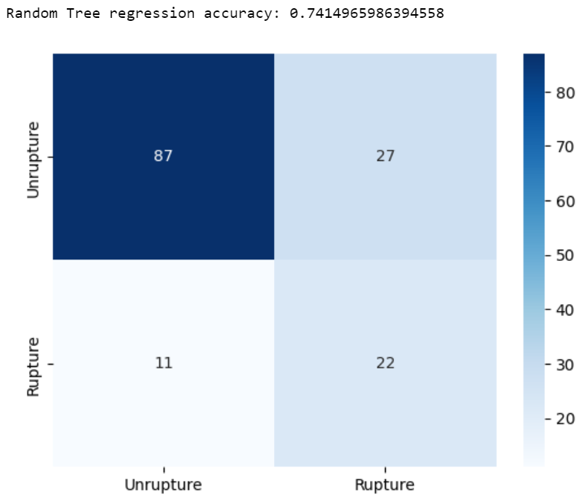
Machine learning methods
With only IA morphology parameters
Linear regression(Ridge and Lasso)
Logistic regression
Random Tree

Slide 6
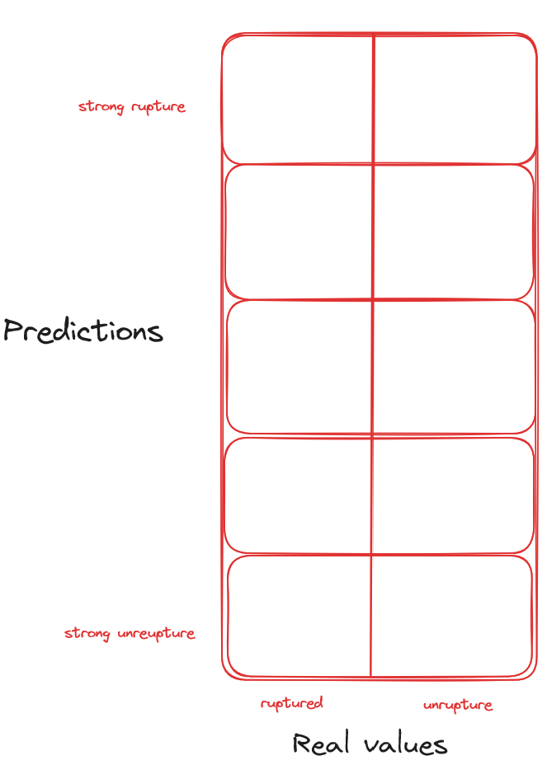
Poor evaluation with confusion matrix with only True/False
Plan to evaluate the prediction base on possibility of rupture

Slide 7
Deep Learning Method
CNN and RNN With only IA morphology parameters
Plan to give up on this, cause the database only contain 750 samples

Slide 8
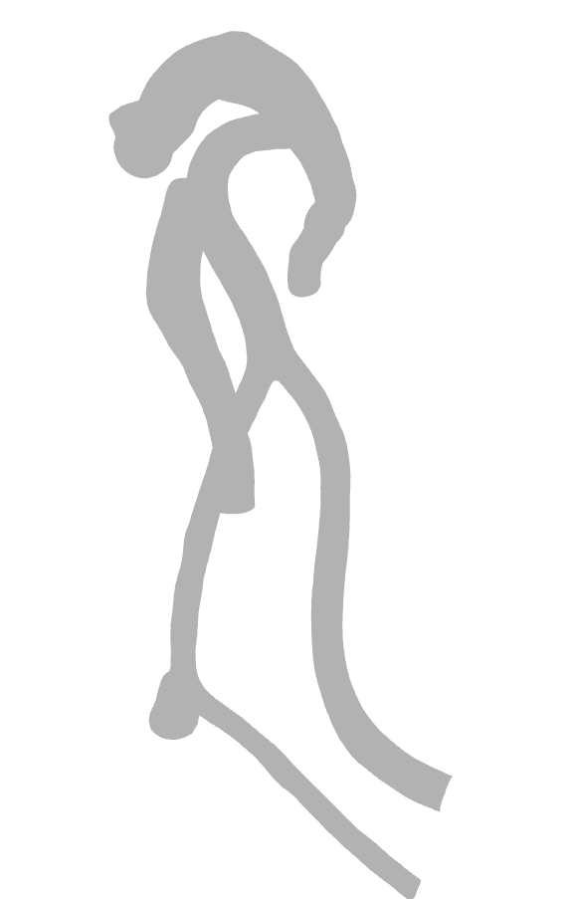
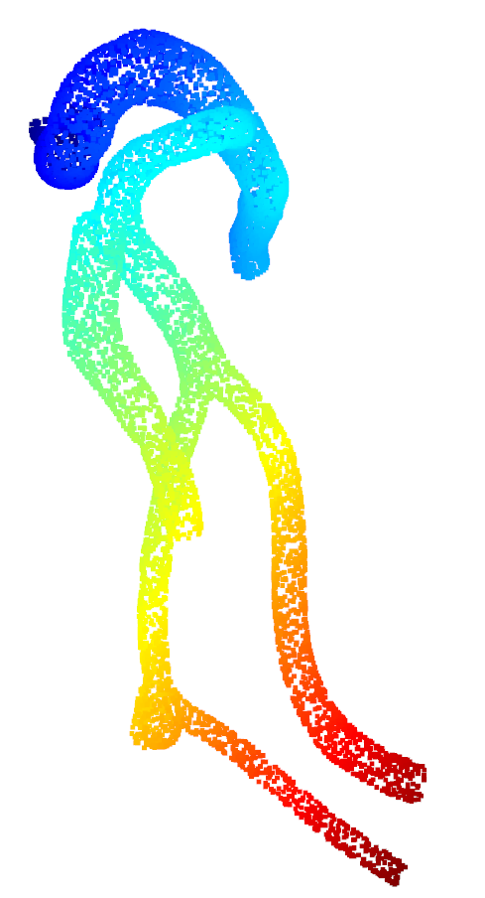
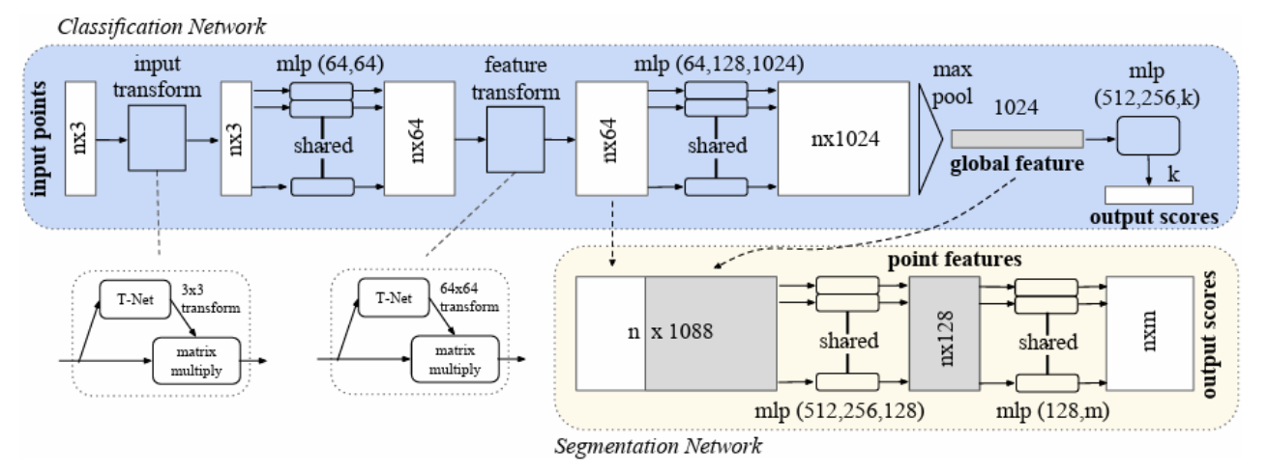
Deep Learning Method Continue
3D model of the IAs
Only 682 are valid
PointNet（Charles R. Qi，Hao Su，Stanford University）

Slide 9
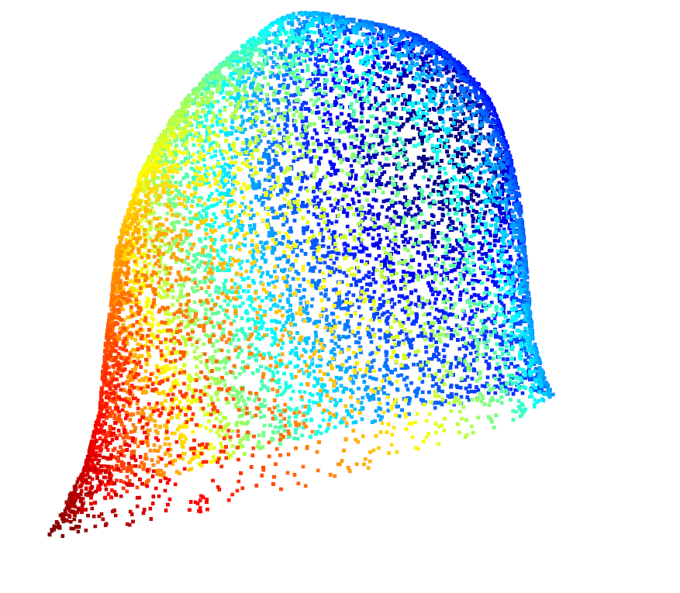
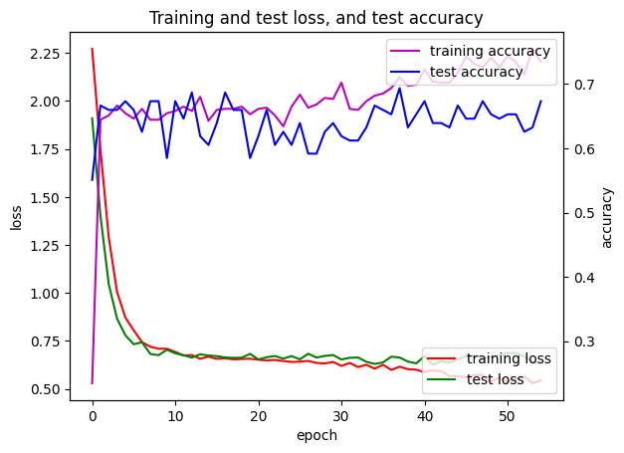
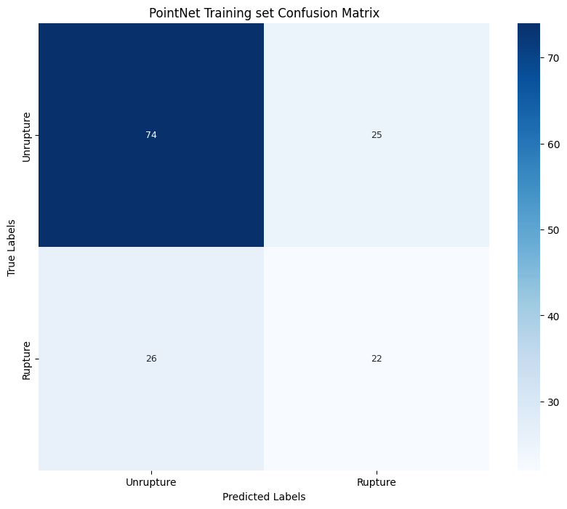
PointNet Result
When using Dome cut
(Plan to also test PointNet on vessel or IA cut1)

Slide 10
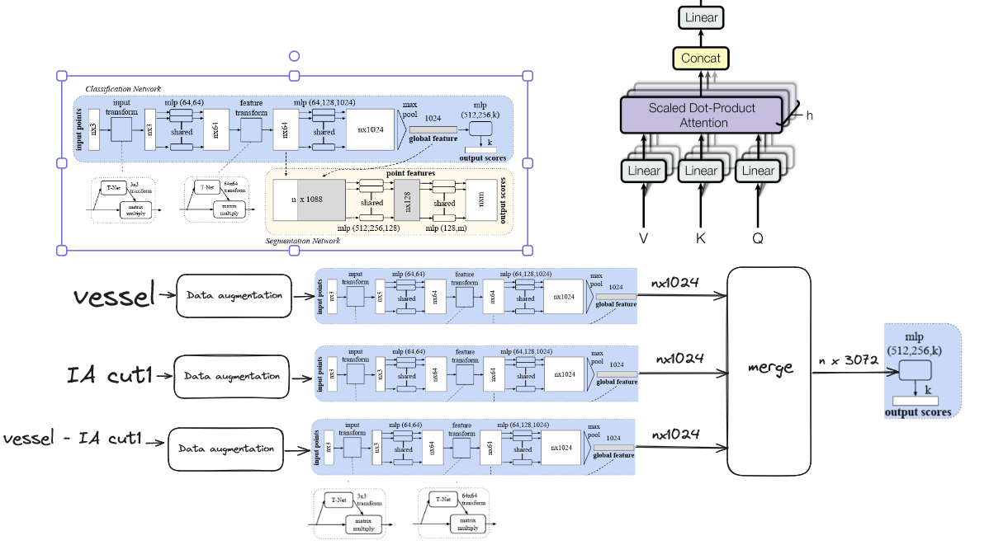
Multi-branch PointNet model

Slide 11
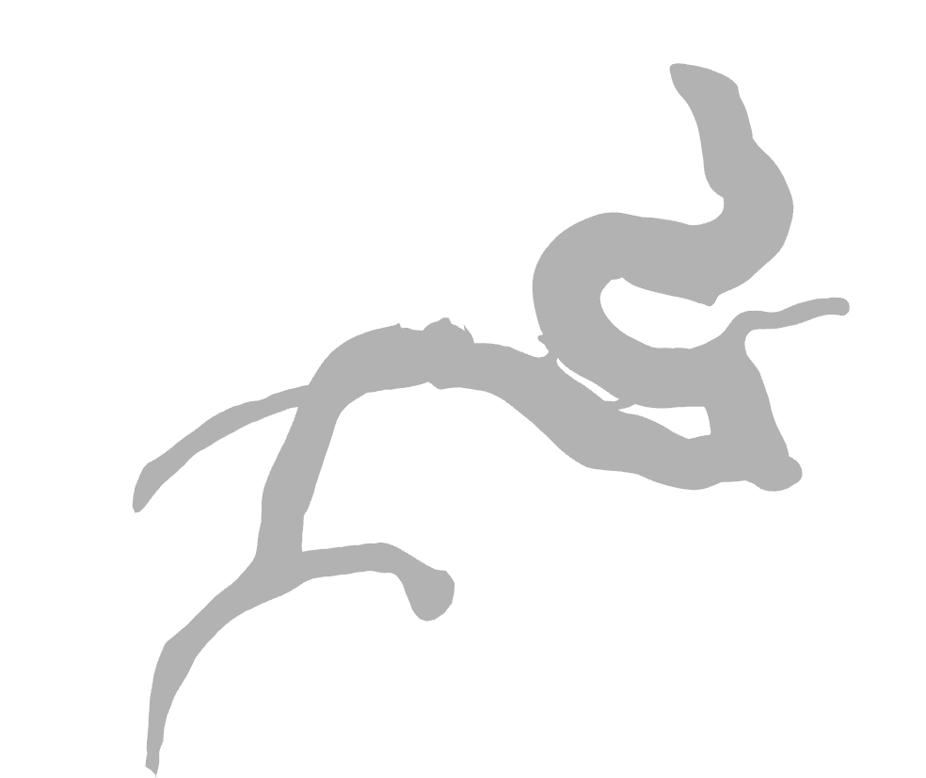

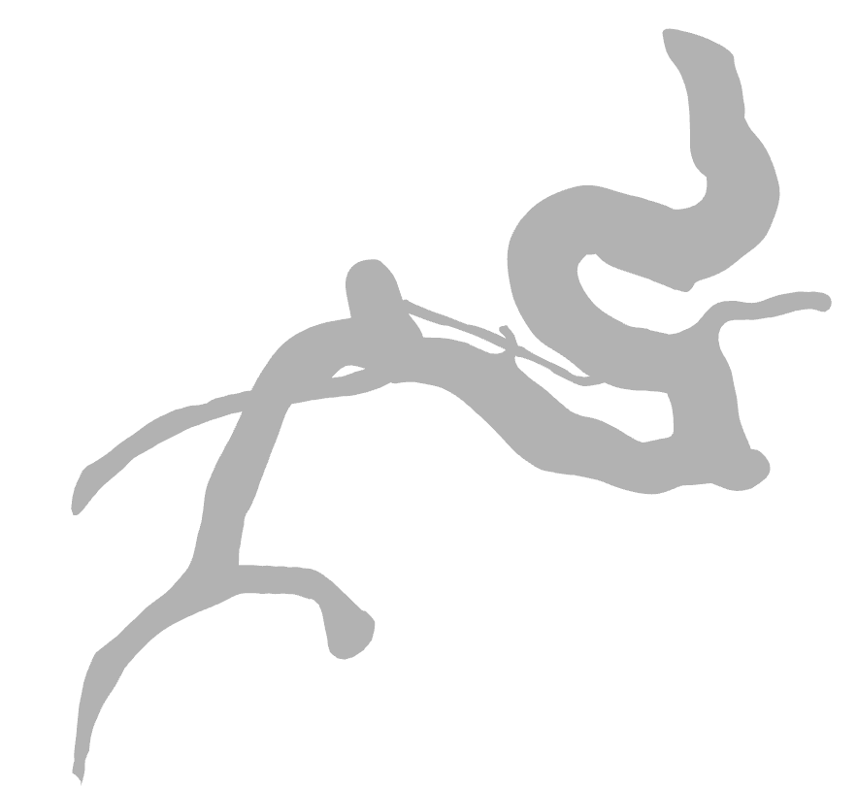
Split the model
Vessel with out IA model
IA dome model
Vessel with IA model

Slide 12
05/06/2024

Slide 13
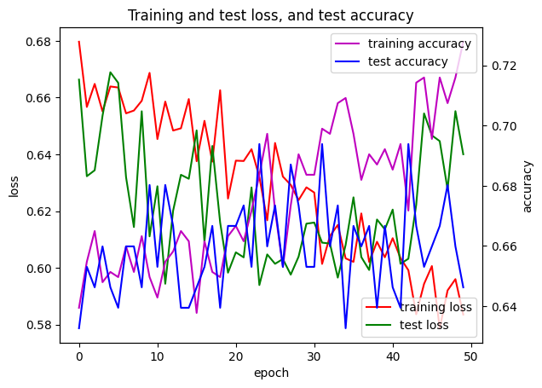
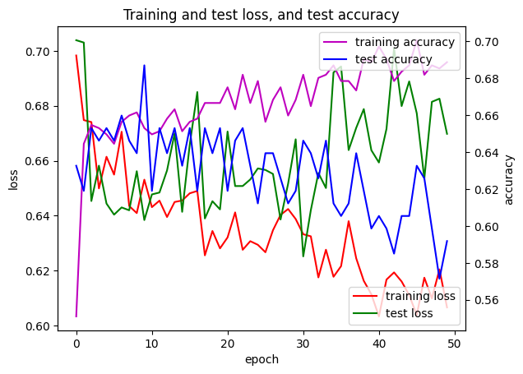
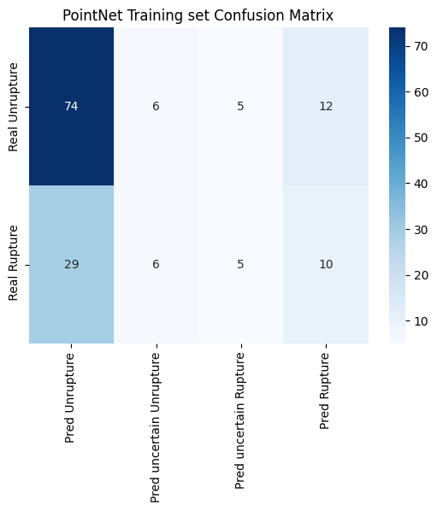
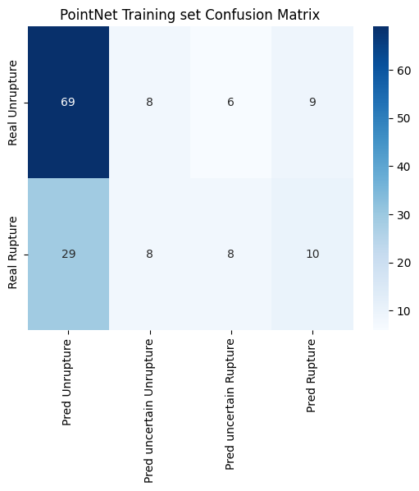
PointNet on cut1
PointNet on vessel

Slide 14
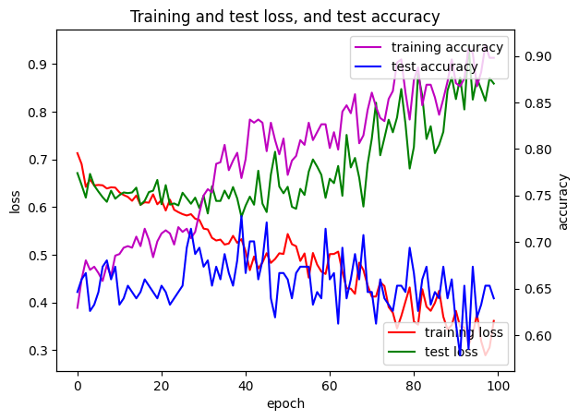
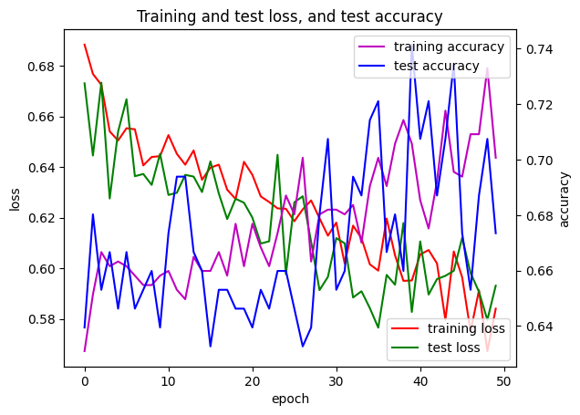
Loss and Accuracy
PointNet on Dome
Double-Branch PointNet on Dome and Vessel

Slide 15
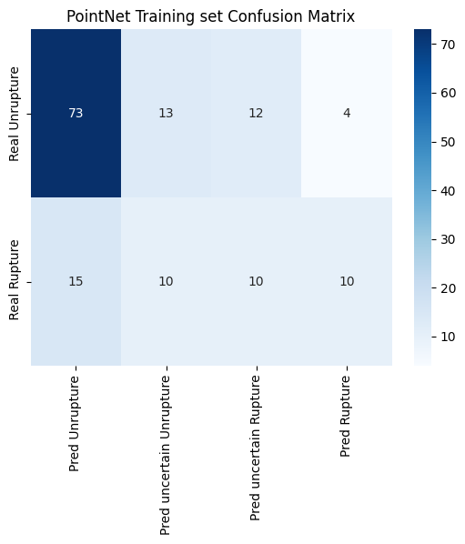
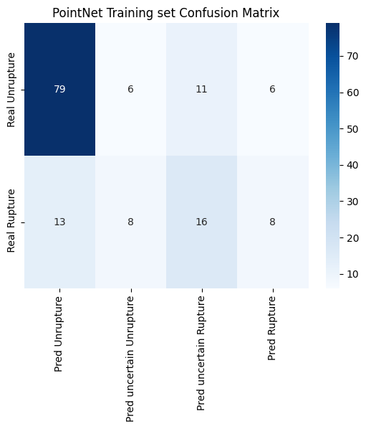
Confusion Matrix
PointNet on Dome
Double-Branch PointNet on Dome and Vessel

