Slide 1
Topic Model Analysis of Berkshire Hathaway’s Annual Shareholder Letters
Capstone Project II for Springboard
Tom Halloin

Slide 2
Background
Berkshire Hathaway is a company run by Warren Buffett.
Famous for long track record of having 20.5% annual return vs 9.7% for the S&P 500 since 1965.
A $100 investment in BRK-A would be worth ~$2.47 million today
Annual report released every year details performance, investment holdings, and economic commentary.
Problem: Summarize letters so investors who are not interested in reading letters get the most important advice.

Slide 3
Natural Language Processing (NLP)
Natural language processing studies how computers process and analyze large amounts of text data.
Topic modeling is a branch of NLP that attempts to find common themes within documents.

Slide 4
Getting the Letters
Letters come in both PDF and HTML form from Berkshire Hathaway’s website.
Used Python libraries PyPDF2 and BeautifulSoup to scrape text from PDF files and HTML text.
Prior to cleaning, corpus contains 42 documents with a total of 489,874 words.

Slide 5
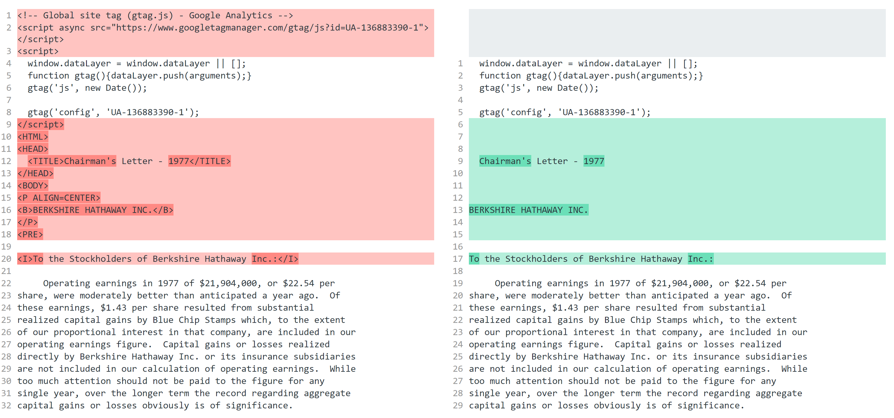
Preprocessing Data: Removing HTML

Slide 6
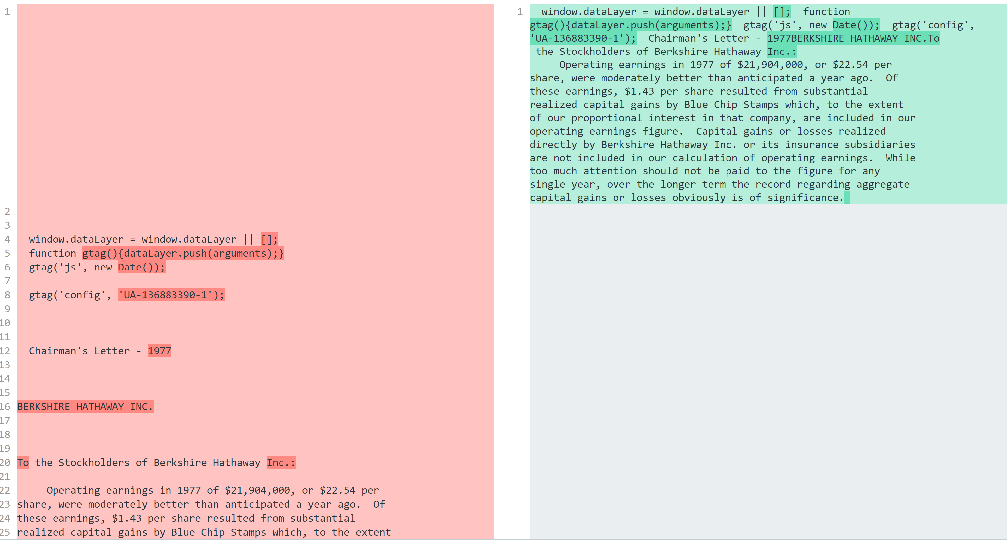
Preprocessing Data: Removing newlines

Slide 7
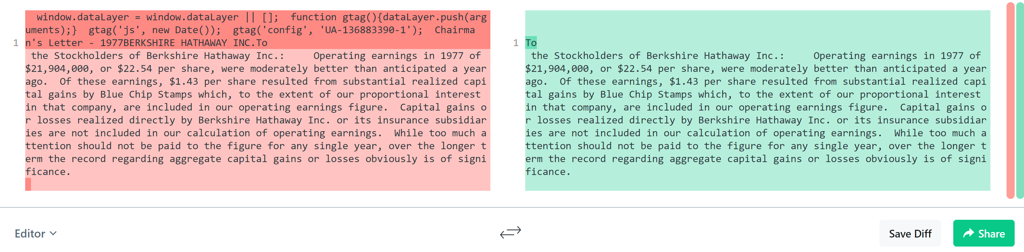
Preprocessing Data: Remove text not in letter

Slide 8
Preprocessing Data: Clean Tables
Cleaning text in tables (will show before / after by Sunday)

Slide 9
Exploratory Data Analysis

Slide 10
Types of Summarization

Slide 11
Summarization Methods

Slide 12
Measuring Summarization Quality

Slide 13
Summarization Examples

Slide 14
Summarization of Corpus (Milestone II)

Slide 15
Topic Modeling: Gensim (Milestone II)

