Slide 1
Topic Model Analysis of Berkshire Hathaway’s Annual Shareholder Letters
Capstone Project II for Springboard
Tom Halloin

Slide 2
Background
Berkshire Hathaway is a company run by Warren Buffett.
Famous for long track record of having 20.5% annual return vs 9.7% for the S&P 500 since 1965.
A $100 investment in BRK-A would be worth ~$2.47 million today
Annual report released every year details performance, investment holdings, and economic commentary.
Problem: Summarize letters so investors who are not interested in reading letters get the most important advice.

Slide 3
Natural Language Processing (NLP)
Natural language processing studies how computers process and analyze large amounts of text data.
Topic modeling is a branch of NLP that attempts to find common themes within documents.

Slide 4
Getting the Letters
Letters come in both PDF and HTML form from Berkshire Hathaway’s website.
Used Python libraries PyPDF2 and BeautifulSoup to scrape text from PDF files and HTML text.
Prior to cleaning, corpus contains 42 documents with a total of 489,874 words.

Slide 5
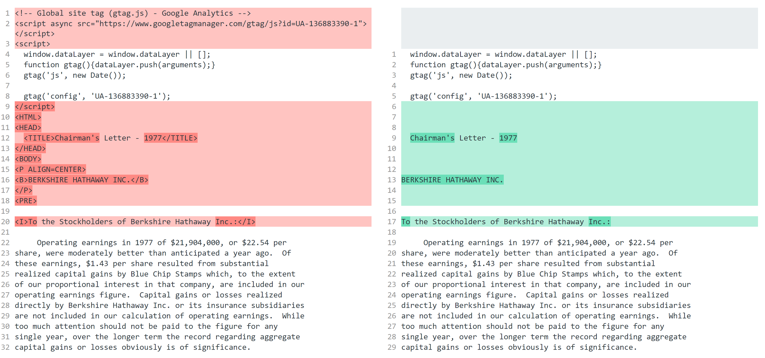
Preprocessing Data: Removing HTML

Slide 6
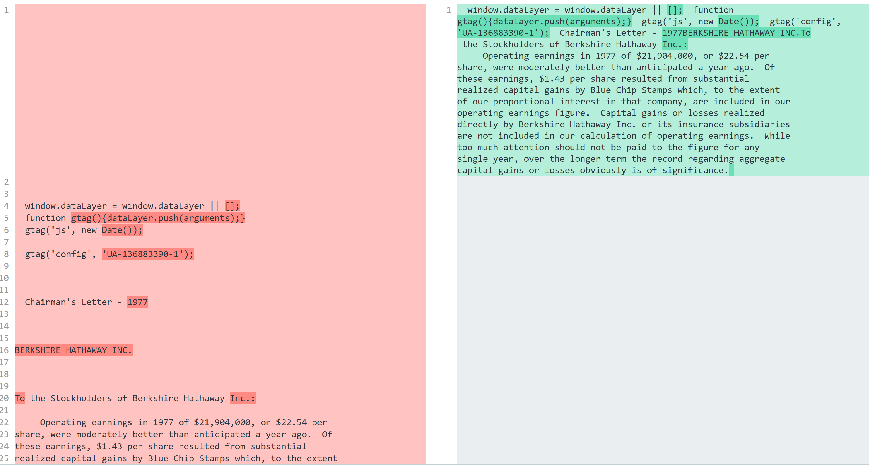
Preprocessing Data: Removing newlines

Slide 7
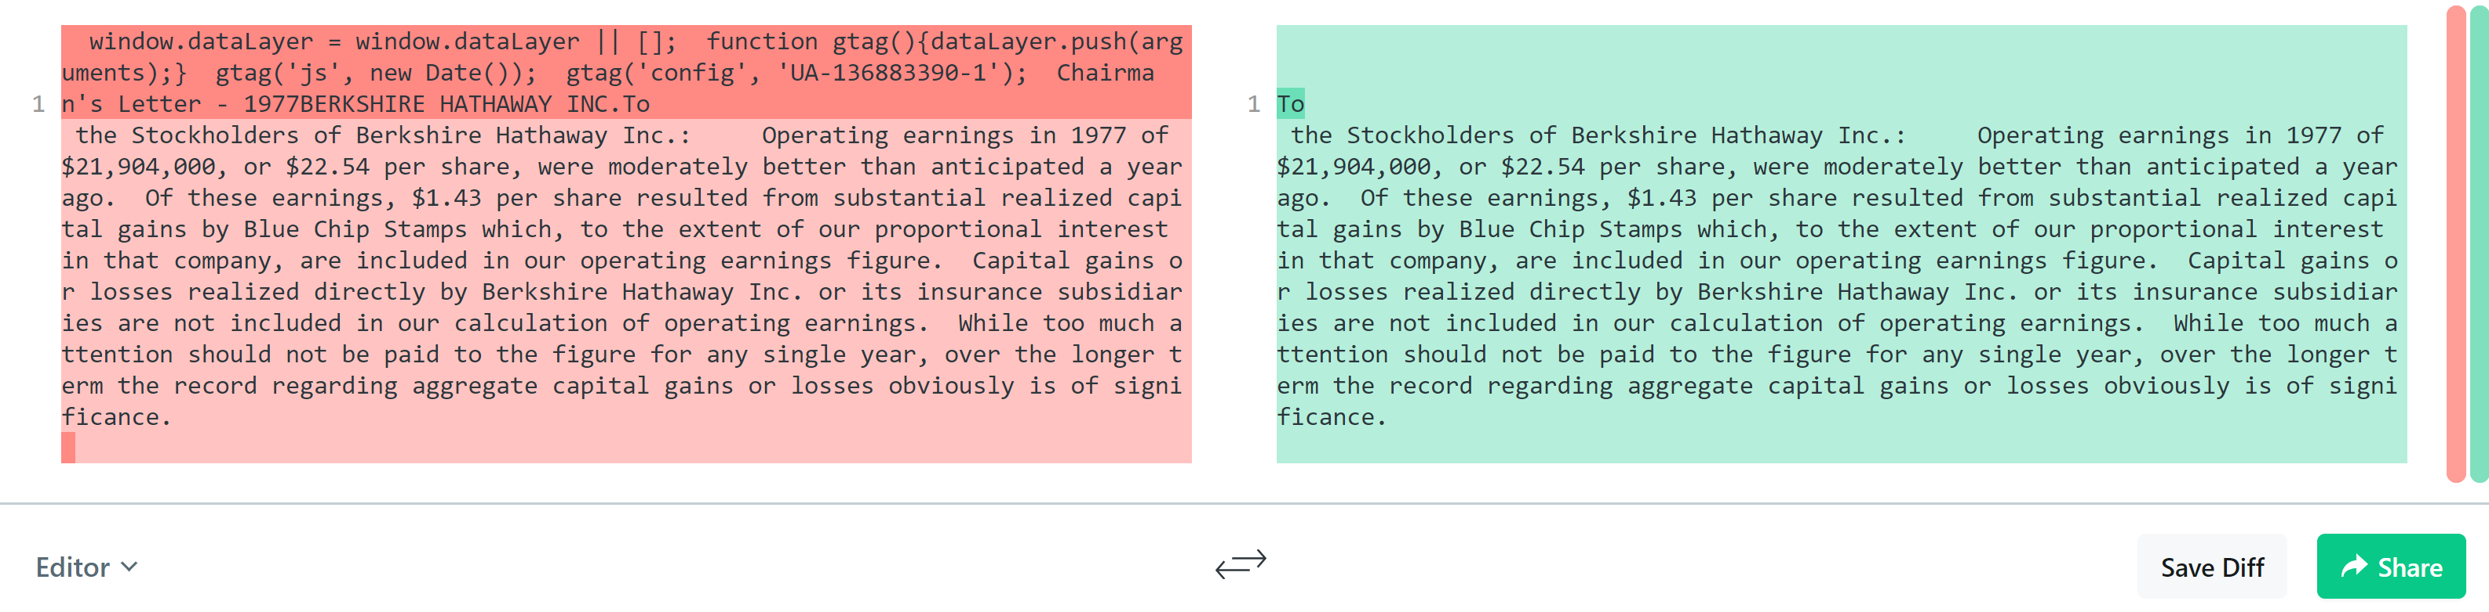
Preprocessing Data: Remove text not in letter

Slide 8
Preprocessing Data: Other Steps (will expand for Capstone II)
Cleaning text in tables
Getting rid of non-breaking spaces
Getting rid of Unicode characters

Slide 9
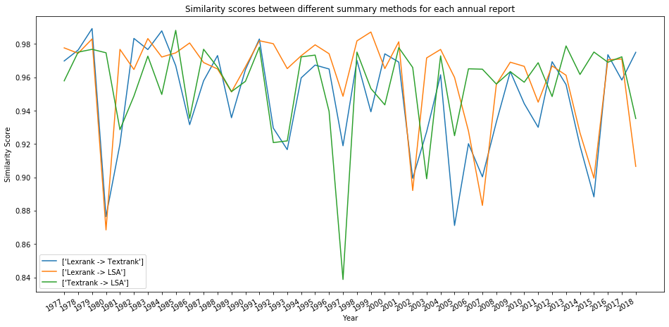
Exploratory Data Analysis

Slide 10
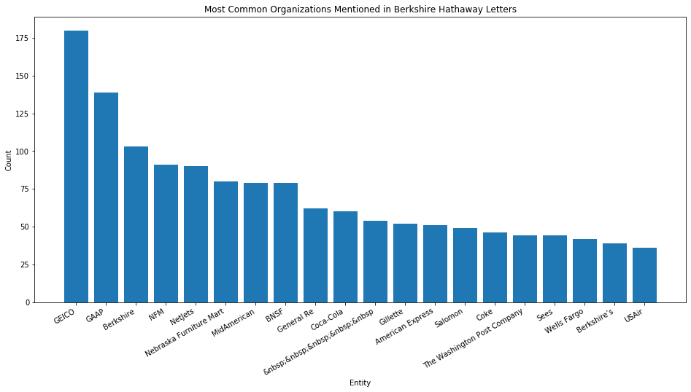
Exploratory Data Analysis – Common Entities (Organizations)

Slide 11
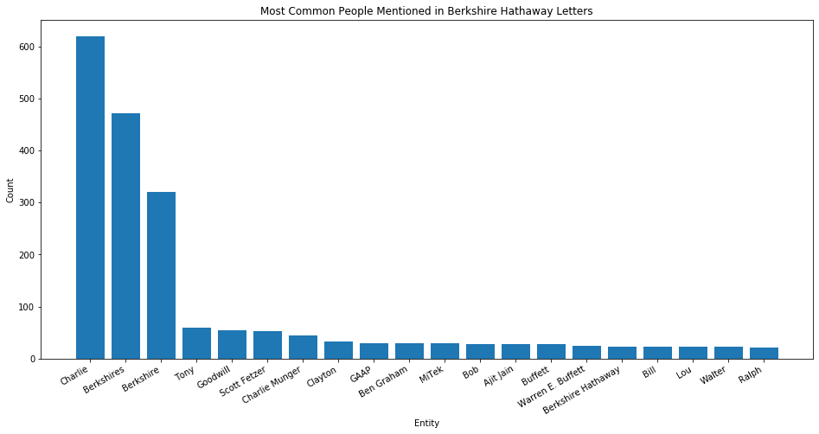
Exploratory Data Analysis – Common Entities (People)

Slide 12
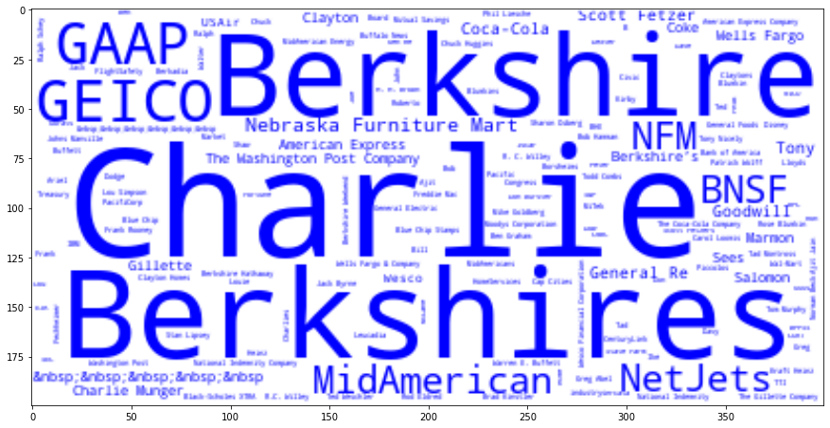
Word clouds – People and Places

Slide 13
Types of Summarization
Extractive summarization involves finding the most salient sentences and presenting them as a summary.
Abstractive summarization creates new summaries based on sentences given.
Extractive summarization easier for computers to process – abstractive requires deep learning beyond the scope of this project.

Slide 14
Summarization Methods
Textrank is a graph based weighting model similar to Google’s PageRank algorithm.
Lexrank uses the same graph-based weighting model as Textrank, but differs in the method of generating weights.
LSA analyzes similarities between the meanings of a series of documents and produces a series of concepts related to the documents.

Slide 15
Measuring Summarization Quality
Use Spacy to measure similarities between summaries extracted between 3 different methods
Plot similarities for each pairwise comparison to find where summaries differ from each other
Examine summaries from years of diverging similarity to find “best” summary method

Slide 16
Similarities in Summarization

Slide 17
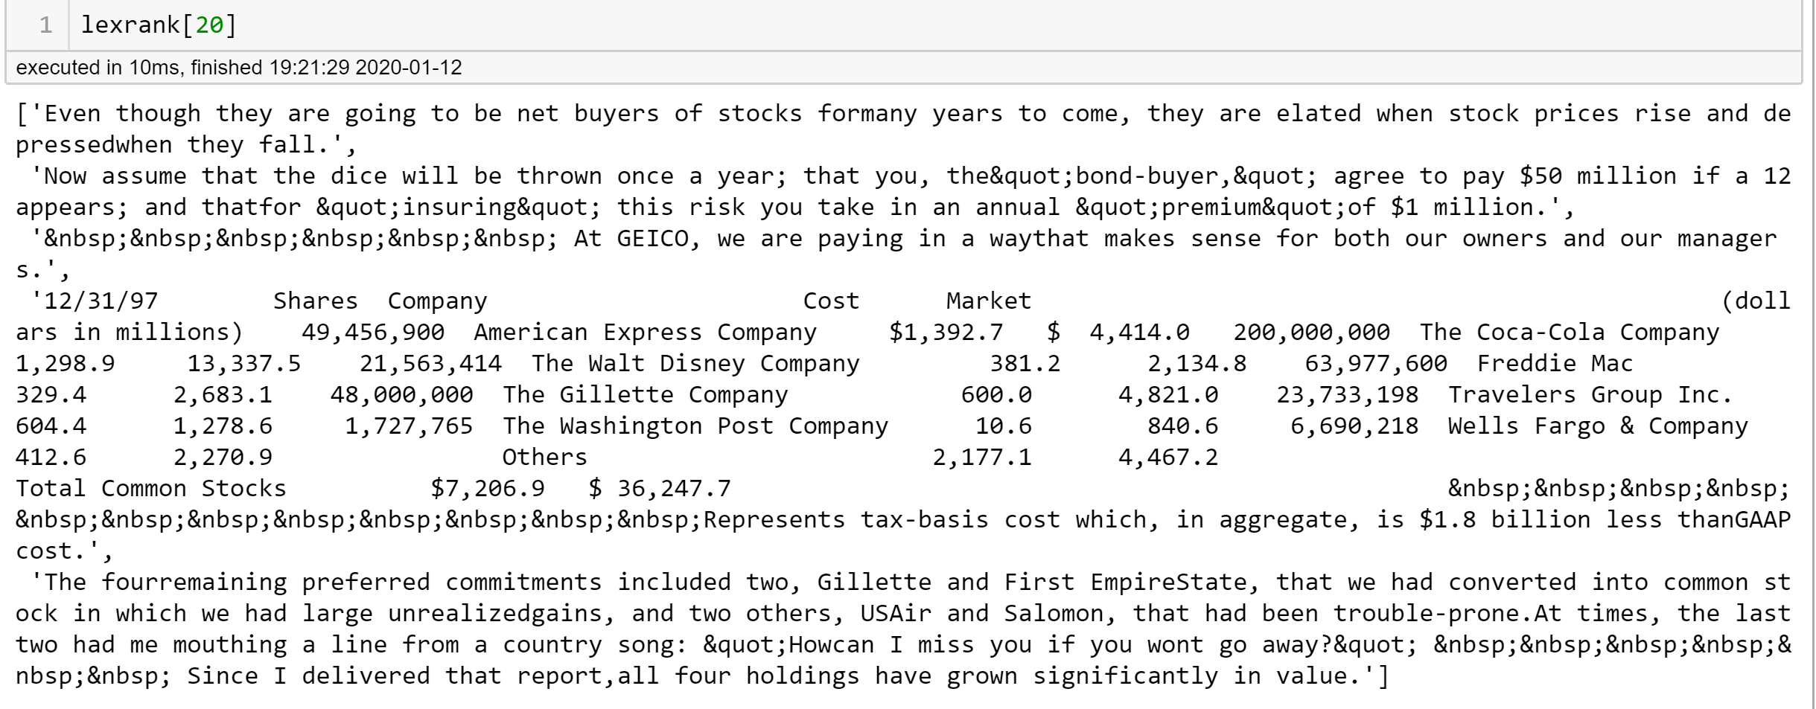
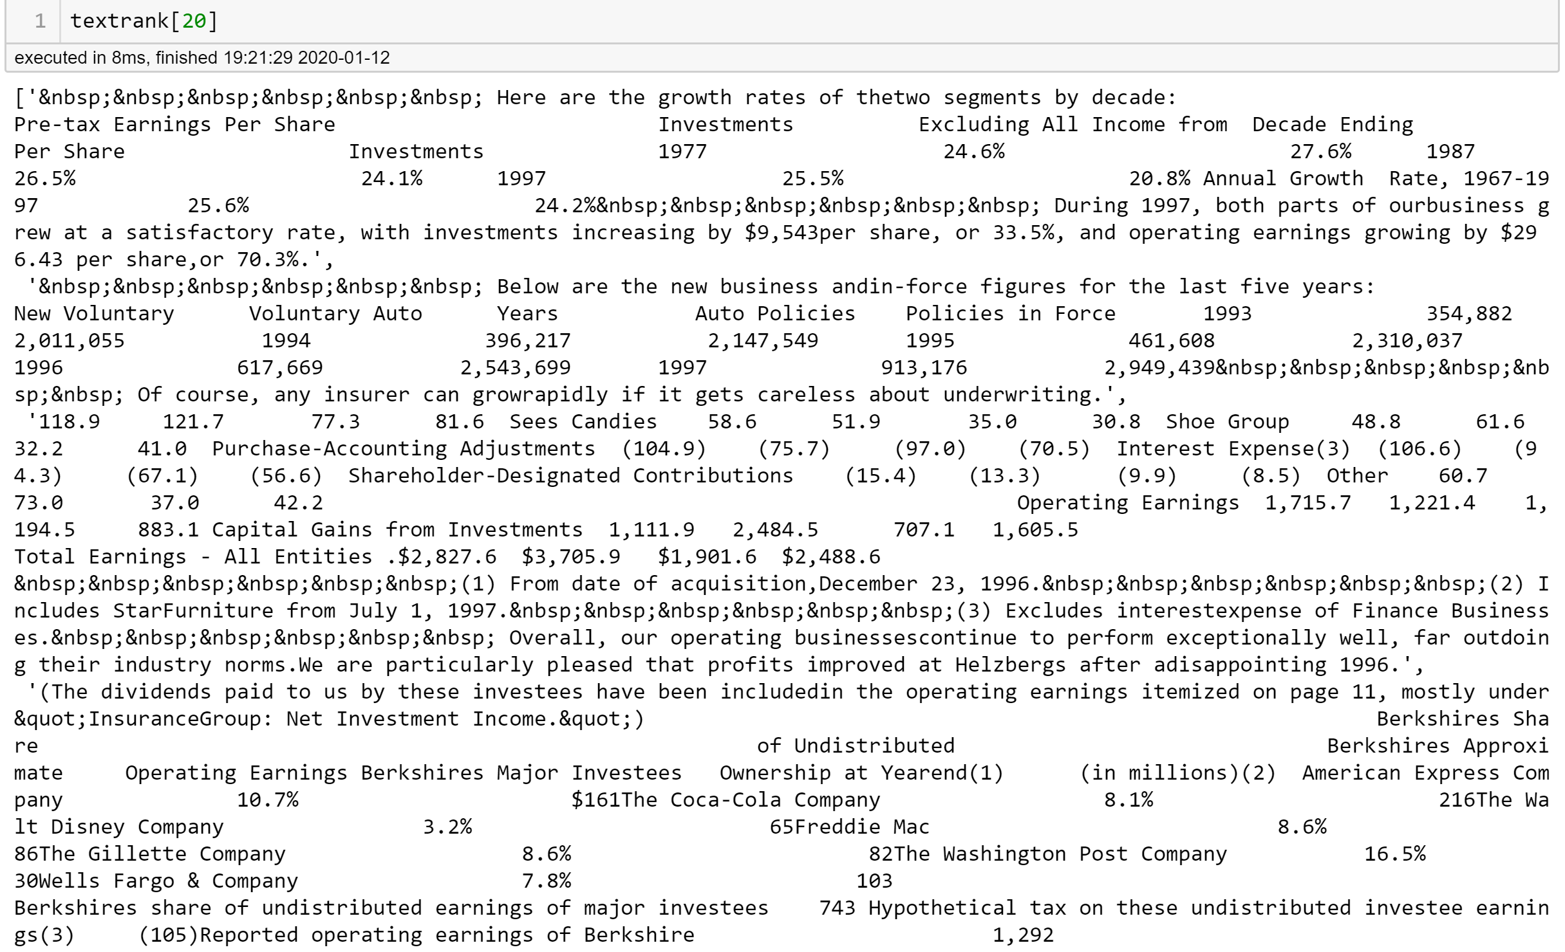
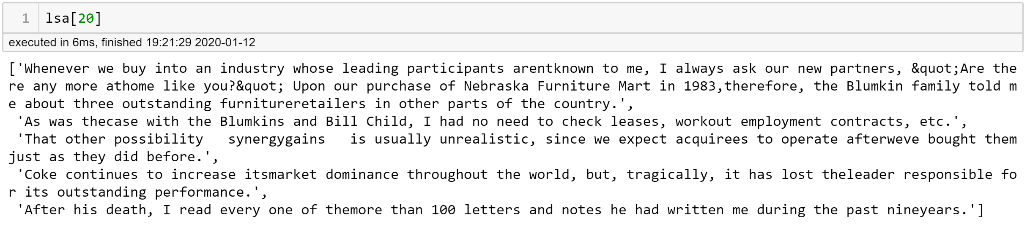
Summarization Examples - 1997

Slide 18
Summarization of Corpus (Milestone II)

Slide 19
Topic Modeling: Gensim (Milestone II)

