Slide 1
R Markdown & Python notebook
Knowledge sharing
Liang Kuang

Slide 2
Topics
Overview of R Markdown
What is R Markdown and why use it?
Document Orientation
How to use R Markdown
Structure layout
Global settings for (hiding code, error warning etc.)
Create paragraphs with styles
Embed chunk and inline code, and Run R code
Embed R code generated graphics and tables etc.
Embed images, hyperlink, animation and java scripts
Embed Mathematic equations
Demo: An live example within R studio
Overview of Python Notebook

Slide 3
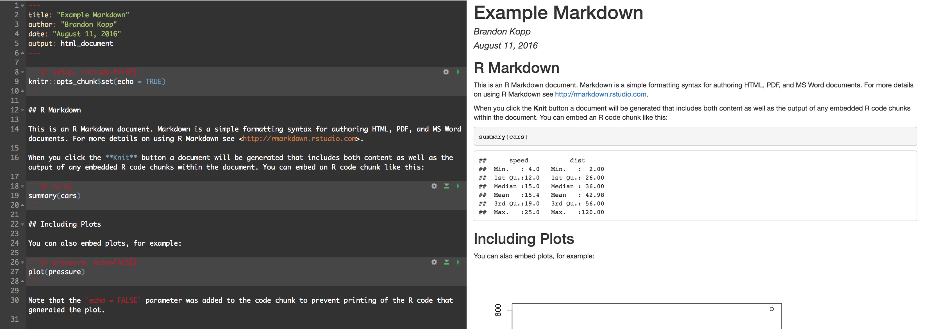
This is R Markdown

Slide 4
Why Use R Markdown
Documents with embedded code are reproducible
The document will serve as a record for how you arrived at the results you include in your papers
You can pass on your code to readers in addition to the report content
Dynamic documents can change as data are updated
Documents can also be used for future data releases and/or different subsets of data

Slide 5
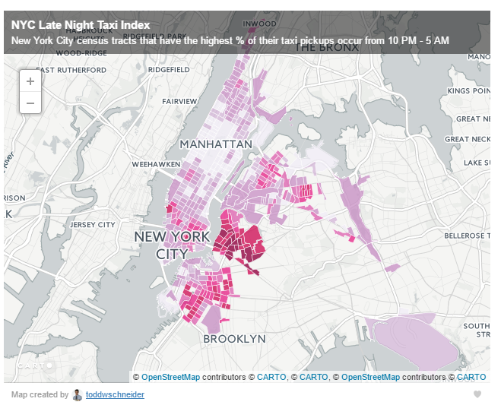
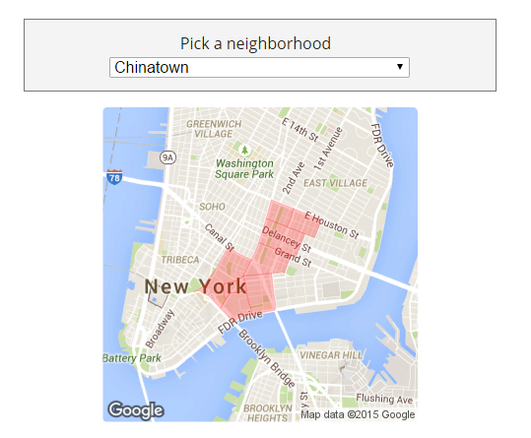
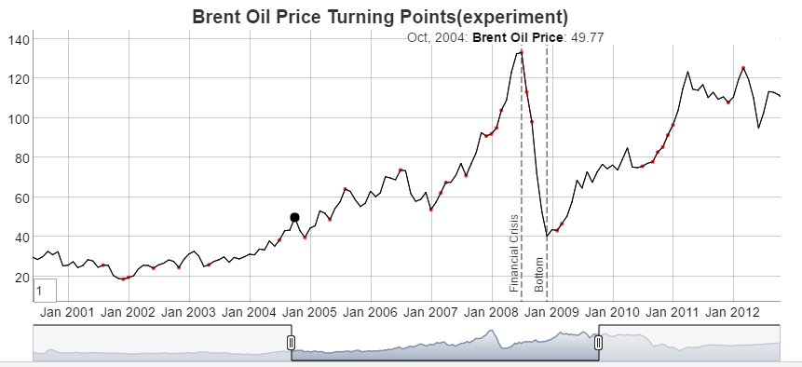
R Markdown Output Format
HTML
PDF
MS Word

Slide 6
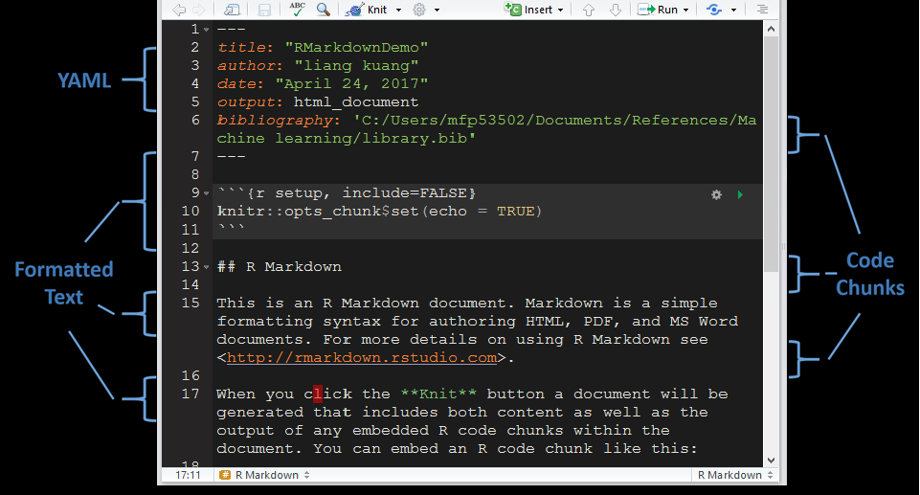
Document Orientation

Slide 7
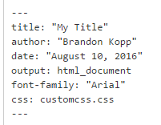
YAML (YAML Ain’t Markup Language)
This is where you set options for your overall document
Through YAML you can set:
font (size and style)
default figure options (height, width, etc.)
reference custom CSS (Cascading Style Sheets) Code

Slide 8
How to use RMarkdown
Structure layout
Global settings for (hiding code, error warning etc.)
Create paragraphs with styles
Embed chunk and inline code, and Run R code
Embed R code generated graphics and tables etc.
Embed images, hyperlink
Embed Mathematic equations
Tables
Citation
Advanced Features (video, interactive graphics)

Slide 9


Slide 10
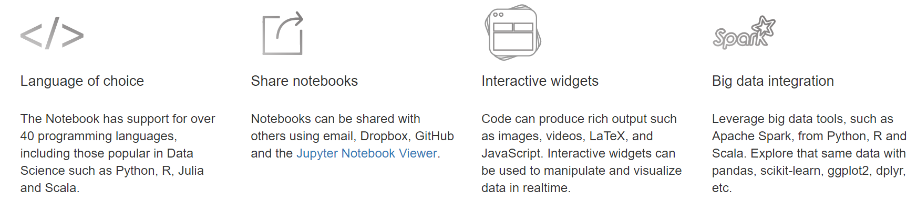
Overview of Jupyter Notebook
The Jupyter Notebook is an open-source web application that allows you to create and share documents that contain live code, equations, visualizations and explanatory text. Uses include: data cleaning and transformation, numerical simulation, statistical modeling, machine learning and much more.

Slide 11
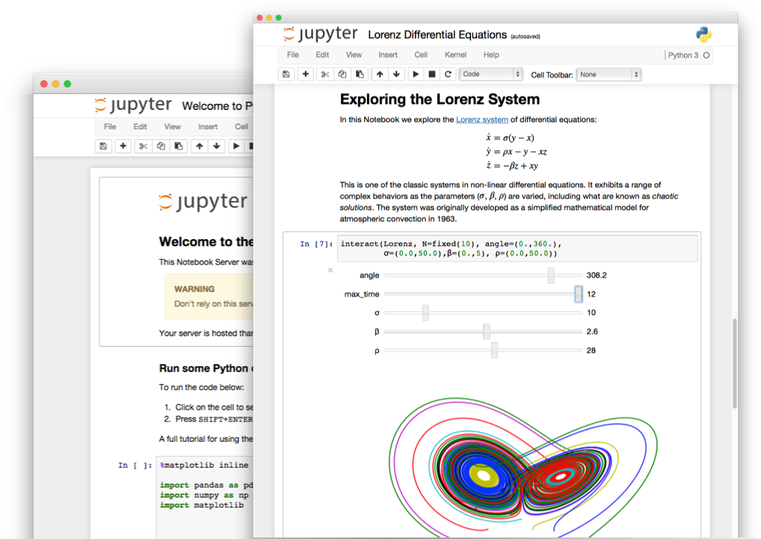

Slide 12
Jupyter Notebook in action

